Slide 1
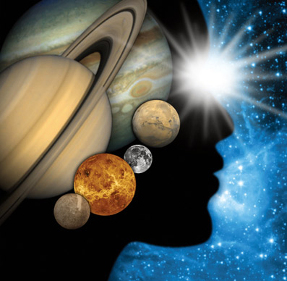
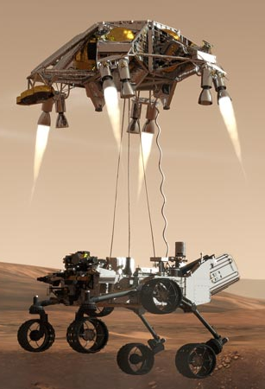
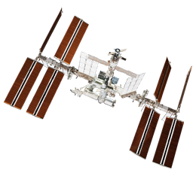
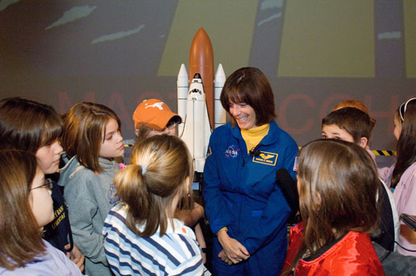
Educator Resources in Space Sciences
Caitlin Nolby and Marissa Saad
North Dakota Space Grant Consortium

Slide 2
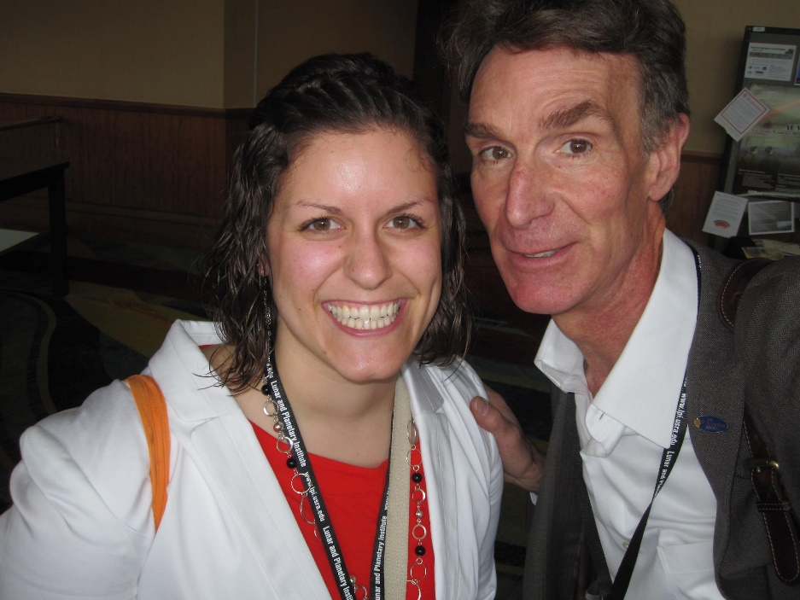
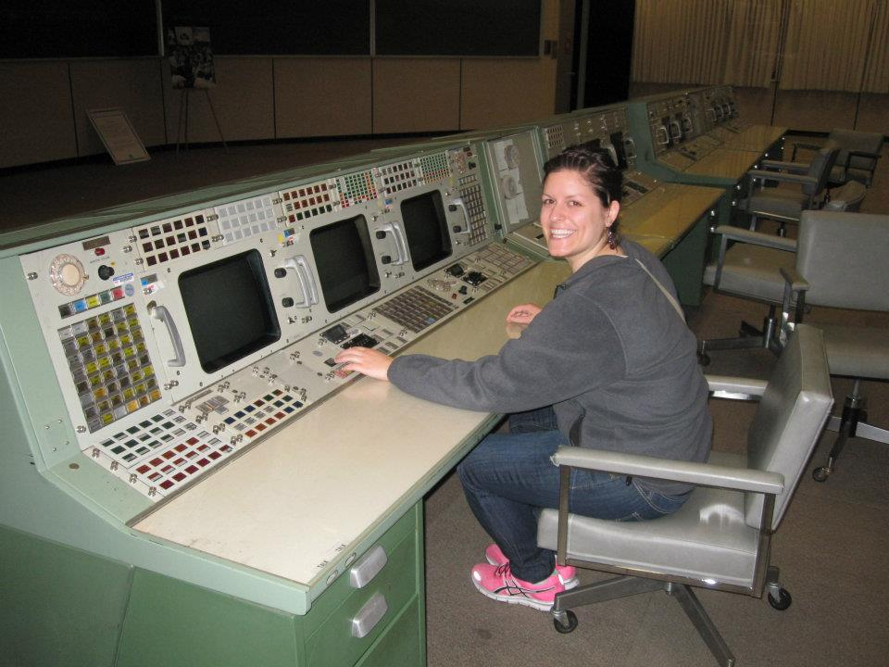
Meet the Space Grant Team: Caitlin Nolby
Deputy Director of Space Grant
PhD Candidate in Teaching and Learning
Master’s Degree in Space Studies
Bachelor’s Degree in Astrophysics
Loves dance parties, Bill Nye the Science Guy, and handstands!

Slide 3
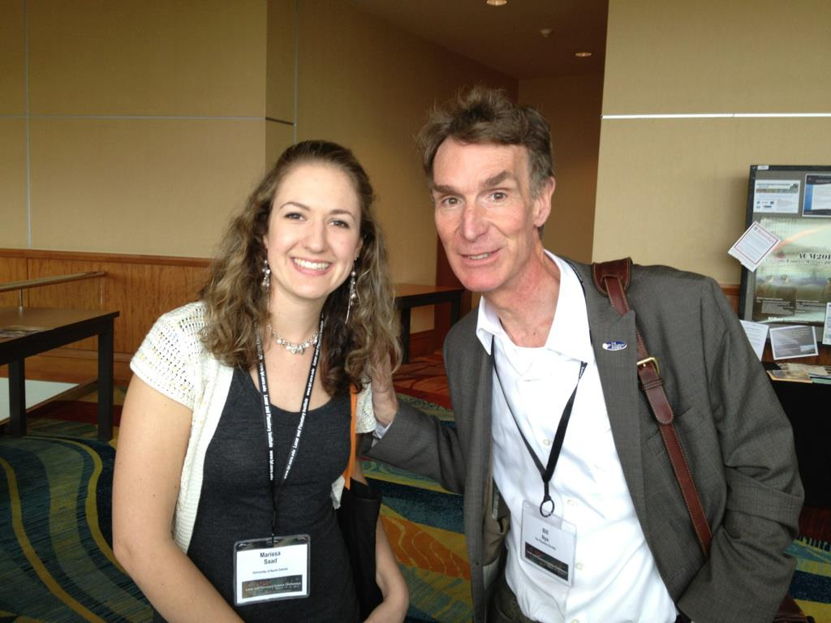
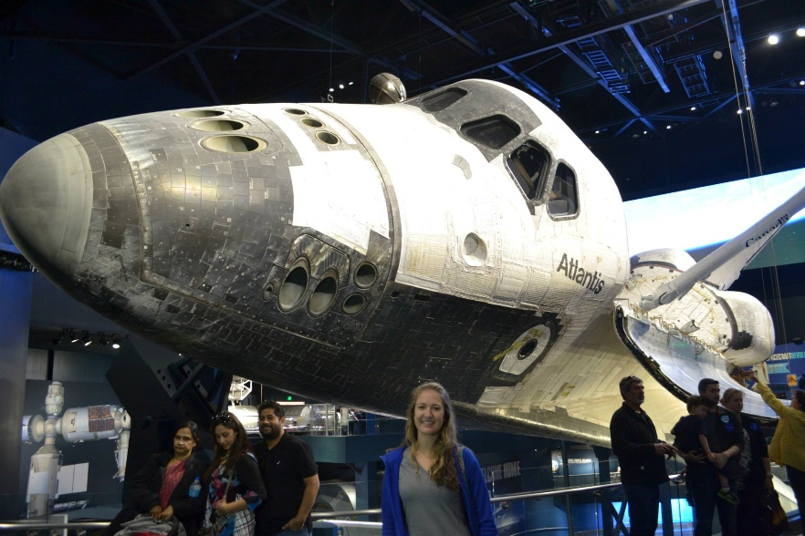
Meet the Space Grant Team: Marissa Saad
Coordinator of Space Grant
Master’s Degree in Space Studies
Bachelor’s Degree in Astronomy
Minors in Education
High School Earth Science Teaching License
11th and 12th grade Earth Science Teacher
Loves to go hiking, birding, and launch high altitude balloons!

Slide 4
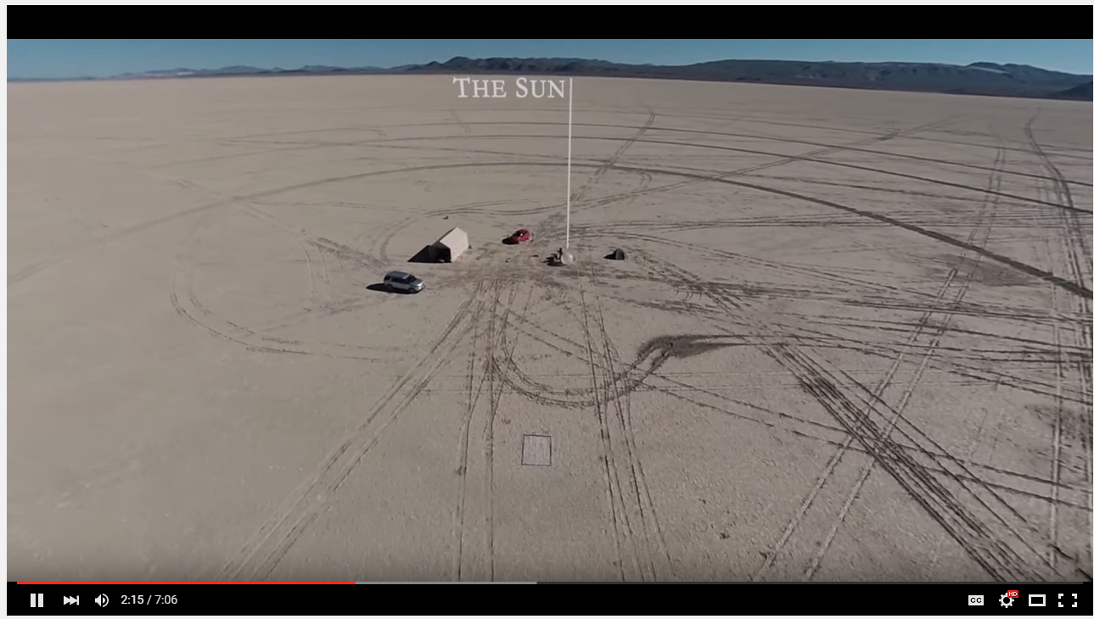
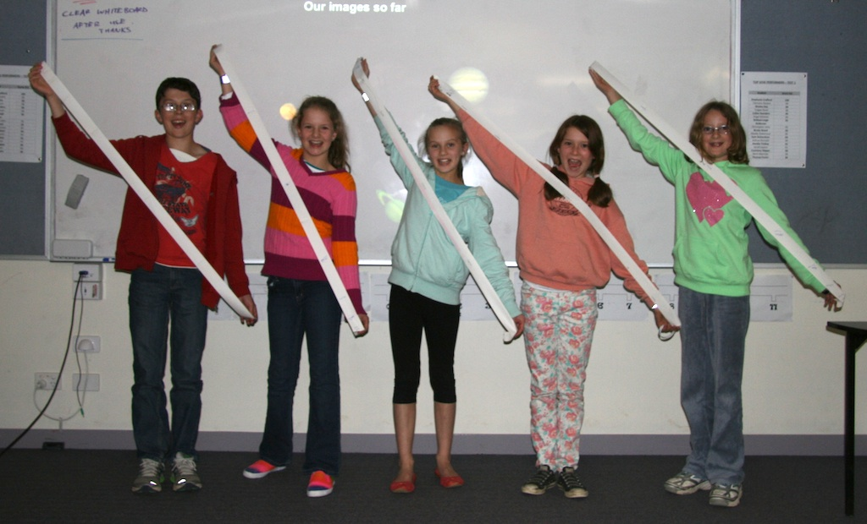
Pocket Solar System

Slide 5
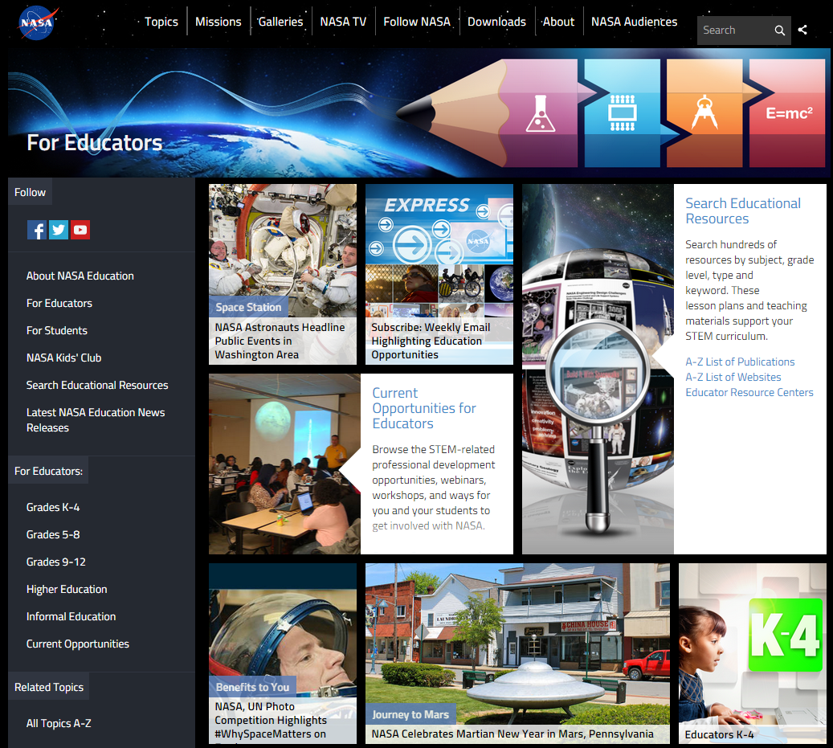
NASA Education

Slide 6
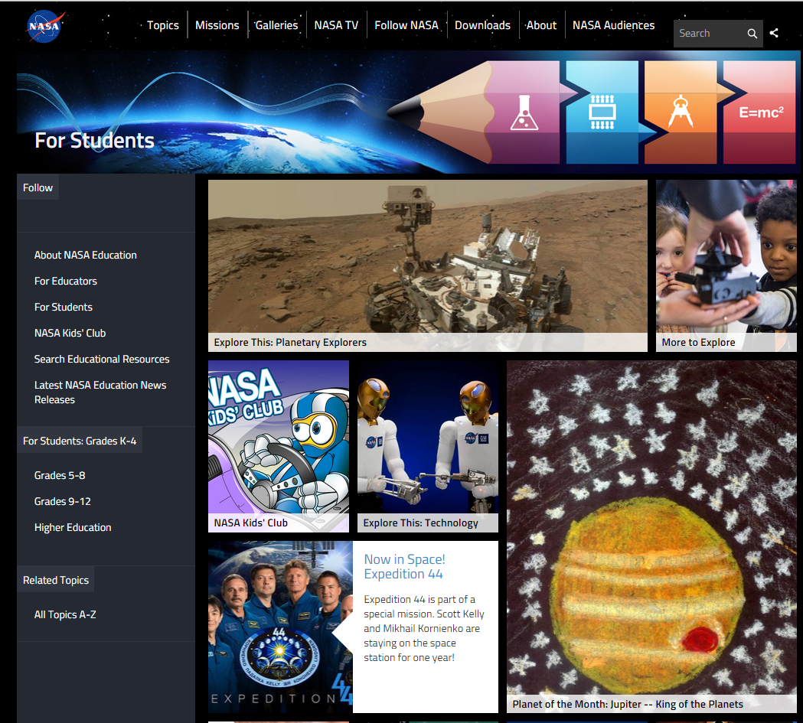
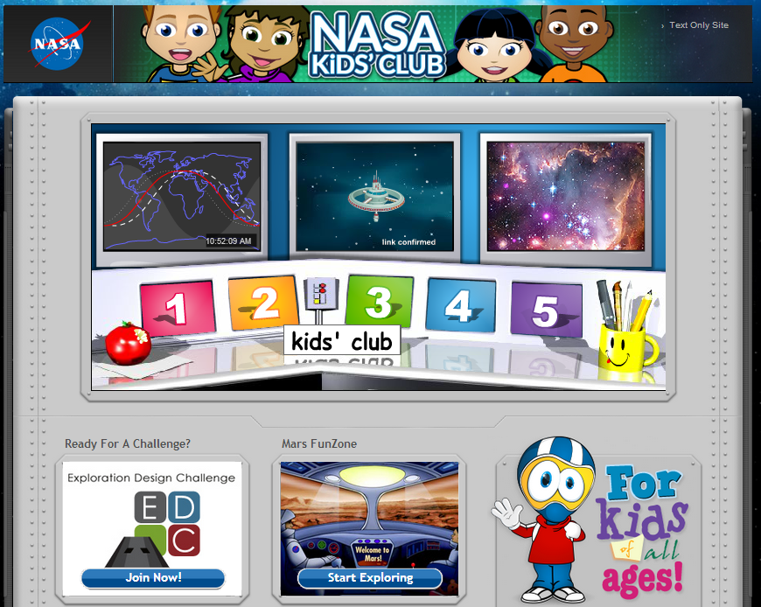
NASA for Students

Slide 7
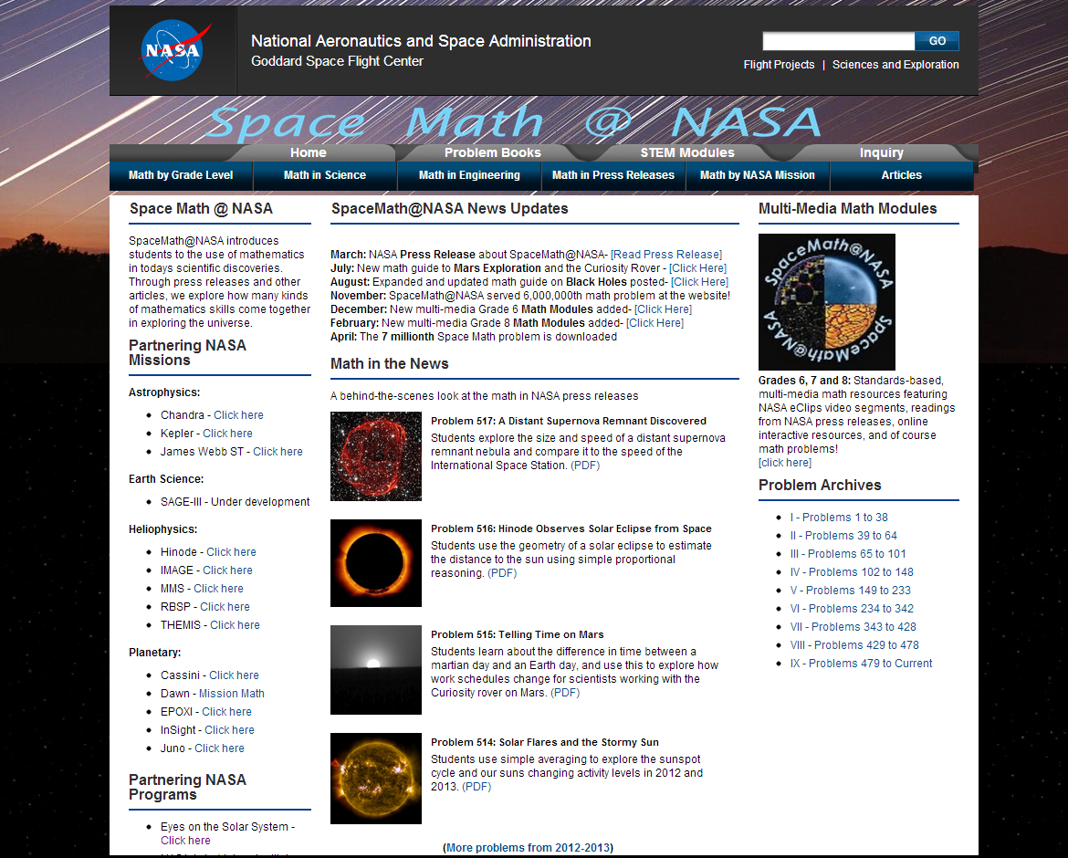
Space Math at NASA

Slide 8
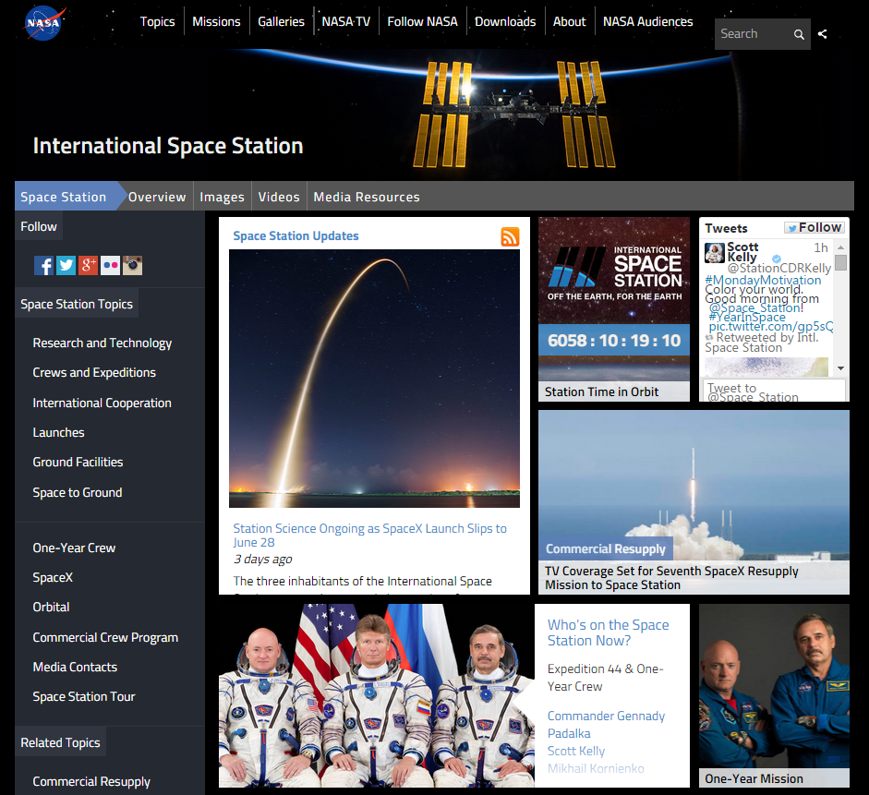
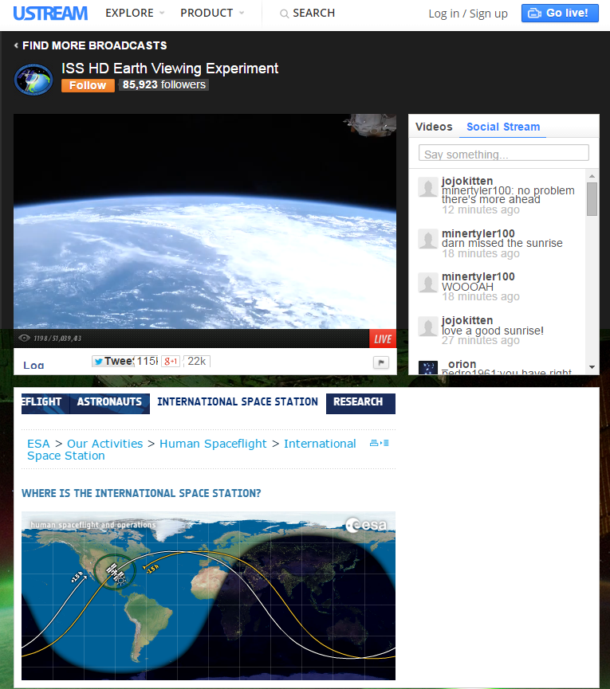
International Space Station - Live!

Slide 9
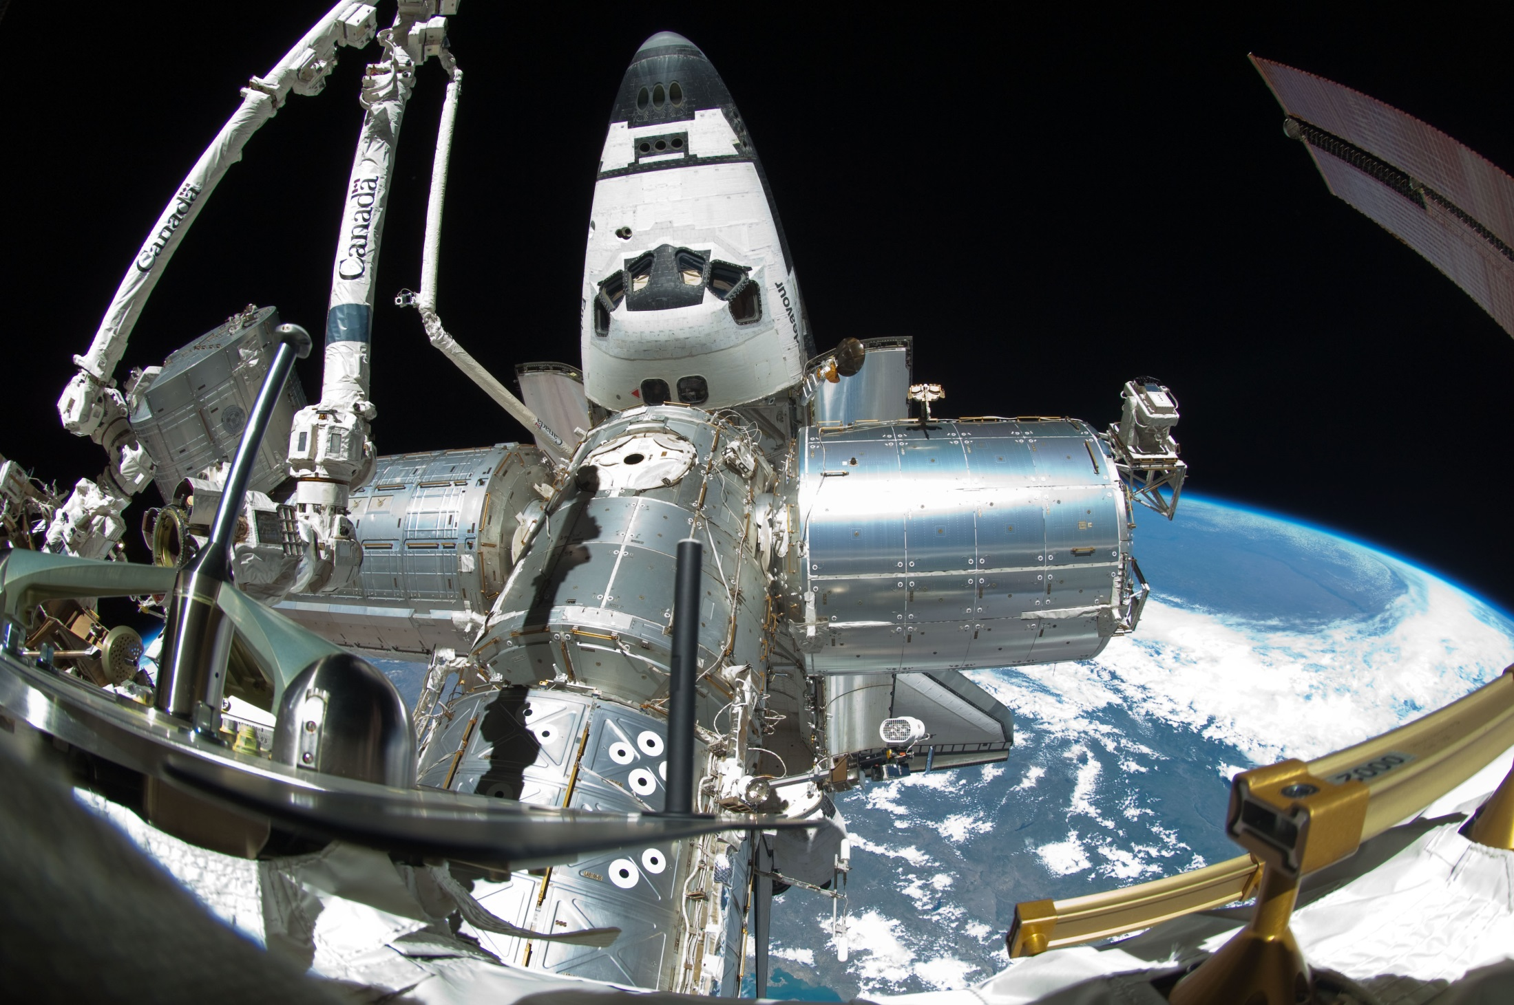
Spot the Station

Slide 10
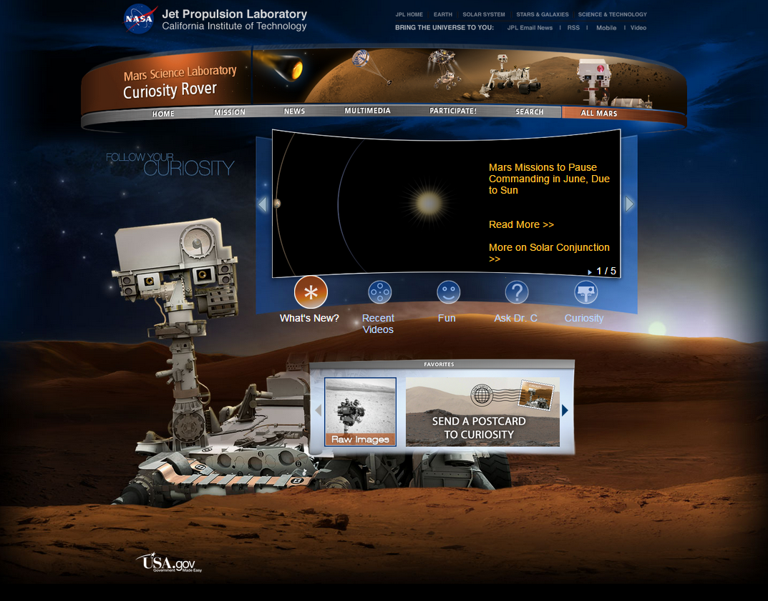
Mars Curiosity Rover

Slide 11
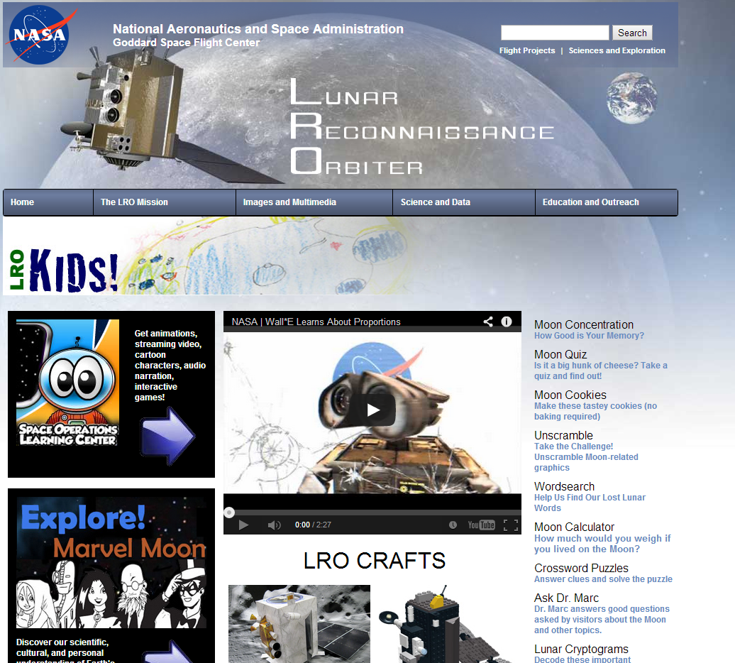
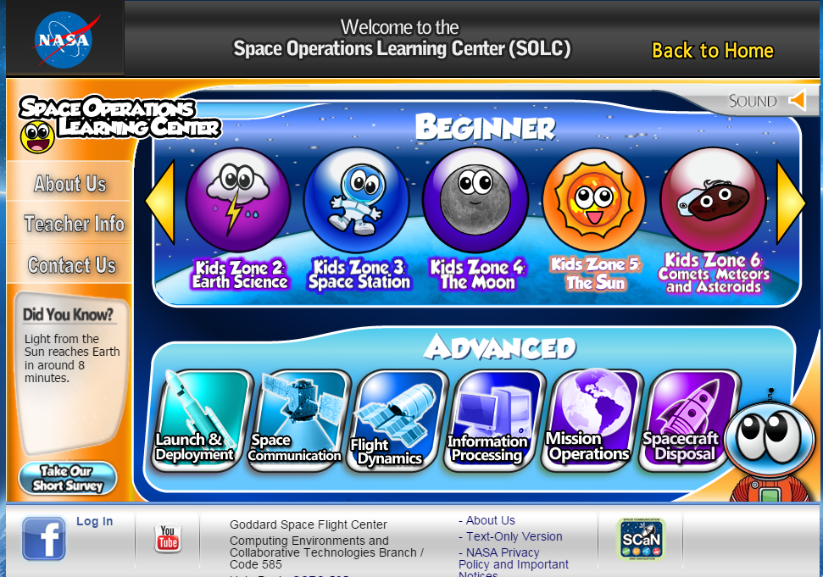
NASA – Lunar Reconnaissance Orbiter

Slide 12
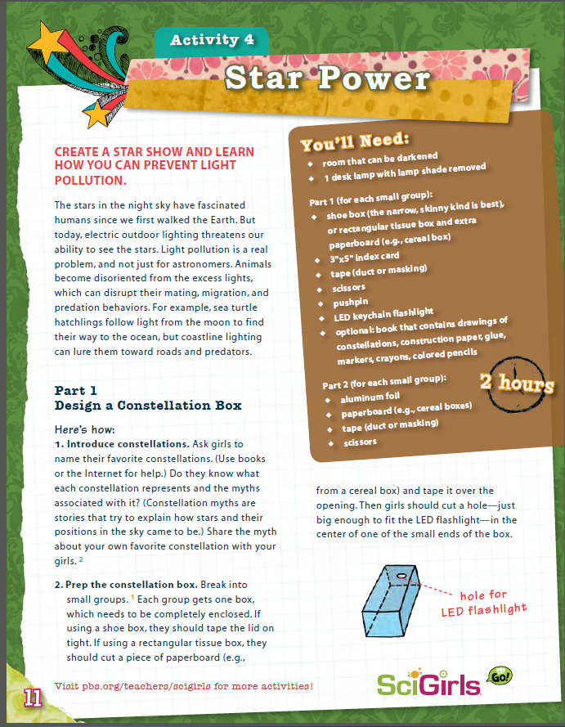
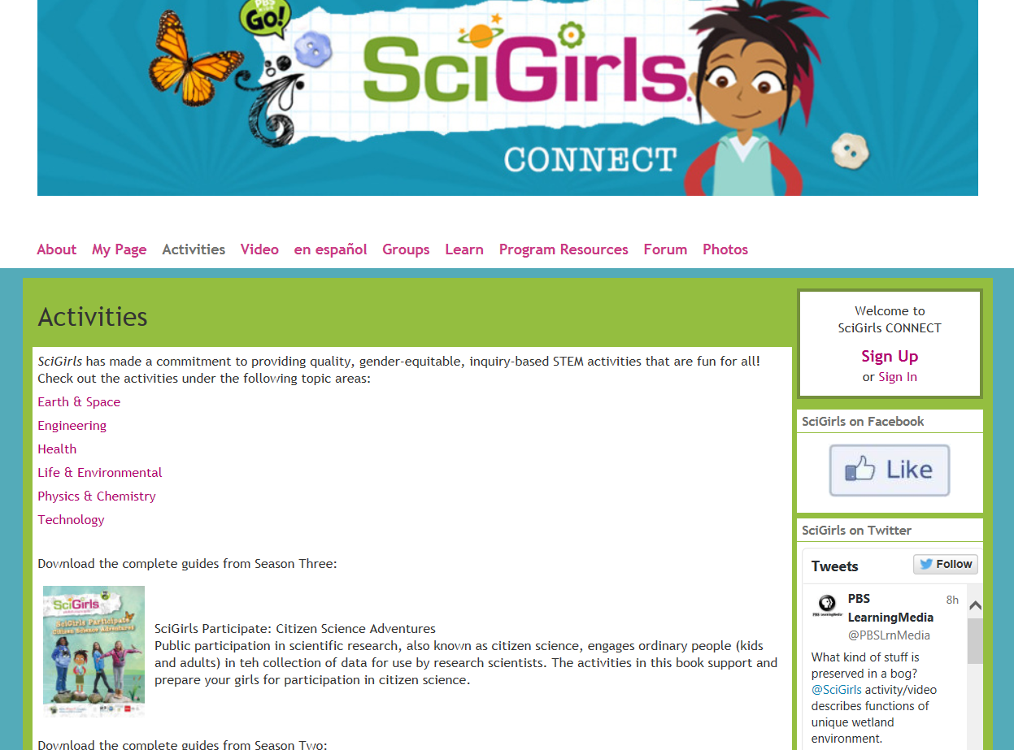
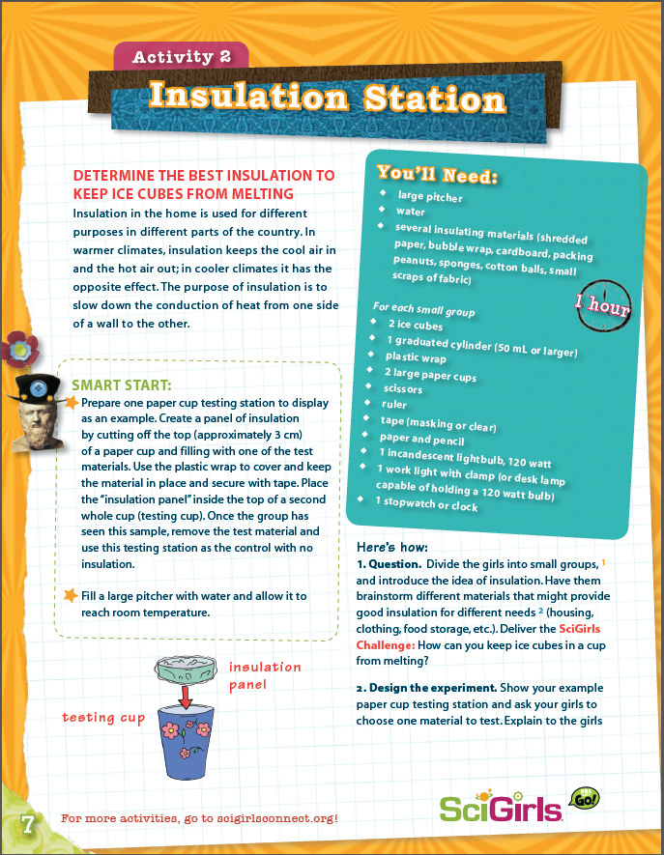
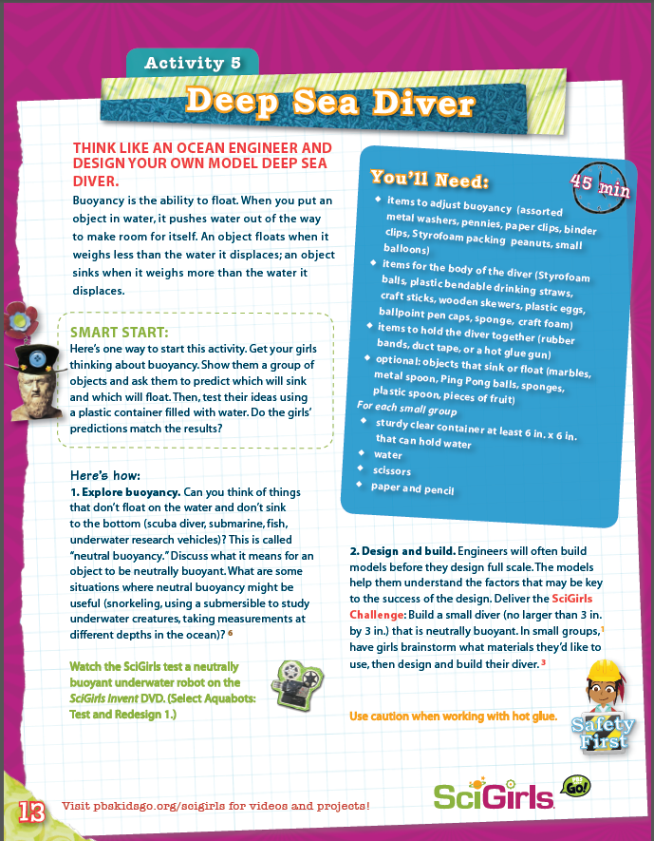
SciGirls Activities

Slide 13
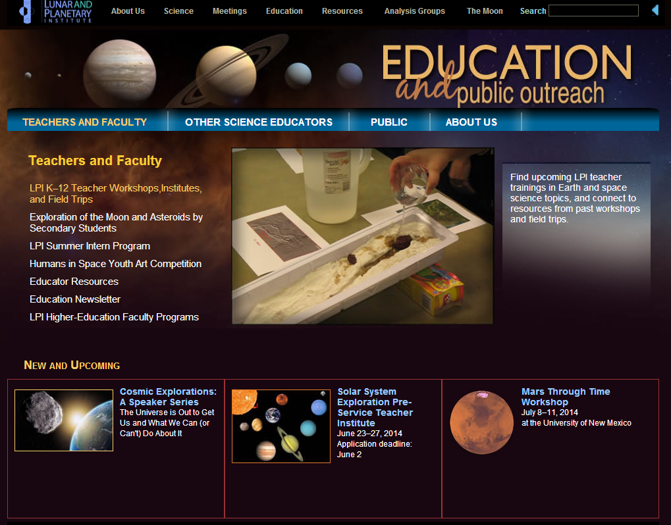
Lunar and Planetary Institute

Slide 14
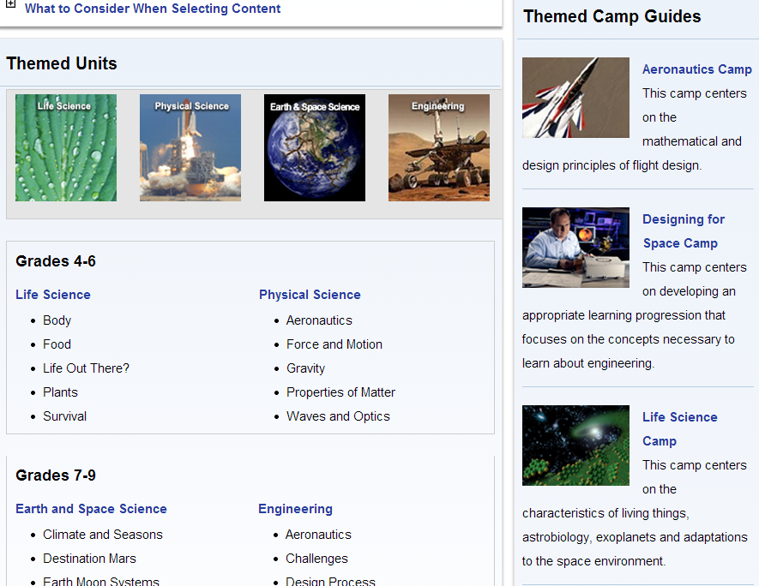
NASA Summer of Innovation

Slide 15
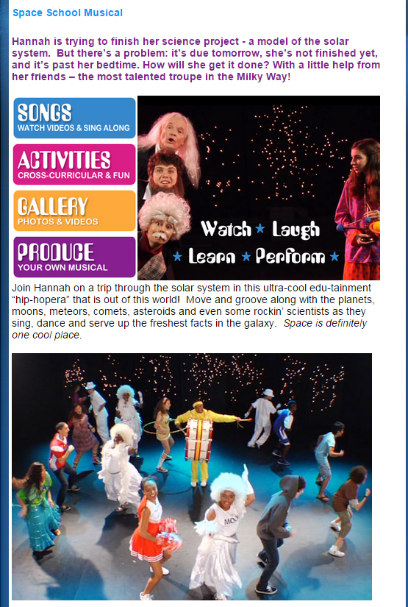
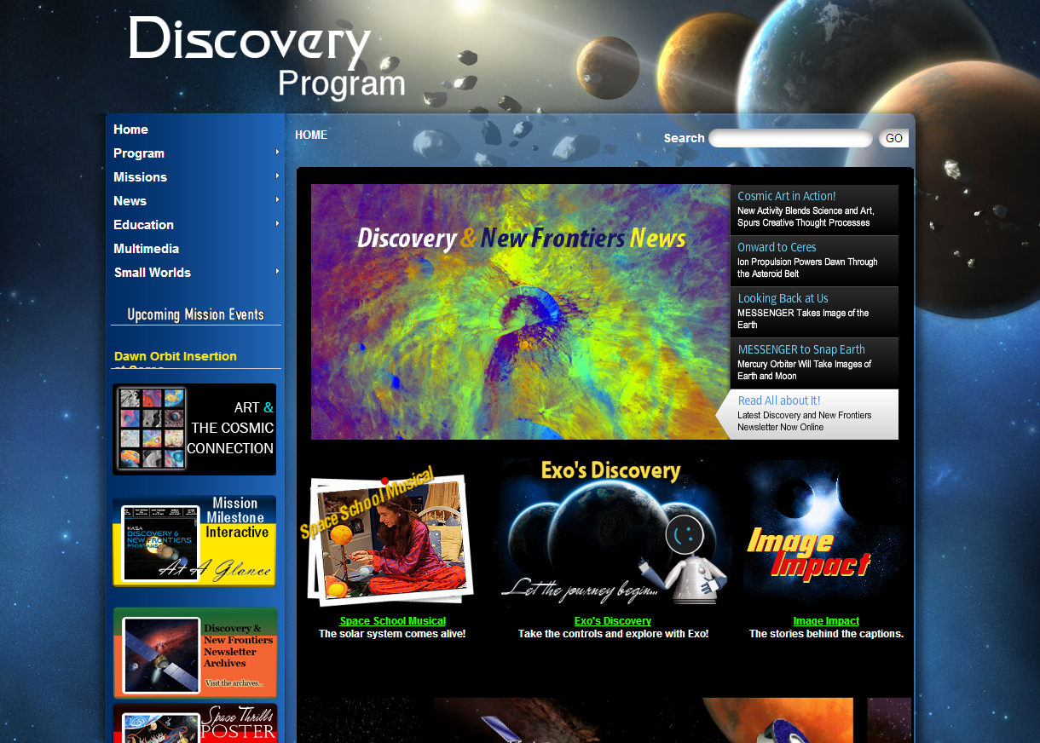
NASA Discovery Program

Slide 16
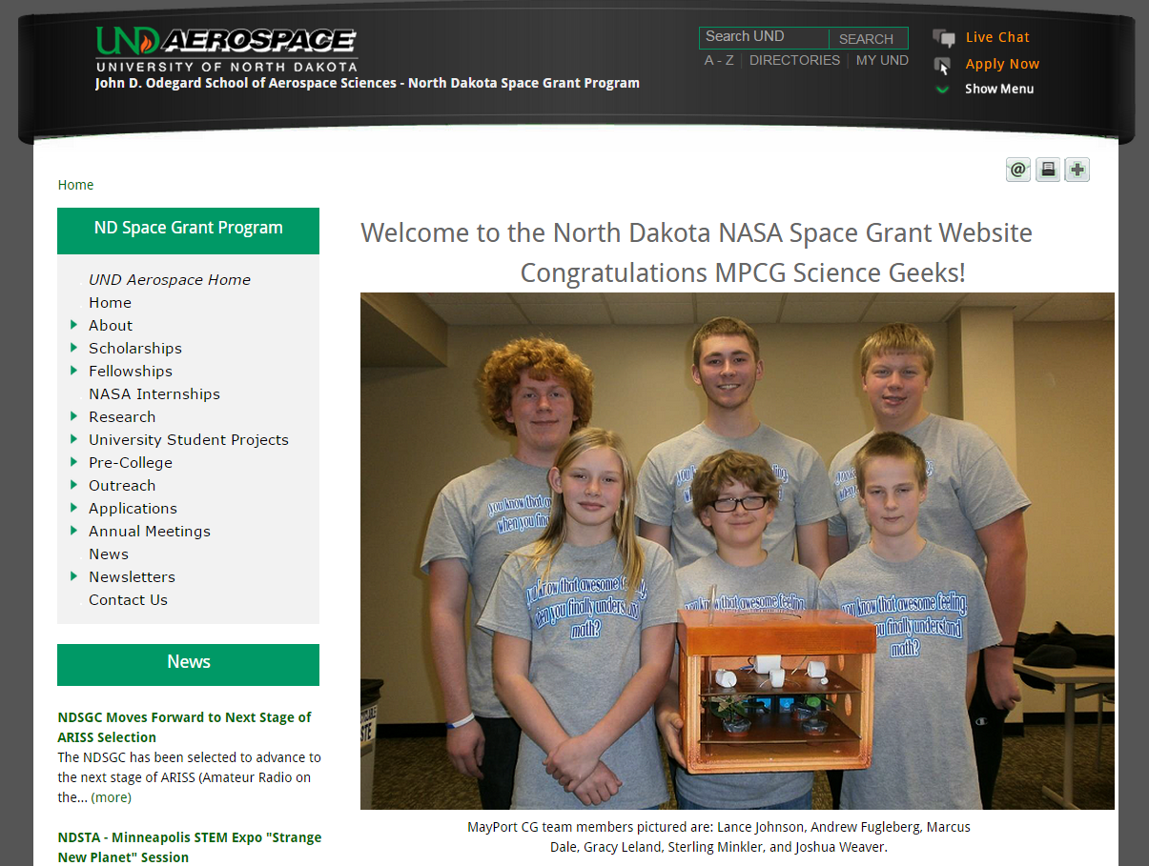
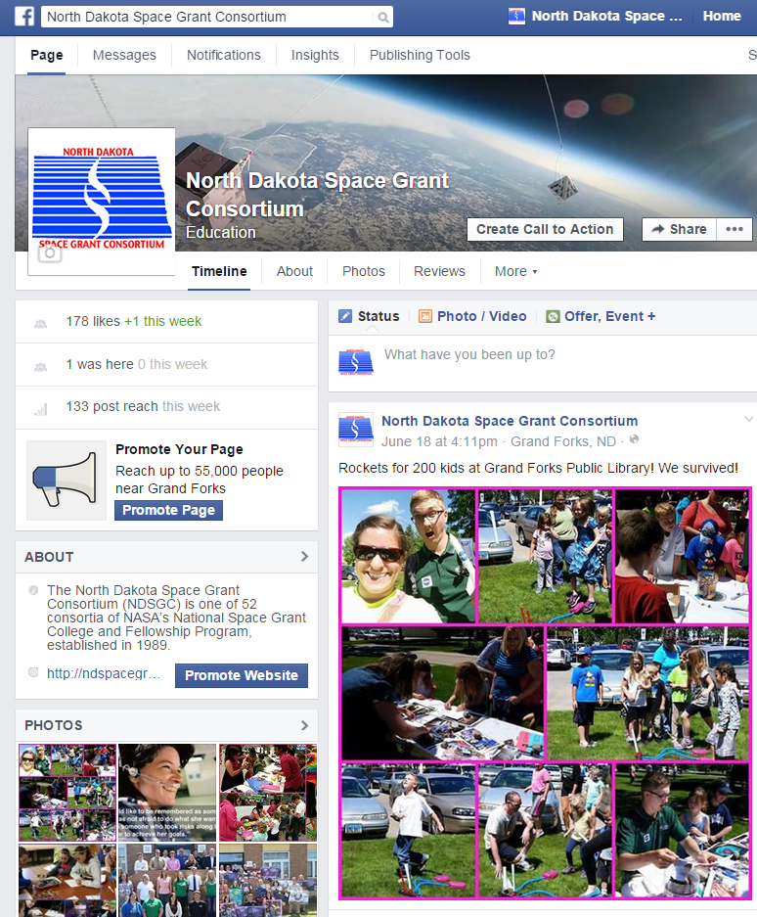
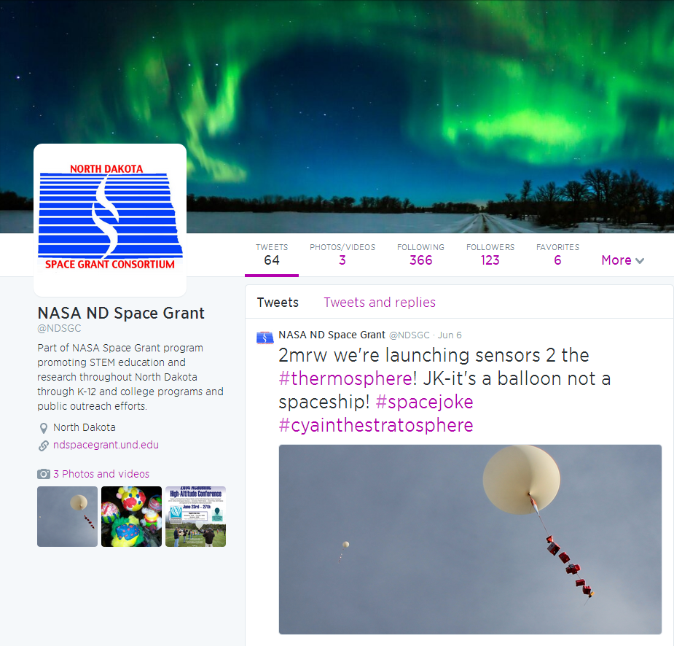
North Dakota Space Grant

Slide 17
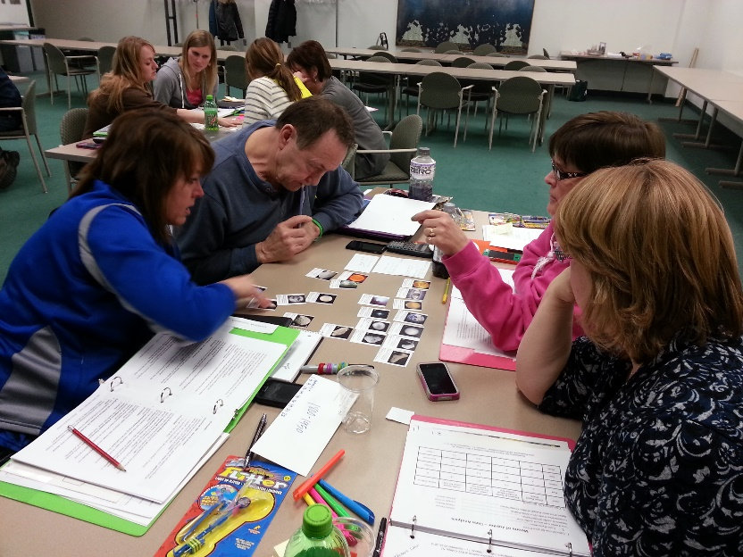
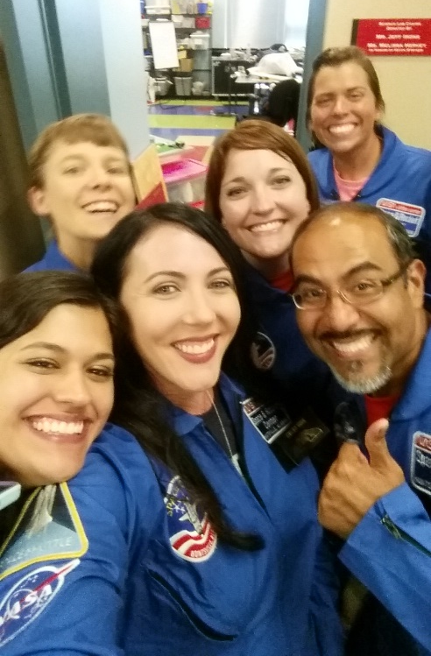
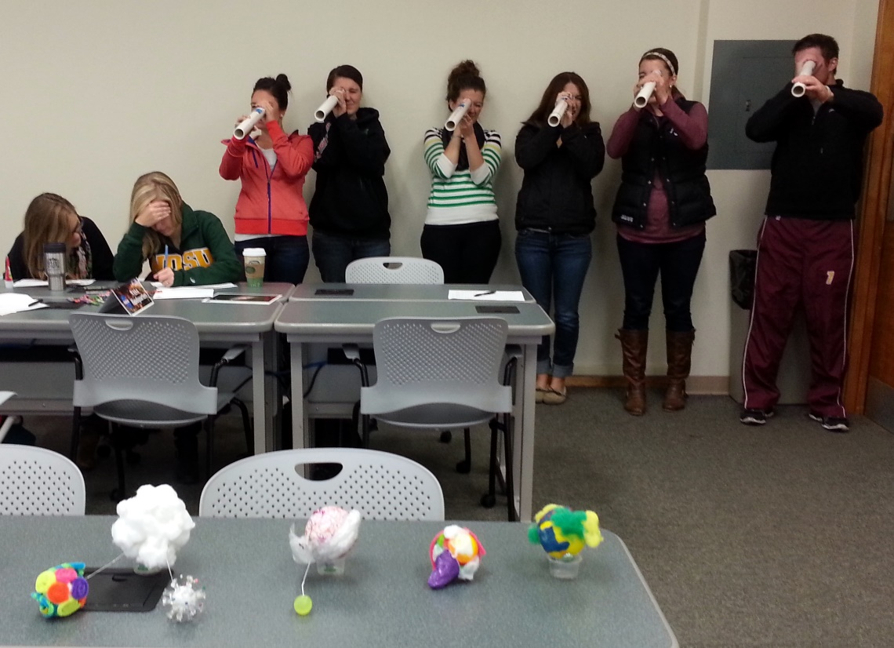
NDSGC K-12 Educator Email Listserv
Workshop opportunities
New STEM education resources for the classroom
NASA student contests/team competitions
Professional Development opportunities
Emails ~once a week

Slide 18
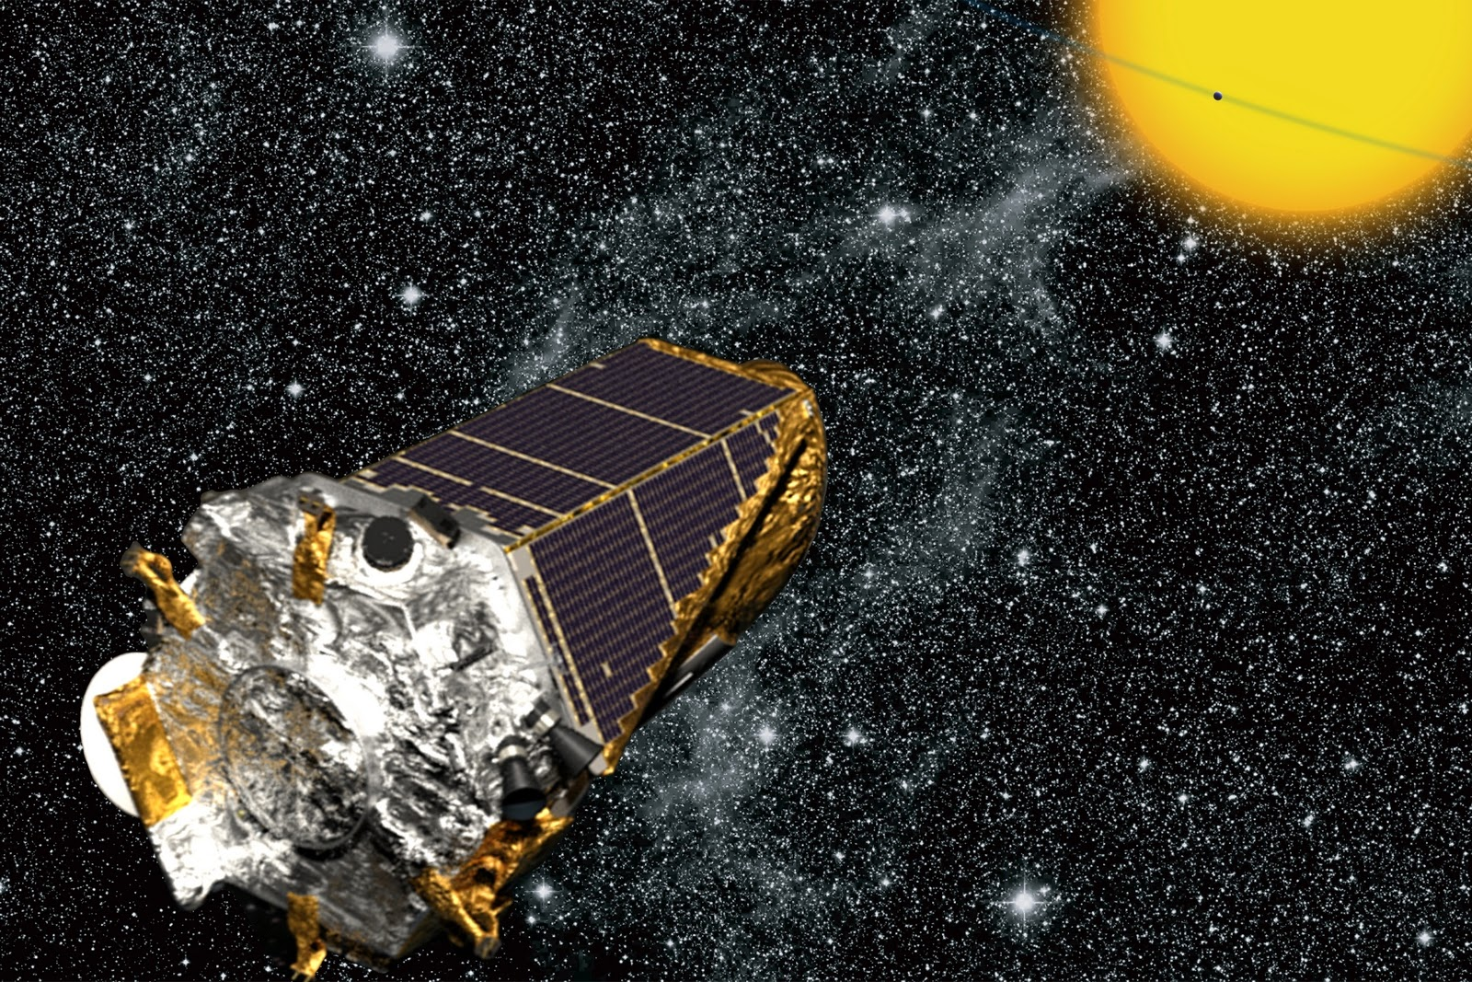
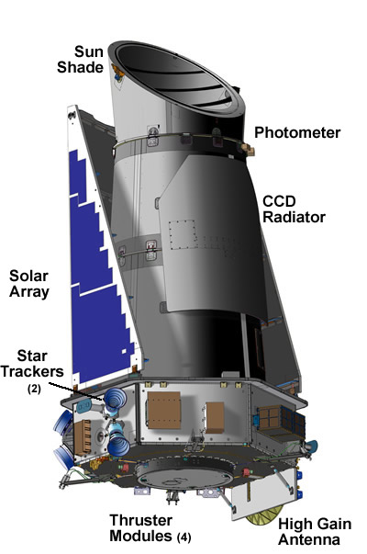
Strange New Planet
Work in NASA teams to collect data to plan missions and explore new worlds!
How Kepler Works
NASA Spacecrafts
Sort students by NASA Center
Assign student roles

Slide 19
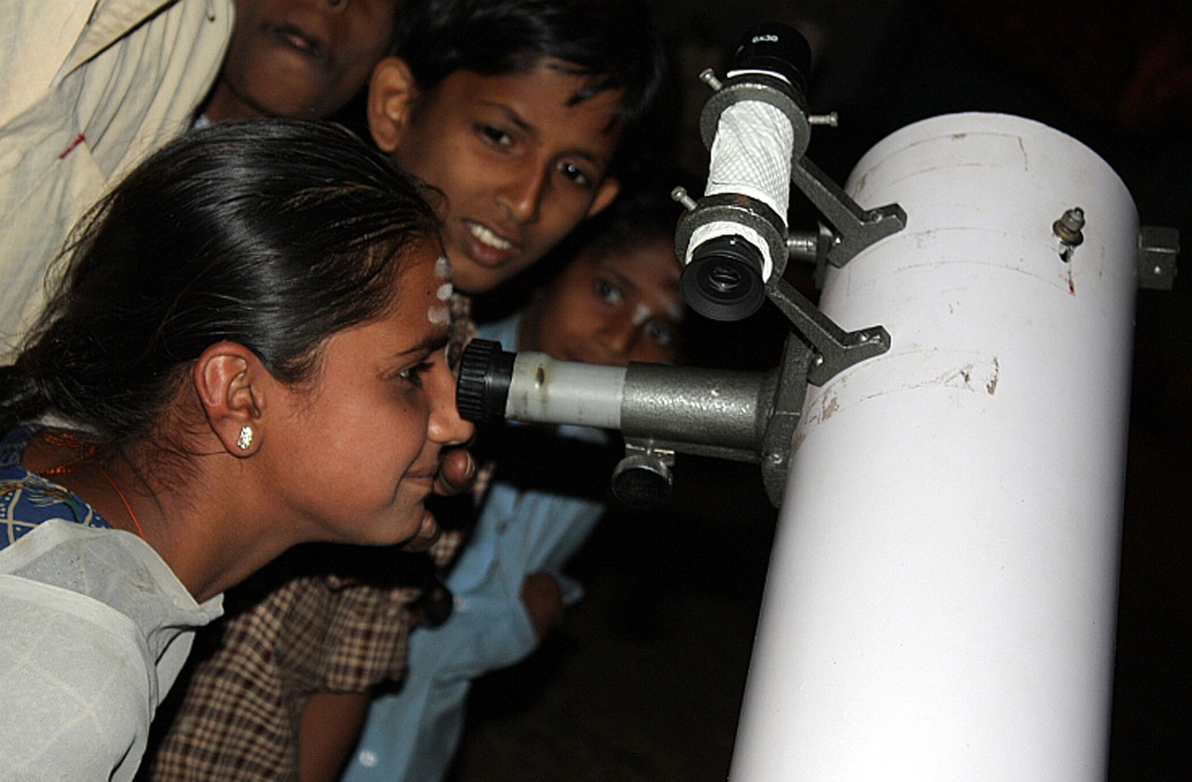
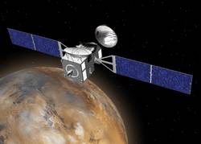
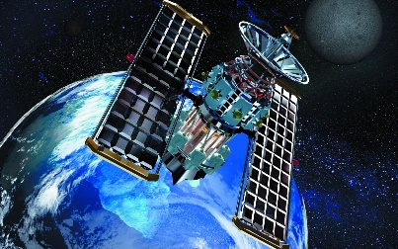
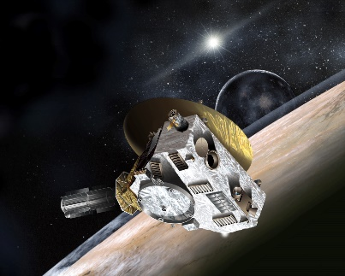
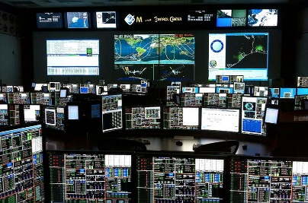
Your Role on the NASA Team
Astronomer
1
2
Orbiter
4
Flyby Spacecraft
Mission Control
3
5
Satellite

Slide 20
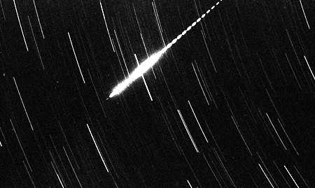
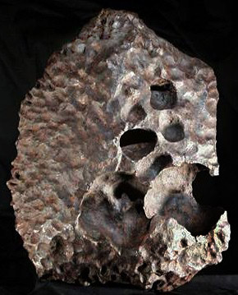
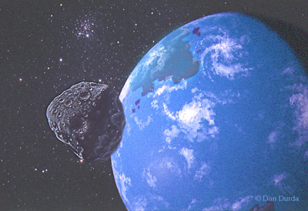
Space Rocks Defined
Meteoroid: Small (less than 10 meters) rock/metallic object IN SPACE
Meteor: The light produced when a meteoroid ENTERS THE ATMOSPHERE (sometimes called a “shooting star”)
Meteorite: A natural rock/metallic object from space that has fallen to EARTH’S SURFACE
A METEORITE which is a part of the meteoroid that survived atmospheric entry and reached the ground.
A METEOROID approaching the Earth.
A METEOR formed by a meteoroid entering the atmosphere at high velocity.

Slide 21
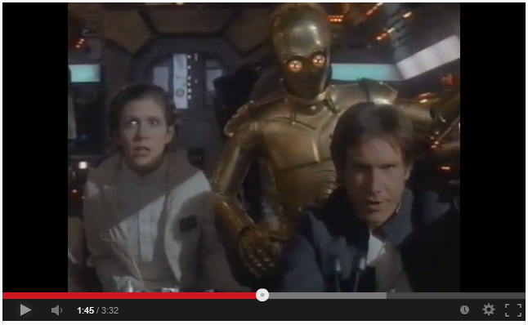
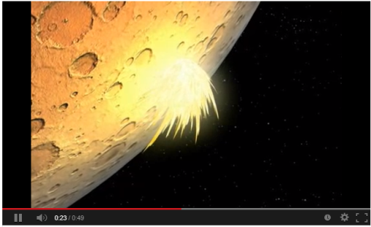
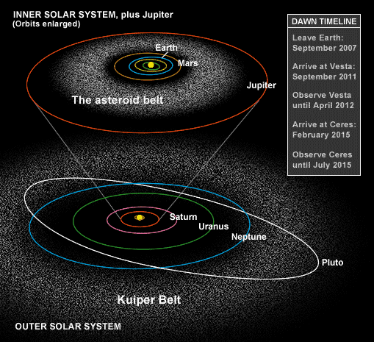
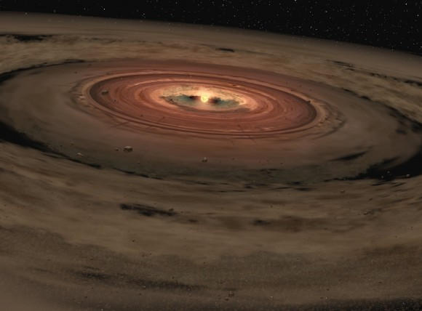
Space Rocks Defined
Where do they come from?
Why study space rocks?
Samples of the early Solar System
Meteor Showers (Comet Tails)
Impacts!! – Planetary Protection

Slide 22
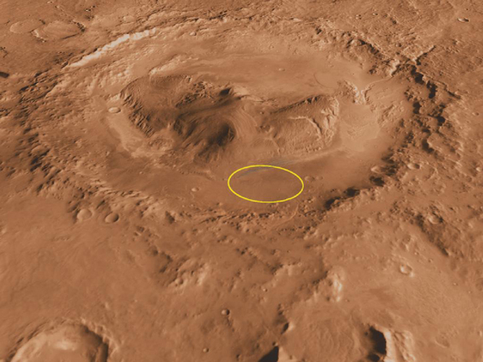
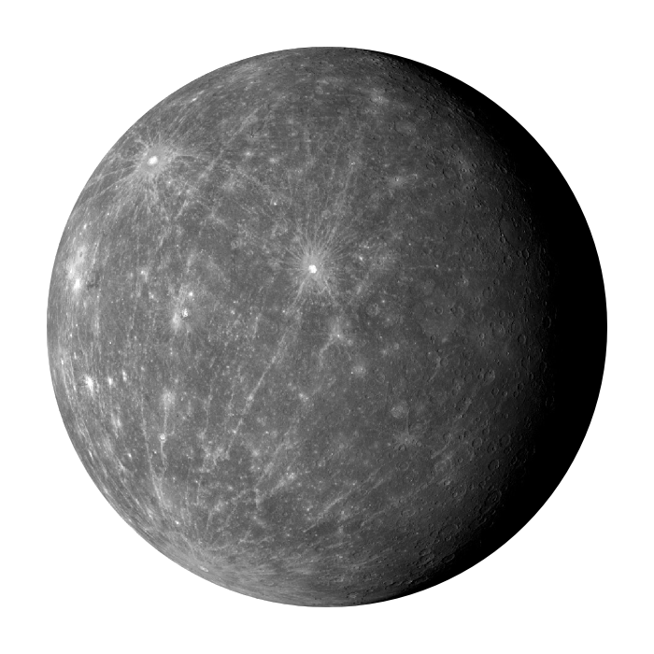
Impacts in Our Solar System
Mercury, Moon, Mars
Gale Crater and Curiosity Rover

Slide 23
Impacts on Earth
Meteor Crater (Arizona) was formed by the impact of an ~50 meter iron asteroid ~50,000 years ago
1 km

Slide 24
Peekskill Meteorite (12.4 kg) and 1980 Chevrolet Malibu
October 9, 1992 – Peekskill, NY
Michelle Knapp - 18 yr old, HS senior
When police arrived on the scene, they filed a report for criminal mischief by a very strong male.
The smell of gas from the punctured gas tank prompted the fire department to investigate, at which time they found the meteorite.

Slide 26
SciGirls Activities
Not just for girls!
Hands-on, inquiry-based learning
Engineering design process
NASA-twist!

Slide 27
Super Sleuths
All meteorites that are found on Earth originally came from a Parent Body, or their starting location. The top four parent bodies are:
6 Hebe = 35%
4 Vesta = 5%
3103 Eger = 1%
Mars
Vesta
Mars
Hebe

Slide 28
Super Sleuths
The activity:
You have found a meteorite in your backyard and want to know its parent body. NASA has generously allowed you to take samples from known parents bodies and it is your job to use the appropriate techniques to match your sample to the NASA sample.
Things to consider:
How will you collect your samples?
How will you avoid cross-contamination?
How will you identify the parent body (what characteristics will you examine)?

Slide 29
Super Sleuths
Students will match samples of glitter (asteroids) with its “Parent Body”. They will:
Identify the problem
We found an asteroid (glitter) with an unknown parent body!
Collect evidence
Students will use tape, microscopes, and tweezers
Prepare slides
Students will use the tape to gather glitter evidence
Observe and collect data
Match the characteristics of the sample to the parent body!
Draw Conclusions
Students will explain which glitter is consistent with the unknown glitter

Slide 30
Space Rocks! Board Game
Dice App: “Prime Dice”
Game Rules
Make each board game space into an 8.5x11, and tape up around the classroom for a “life size” version of the game
Meteor Zone and Meteorite Zone

