Slide 1
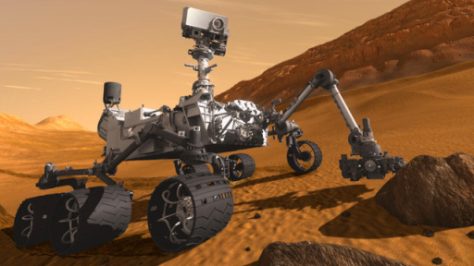
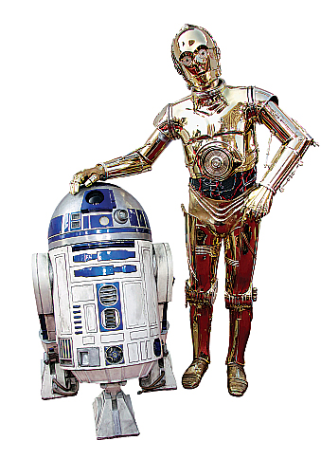
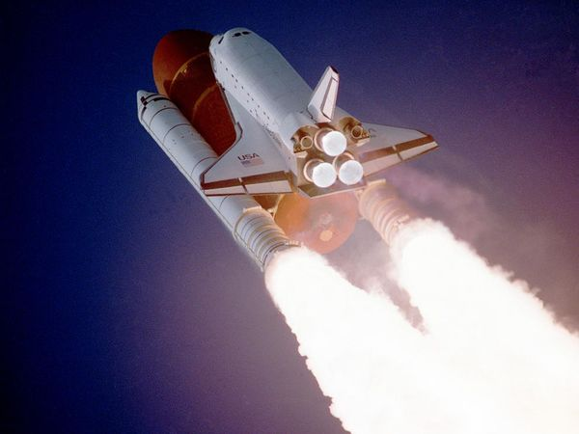
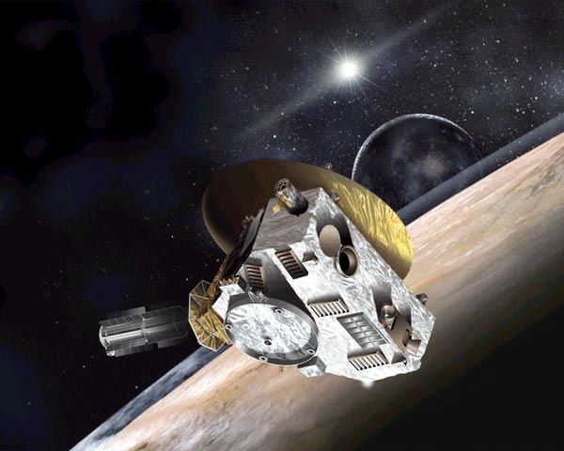
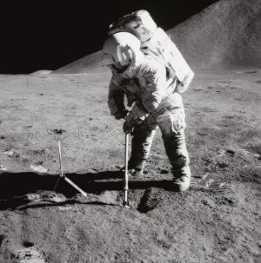
Human and Robotic Space Exploration
Caitlin Nolby
North Dakota Space Grant Consortium

Slide 2
Strange New Planet
Work in NASA teams to collect data to plan missions and explore new worlds!
http://kepler.nasa.gov/multimedia/Interactives/HowKeplerDiscoversPlanetsElementary/#
Sort students by NASA center
Assign student roles

Slide 3
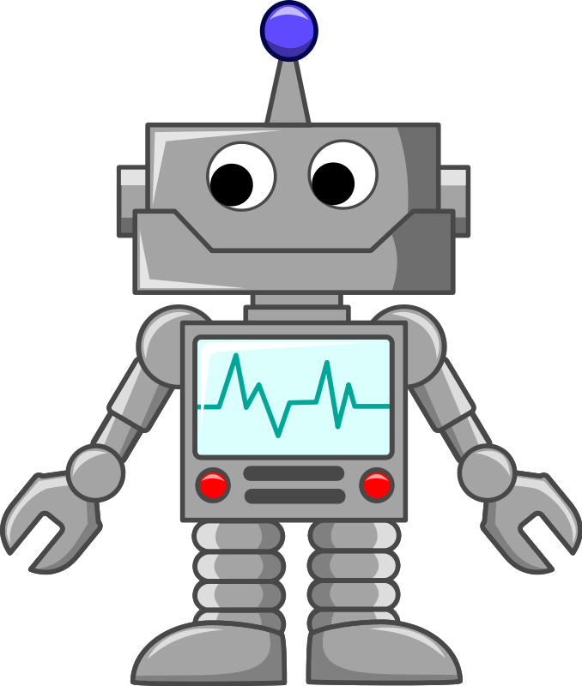
What is a Robot?
A mechanical device that:
Operates at a distance (remotely).
Operates automatically (autonomous) or by remote control (tele-operated).
NASA definition: a machine that is built to do a certain job again and again, or to do work that might be dangerous for humans

Slide 4
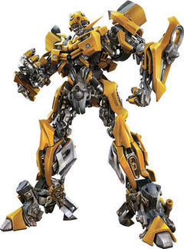
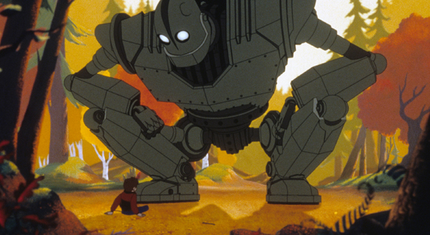
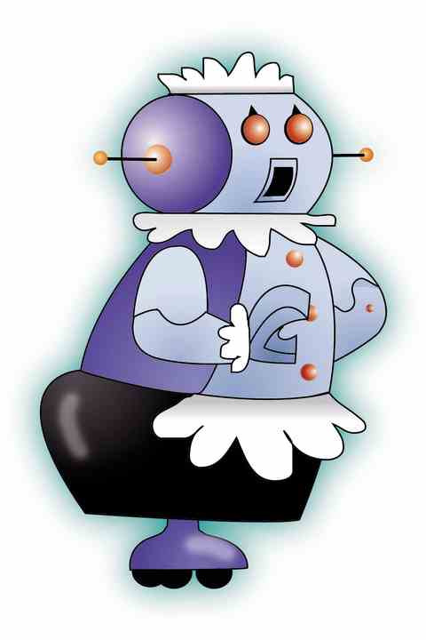
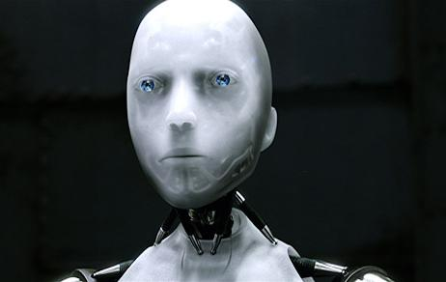
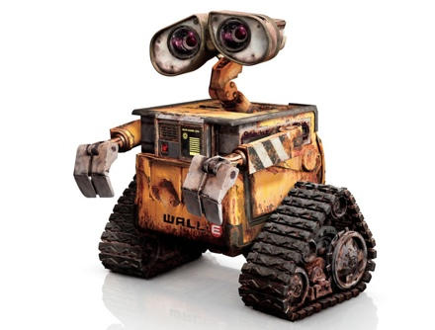
Robots in Movies
Bumblebee - Transformers
The Iron Giant
R2D2 & C3PO – Star Wars
WALL-E
Sonny - I, Robot
Rosie - The Jetsons

Slide 5
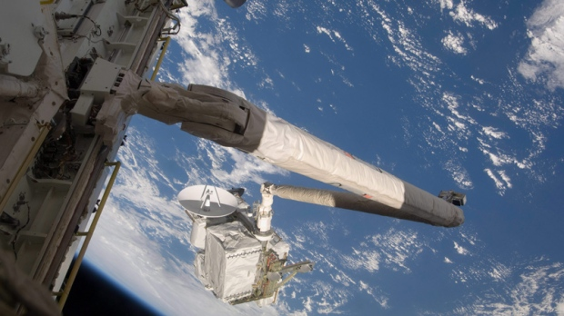
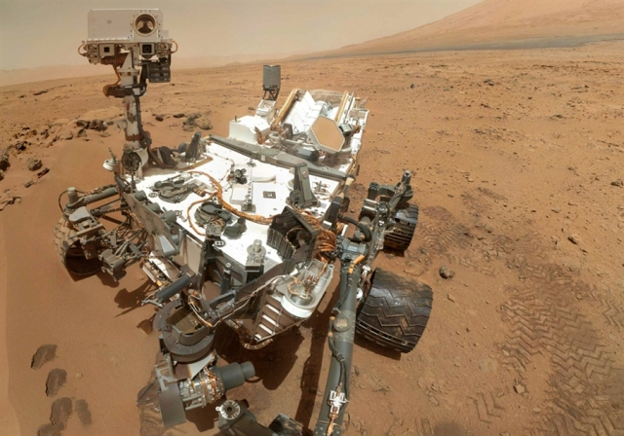
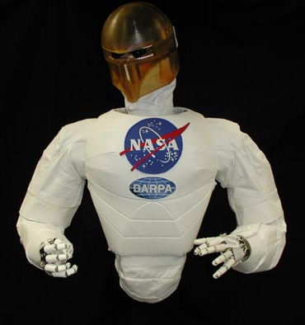
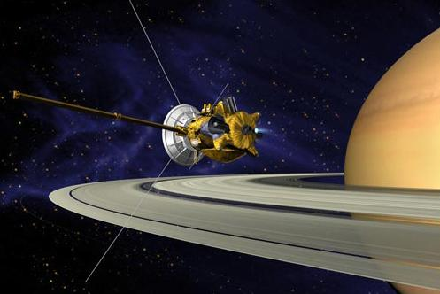
NASA Robots
Canadarm, ISS
Mars Curiosity
Cassini
Robonaut, ISS
New Horizons
Mars 1: http://www.youtube.com/watch?v=-nAhag_iFx0
Mars 2: http://www.youtube.com/watch?v=8-X8acD_r38

Slide 6
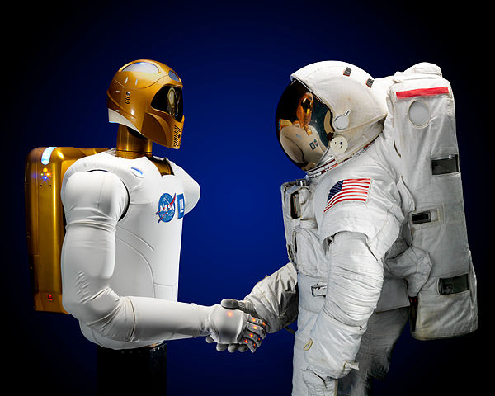
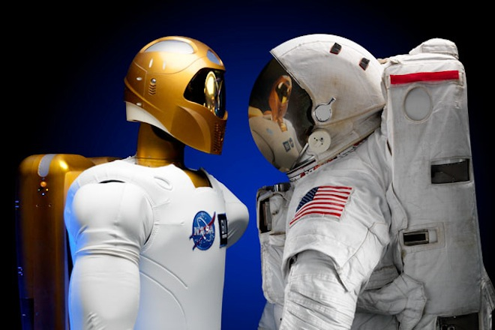
Robots (versus/and) Humans
Pros and Cons:
Safety
Efficiency
Cost
Human need to explore

Slide 7
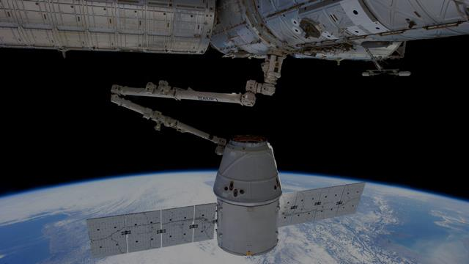
Robot Arm Activity
Real world situations in NASA
You and your crew are astronauts aboard the International Space Station
Your recent shipment of cargo was hit by micrometeoroids (tiny space rocks) and now your food and supplies are floating everywhere!
In order to get your cargo, your team must build a robotic arm with only the materials you have onboard before your cargo drifts away!

Slide 8
How Teams Work at NASA
Ask – What is our problem that needs to be solved?
Imagine – Brainstorm all possible answers!
Plan – Decide which ideas to try!
Create – Build your robot arm, and remember to work as a team!
Experiment – Try out your design!
Improve – Change your design to make it better!

Slide 10
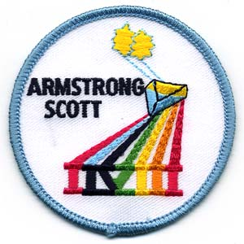
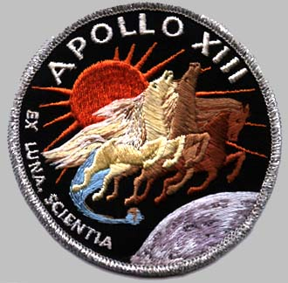
NASA and Human Space Flight
Mercury – give background on how they design patches
Gemini (8) – story behind this
Apollo!!

Slide 11
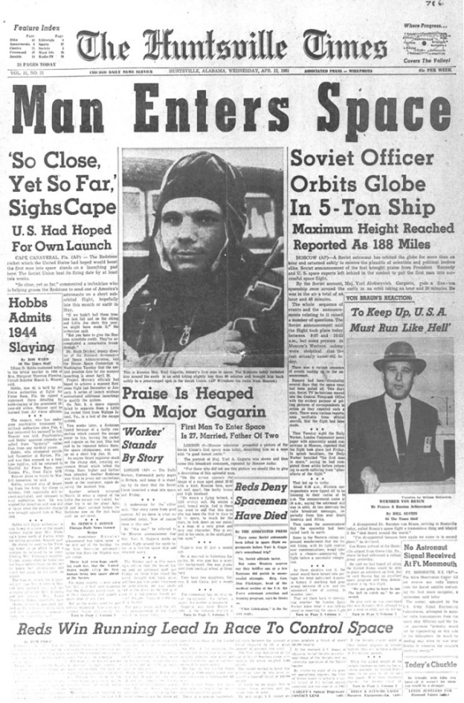
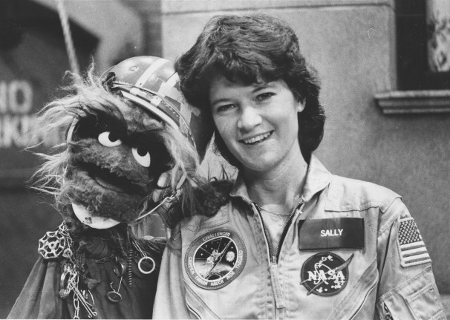
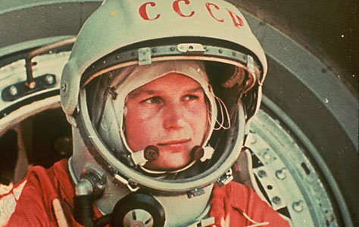
Firsts: Human Exploration
1st human in space: Yuri Gagarin, April 12, 1961
1st American in space: Alan Shepard, May 5, 1961 (http://www.nasa.gov/externalflash/shepard50/)
1st woman in space: Valentina Tereshkova, June 16, 1963
1st American woman in space: Sally Ride, June 18, 1983

Slide 12
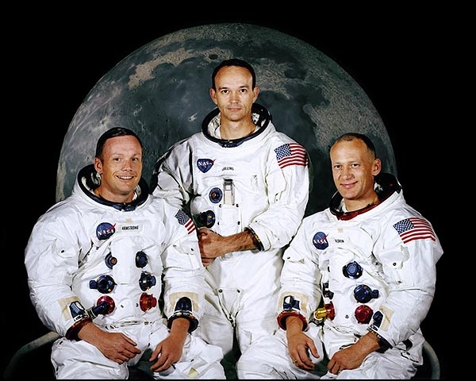
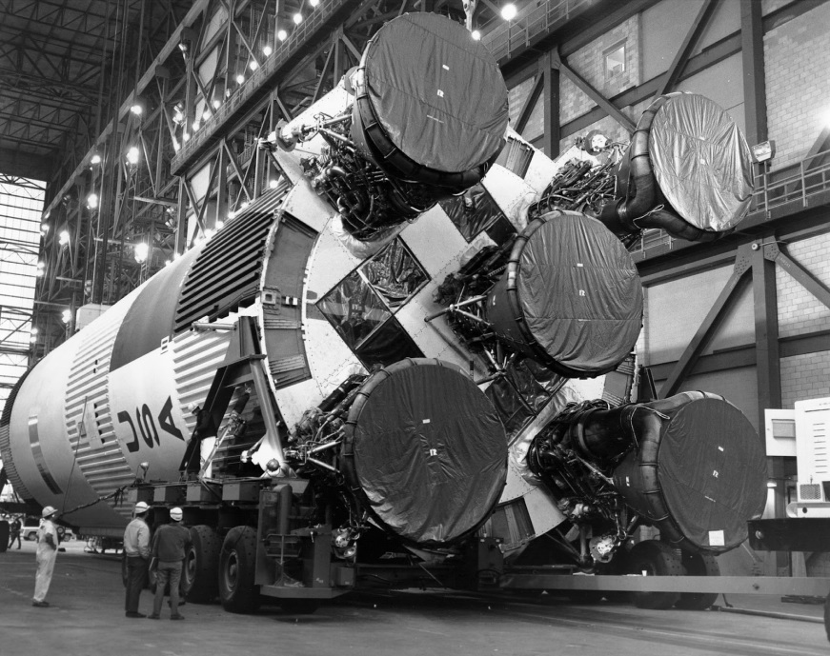
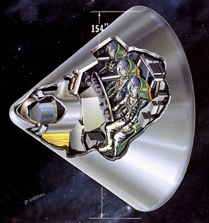
Apollo Program
Apollo 11 was the first manned-lunar landing
Landing: July 20, 1969
Neil Armstrong, Buzz Aldrin, Michael Collins
Saturn V Rocket: 36 stories tall
How many men walked on the Moon?
12! One geologist (Harrison “Jack” Schmitt)
How much moon rock?
842 pounds!

Slide 13
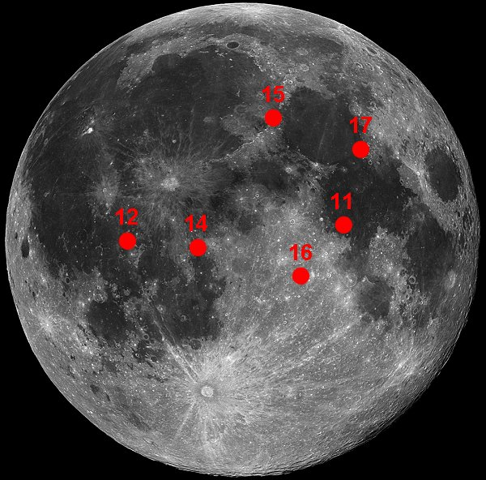
Apollo Landing Sites
Notes:
High resolution versions of this image are available at http://www.lpi.usra.edu/resources/mapcatalog/LandingSite/index.html
Early observers thought the dark plains on the Moon were seas and lakes and gave them names like Mare Tranquillitatis (Sea of Tranquillity, where Apollo 11 landed). We retain those traditional names even though, of course, we know they are not seas.
In the 1600's, the Italian astronomer Giovanni Riccioli began the custom of naming craters on the Moon for great astronomers. A large crater was later named for Riccioli himself. There's almost a perverse, inverse relationship between the size of a crater and the astronomer's contribution to lunar studies. Great as Plato, Tycho, and Copernicus are, they did not advance our understanding of the Moon much, but they have some of the largest and most conspicuous craters named for them. (By the time telescopes were powerful enough to allow serious research on the Moon, all the good craters were taken!)

Slide 14
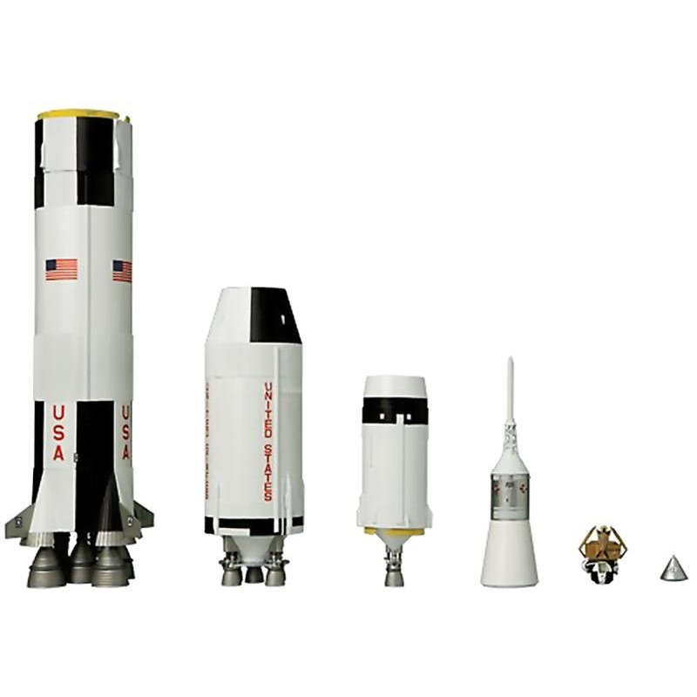
Saturn V Rocket and Apollo Capsule
Notes:
High resolution versions of this image are available at http://www.lpi.usra.edu/resources/mapcatalog/LandingSite/index.html
Early observers thought the dark plains on the Moon were seas and lakes and gave them names like Mare Tranquillitatis (Sea of Tranquillity, where Apollo 11 landed). We retain those traditional names even though, of course, we know they are not seas.
In the 1600's, the Italian astronomer Giovanni Riccioli began the custom of naming craters on the Moon for great astronomers. A large crater was later named for Riccioli himself. There's almost a perverse, inverse relationship between the size of a crater and the astronomer's contribution to lunar studies. Great as Plato, Tycho, and Copernicus are, they did not advance our understanding of the Moon much, but they have some of the largest and most conspicuous craters named for them. (By the time telescopes were powerful enough to allow serious research on the Moon, all the good craters were taken!)

Slide 15
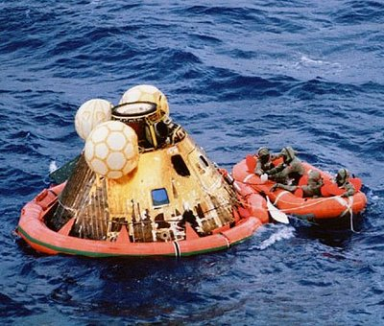
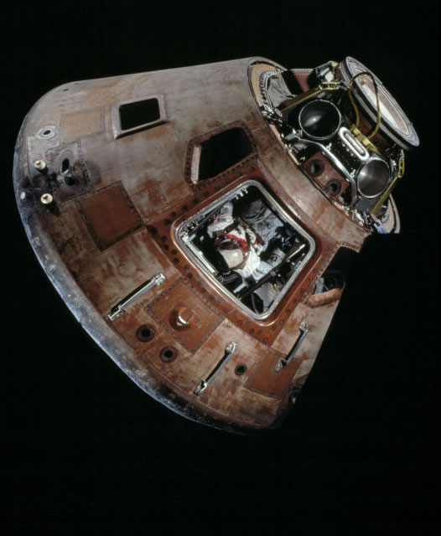
Apollo Capsule
Notes:
High resolution versions of this image are available at http://www.lpi.usra.edu/resources/mapcatalog/LandingSite/index.html
Early observers thought the dark plains on the Moon were seas and lakes and gave them names like Mare Tranquillitatis (Sea of Tranquillity, where Apollo 11 landed). We retain those traditional names even though, of course, we know they are not seas.
In the 1600's, the Italian astronomer Giovanni Riccioli began the custom of naming craters on the Moon for great astronomers. A large crater was later named for Riccioli himself. There's almost a perverse, inverse relationship between the size of a crater and the astronomer's contribution to lunar studies. Great as Plato, Tycho, and Copernicus are, they did not advance our understanding of the Moon much, but they have some of the largest and most conspicuous craters named for them. (By the time telescopes were powerful enough to allow serious research on the Moon, all the good craters were taken!)

Slide 16
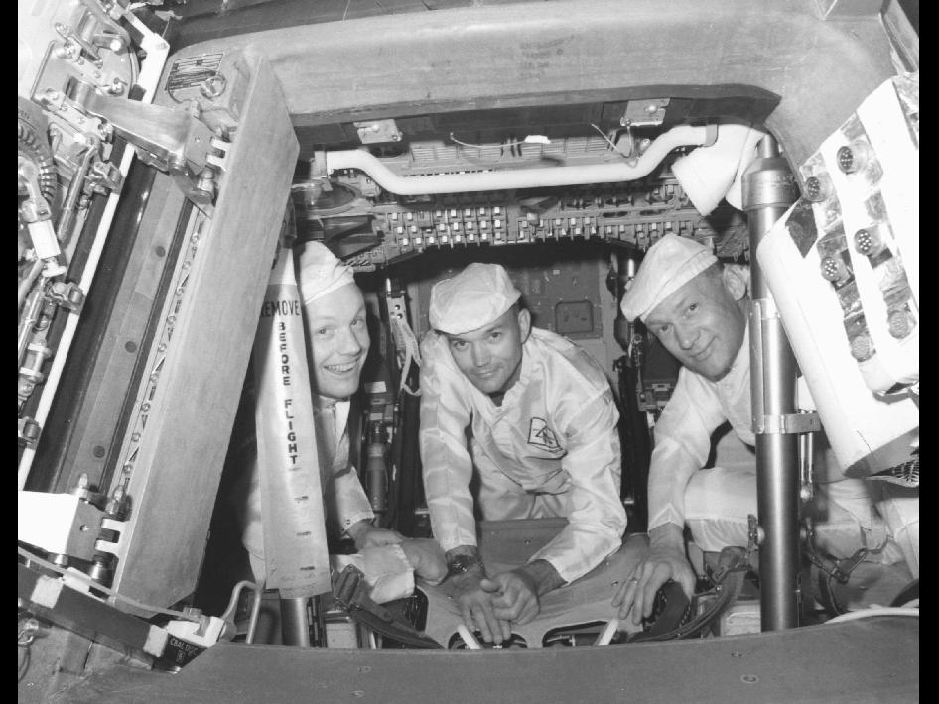
Apollo Capsule
Notes:
High resolution versions of this image are available at http://www.lpi.usra.edu/resources/mapcatalog/LandingSite/index.html
Early observers thought the dark plains on the Moon were seas and lakes and gave them names like Mare Tranquillitatis (Sea of Tranquillity, where Apollo 11 landed). We retain those traditional names even though, of course, we know they are not seas.
In the 1600's, the Italian astronomer Giovanni Riccioli began the custom of naming craters on the Moon for great astronomers. A large crater was later named for Riccioli himself. There's almost a perverse, inverse relationship between the size of a crater and the astronomer's contribution to lunar studies. Great as Plato, Tycho, and Copernicus are, they did not advance our understanding of the Moon much, but they have some of the largest and most conspicuous craters named for them. (By the time telescopes were powerful enough to allow serious research on the Moon, all the good craters were taken!)

Slide 17
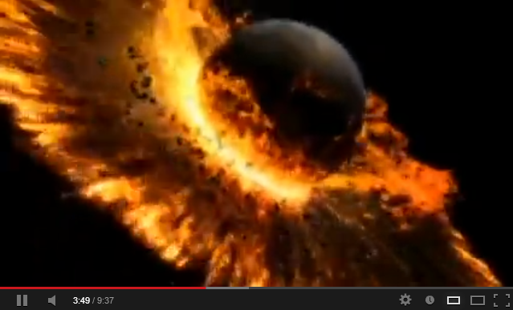
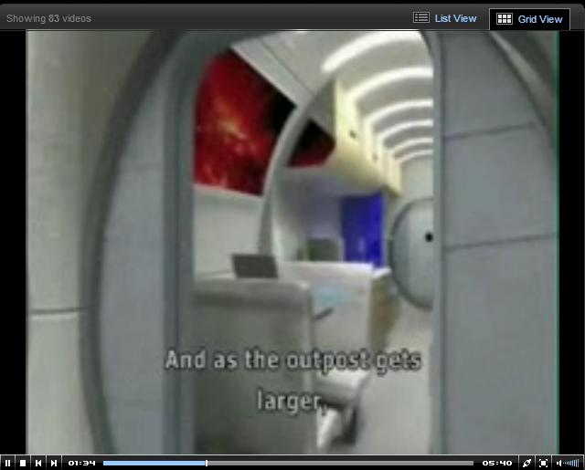
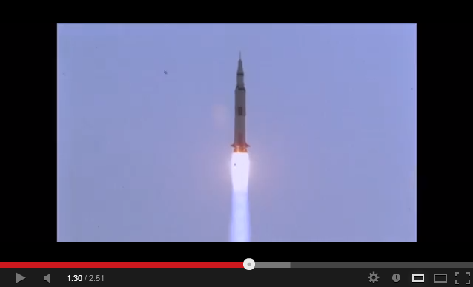
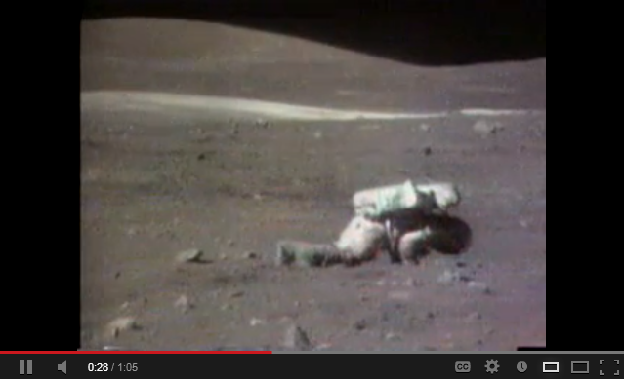
Field Trip to the Moon Activity
Introductory Videos (Period 1)
Formation of the Moon
K-5: Lunar Habitat – Structure
(downloadable)
Apollo 11 Launch (no sound)
Apollo 14 – Golfing on the Moon
Apollo 16 Astronaut loses balance
Apollo 17 Astronauts singing
Apollo 17 Launch from Moon

Slide 18
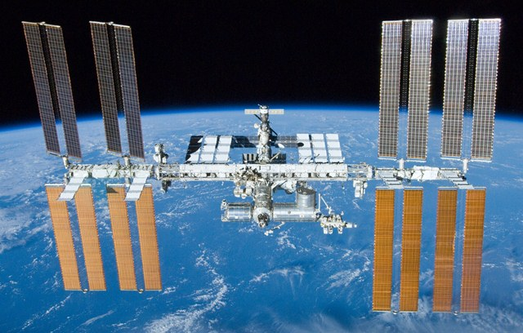
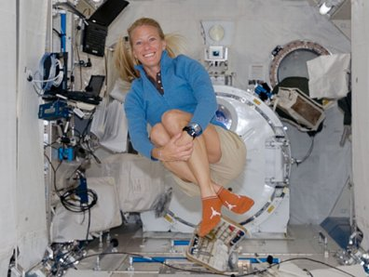
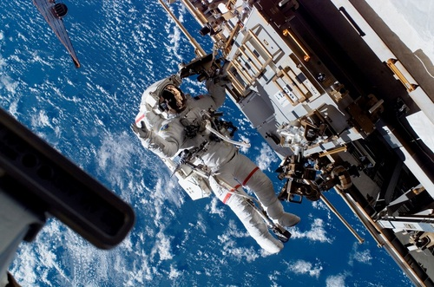
International Space Station
In-orbit construction began 1998
Continuously crewed since November 2000
Space Shuttle delivered missions
Orbits the Earth at 230 miles up, (Dickinson to Valley City)
One orbit every 90 minutes
Karen Nyberg: graduate of UND
Spot the Station Website
http://spotthestation.nasa.gov/

Slide 19
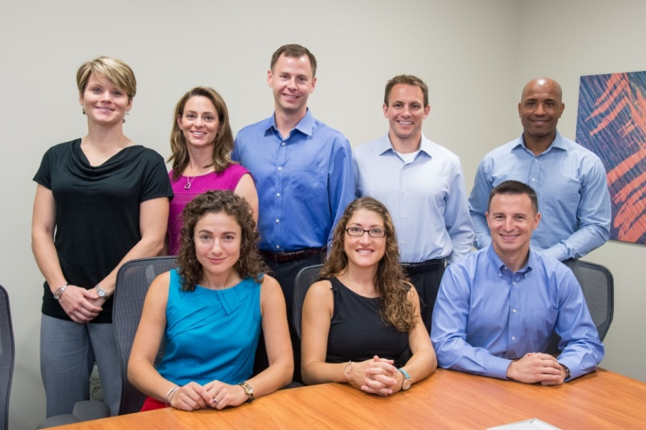
NASA Today
Current missions
Orion and SLS
MAVEN
Human and Biology stuff
Astronaut Candidates – a lil background on each/some
Education programs

Slide 20
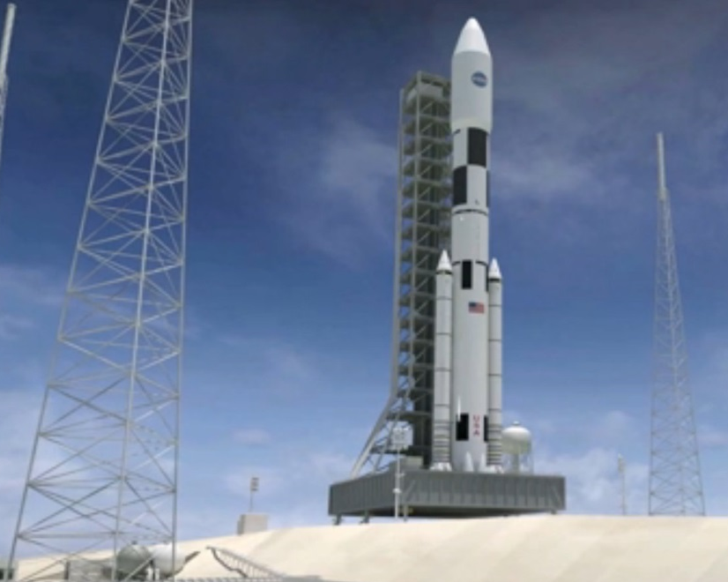
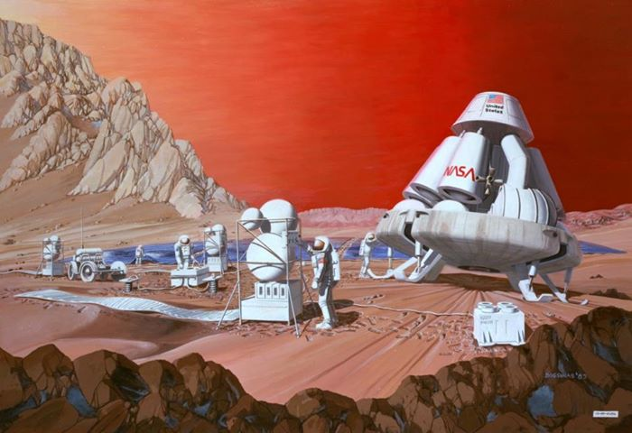
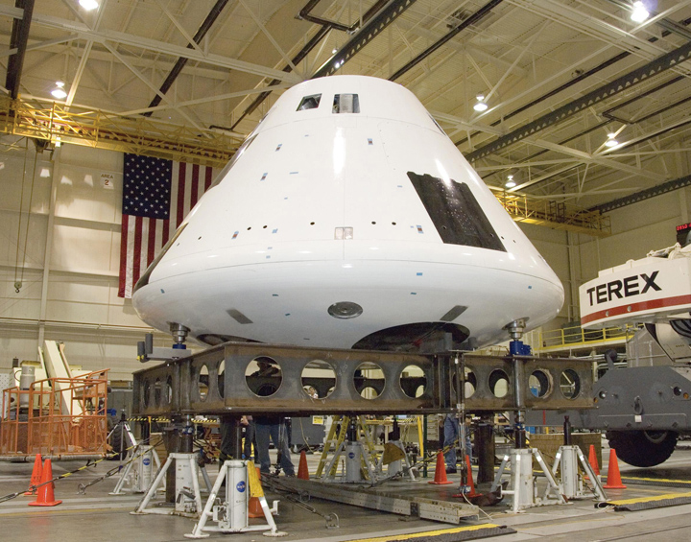
Future Space Exploration
Manned mission to an asteroid?
Return to Moon?
Manned mission to Mars?
NASA Space Launch System (SLS), Orion (Multi-purpose crew vehicle)

Slide 21
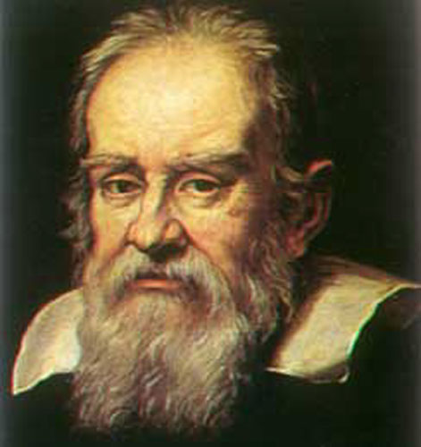
Galileo Galilei (1564 – 1642)
21
Notes:
21
Theresa

Slide 22
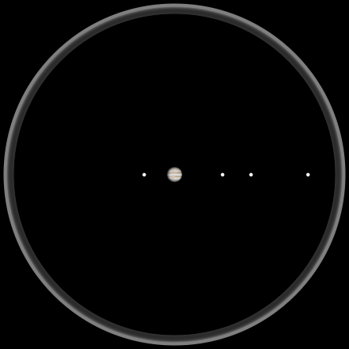
Jupiter as Seen by Galileo
22
Notes:
Theresa

Slide 23
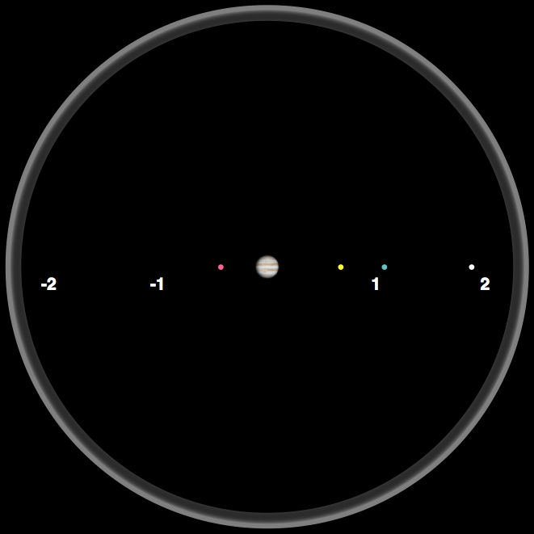
Observing Jupiter
Night 1
23
Notes:
Theresa

Slide 24
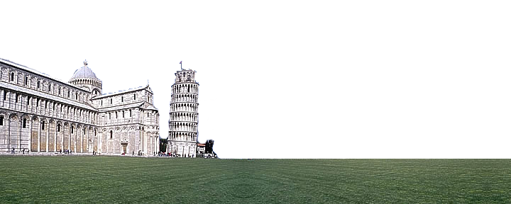
Day Time
24
Notes:
Theresa

Slide 25
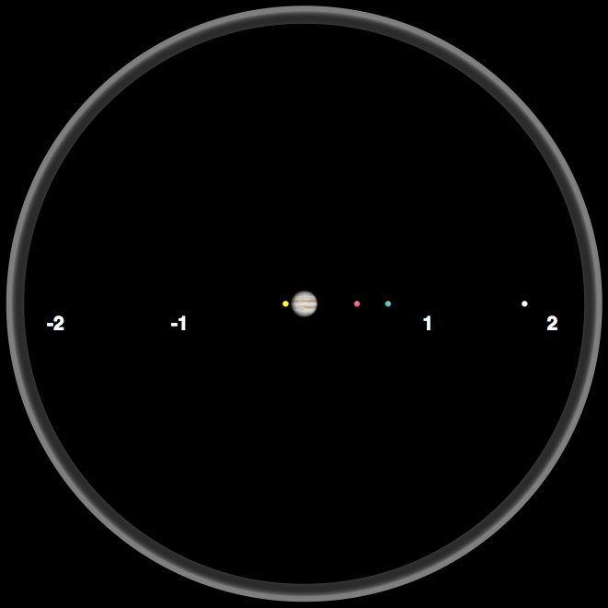
Observing Jupiter
Night 2
25
Notes:
Theresa

Slide 26
Day Time
26
Notes:
Theresa

Slide 27
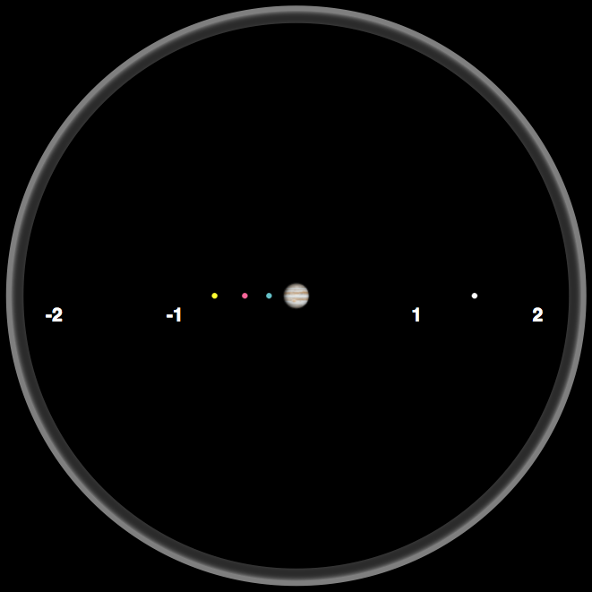
Observing Jupiter
Night 3
27
Notes:
Theresa

Slide 28
Day Time
Make a Prediction for Night 4 …
28
Notes:
Theresa

Slide 29
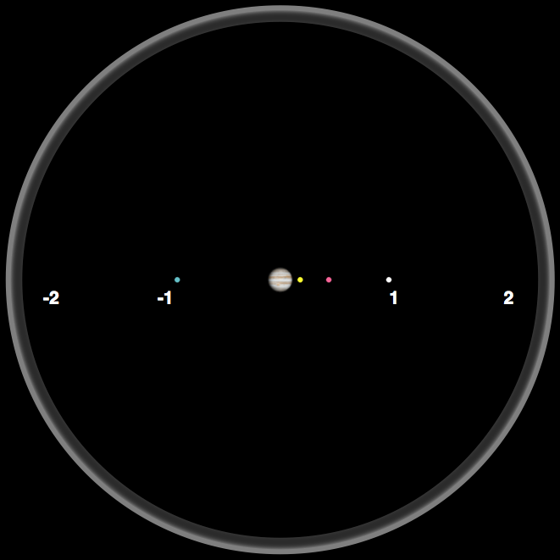
Observing Jupiter
Night 4
29
Notes:
Theresa

Slide 30
Day Time
Make a Prediction for Night 5 …
30
Notes:
Theresa

Slide 31
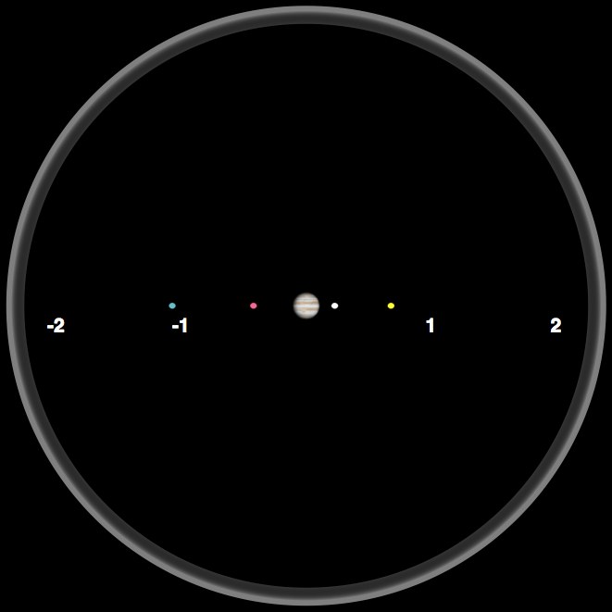
Observing Jupiter
Night 5
31
Notes:
Theresa

Slide 32
Day Time
Make a Prediction for Night 6 …
32
Notes:
Theresa

Slide 33
Observing Jupiter
Night 6
33
Notes:
Theresa

Slide 34
Day Time
Make a Prediction for Night 7 …
34
Notes:
Theresa

Slide 35
Trying to Observe Jupiter
Night 7
35
Notes:
Theresa

Slide 36
Day Time
Make a Prediction for Night 8 …
36
Notes:
Theresa

Slide 37
Observing Jupiter
Night 8
37
Notes:
Theresa

Slide 38
Day Time
Make a Prediction for Night 9 …
38
Notes:
Theresa

Slide 39
Observing Jupiter
Night 9
39
Notes:
Theresa

Slide 40
Analyzing Jupiter Data
Work with your table group to analyze the Jupiter data.
What patterns do you observe?
How would you describe the data?
Don’t try to explain the data!
40

Slide 41
Modeling the Jupiter Data
Work with your table group and discuss the following questions:
What does the data tell us about the motion of the 4 objects?
Can you build a model that explains the observations?
What do you think is the nature of these 4 objects?
Other model ideas?
41

Slide 42
Reflecting on Galileo’s Observations
Video: Galileo's observations of the Moons of Jupiter.
When watching the video, think about what Galileo did as a scientist and why he did it.
Notes:
Theresa

Slide 43
Reflecting on the Nature of Science
Why did Galileo look at Jupiter?
Why did Galileo repeat his observation?
What question did Galileo ask?
What did Galileo do that helped to answer his question?
43
Notes:
These may need to be changed to reflect document or vice versa

Slide 44
Understandings about the Nature of Science
Scientific knowledge is based on empirical evidence.
New technologies advance scientific knowledge.
44
Notes:
These may need to be changed to reflect document or vice versa

Slide 45
Reflecting on the Nature of Science
Did Galileo follow the “scientific method”?
45
Notes:
These may need to be changed to reflect document or vice versa

Slide 46
Understandings about the Nature of Science
Science investigations use diverse methods and do not always use the same set of procedures to obtain data.
46
Notes:
These may need to be changed to reflect document or vice versa

Slide 47
Reflecting on the Nature of Science
Why do you think scientific knowledge changes?
New Technologies allow us to collect new evidence
47
Notes:
These may need to be changed to reflect document or vice versa

Slide 48
Understandings about the Nature of Science
Scientific explanations are subject to revision and improvement in light of new evidence.
The certainty and durability of science findings varies.
Science findings are frequently revised and/or reinterpreted based on new evidence.
48
Notes:
These may need to be changed to reflect document or vice versa

Slide 49
Reflecting on the Nature of Science
Do you think Galileo’s work involved creativity?
49
Notes:
These may need to be changed to reflect document or vice versa

Slide 50
Understandings about the Nature of Science
Science is a human endeavor.
Scientists and engineers rely on human qualities such as persistence, precision, reasoning, logic, imagination, and creativity.
50
Notes:
These may need to be changed to reflect document or vice versa

Slide 51
Analyzing Data
We will assume circular motion.
Discuss with your table group how the data can be used to compare the times it takes each moon to complete an orbit.
51
Notes:
Wil

Slide 52
Data Analysis Steps
Determine the time it takes for your moon to complete one orbit. [unit = day]
Determine the distance to Jupiter (or the radius of the orbit). [unit is million km]
Determine the length of the orbital path for your moon. [unit is million km]
Calculate the speed by dividing the length of the orbit by the time it takes the moon to complete it. [unit = million km / day]
52
Notes:
Wil

Slide 53
Graphing the Data
Graph the data for speed versus distance and describe what this graph tells you.
53
Notes:
Wil

Slide 56
NASA Education
Can search for materials by subject and grade level
http://search.nasa.gov/search/edFilterSearch.jsp?empty=true

Slide 57
NASA for Students
http://www.nasa.gov/audience/forstudents/k-4/

Slide 58
NASA – Lunar Reconnaissance Orbiter

Slide 59
Year of the Solar System

Slide 60
International Space Station - Live!

Slide 61
Planetary Science Institute

Slide 62
Planetary Science Institute

Slide 63
Space Foundation

Slide 64
Lunar and Planetary Institute

Slide 65
NASA Summer of Innovation

Slide 66
Free Poster for Educators!

Slide 67
Mars Curiosity Rover
http://mars.jpl.nasa.gov/drc/

Slide 68
North Dakota Space Grant

Slide 69
NASA Discovery Program

Slide 70
NDSGC K-12 Educator Email Listserv!
Workshop opportunities
New STEM education resources for the classroom
NASA student contests/team competitions
Professional Development opportunities
Emails ~once a week

Slide 71
Space Rocks Defined
Meteoroid: Small (less than 10 meters) rock/metallic object IN SPACE
Meteor: The light produced when a meteoroid ENTERS THE ATMOSPHERE (sometimes called a “shooting star”)
Meteorite: A natural rock/metallic object from space that has fallen to EARTH’S SURFACE
A METEORITE which is a part of the meteoroid that survived atmospheric entry and reached the ground.
A METEOROID approaching the Earth.
A METEOR formed by a meteoroid entering the atmosphere at high velocity.
Task 2

Slide 72
Space Rocks Defined
Where do they come from?
Why study space rocks?
Samples of the early Solar System
Meteor Showers (Comet Tails)
Impacts!! – Planetary Protection
Task 2

Slide 73
Impacts in Our Solar System
Mercury, Moon, Mars
Gale Crater and Curiosity Rover
Task 2

Slide 74
Impacts on Earth
Meteor Crater (Arizona) was formed by the impact of an ~50 meter iron asteroid ~50,000 years ago
1 km
Task 2

Slide 75
Peekskill Meteorite (12.4 kg) and 1980 Chevrolet Malibu
October 9, 1992 – Peekskill, NY
Michelle Knapp - 18 yr old, HS senior
When police arrived on the scene, they filed a report for criminal mischief by a very strong male.
The smell of gas from the punctured gas tank prompted the fire department to investigate, at which time they found the meteorite.

Slide 76
Space Rocks! Board Game
Dice App: “Prime Dice”
Game Rules
Make each board game space into an 8.5x11, and tape up around the classroom for a “life size” version of the game
Meteor Zone and Meteorite Zone
Task 2

Slide 77
Sorting the Solar System
You are the astronomers!
And you get to travel back in time…
3 Envelopes of different time periods
Categorize solely based on information provided
77
Notes:
77

Slide 78
Sorting the Solar System
Use index cards to label/name each grouping and include the following information on the card:
Name for your grouping
Description of your grouping
Criteria you used to create the categories.
The Card numbers of the objects in your group
78
Notes:
78

Slide 79
Let’s categorize!
Antiquity – 1799… Go!
1800 – 1950… Go!
1951 – Today… Go!
79

Slide 80
Reflection
Individually answer the following question:
How did your previous knowledge and experiences (related to Solar System objects) interfere or help you as you completed this investigation?
80

Slide 81
Reflection
Individually answer the following question:
How would you reply to a student who said “If science constantly changes, how can we trust it?”
81

