Slide 1
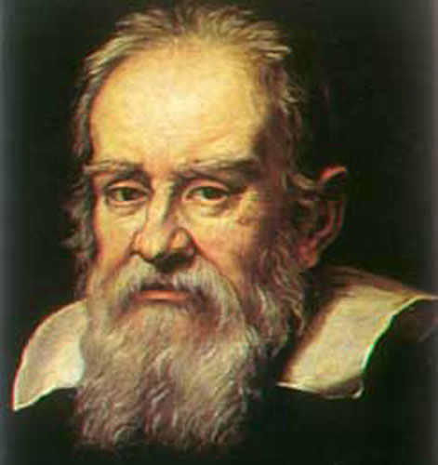
Galileo Galilei (1564 – 1642)
1
Notes:
1
Theresa

Slide 2
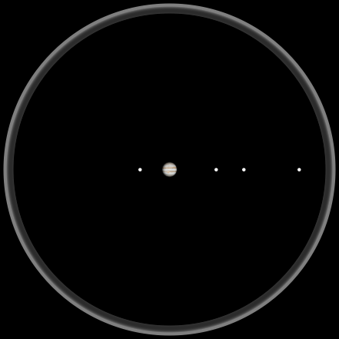
Jupiter as Seen by Galileo
2
Notes:
Theresa

Slide 3
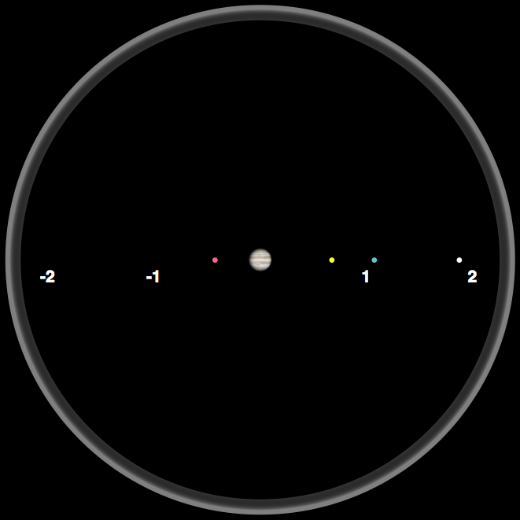
Observing Jupiter
Night 1
3
Notes:
Theresa

Slide 4
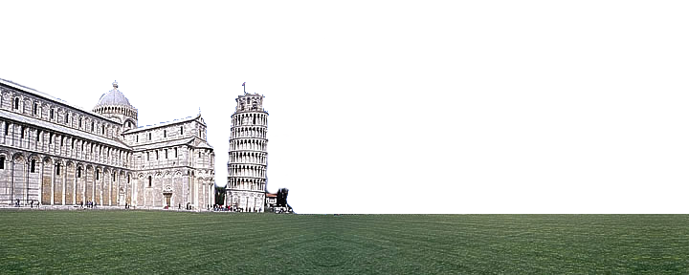
Day Time
4
Notes:
Theresa

Slide 5
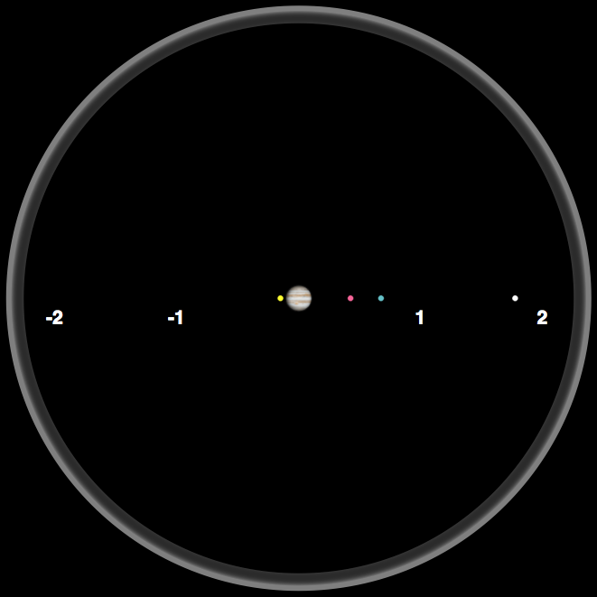
Observing Jupiter
Night 2
5
Notes:
Theresa

Slide 6
Day Time
6
Notes:
Theresa

Slide 7
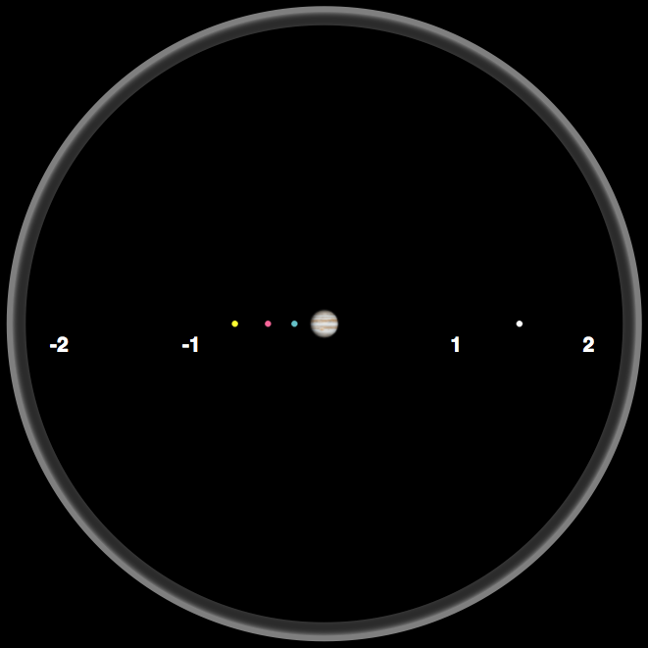
Observing Jupiter
Night 3
7
Notes:
Theresa

Slide 8
Day Time
Make a Prediction for Night 4 …
8
Notes:
Theresa

Slide 9
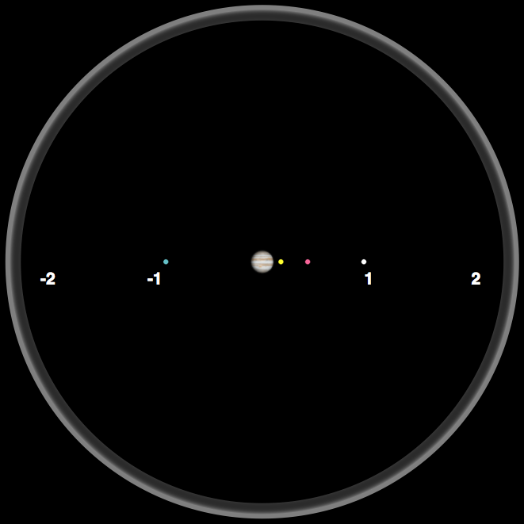
Observing Jupiter
Night 4
9
Notes:
Theresa

Slide 10
Day Time
Make a Prediction for Night 5 …
10
Notes:
Theresa

Slide 11
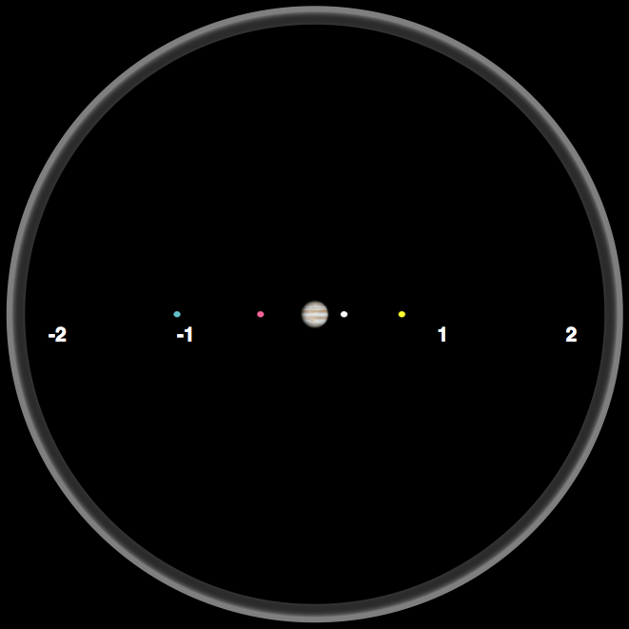
Observing Jupiter
Night 5
11
Notes:
Theresa

Slide 12
Day Time
Make a Prediction for Night 6 …
12
Notes:
Theresa

Slide 13
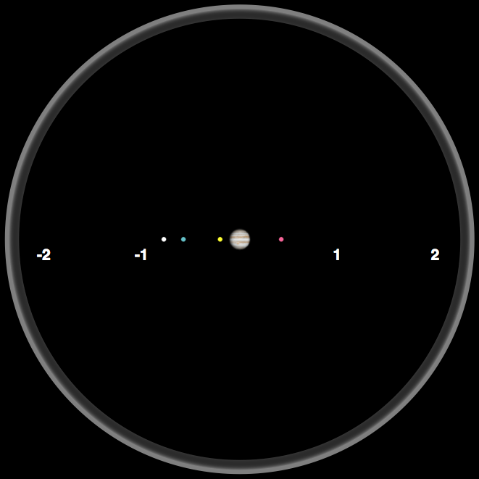
Observing Jupiter
Night 6
13
Notes:
Theresa

Slide 14
Day Time
Make a Prediction for Night 7 …
14
Notes:
Theresa

Slide 15
Trying to Observe Jupiter
Night 7
15
Notes:
Theresa

Slide 16
Day Time
Make a Prediction for Night 8 …
16
Notes:
Theresa

Slide 17
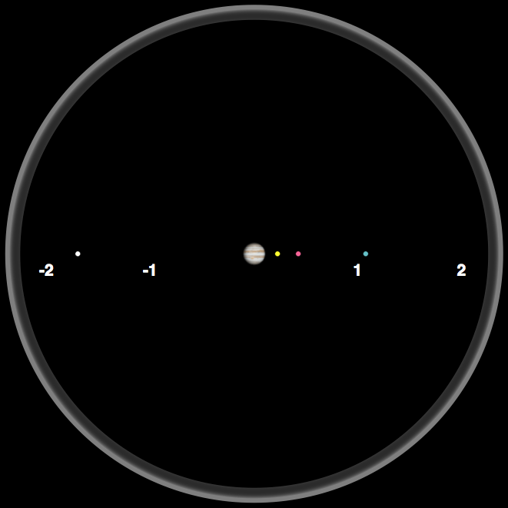
Observing Jupiter
Night 8
17
Notes:
Theresa

Slide 18
Day Time
Make a Prediction for Night 9 …
18
Notes:
Theresa

Slide 19
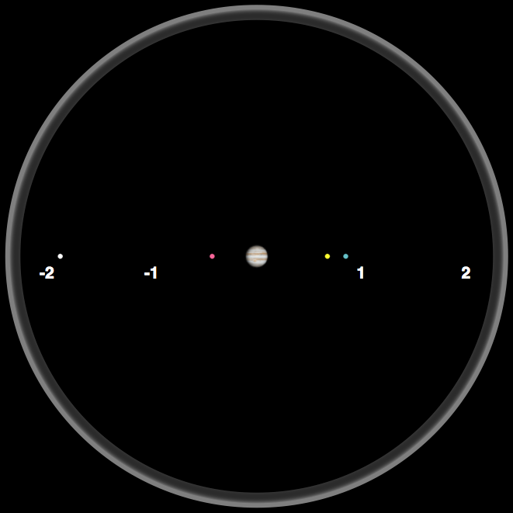
Observing Jupiter
Night 9
19
Notes:
Theresa

Slide 20
Analyzing Jupiter Data
Work with your table group to analyze the Jupiter data.
What patterns do you observe?
How would you describe the data?
Don’t try to explain the data!
20

Slide 21
Modeling the Jupiter Data
Work with your table group and discuss the following questions:
What does the data tell us about the motion of the 4 objects?
Can you build a model that explains the observations?
What do you think is the nature of these 4 objects?
21

Slide 22
Reflecting on Galileo’s Observations
We will now watch a short video about Galileo's observations of the Moons of Jupiter.
When watching the video, think about what Galileo did as a scientist and why he did it.
Galileo Discovery of Jupiter’s Moons
This video is online at: http://www.teachersdomain.org/resource/ess05.sci.ess.eiu.galileomoon/
Notes:
Theresa

Slide 23
Reflecting on the Nature of Science
Why did Galileo look at Jupiter?
Why did Galileo repeat his observation?
What question did Galileo ask?
What did Galileo do that helped to answer his question?
23
Notes:
These may need to be changed to reflect document or vice versa

Slide 24
Understandings about the Nature of Science
Scientific knowledge is based on empirical evidence.
New technologies advance scientific knowledge.
24
Notes:
These may need to be changed to reflect document or vice versa

Slide 25
Reflecting on the Nature of Science
Did Galileo follow the “scientific method”?
25
Notes:
These may need to be changed to reflect document or vice versa

Slide 26
Understandings about the Nature of Science
Science investigations use diverse methods and do not always use the same set of procedures to obtain data.
26
Notes:
These may need to be changed to reflect document or vice versa

Slide 27
Reflecting on the Nature of Science
Why do you think scientific knowledge changes?
27
Notes:
These may need to be changed to reflect document or vice versa

Slide 28
Understandings about the Nature of Science
Scientific explanations are subject to revision and improvement in light of new evidence.
The certainty and durability of science findings varies.
Science findings are frequently revised and/or reinterpreted based on new evidence.
28
Notes:
These may need to be changed to reflect document or vice versa

Slide 29
Reflecting on the Nature of Science
Do you think Galileo’s work involved creativity?
29
Notes:
These may need to be changed to reflect document or vice versa

Slide 30
Understandings about the Nature of Science
Science is a human endeavor.
Scientists and engineers rely on human qualities such as persistence, precision, reasoning, logic, imagination and creativity.
30
Notes:
These may need to be changed to reflect document or vice versa

Slide 31
Break

Slide 32
Analyzing Data
We will assume circular motion.
Discuss with your table group how the data can be used to determine the speed of each moon.
32
Notes:
Wil

Slide 33
Data Analysis Steps
Determine the time it takes for your moon to complete one orbit. [unit = day]
Determine the distance to Jupiter (or the radius of the orbit). [unit is million km]
Determine the length of the orbital path for your moon. [unit is million km]
Calculate the speed by dividing the length of the orbit by the time it takes the moon to complete it. [unit = million km / day]
33
Notes:
Wil

Slide 34
Graphing the Data
Graph the data for speed versus distance and describe what this graph tells you.
34
Notes:
Wil

