Slide 1
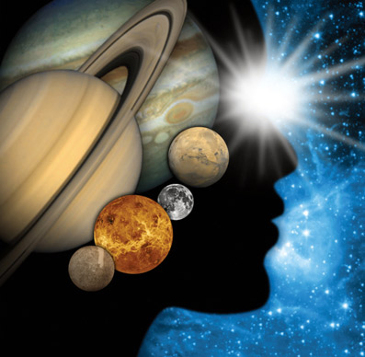
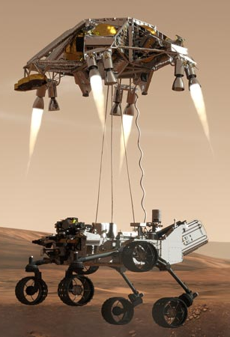
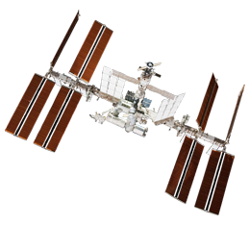
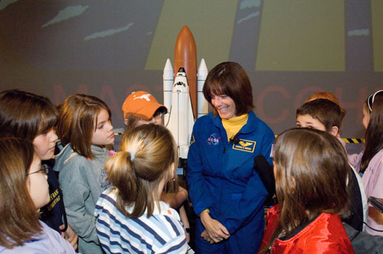
Space Rocks!
Caitlin Nolby
North Dakota NASA Space Grant

Slide 2
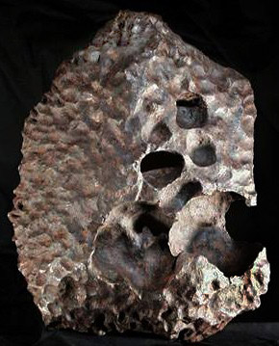
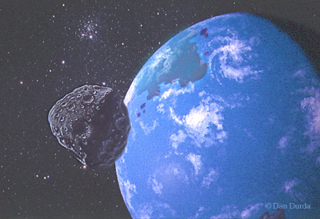
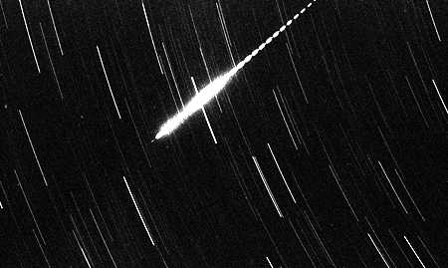
Space Rocks Defined
Meteoroid: Small (less than 10 meters) rock/metallic object IN SPACE
Meteor: The light produced when a meteoroid ENTERS THE ATMOSPHERE (sometimes called a “shooting star”)
Meteorite: A natural rock/metallic object from space that has fallen to EARTH’S SURFACE
A METEORITE which is a part of the meteoroid that survived atmospheric entry and reached the ground.
A METEOROID approaching the Earth.
A METEOR formed by a meteoroid entering the atmosphere at high velocity.

Slide 3
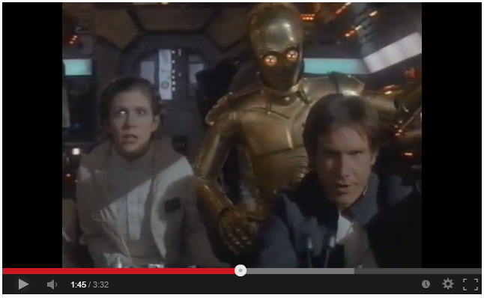
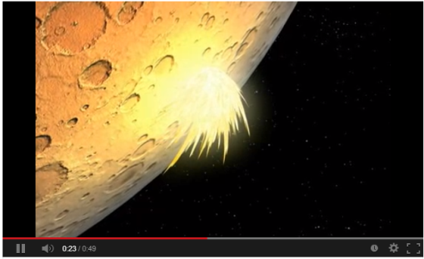
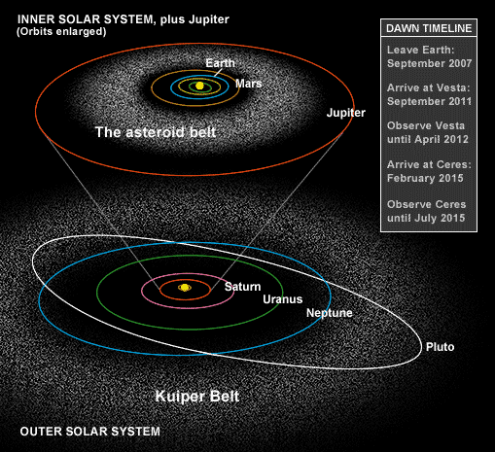
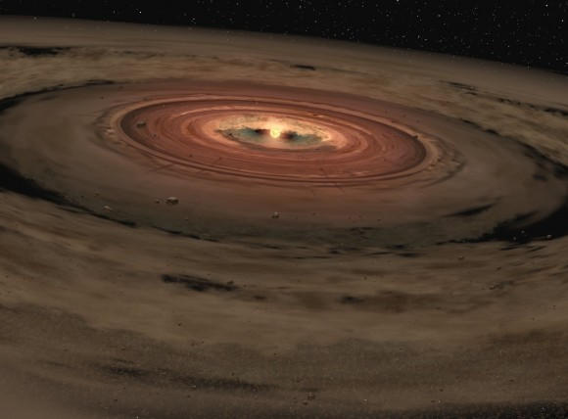
Space Rocks Defined
Where do they come from?
Why study space rocks?
Samples of the early Solar System
Meteor Showers (Comet Tails)
Impacts!! – Planetary Protection

Slide 4
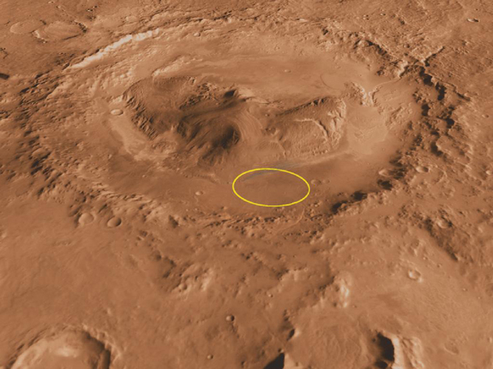
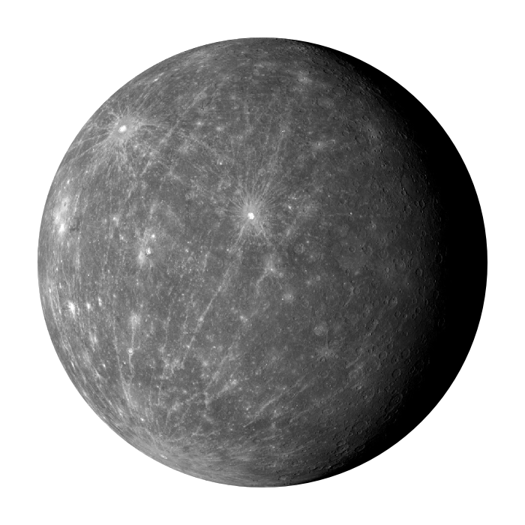
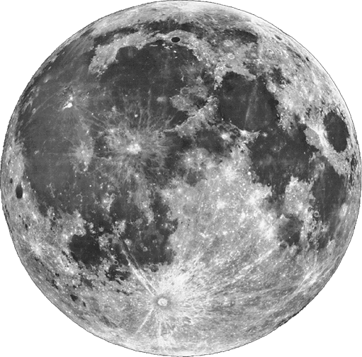
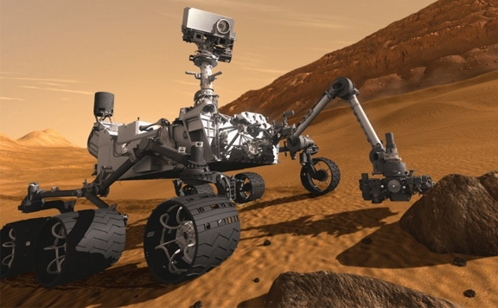
Impacts in Our Solar System
Mercury, Moon, Mars
Gale Crater and Curiosity Rover

Slide 5
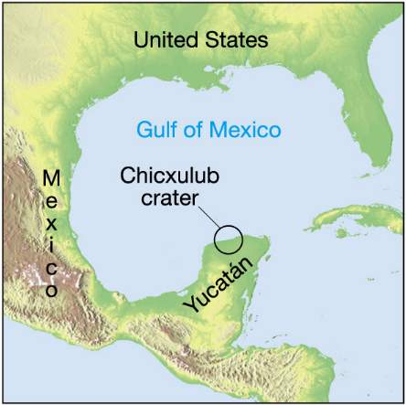
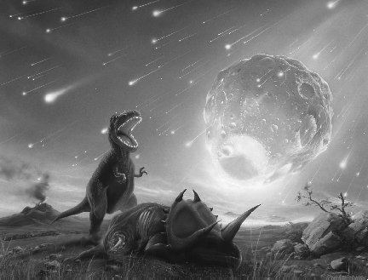
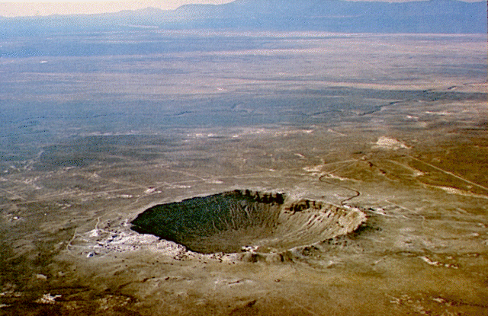
Impacts on Earth
Meteor Crater (Arizona) was formed by the impact of an ~50 meter iron asteroid ~50,000 years ago
1 km

Slide 6
Peekskill Meteorite (12.4 kg) and 1980 Chevrolet Malibu
October 9, 1992 – Peekskill, NY
Michelle Knapp - 18 yr old, HS senior
When police arrived on the scene, they filed a report for criminal mischief by a very strong male.
The smell of gas from the punctured gas tank prompted the fire department to investigate, at which time they found the meteorite.

Slide 7
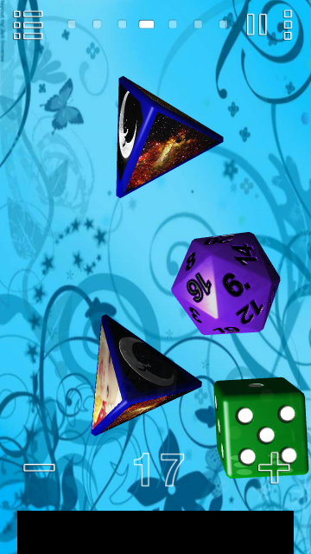
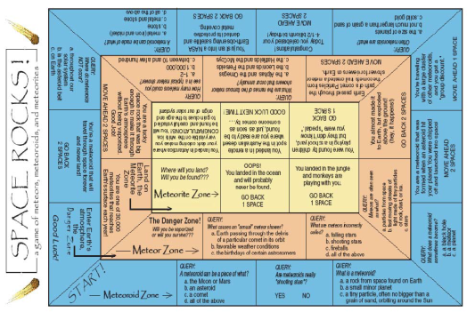
Space Rocks! Board Game
Dice App: “Prime Dice”
Game Rules
Make each board game space into an 8.5x11, and tape up around the classroom for a “life size” version of the game
Meteor Zone and Meteorite Zone

