Slide 1
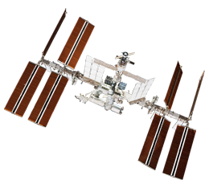
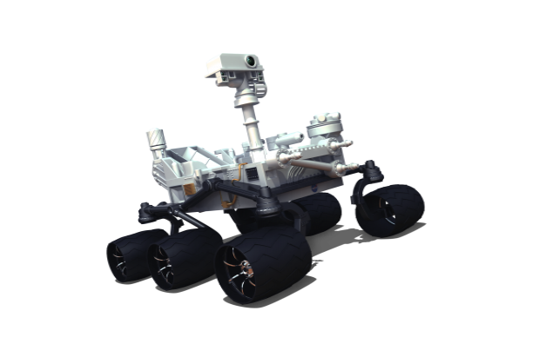
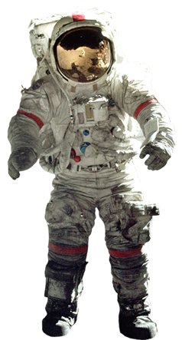
Mission to Mars and NASA Educator Resources
Marissa Saad
North Dakota Space Grant Consortium

Slide 2
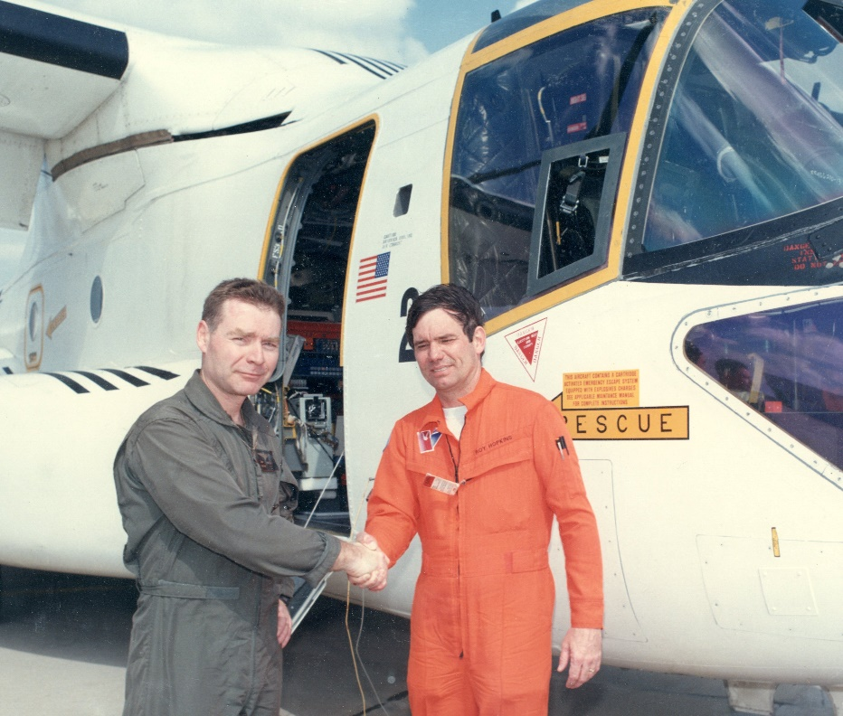
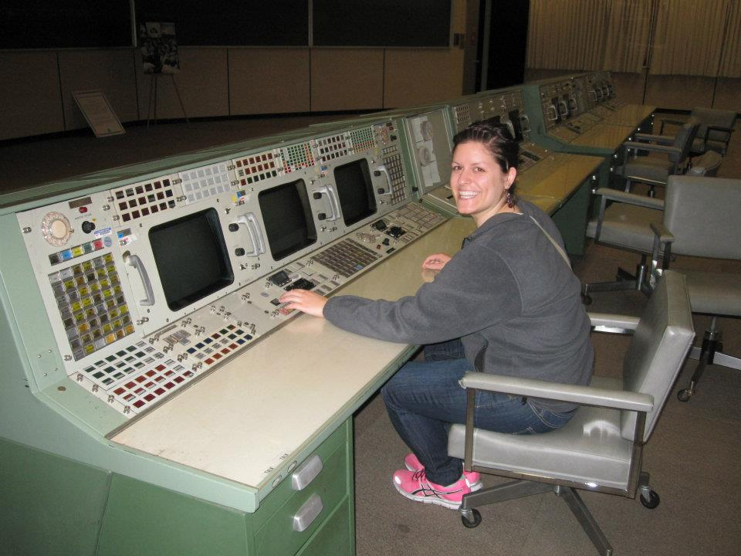
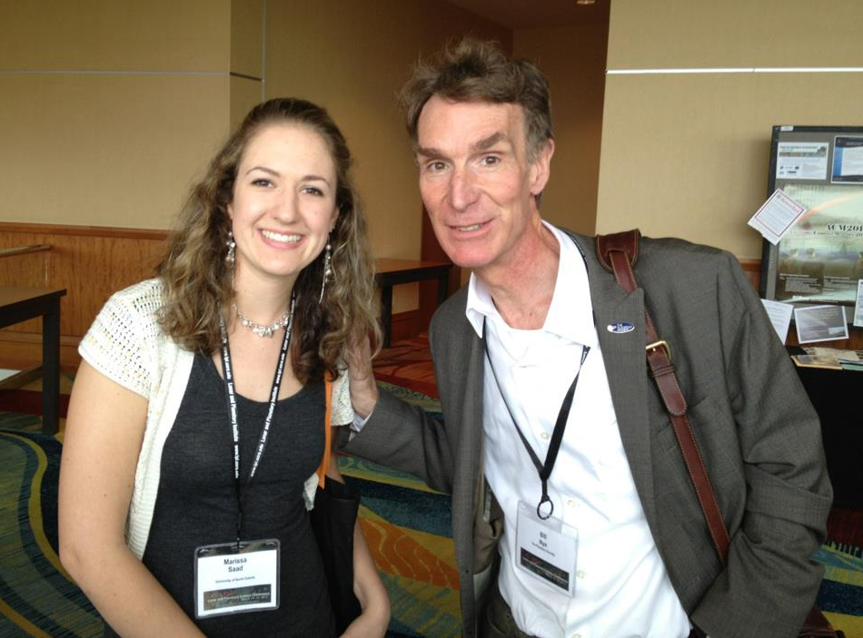
Meet the Space Grant Team!
Director of Space Grant, Jim Casler
Deputy Director, Caitlin Nolby
Coordinator, Marissa Saad

Slide 3
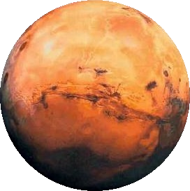
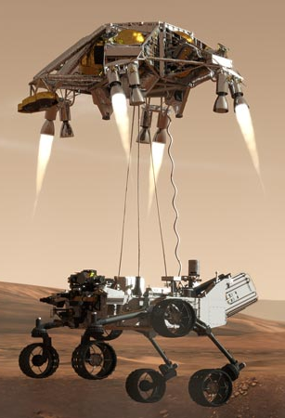
Workshop goals
You will be able to:
Confidently conduct today’s activities in the classroom.
Better understand concepts regarding space sciences.
Effectively communicate in teams to successfully complete a mission to Mars.
Save Mark Watney!
Create a neutrally buoyant object to be used by astronauts in the NBL.
Understand how YOU can get involved with NASA in ND!

Slide 4
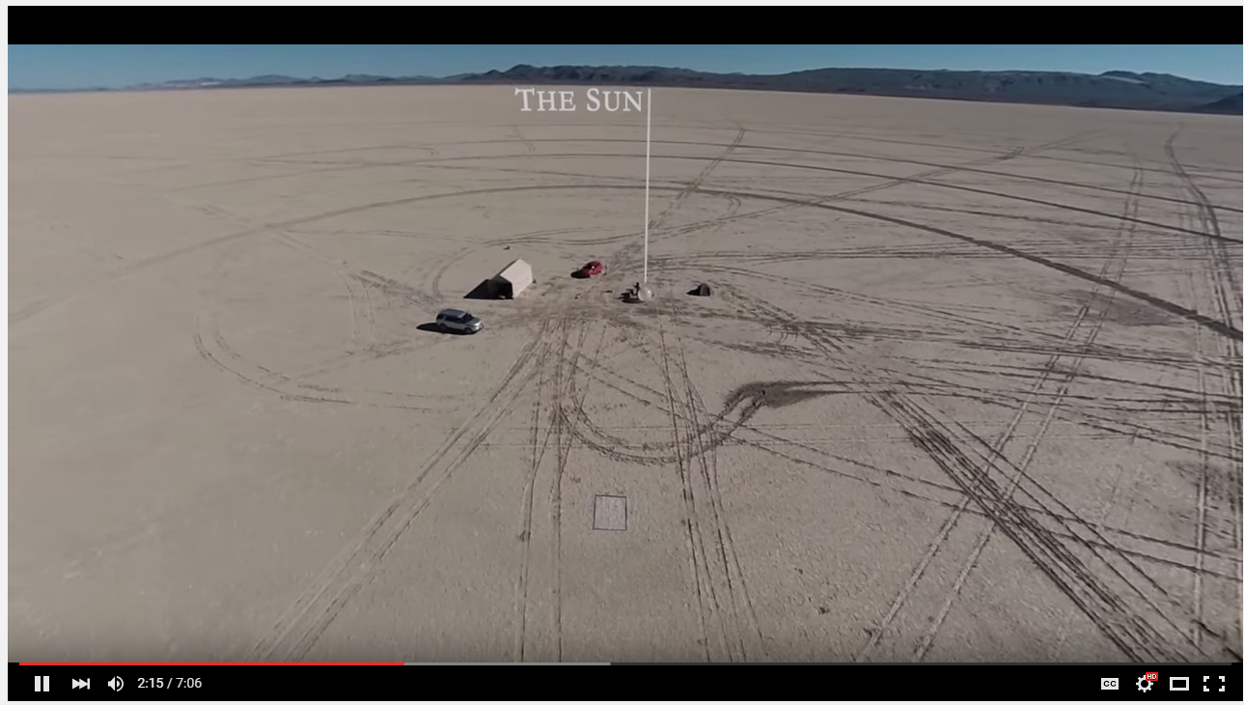
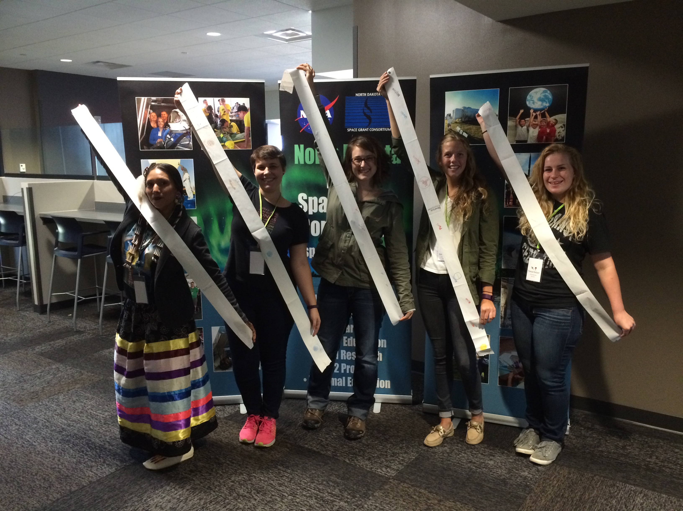
Pocket Solar System

Slide 5
Rockets to the rescue!

Slide 6
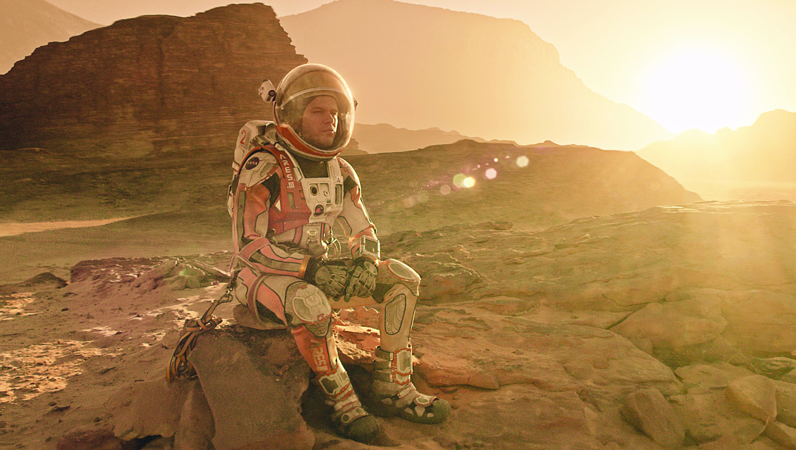

Slide 7
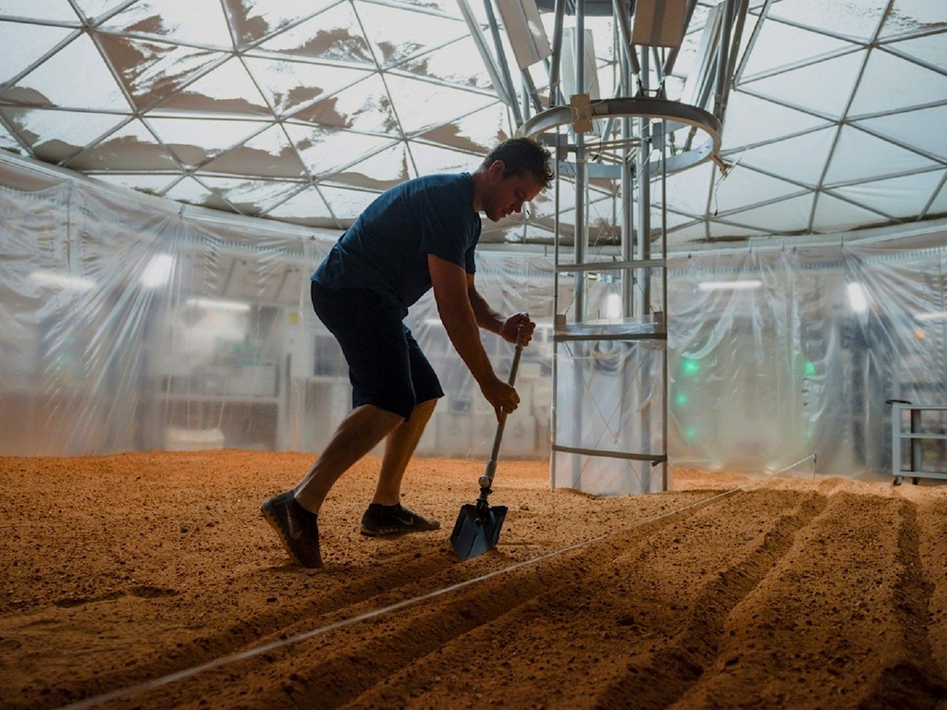

Slide 8
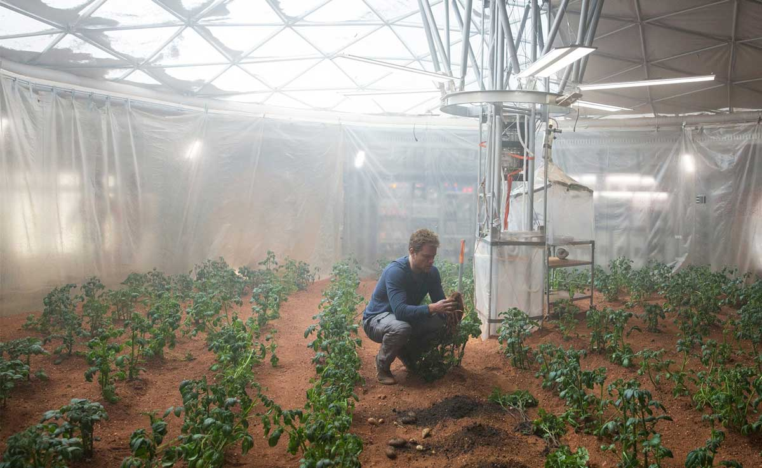

Slide 9
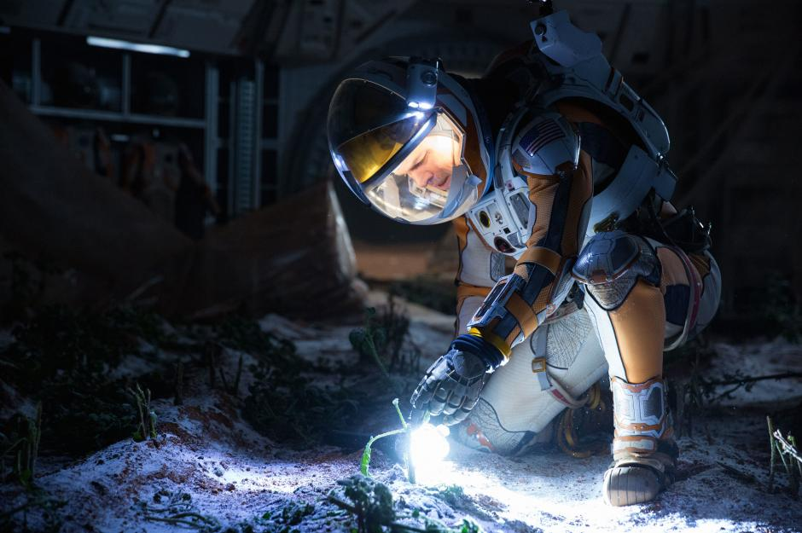

Slide 10
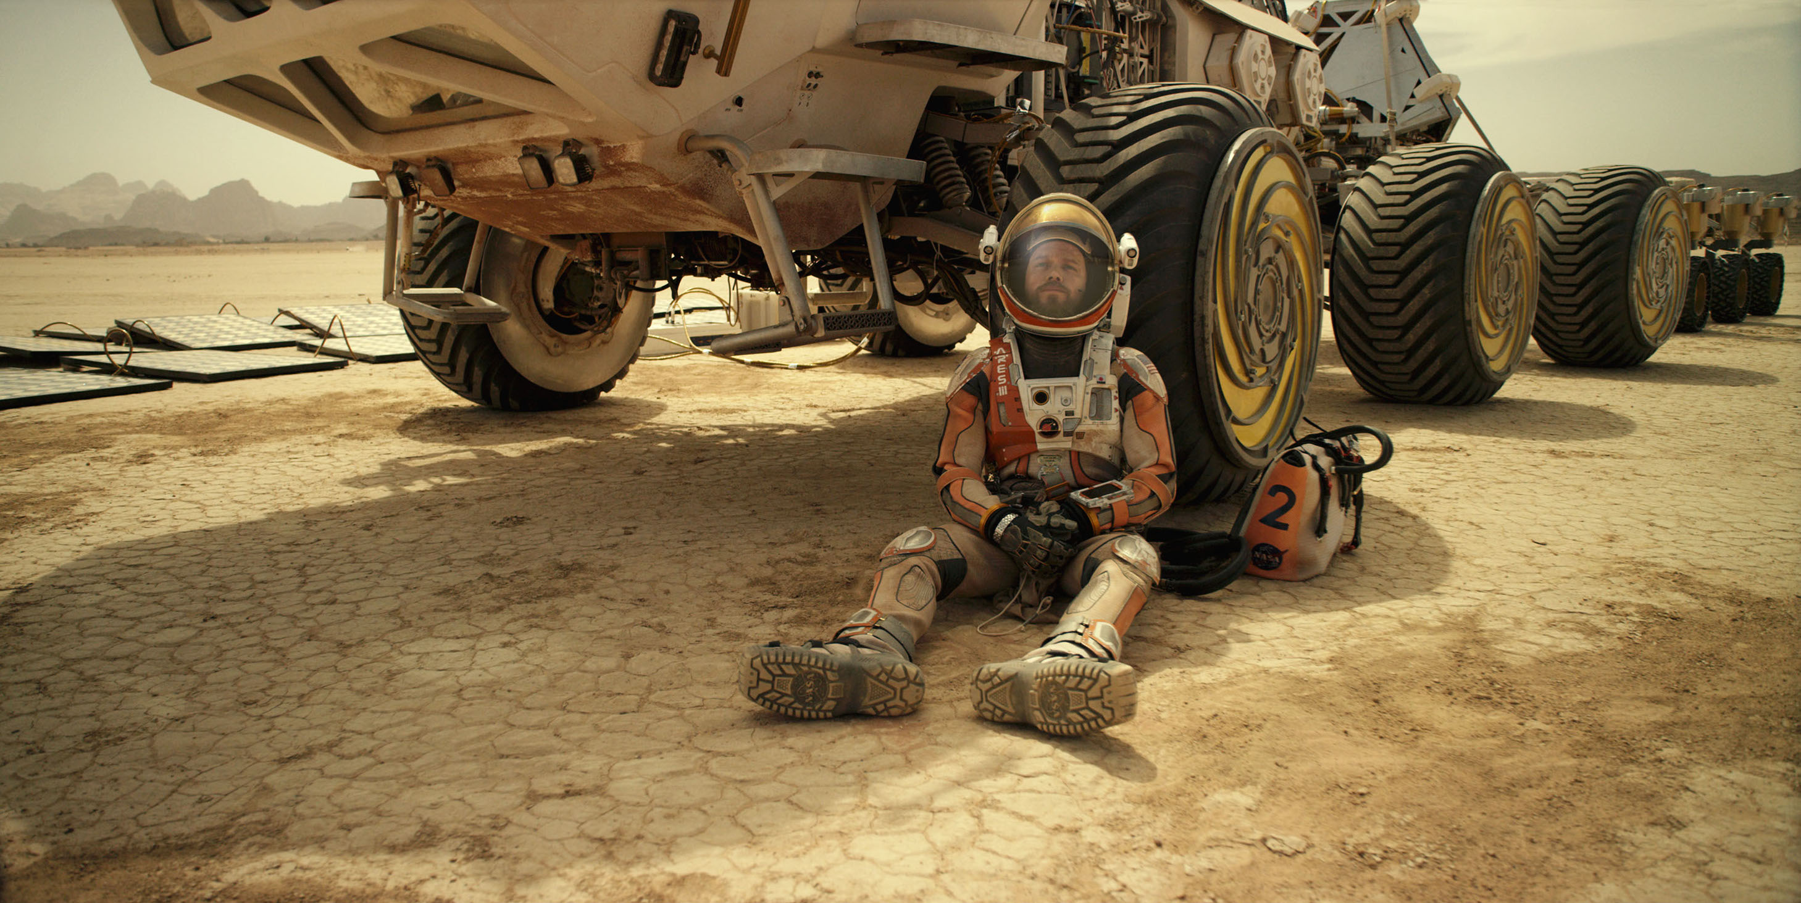

Slide 11
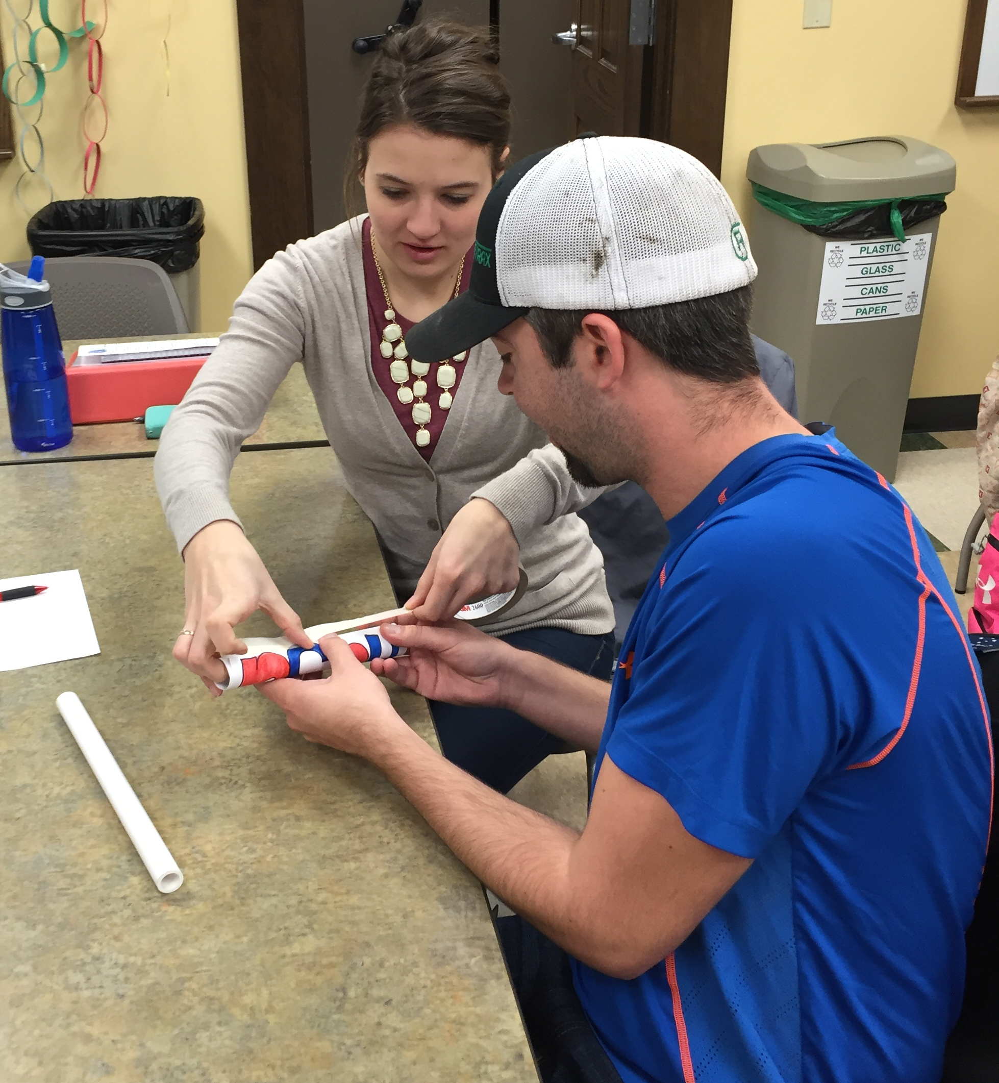
Rockets to the Rescue
Goal: Build and launch a rocket, keep your payload intact, and save Mark Watney!
Launch your payload to Mars!
What will be your team’s strategy?

Slide 12
Rockets to the Rescue - BUDGET
Maximum Budget: $50,000,000
Item Description | Cost Per Unit | Total Units | Total Item Cost
1 mini rubber band | $40,000
6 inches of duct tape | $3,000,000
6 inches of masking tape | $2,000,000
1 regular/large rubber band | $80,000
1 Pipe Cleaner | $500,000
1 Cotton Ball | $5,000,000
1 Straw | $500,000
1 Puff Ball | $4,000,000
12 inches of string | $600,000
1 full sheet of Tissue Paper | $6,000,000

Slide 13
Rockets to the rescue Critical Thinking Questions
Was your rocket successful?
Take a look at other teams’ designs. What materials did they use? Did their results differ from yours? Describe the outcomes.
How did gravity affect your design?
What should scientists consider when selecting materials? (think of sizes, weight, composition of the atmosphere, etc.)
Extra consideration: Integrate this activity into the classroom – add budgets, weight restrictions, competition between NASA centers, etc.
What shapes were the most aerodynamic? Are these necessarily the best designs?

Slide 14
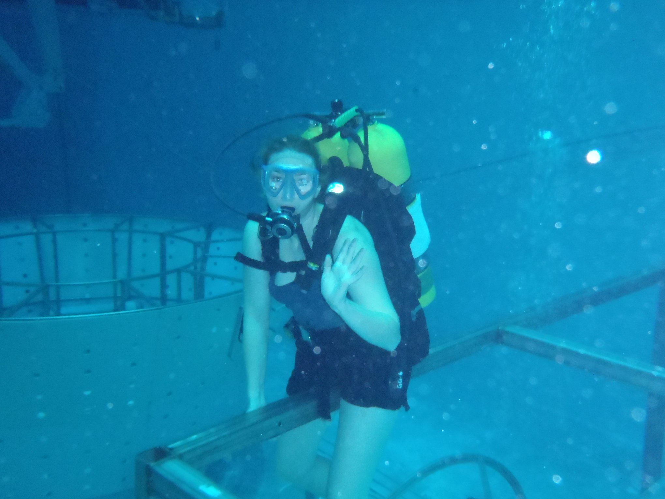
Deep Sea Diver
Eryn Beisner, a UND alumna

Slide 15
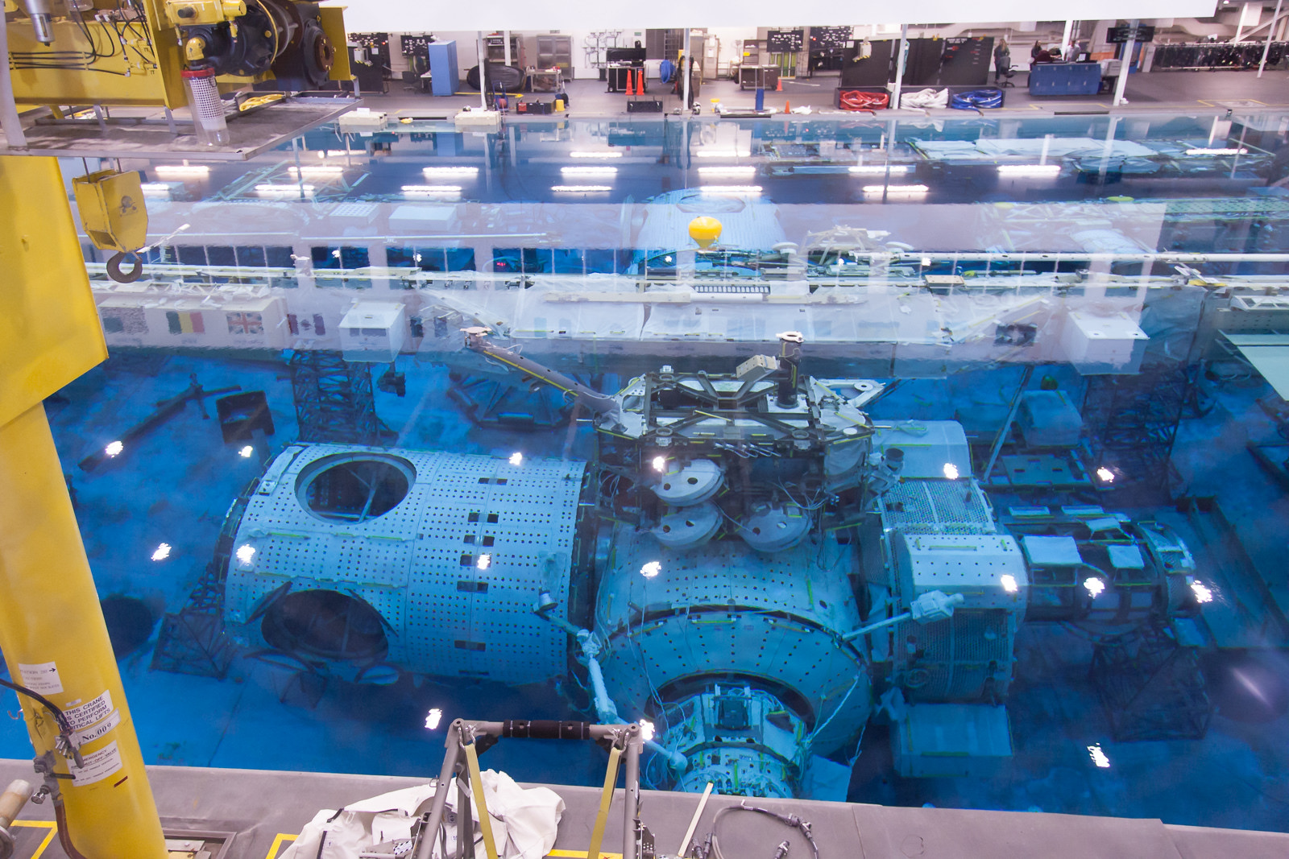

Slide 16
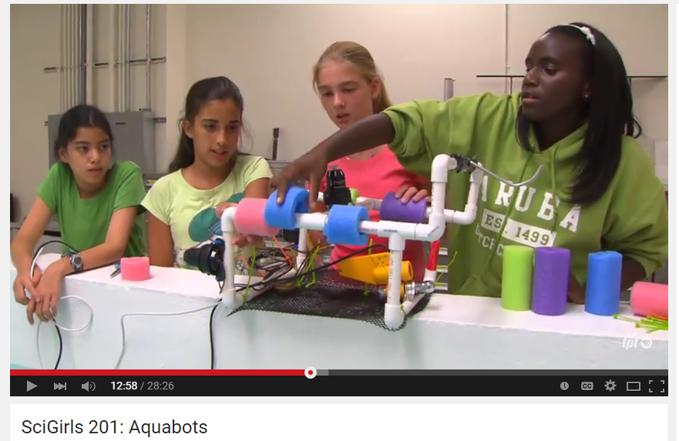
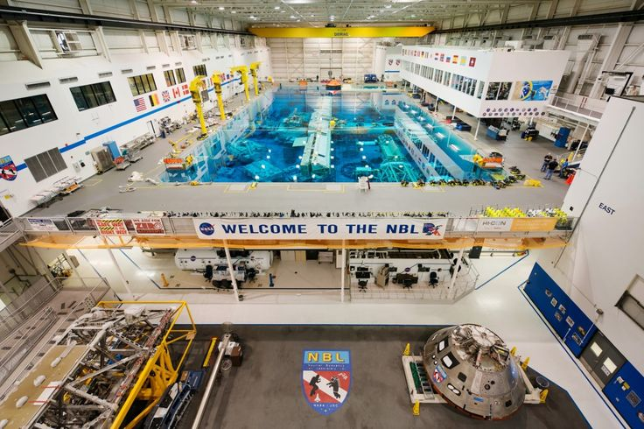
SCIGIRLS DEEP SEA DIVER
Season 2, episode 1: Aquabots
Challenge: NASA is currently preparing for long-duration spaceflight to Mars and needs to practice procedures in the NBL. They need to select a contractor to design and build neutrally buoyant tools for training.
Make predictions on given materials
Design your “deep sea diver”
Collaborative Design Review

Slide 17
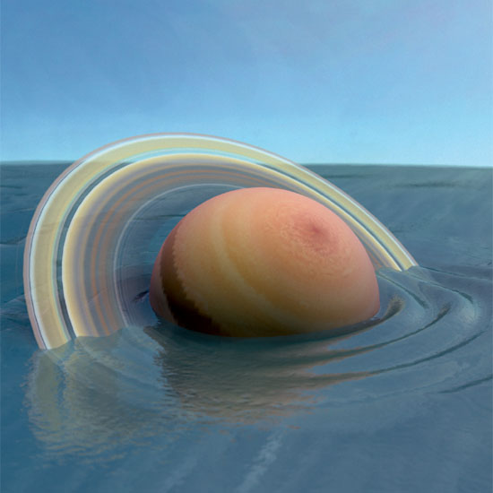
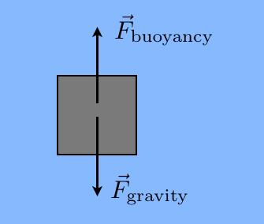
SCIGIRLS DEEP SEA DIVER
What does it mean to be neutrally buoyant?
Balancing act between forces
Densities are equal
Which planet would “float” in a giant pool of water?

Slide 18
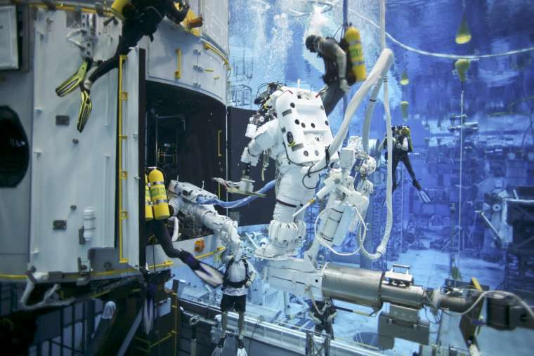
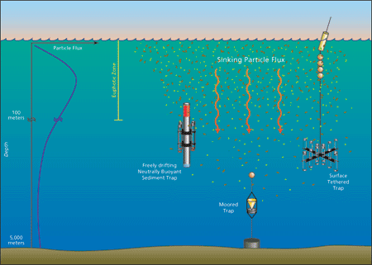
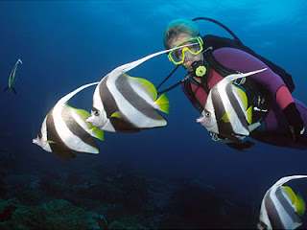
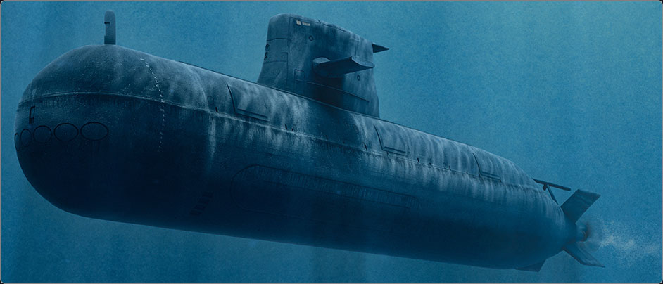
REFLECTION
What worked? Materials?
Other applicaitons?
Scuba divers
Submarines
Fish
Science! –Taking ocean measurements

Slide 19
How can you get involved?
NASA Resources (K-12)
North Dakota funding and opportunities
STEM Ambassador Program
Future Professional Development as a ND teacher

Slide 20
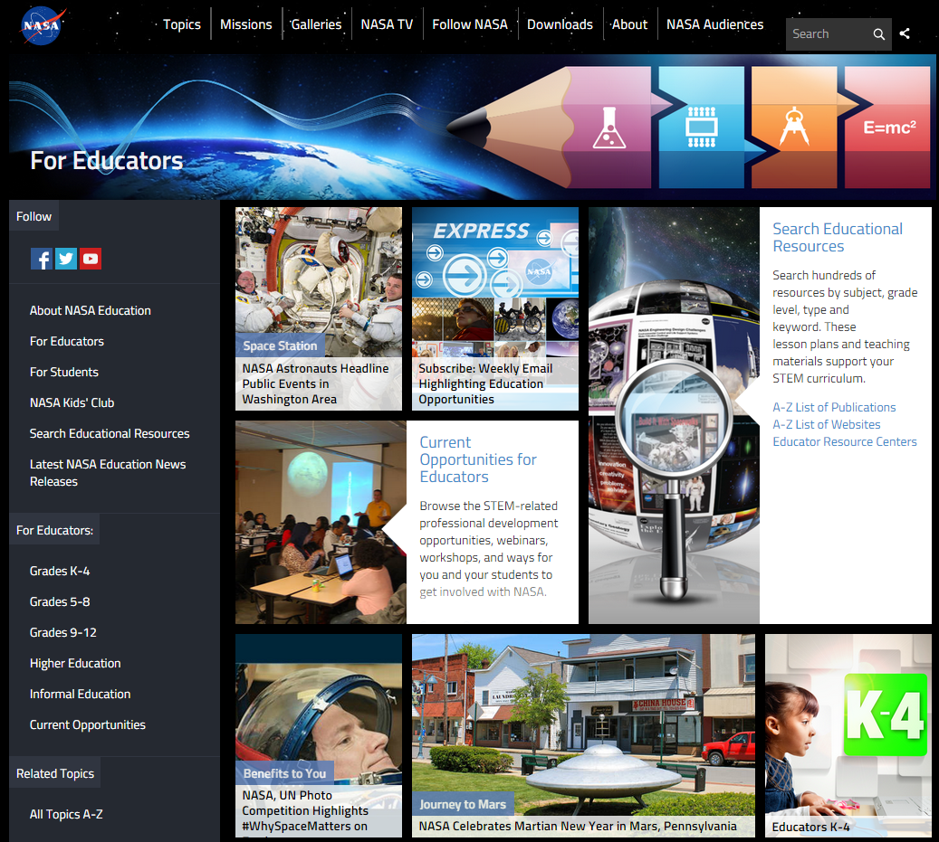
NASA Education

Slide 21
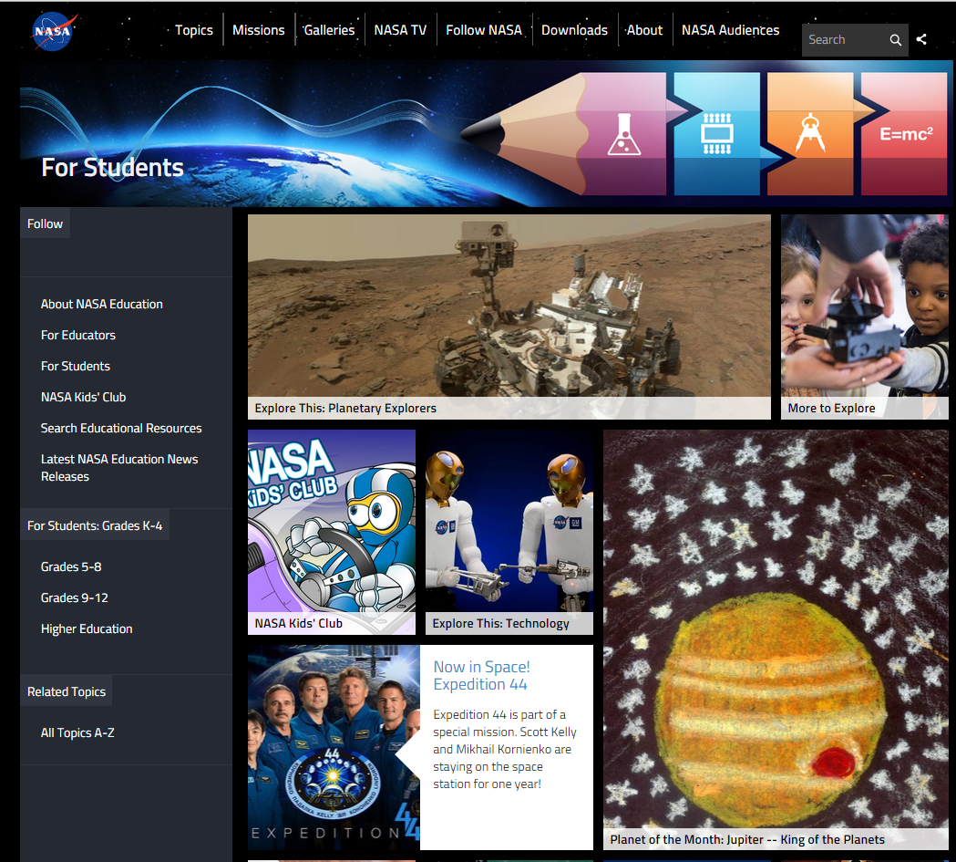
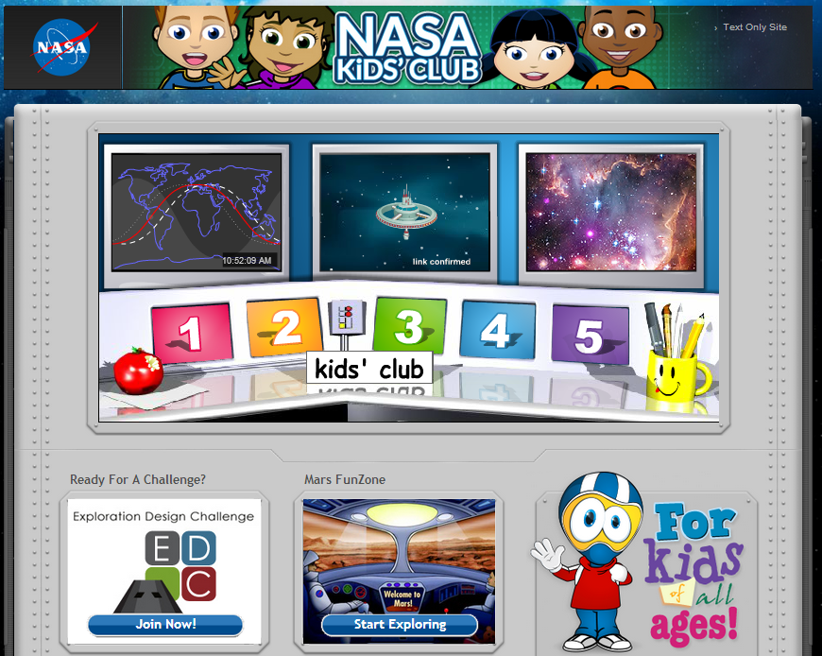
NASA for Students

Slide 22
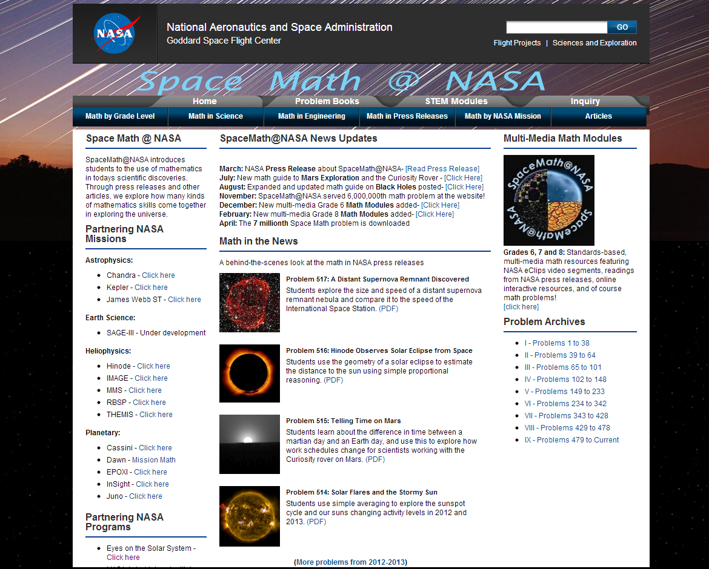
Space Math at NASA

Slide 23
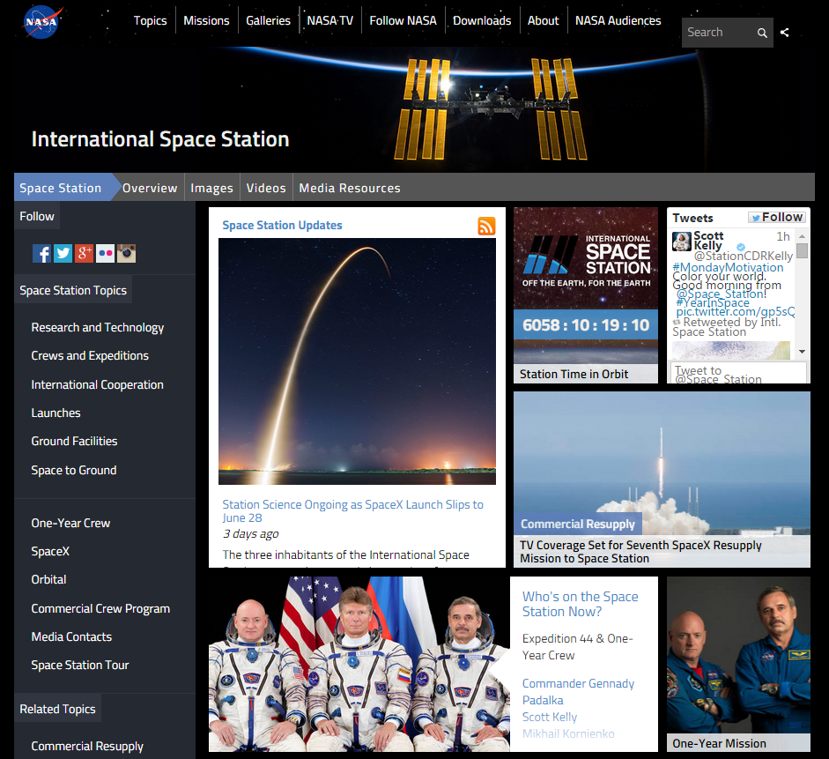
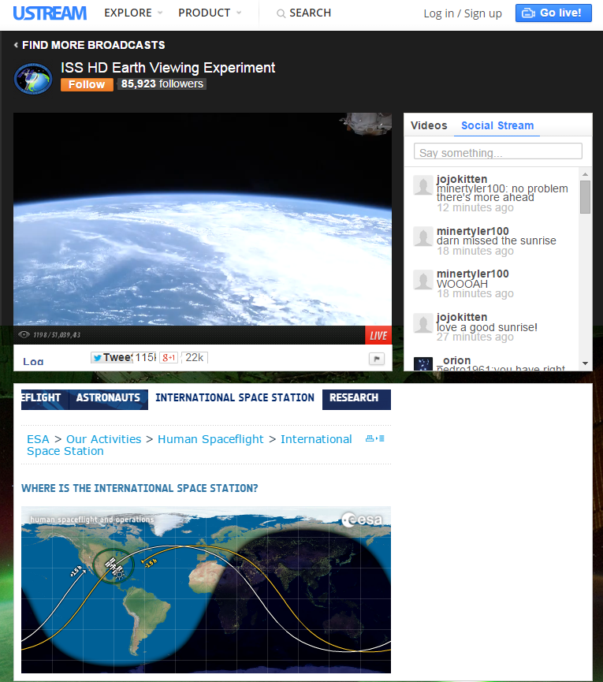
International Space Station - Live!

Slide 24
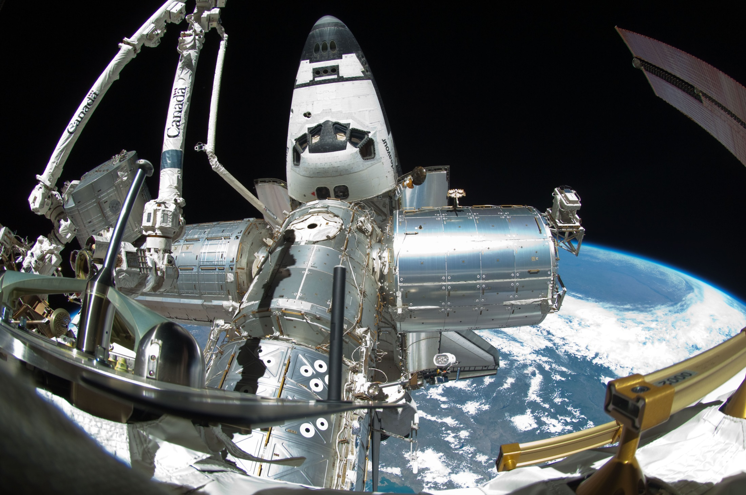
Spot the Station

Slide 25
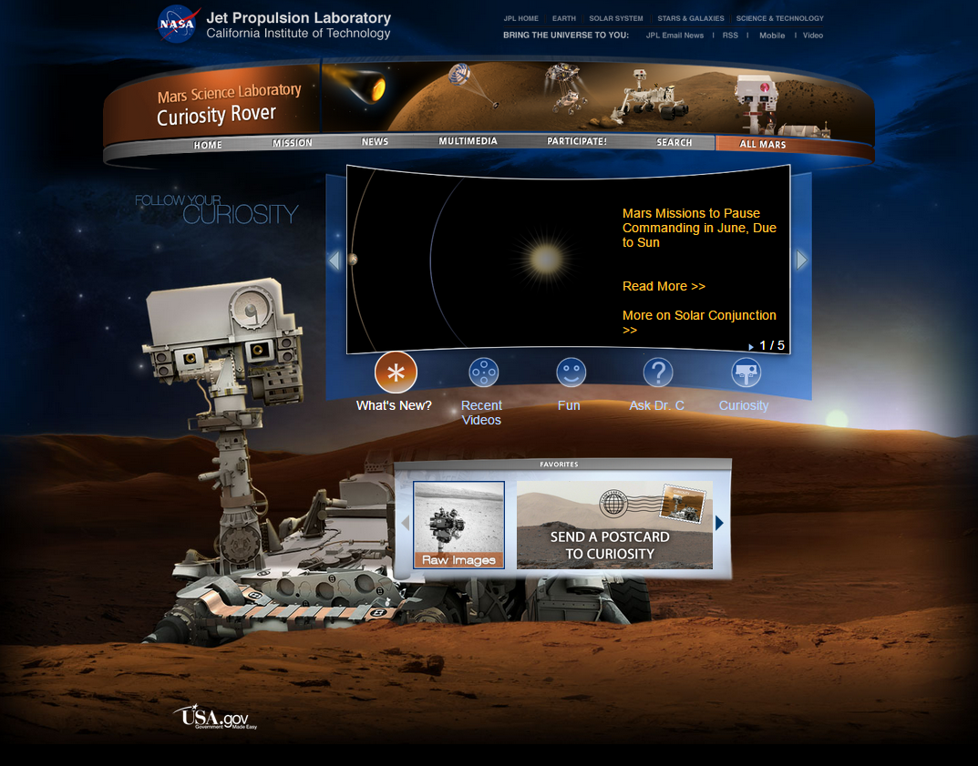
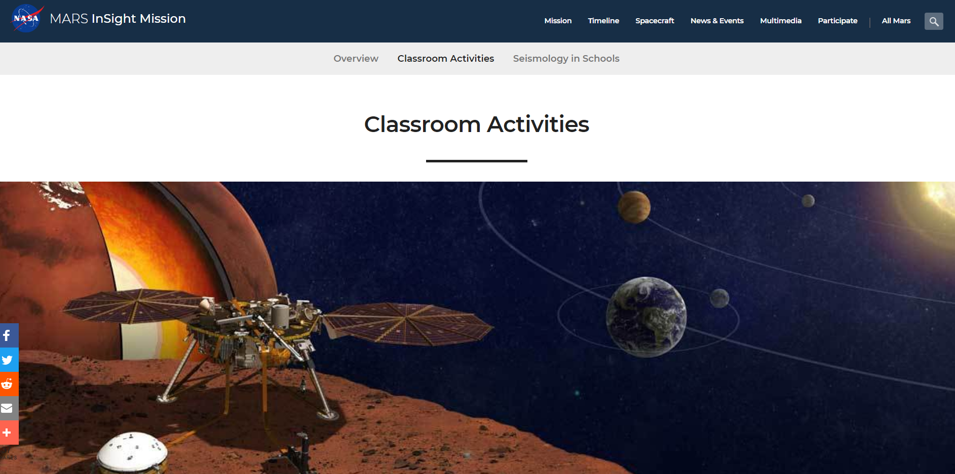
Mars Curiosity Rover
and now… the Insight Rover!

Slide 26
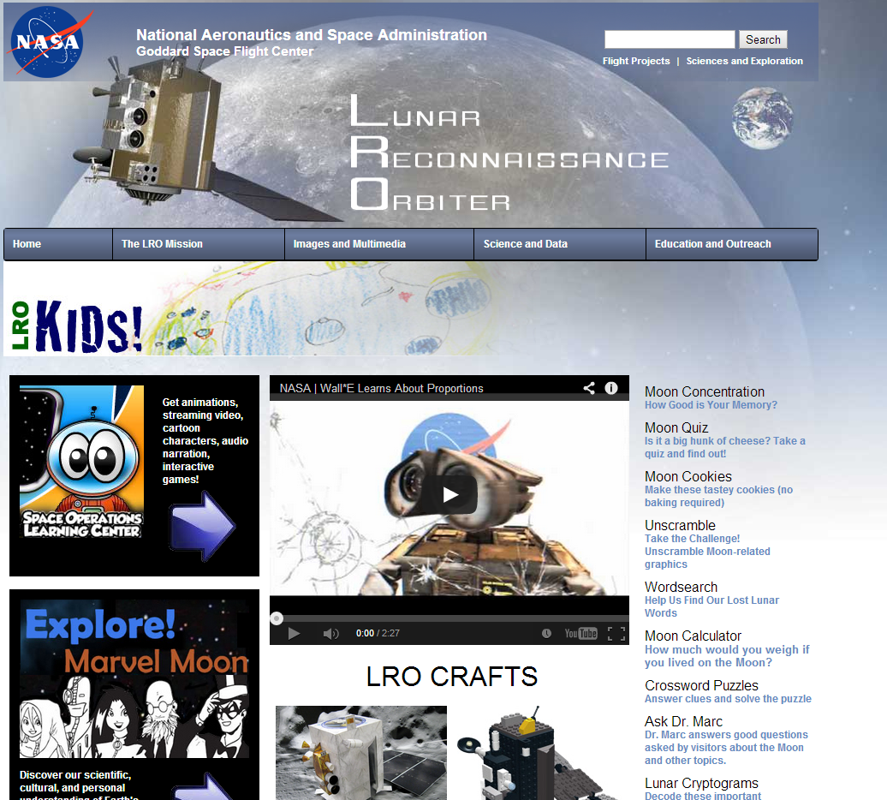
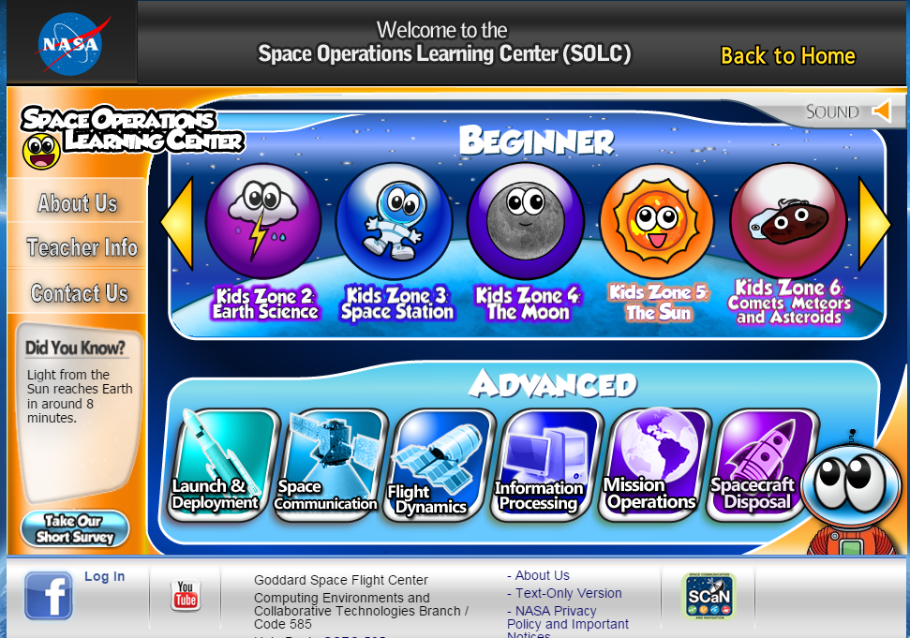
NASA – Lunar Reconnaissance Orbiter

Slide 27
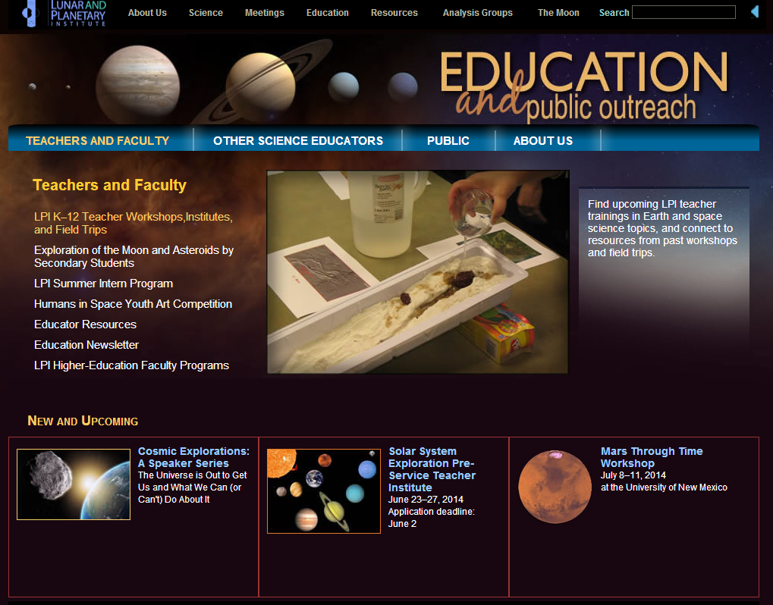
Lunar and Planetary Institute

Slide 28
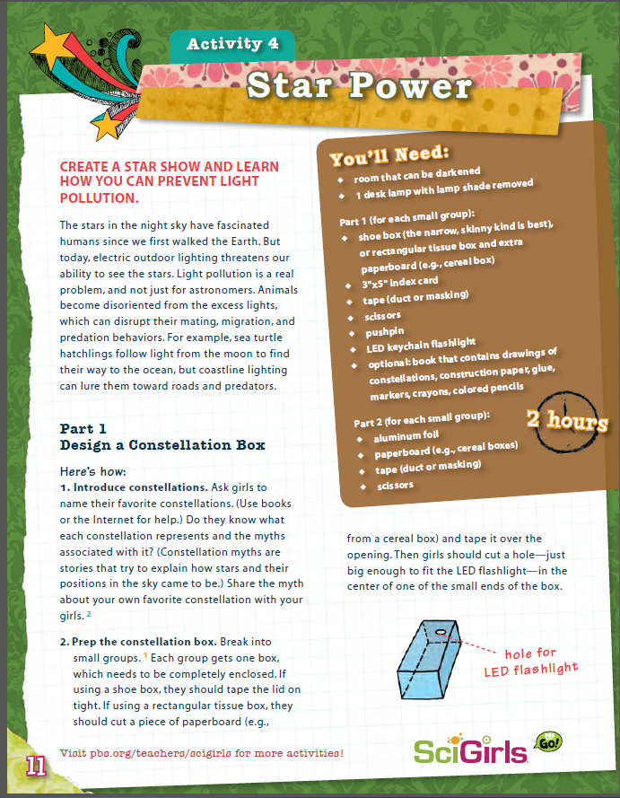
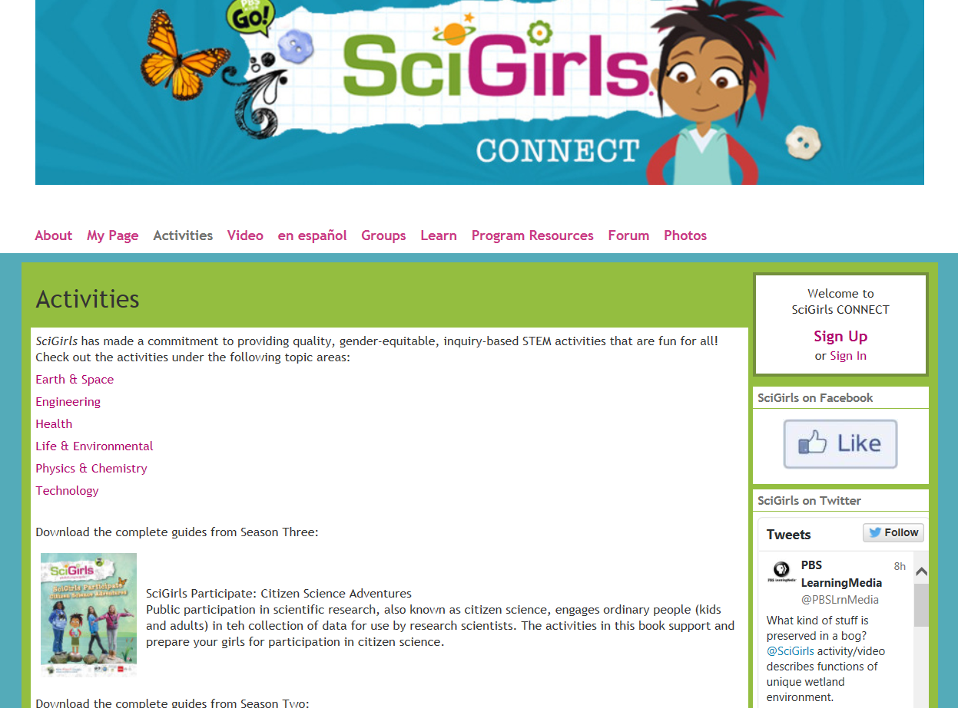
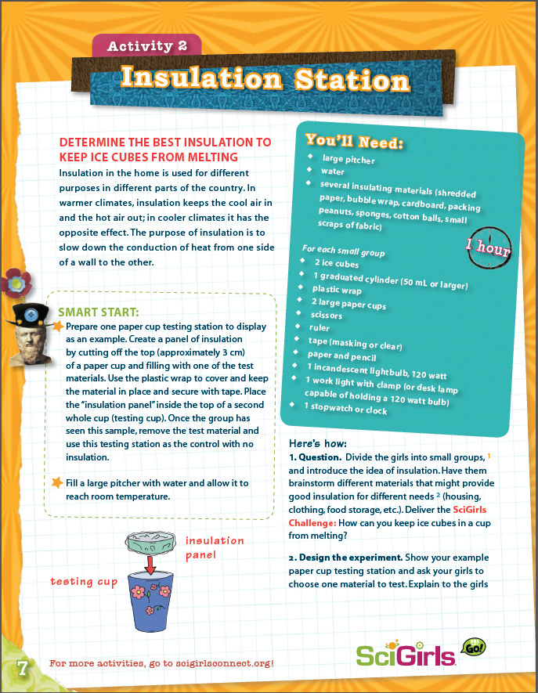
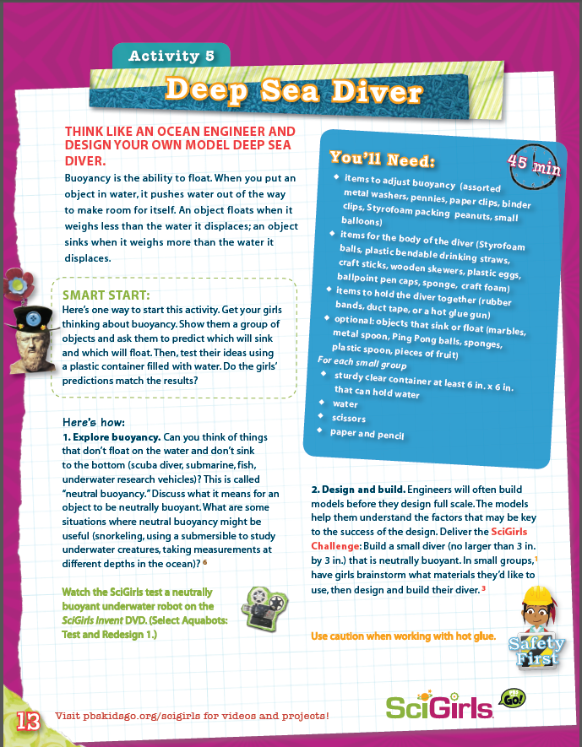
SciGirls Activities

Slide 29
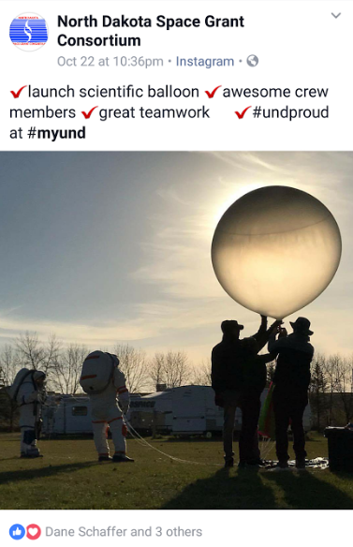
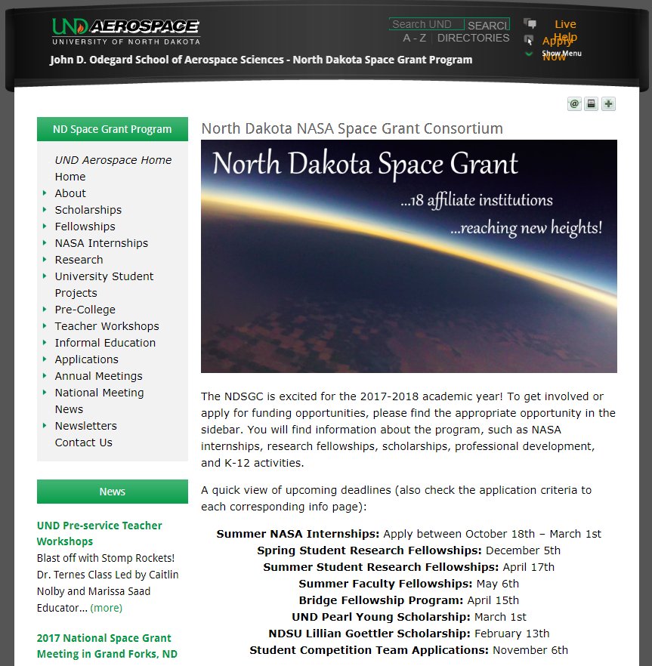
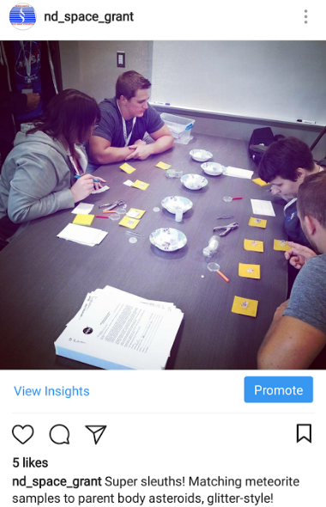
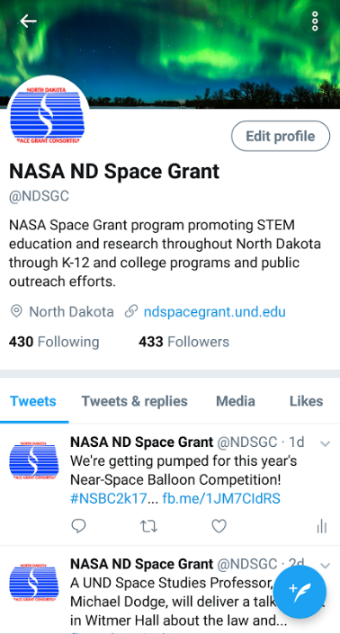
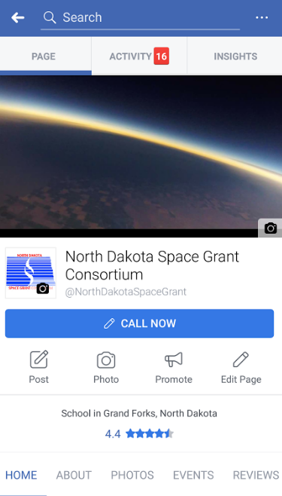
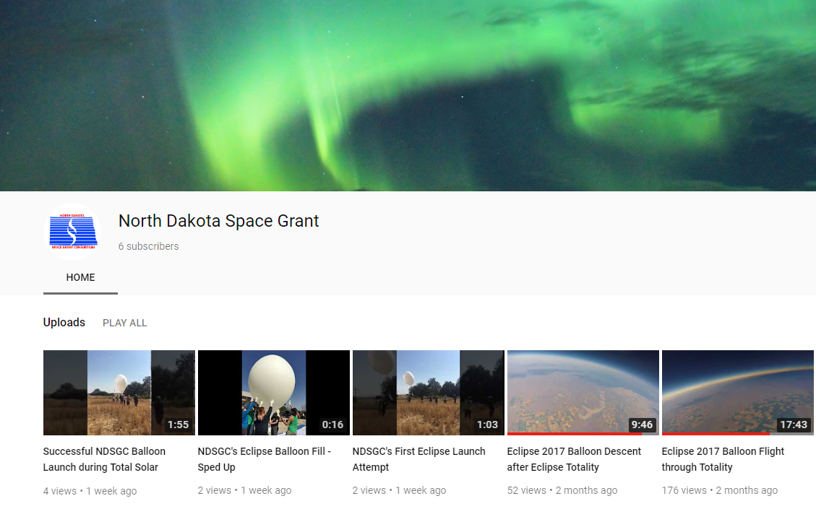
NDspacegrant.und.edu

Slide 30
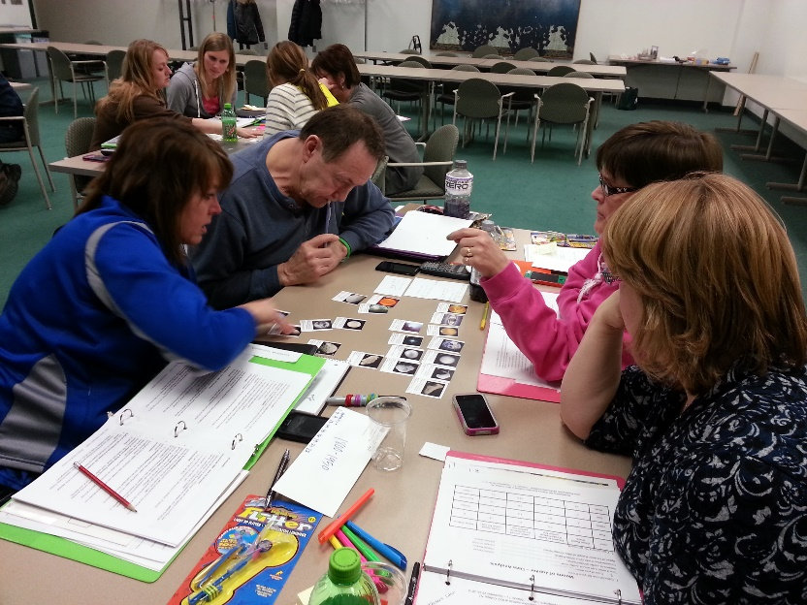
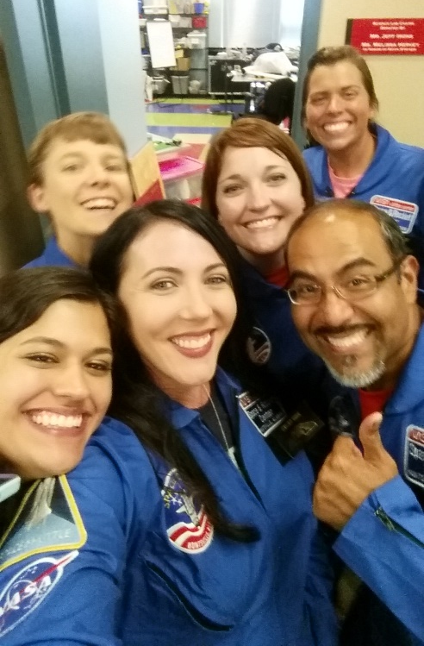
NDSGC K-12 Educator Email Listserv
Workshop opportunities
New STEM education resources for the classroom
NASA student contests/team competitions
Professional Development opportunities
Emails ~once a week

Slide 31
STEM Ambassador Program
Are you volunteering for outreach activities, want NASA on your resume?
May 31st application deadline
$12/hour to conduct K-12 visits, informal education sessions, lesson plan prepping, or any other STEM engagement activities.
School comes first – flexible schedule!
Anywhere in ND, from your own local area!
Training session at UND (lesson plans, hands-on activities, take home materials).
Some events are scheduled through Space Grant. Most are whatever you find!
Some events have been:
ISS Calls (2016, 2019 TBD)
Eclipse trips
K-12 visits with the NDSGC Team
Near-Space Balloon Competition judging and facilitation
Super Science Day (GF)
Marketplace for Kids (all over ND)
Water Festival (Bottineau)
Girl scouts, boy scouts
FIRST Lego League, FIRST Robotics

Slide 32
Please fill out a quick survey
https://und.qualtrics.com/jfe/form/SV_1ZylfLa4dVilxDT
http://tinyurl.com/y4qxv3cl
This helps us for our NASA reporting, so thank you!

