Slide 1
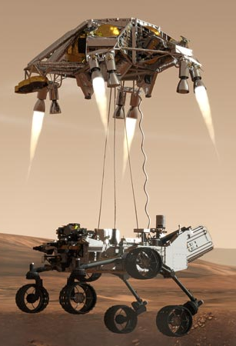
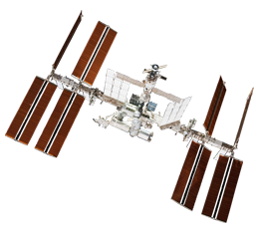
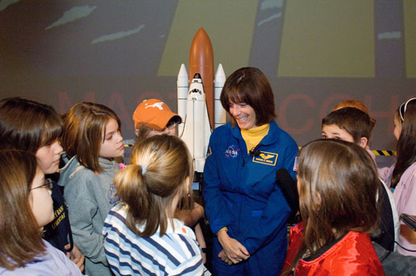
NASA Educator Resources and Mars Rover Lander
Caitlin Nolby and Marissa Saad
North Dakota Space Grant Consortium

Slide 2
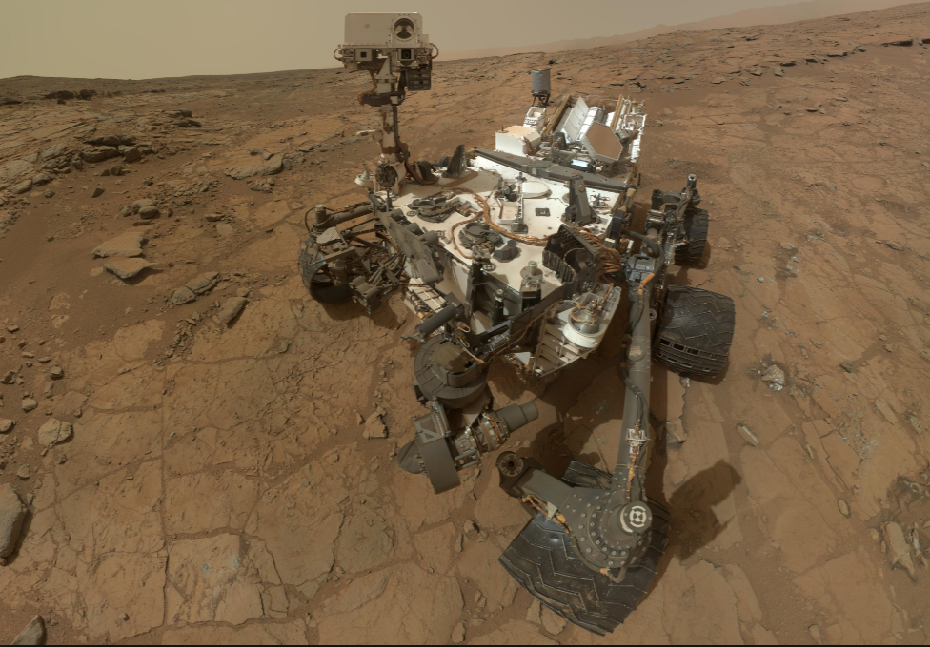
Mars Rover Lander
You’ve been selected by NASA to design a landing system that will safely land the NASA Insight Rover on Mars! NASA has provided you with an assortment of materials. Chose wisely; NASA is depending on you!

Slide 3
Mars rover lander Critical Thinking Questions
Did your rover land safely?
What caused it to land safely? (or) Why did your rover crash land? What could you have done differently?
Take a look at other teams’ designs. What materials did they use? Did their results differ from yours? Describe the outcomes.
What could be the real-life consequences of using a compromised parachute?
What should scientists consider when selecting materials? (think of sizes, weight, composition of the atmosphere, etc.)
Extra consideration: Integrate this activity into the classroom – add budgets, weight restrictions, competition between NASA centers, etc.
Land on Mars

Slide 4
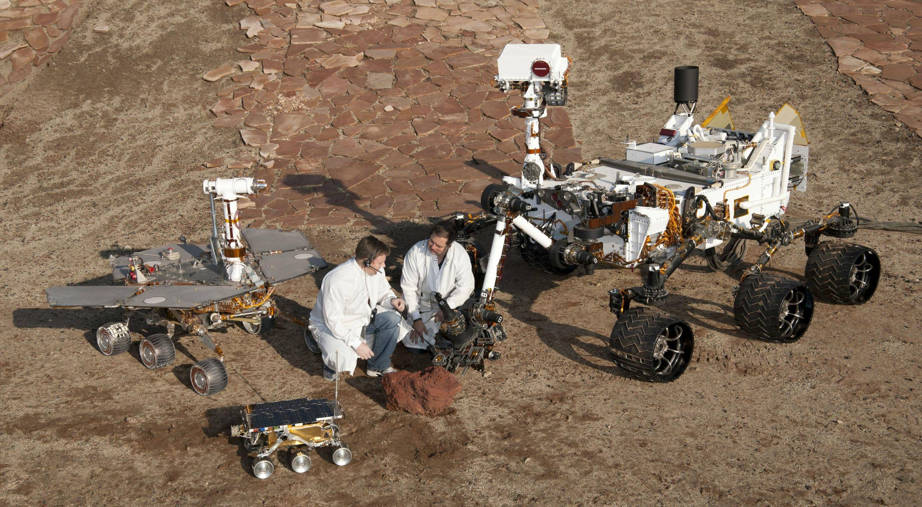
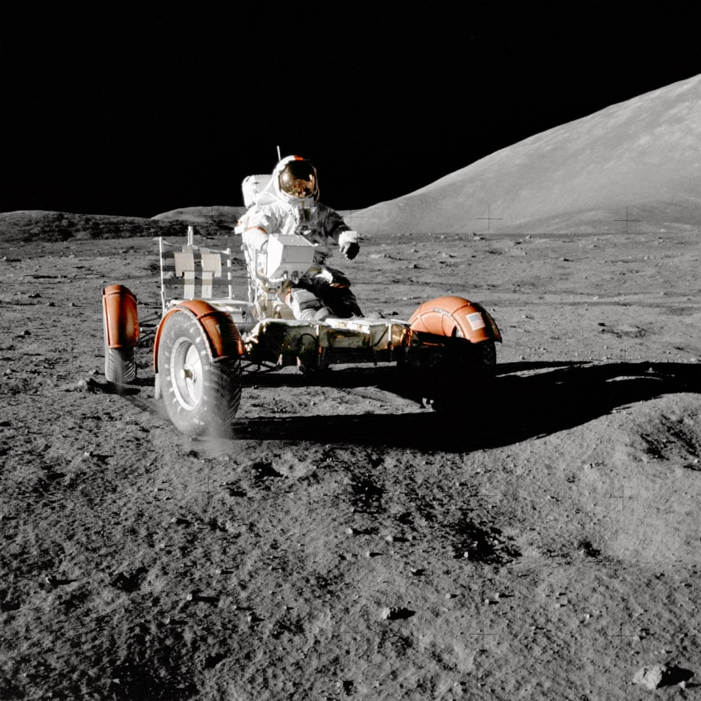
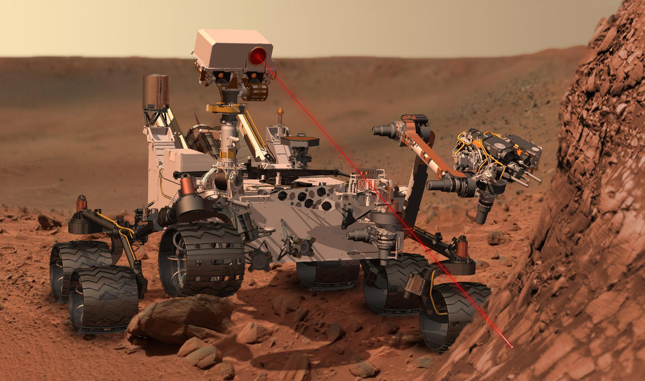
How can students relate to rovers?
Mars, Moon, remote RC cars, drones, Roomba, etc.\
Mars Rover Test Drive: Send Rhett & Link to Mars

Slide 5
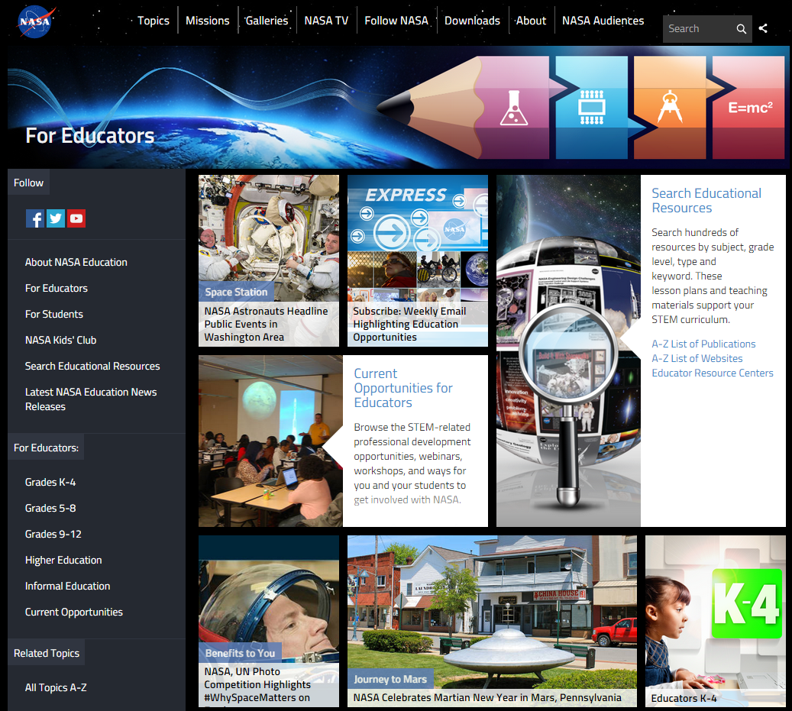
NASA Education

Slide 6
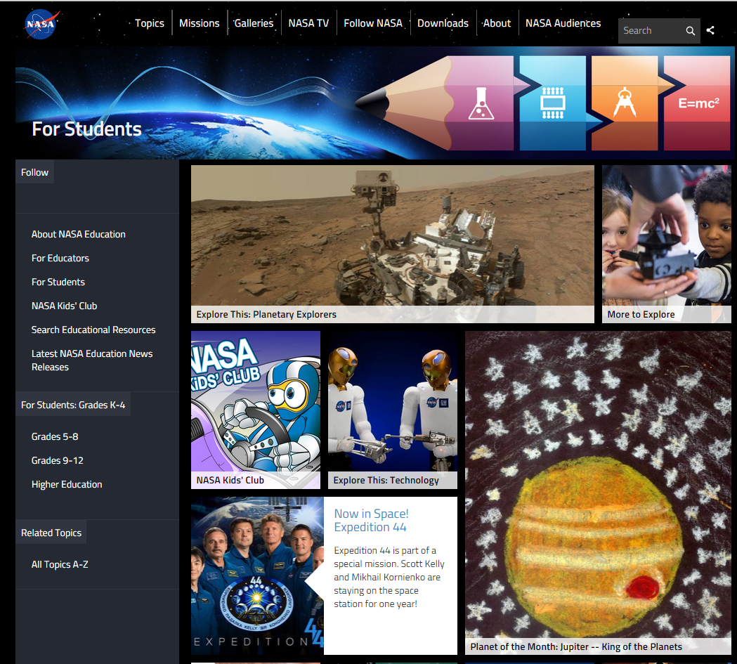
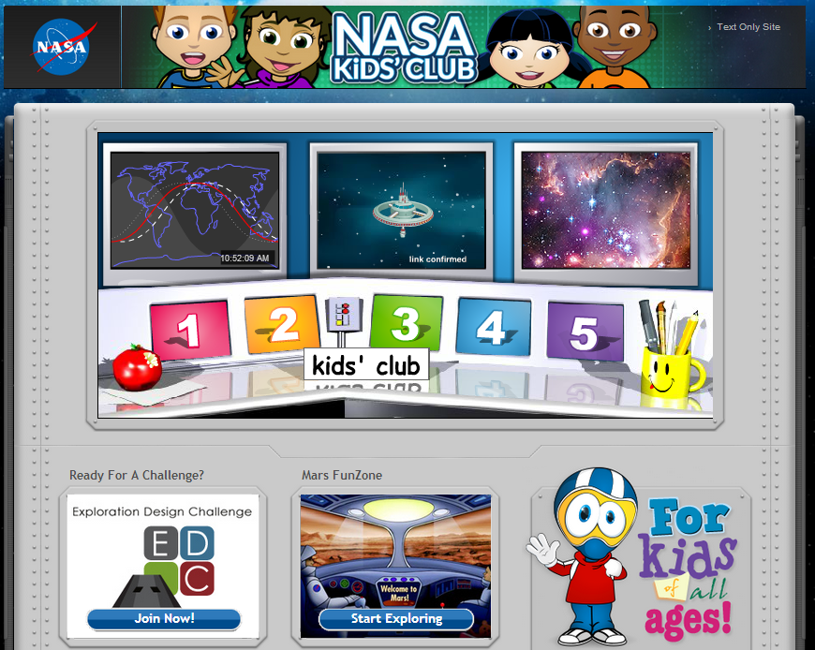
NASA for Students

Slide 7
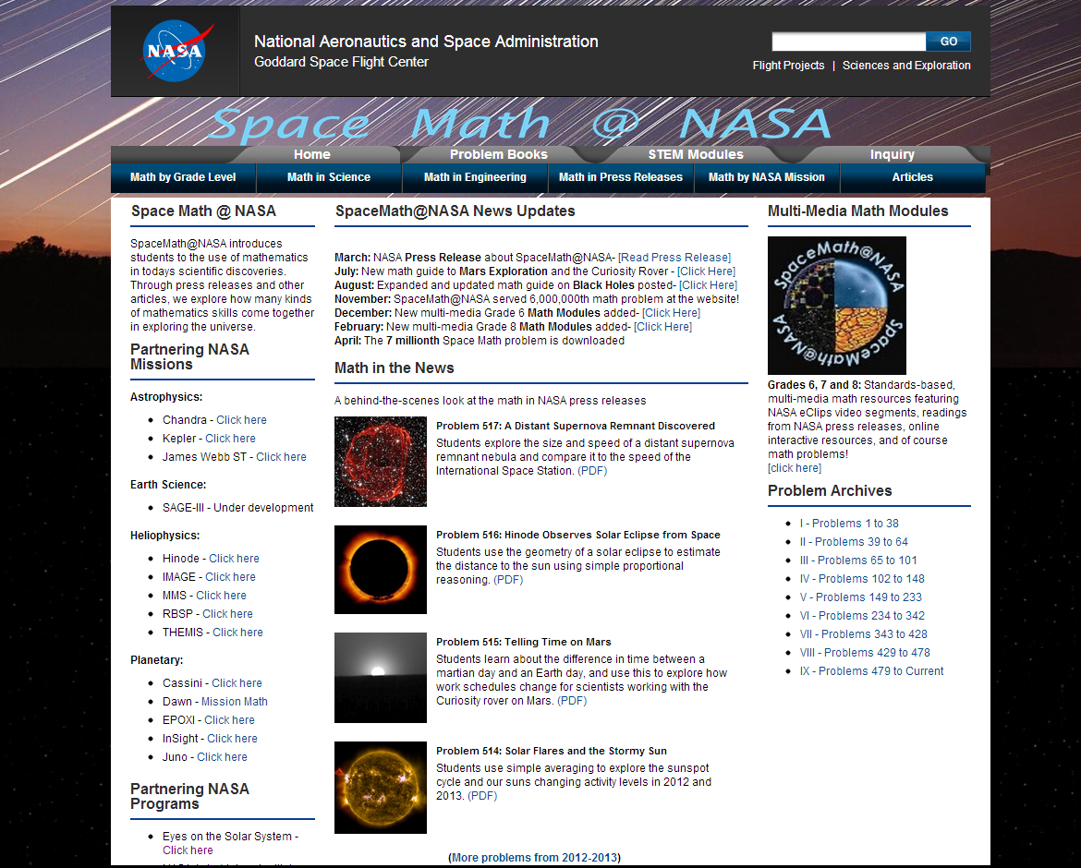
Space Math at NASA

Slide 8
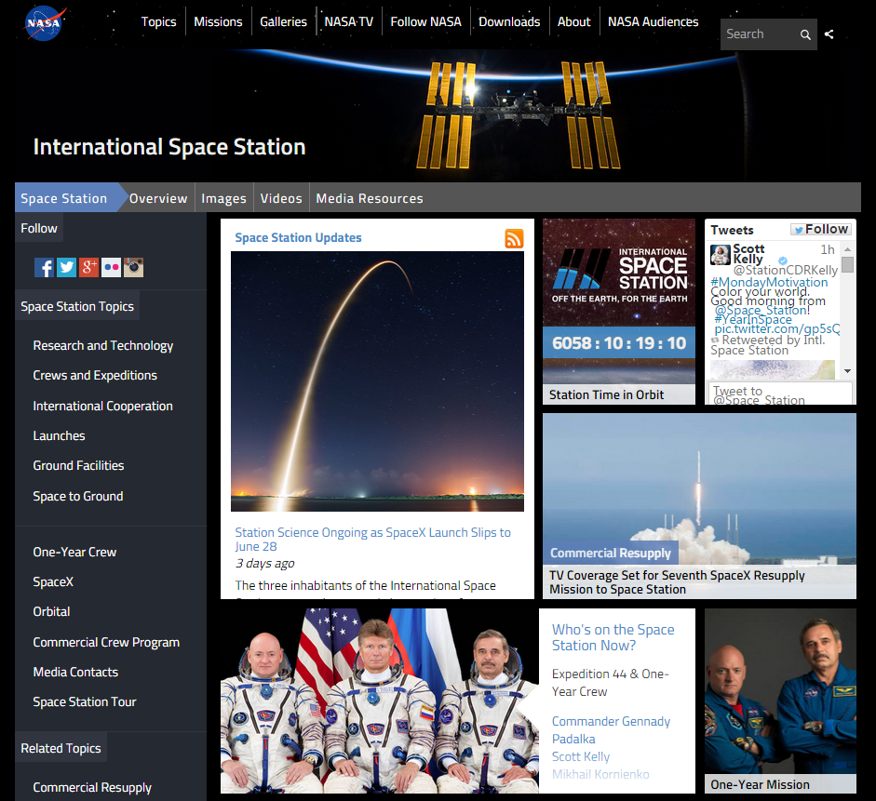
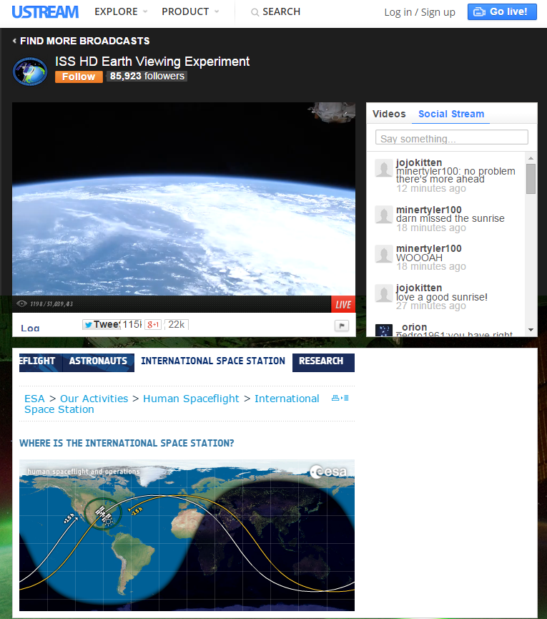
International Space Station - Live!

Slide 9
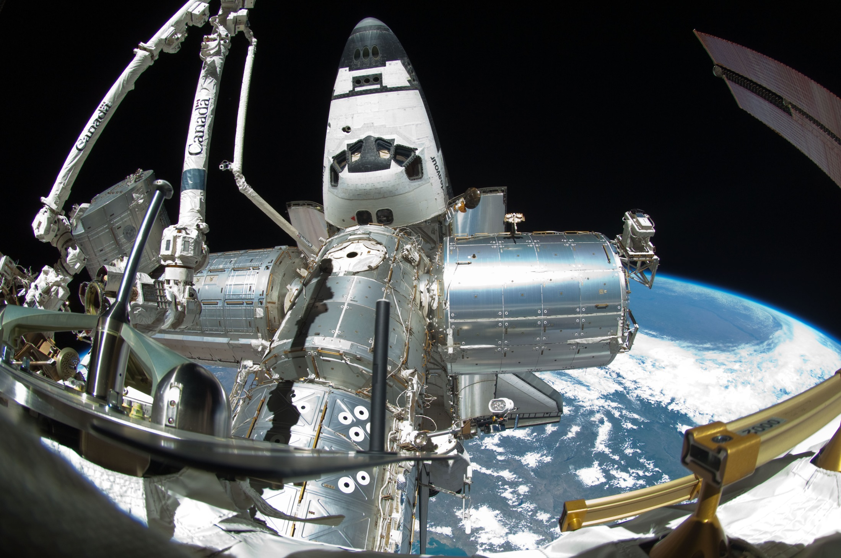
Spot the Station

Slide 10
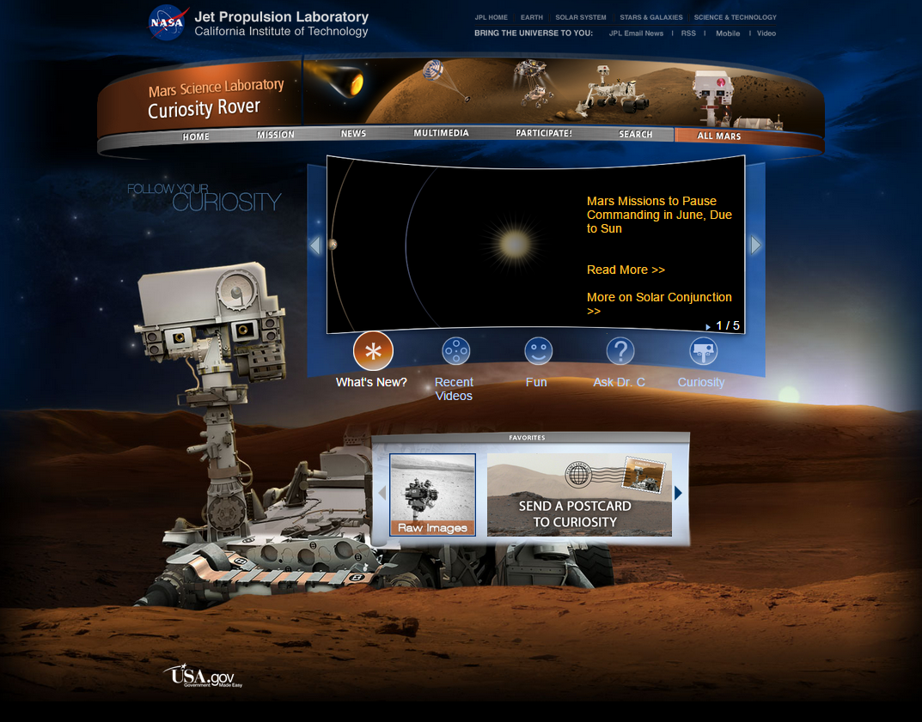
Mars Curiosity Rover

Slide 11
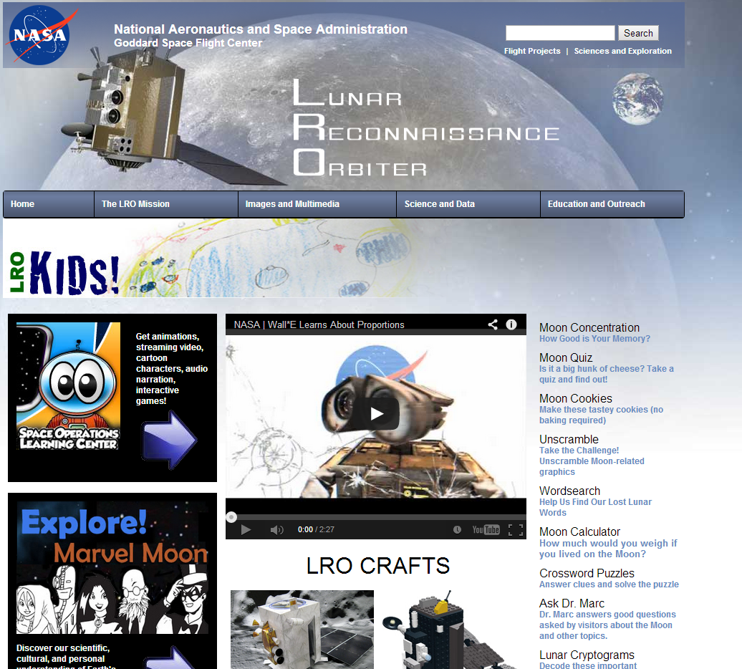
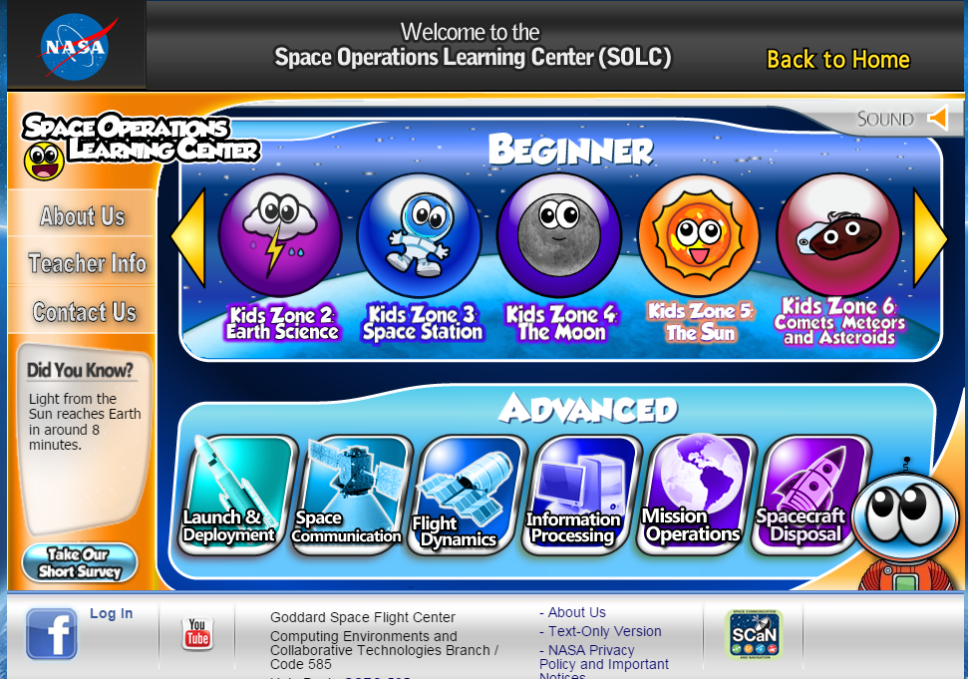
NASA – Lunar Reconnaissance Orbiter

Slide 12
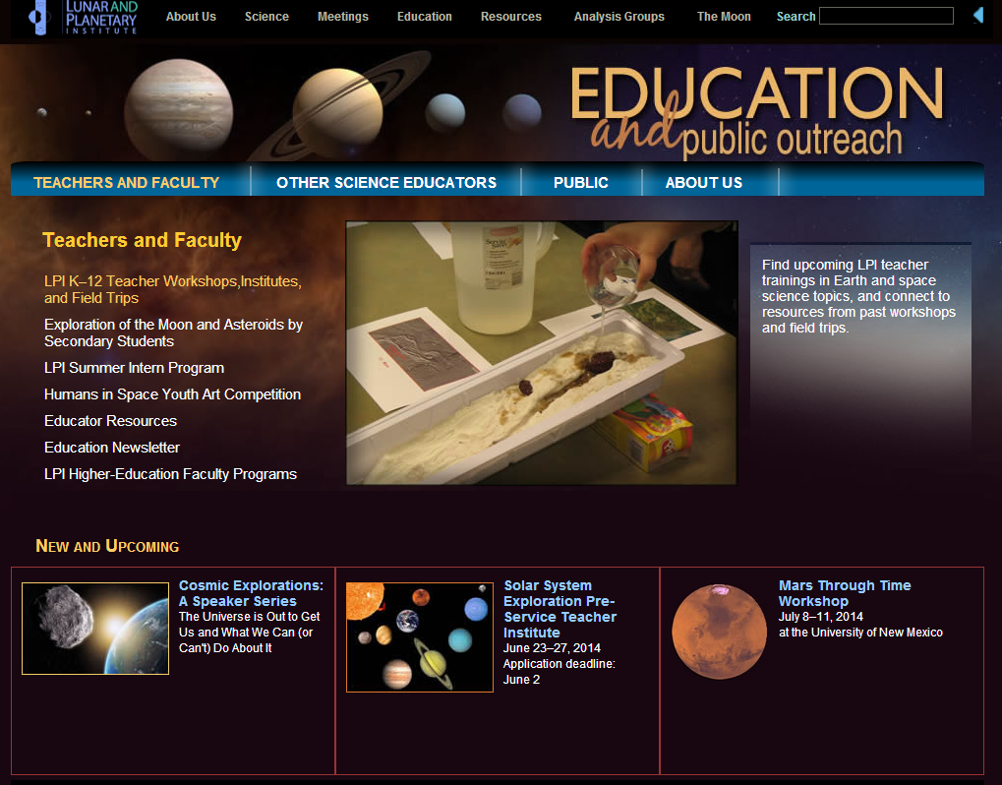
Lunar and Planetary Institute

Slide 13
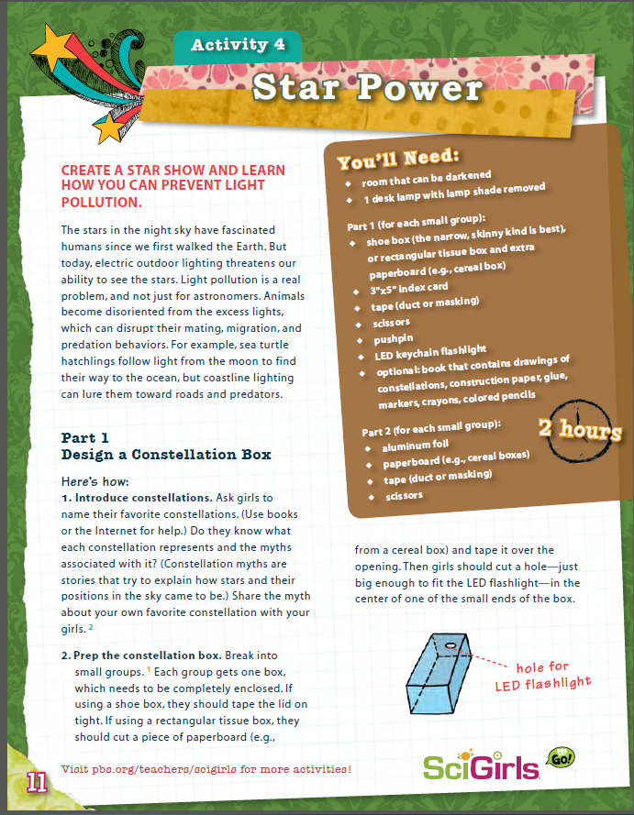
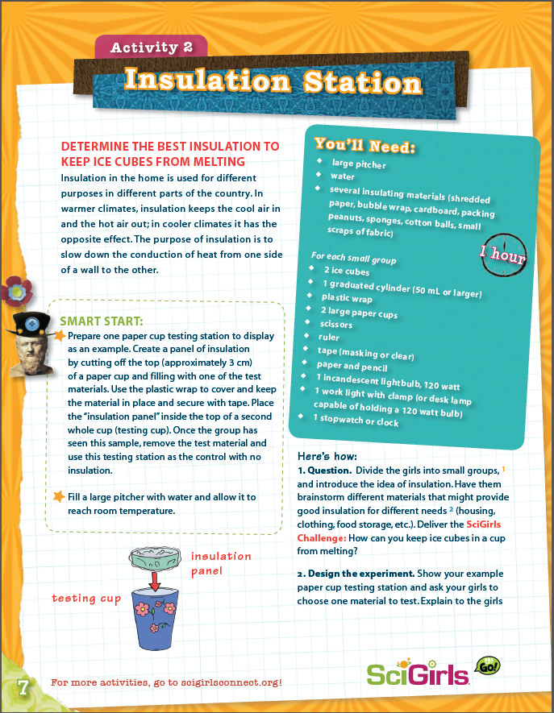
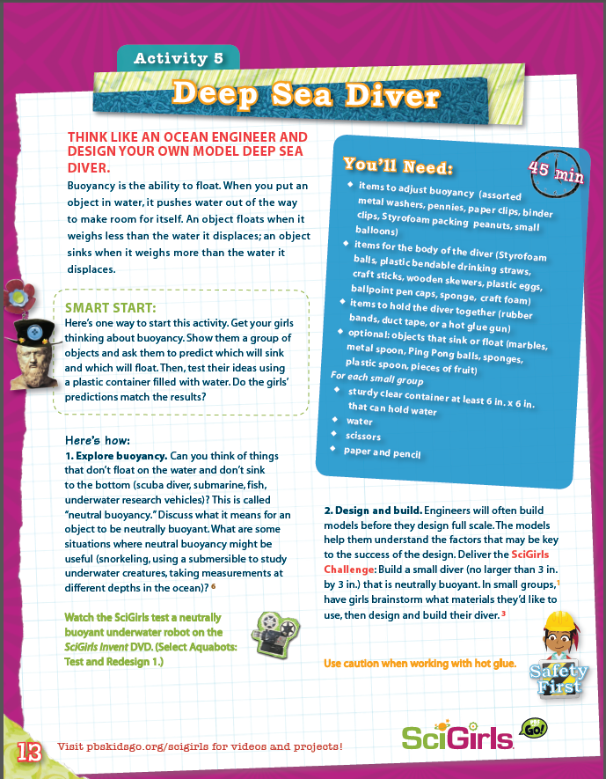
SciGirls Activities

Slide 14
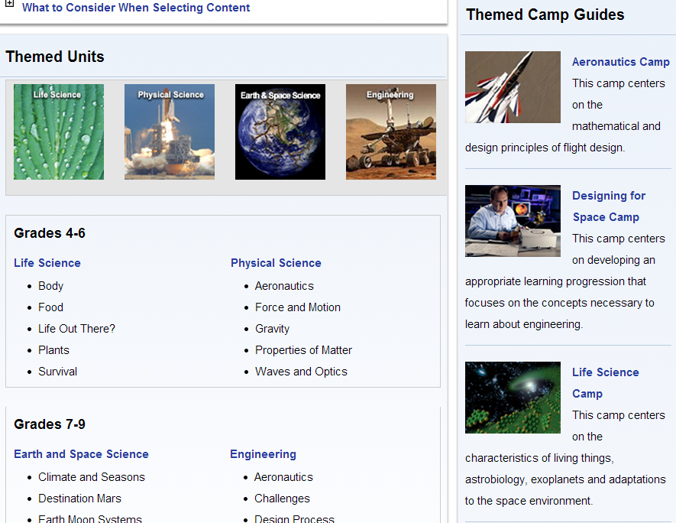
NASA Summer of Innovation

Slide 15
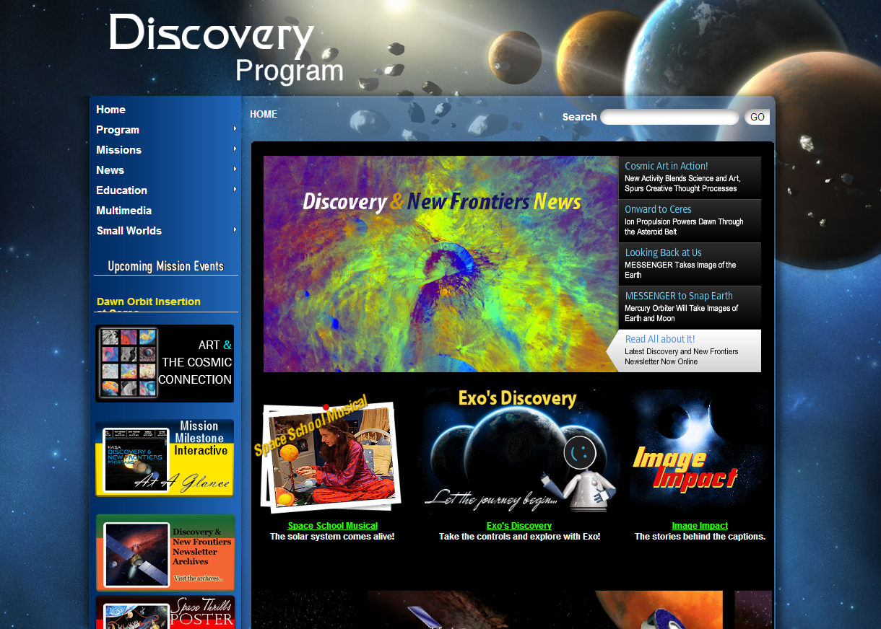
NASA Discovery Program

Slide 16
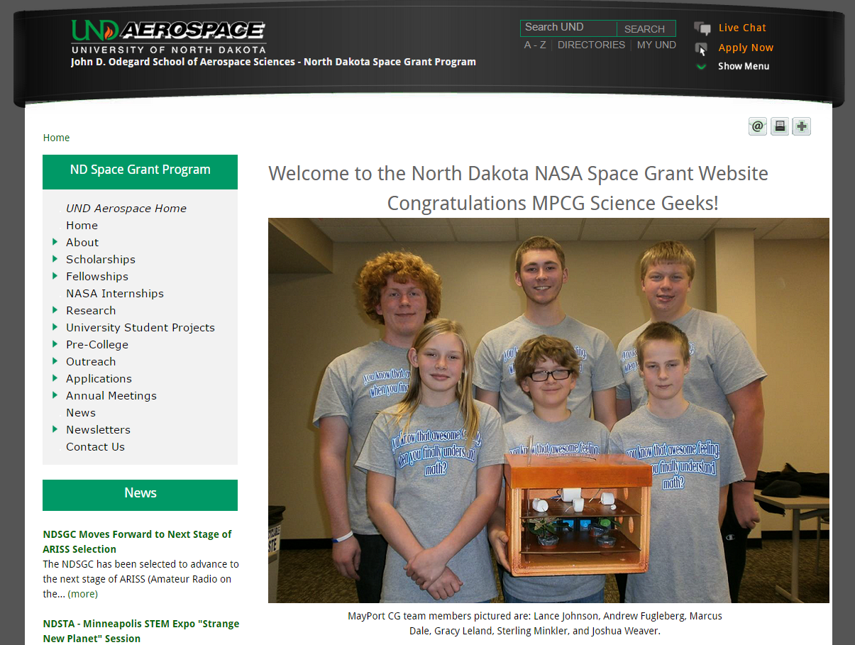
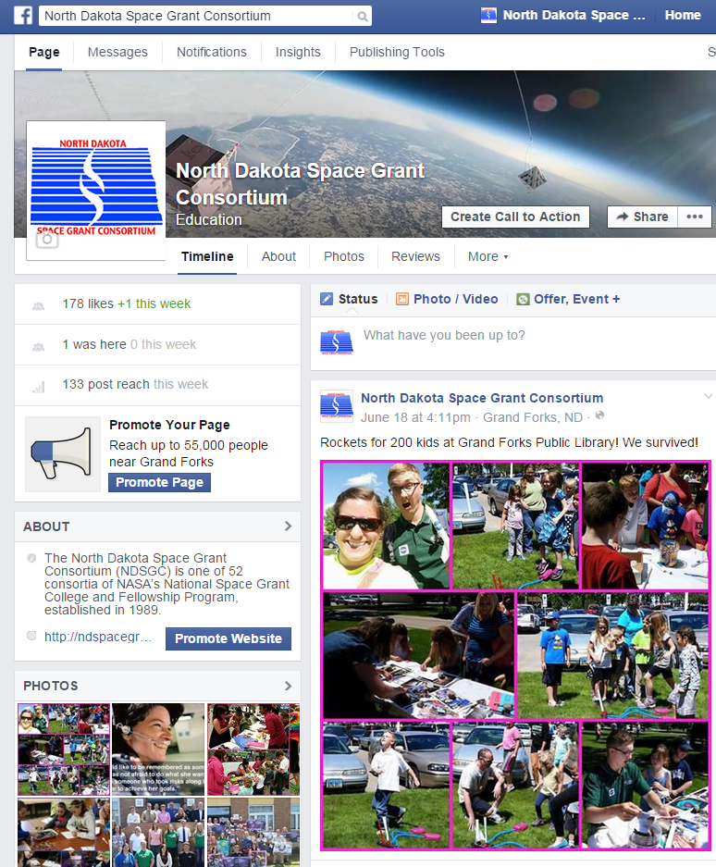
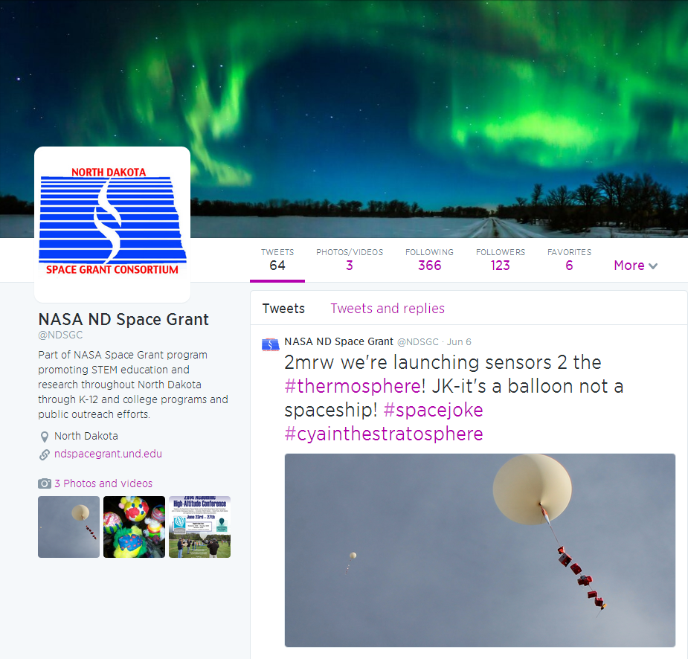
North Dakota Space Grant

Slide 17
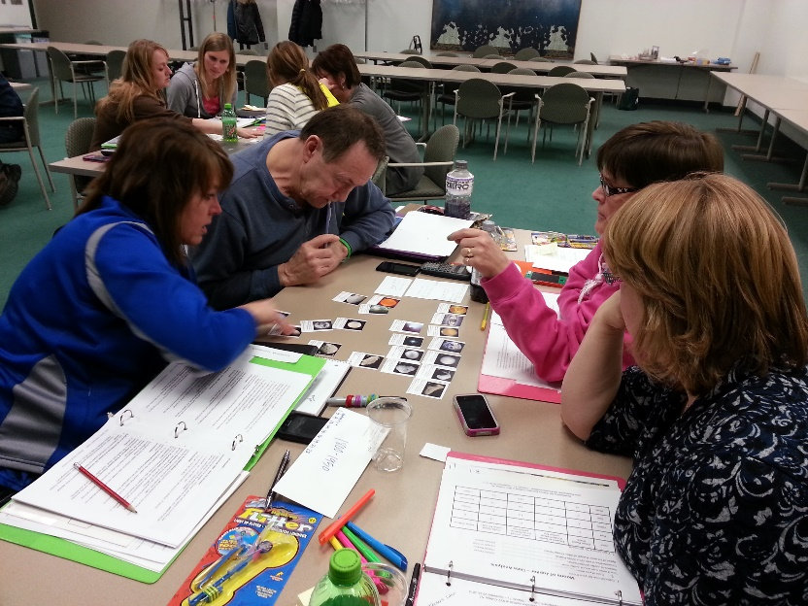
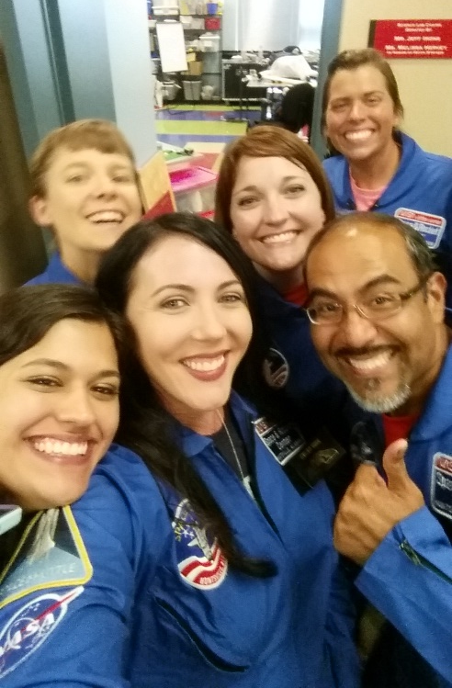
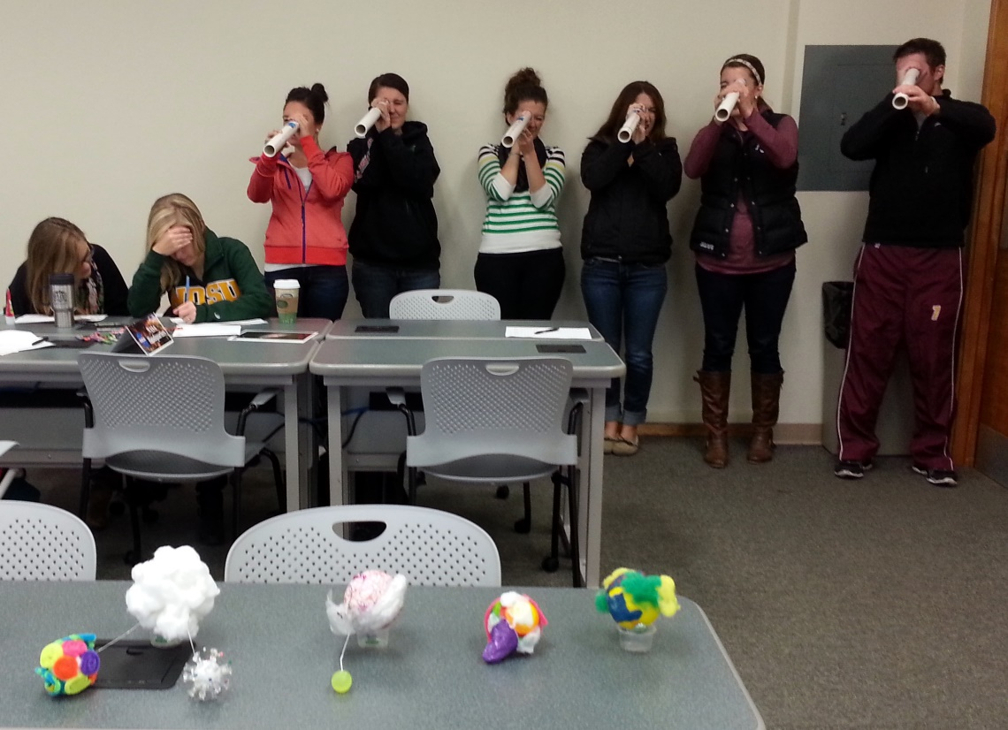
NDSGC K-12 Educator Email Listserv
Workshop opportunities
New STEM education resources for the classroom
NASA student contests/team competitions
Professional Development opportunities
Emails ~once a week

