Slide 1
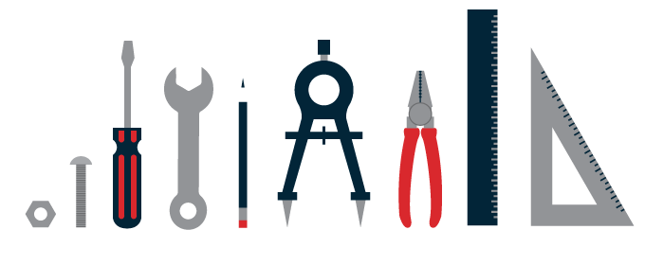
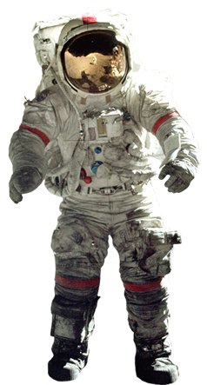
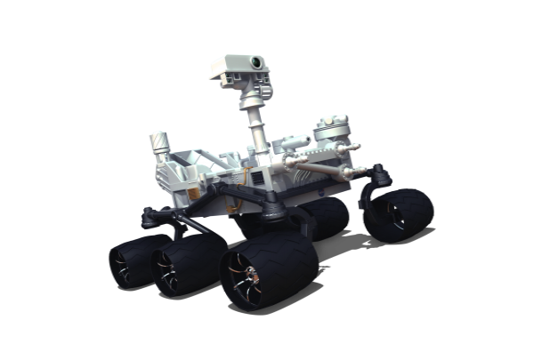
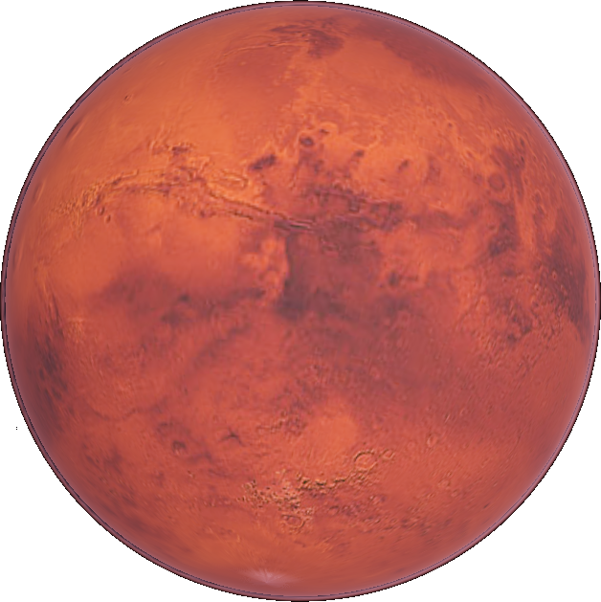
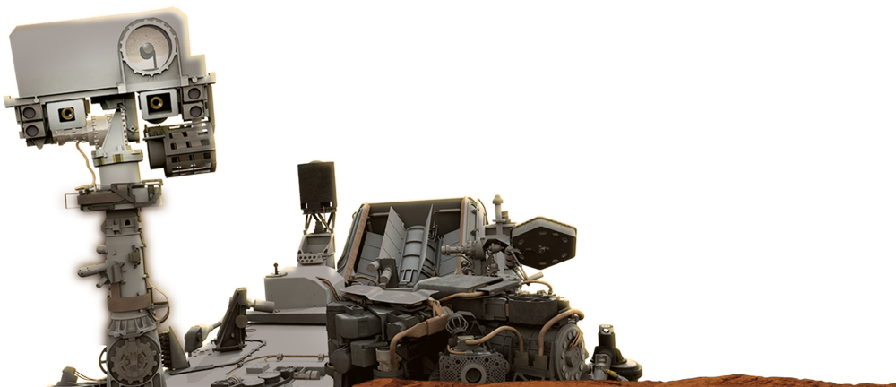
Mission to Mars and NASA educator resources
Neutral Buoyancy Lab
January 15, 2018
Caitlin Nolby (cnolby@space.edu)
Marissa Saad (msaad@space.edu)
North Dakota Space Grant Consortium

Slide 2
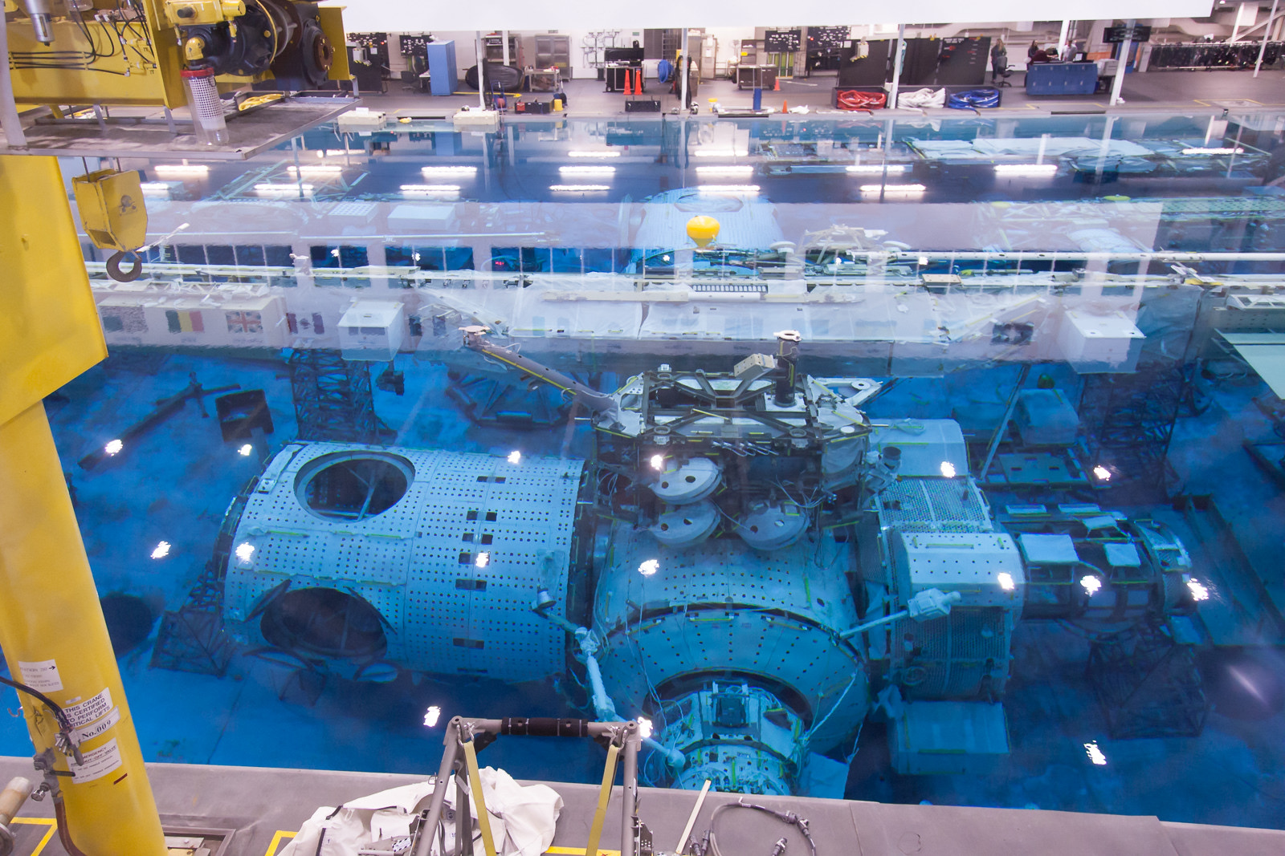

Slide 3
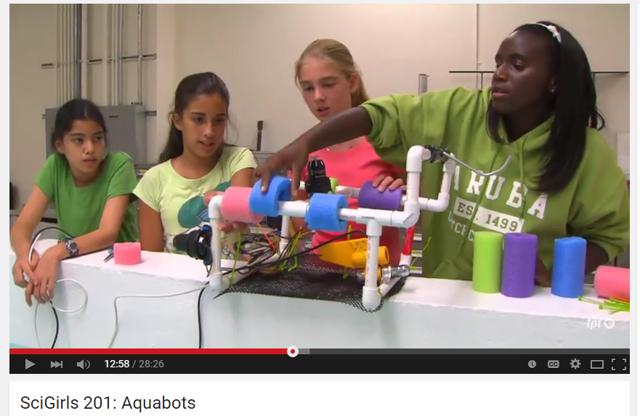
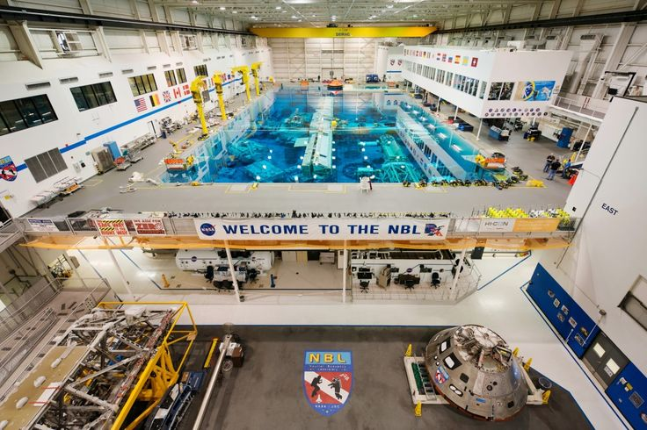
SCIGIRLS DEEP SEA DIVER
Season 2, episode 1: Aquabots
Challenge: NASA is currently preparing for long-duration spaceflight to Mars and needs to practice procedures in the NBL. They need to select a contractor to design and build neutrally buoyant tools for training.
Make predictions on given materials
Design your “deep sea diver”
Collaborative Design Review

Slide 4
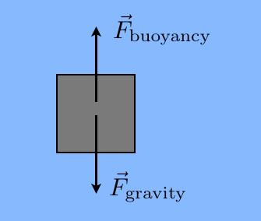
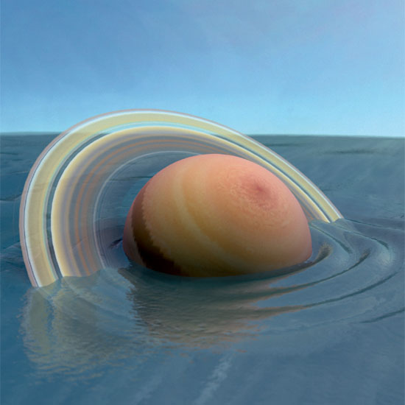
SCIGIRLS DEEP SEA DIVER
Objective: Design and Build a Neutrally Buoyant Object
What does it mean to be neutrally buoyant?
Balancing act between forces
Densities are equal
Which planet would “float” in a giant pool of water?

Slide 5
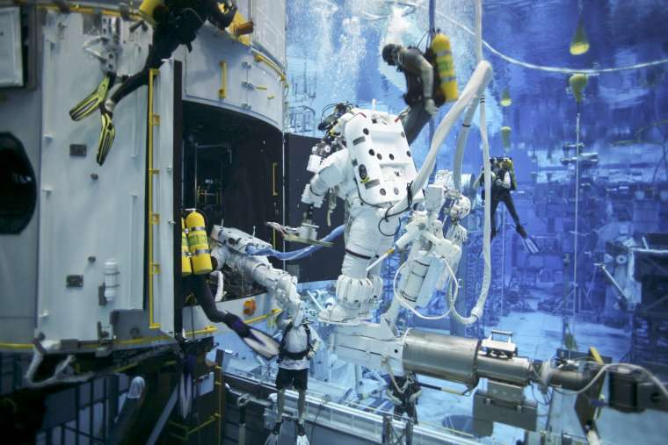
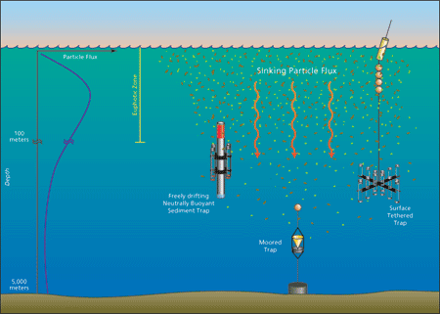
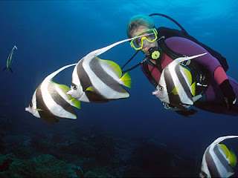
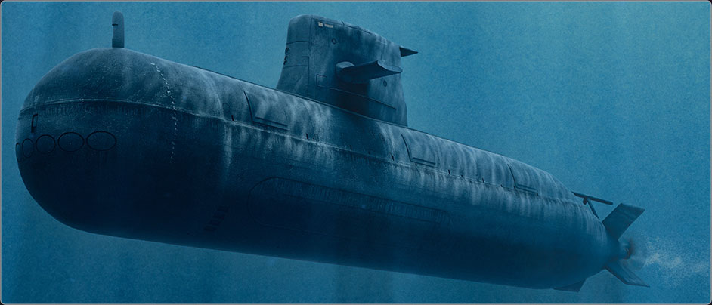
REFLECTION
What worked? Materials?
Other applicaitons?
Scuba divers
Submarines
Fish
Science! –Taking ocean measurements

