Slide 1
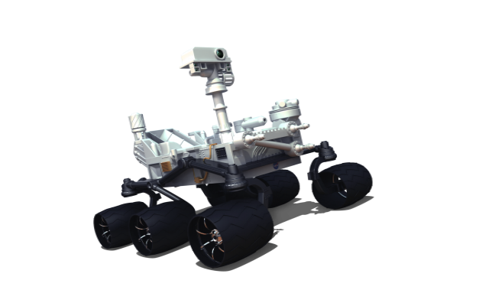
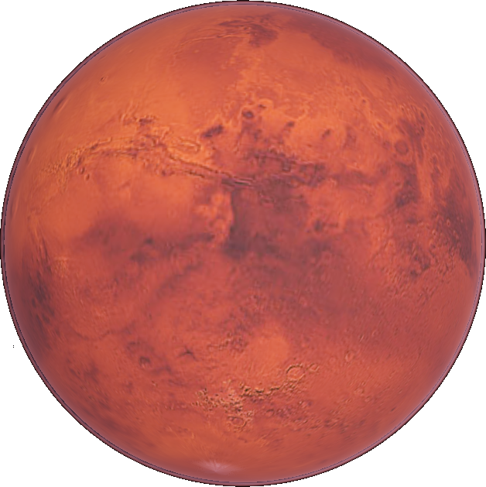
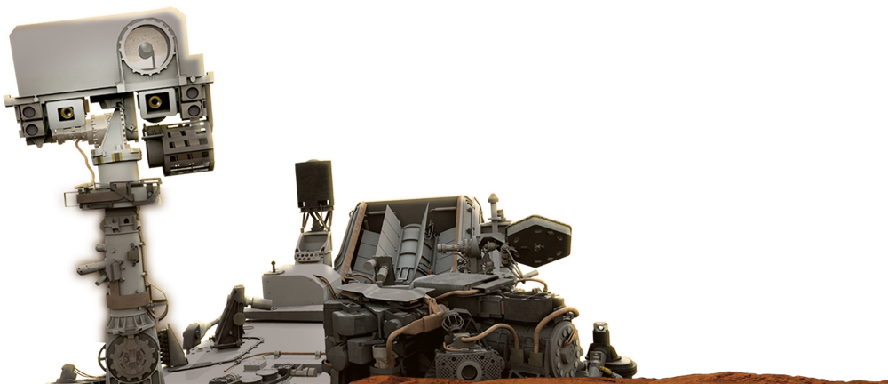
Mission to Mars and NASA educator resources
Parachutes
January 15, 2018
Caitlin Nolby (cnolby@space.edu)
Marissa Saad (msaad@space.edu)
North Dakota Space Grant Consortium

Slide 2
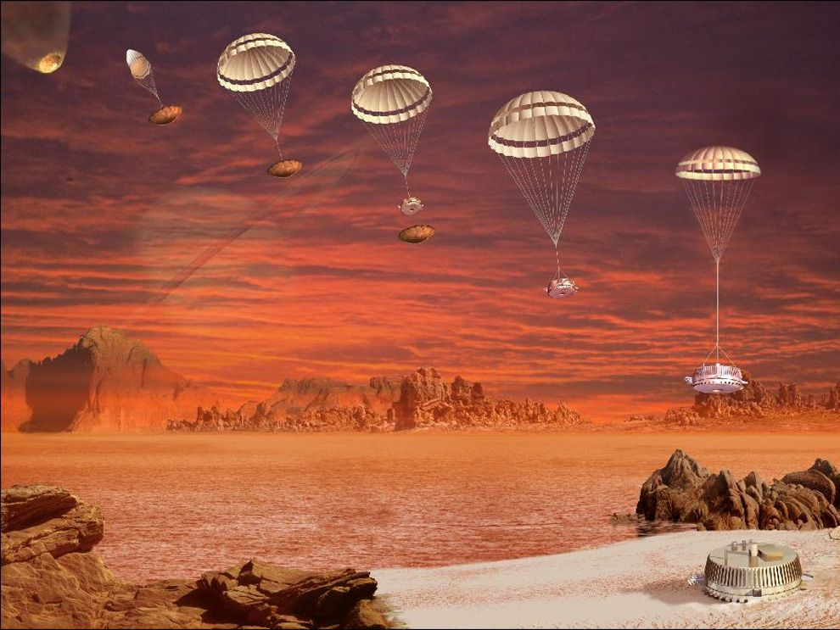
Two lessons on parachutes
Parachute Parade
(simpler activity for elementary)
Mars Rover Lander
(able to adapt to higher levels)

Slide 3
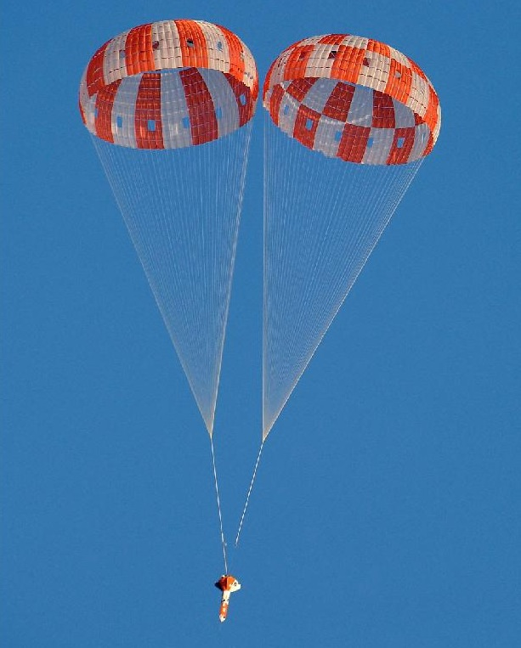
Parachute Parade
Ask students if they’ve seen a parachute before.
Introduce Orion and SLS
Decorate their capsules
Brainstorm and build
How do you construct a parachute using only the materials provided to help their astronauts reach the ground safely.
Plan
Test the designs with other groups
Predict
Interpret
Discuss astronaut safety

Slide 4
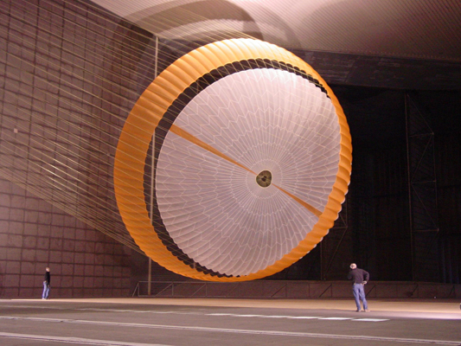
Your task:
Parachute Parade
You’ve been selected by NASA to design a parachute that will safely land their astronauts back to Earth! NASA has provided you with an assortment of parachute-building materials. Chose wisely, the lives of the crew are depending on you!
How do you land on Mars?
https://www.youtube.com/watch?v=8-X8acD_r38

Slide 5
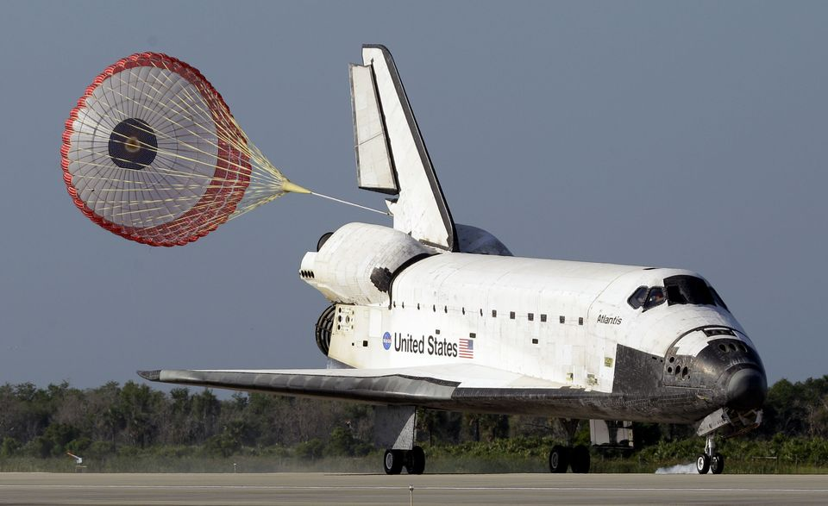
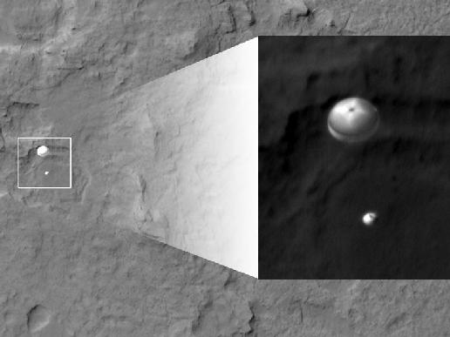
Mars Rover Lander
Why should we worry about parachutes?
Many space missions still use parachutes:
1981-2011, the Shuttles land with them
Probes or Rovers use them to land on planetary surfaces

Slide 6
Let’s take a look at NASA’s Parachutes
7 Minutes of Terror (Curiosity landing on Mars; 2012)
https://goo.gl/mi8gX3
Take a look at the Orion Parachutes!
https://goo.gl/WjAXBm
Extra consideration: Integrate this activity into your classroom – add budgets, weight restrictions, competition between NASA centers, etc.

