Slide 1
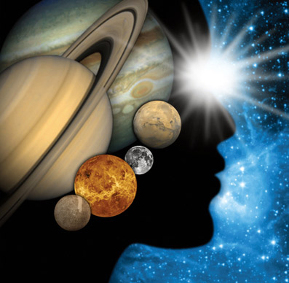
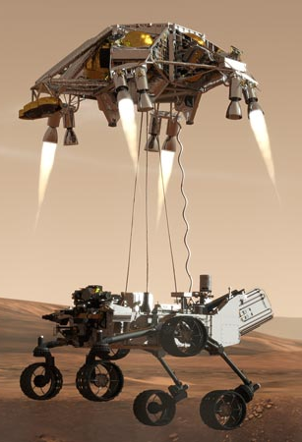
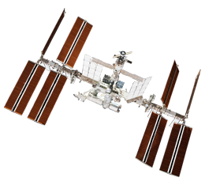
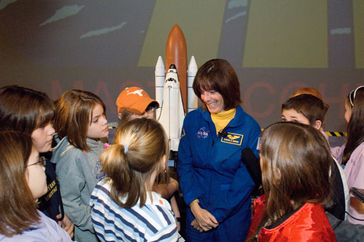
NASA Resources and Opportunities for Educators
Caitlin Nolby
North Dakota NASA Space Grant

Slide 2
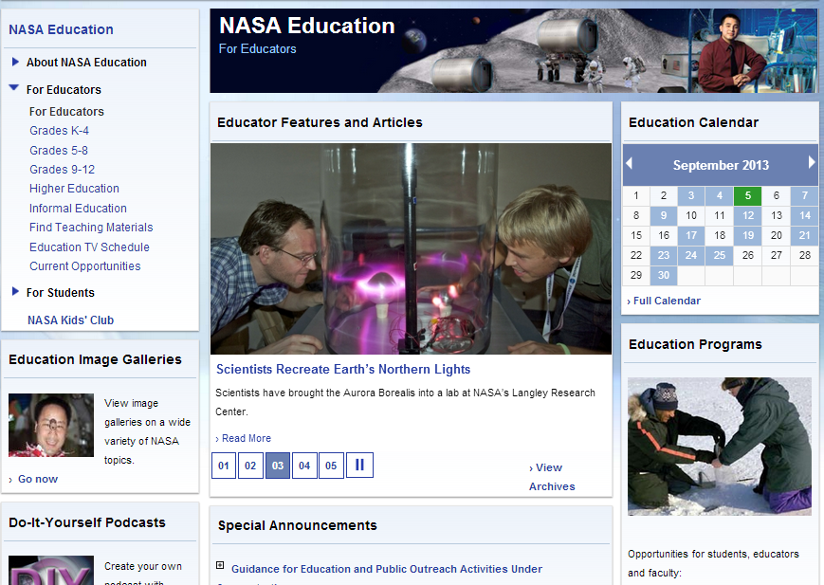
NASA Education
Can search for materials by subject and grade level

Slide 3
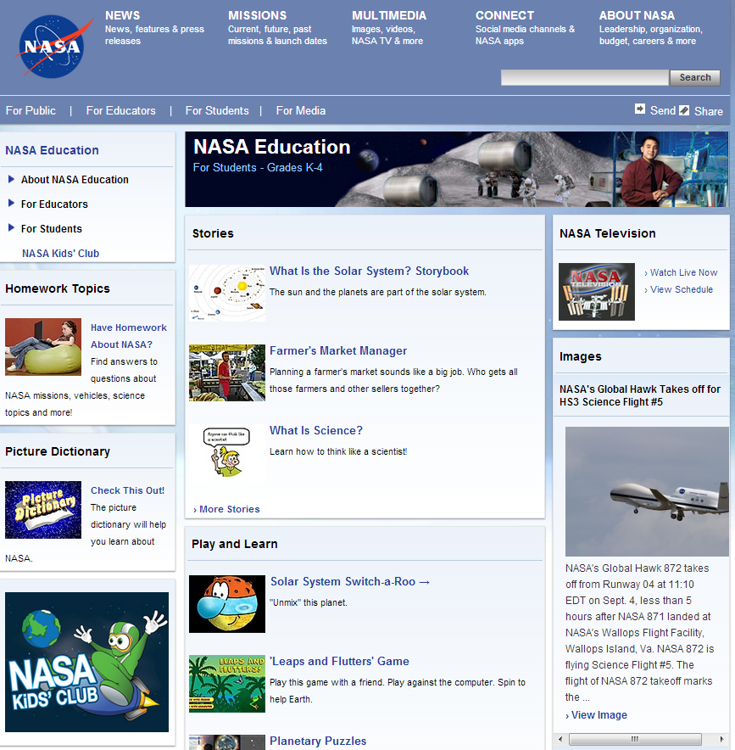
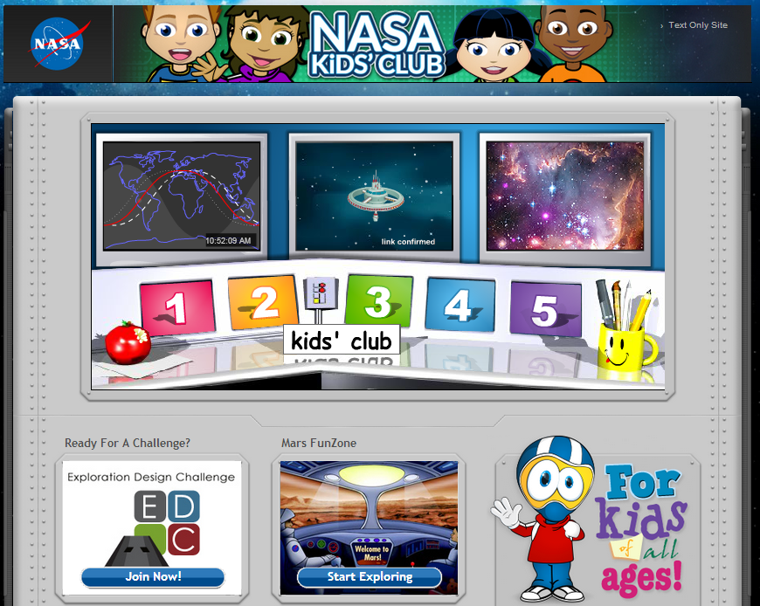
NASA for Students

Slide 4
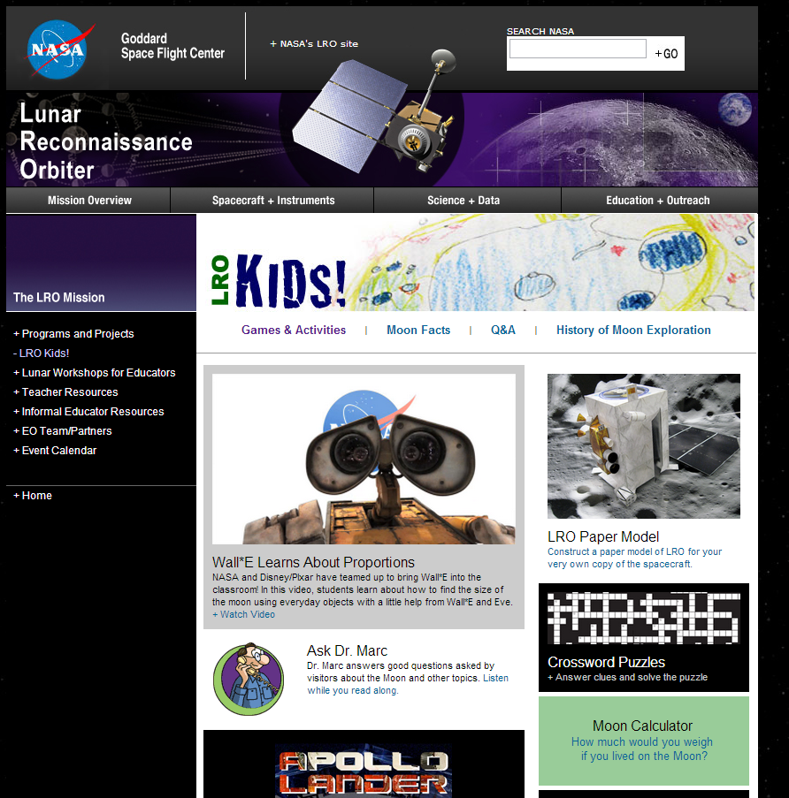
NASA – Lunar Reconnaissance Orbiter

Slide 5
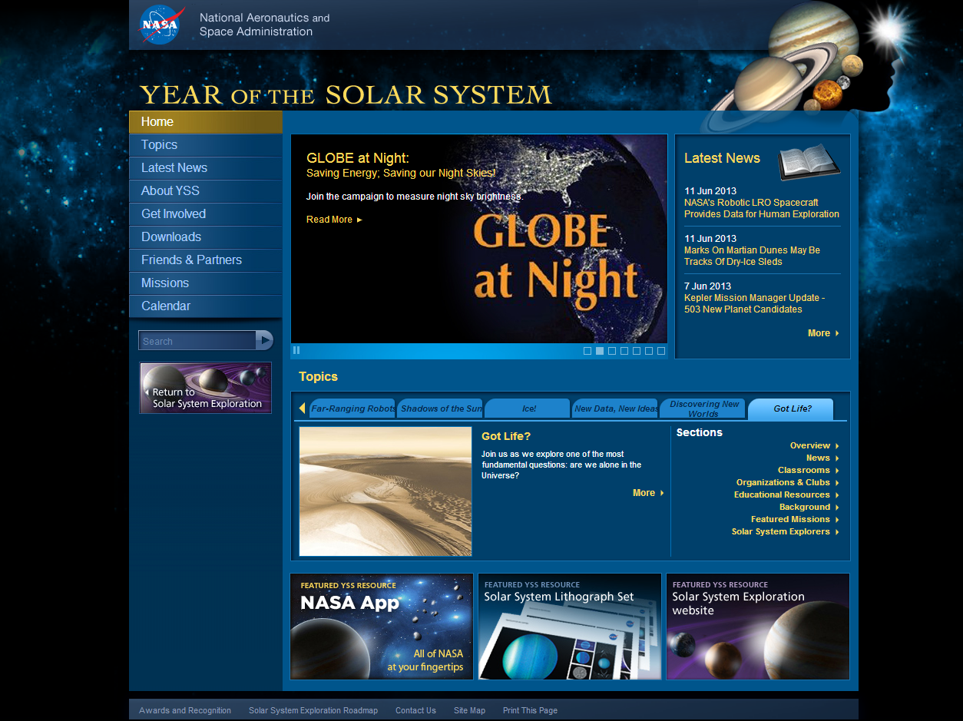
Year of the Solar System

Slide 6
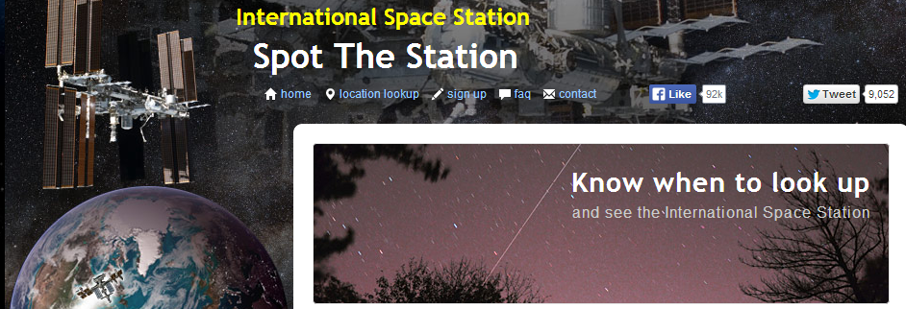
International Space Station - Live!

Slide 7
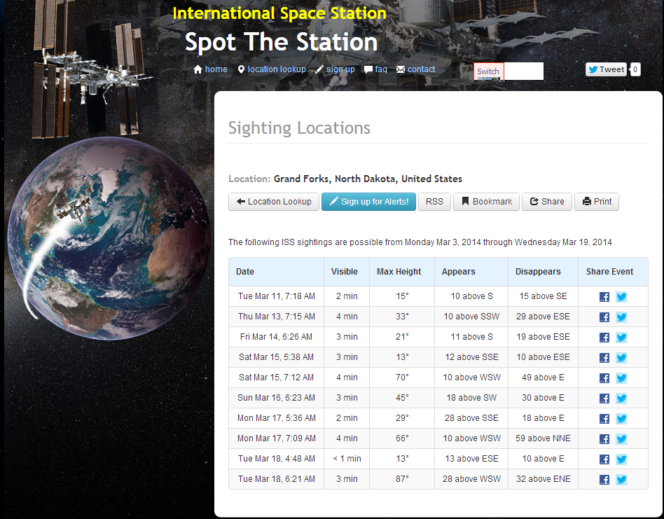

Slide 8
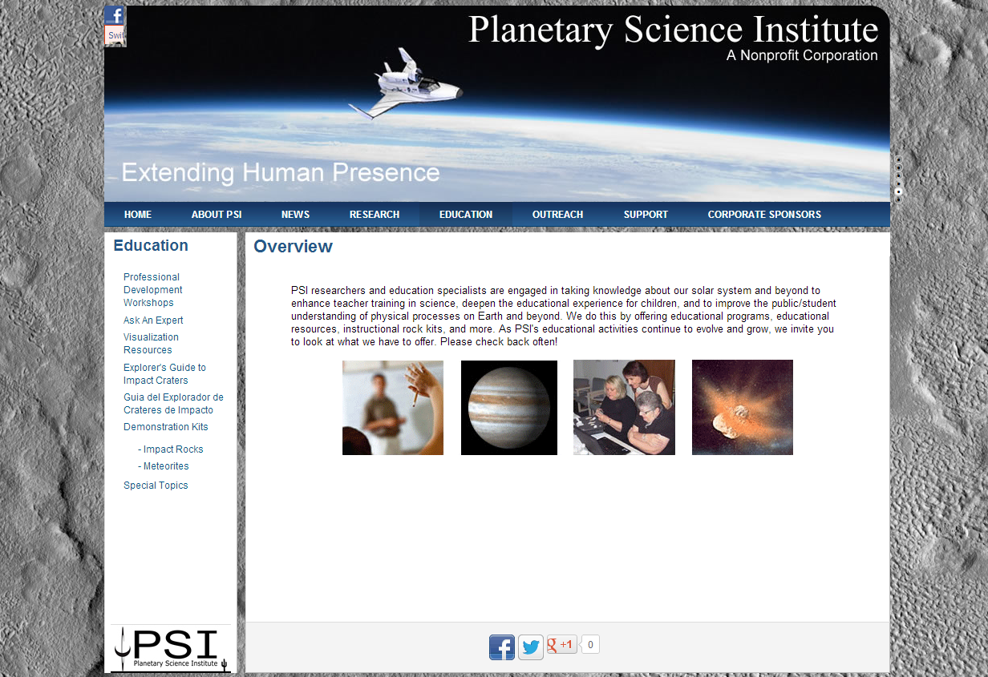
Planetary Science Institute

Slide 9
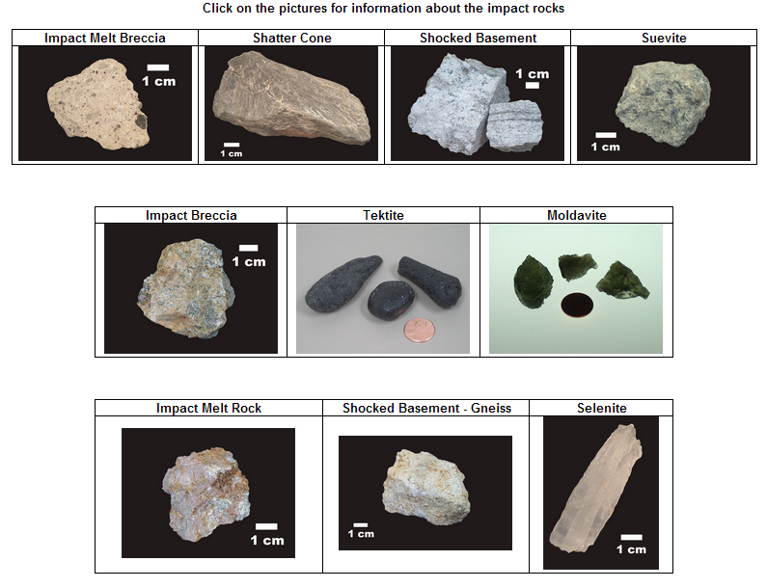
Planetary Science Institute

Slide 10
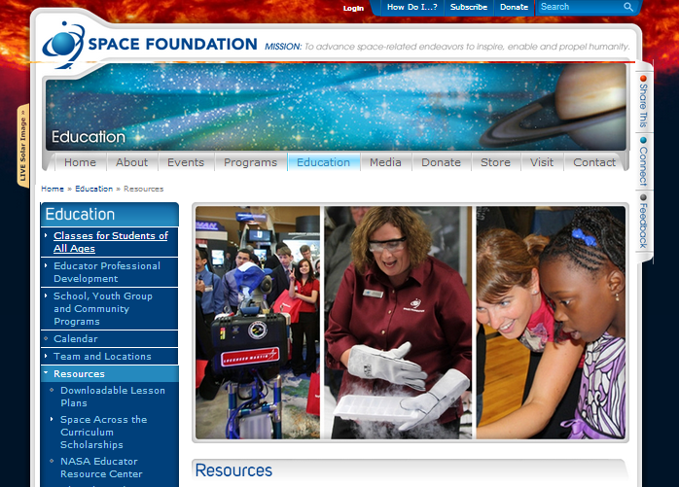
Space Foundation

Slide 11
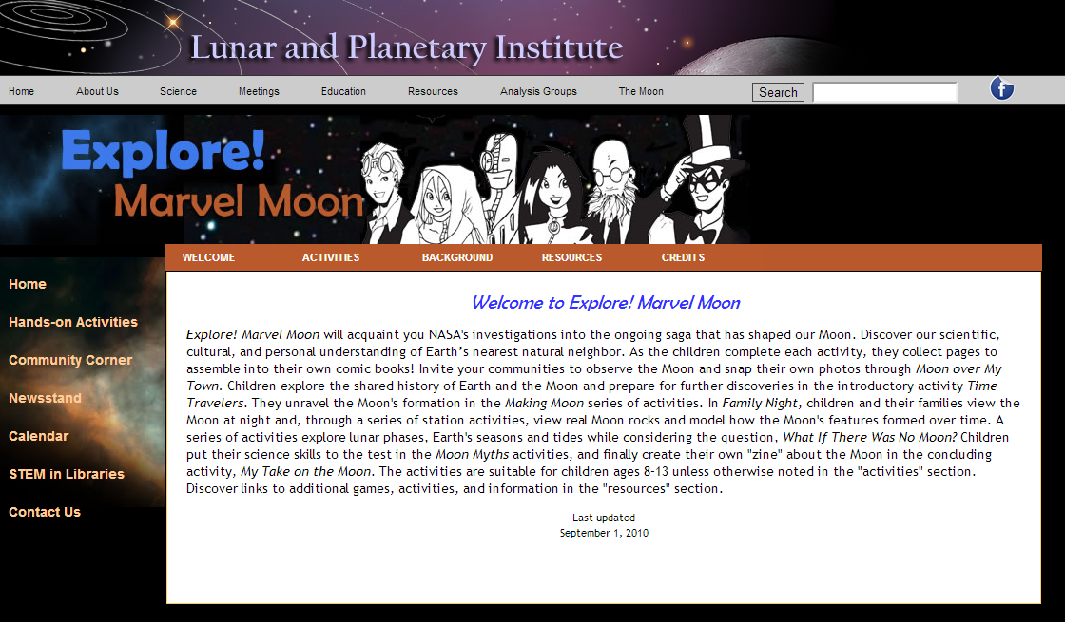
Lunar and Planetary Institute

Slide 12
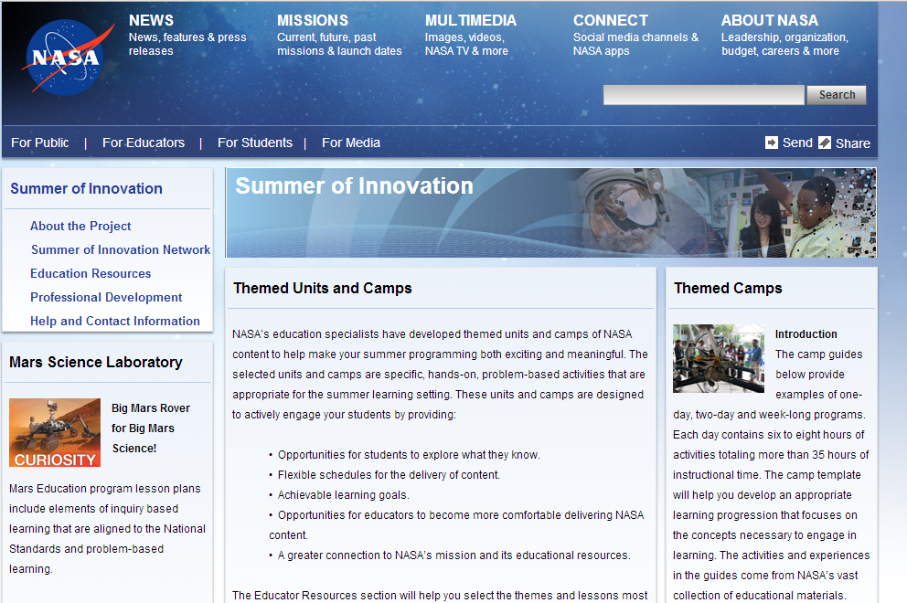
NASA Summer of Innovation

Slide 13
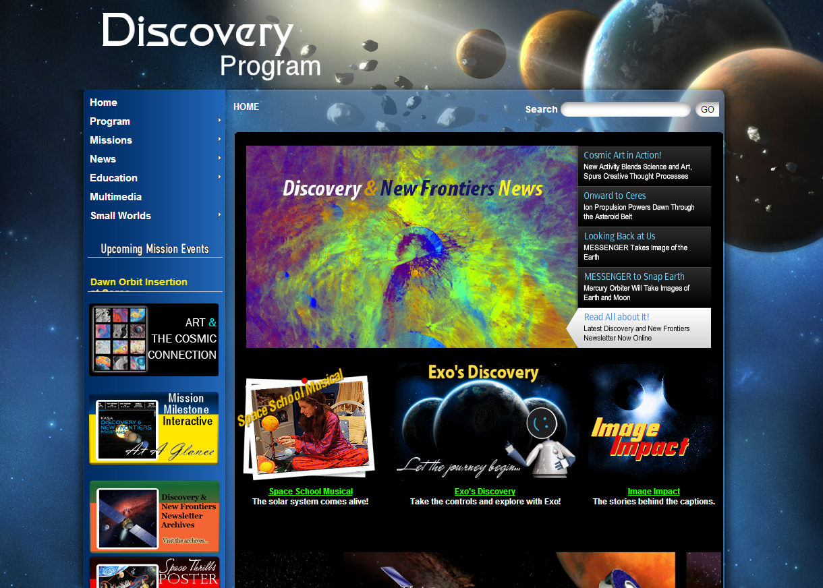
NASA Discovery Program

Slide 14
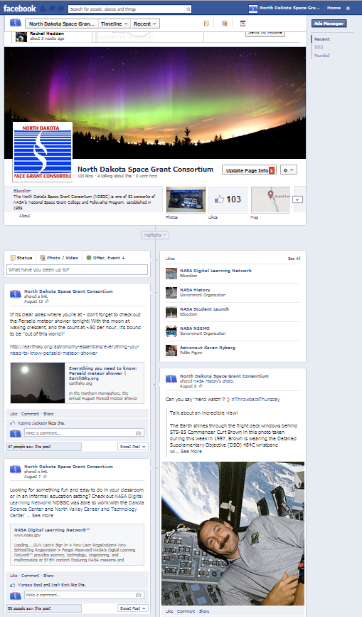
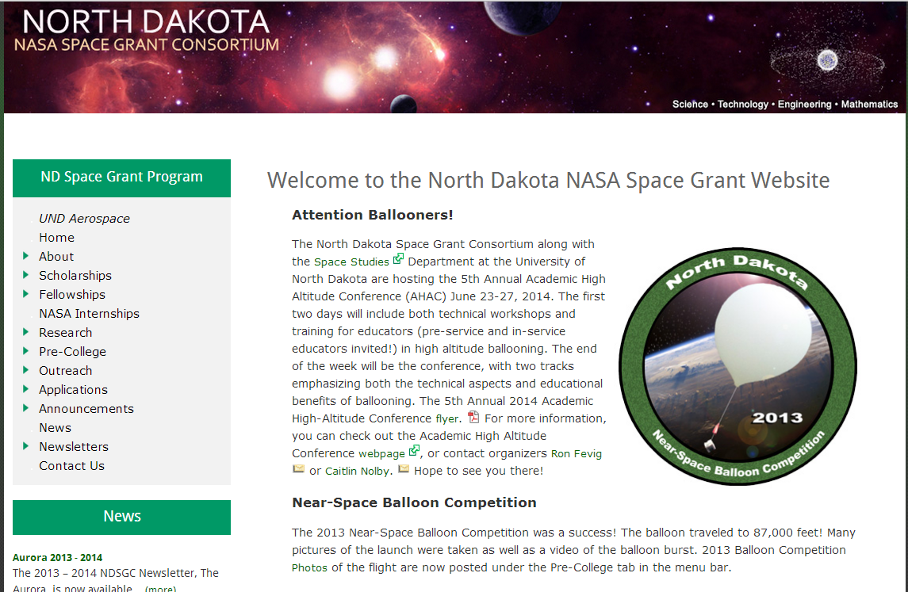
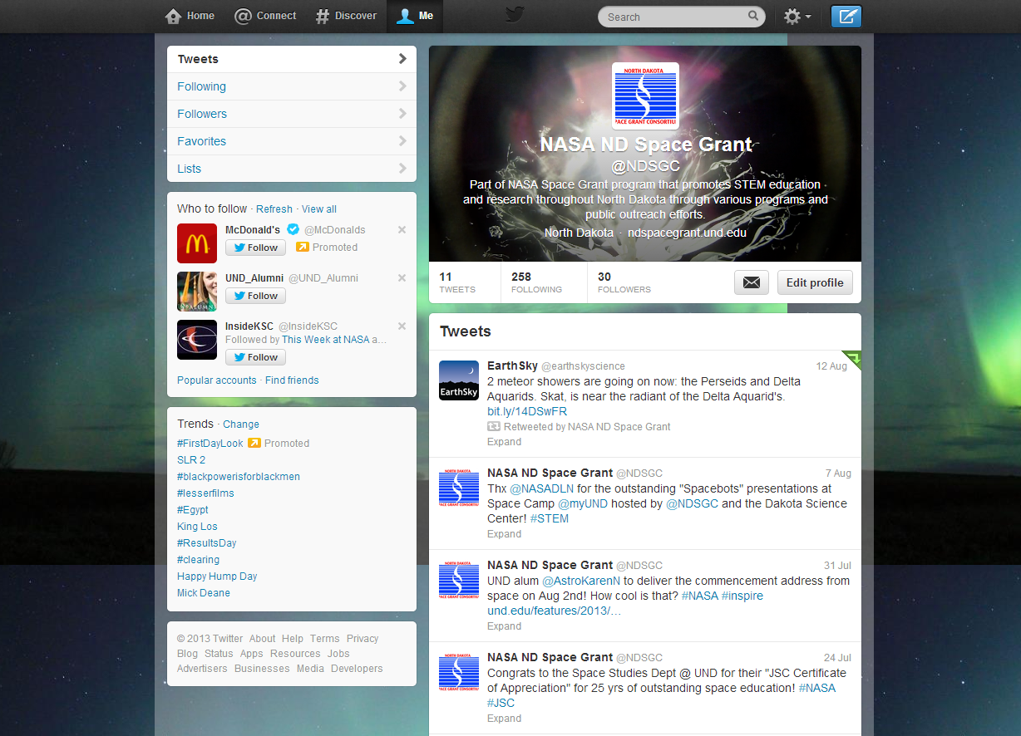
North Dakota Space Grant

Slide 15
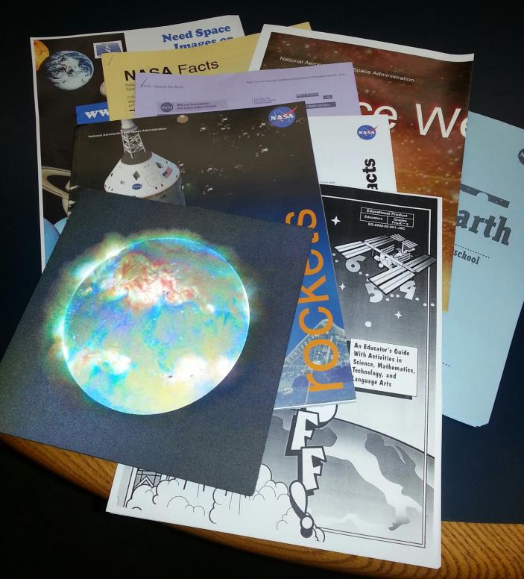
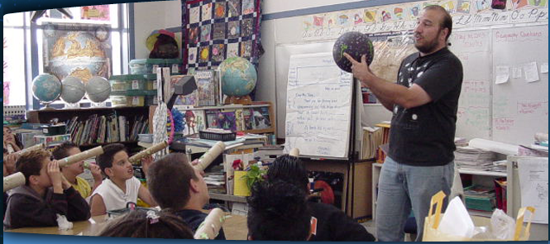
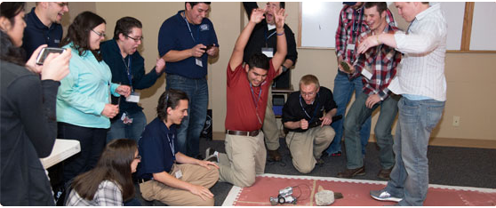
NDSGC K-12 Educator Email Listserv!
Workshop opportunities:
March 28-29, 2014 (Fri-Sat) at UND!
New STEM education resources for the classroom
NASA student contests/team competitions
Professional Development opportunities
Emails ~once a week

Slide 16
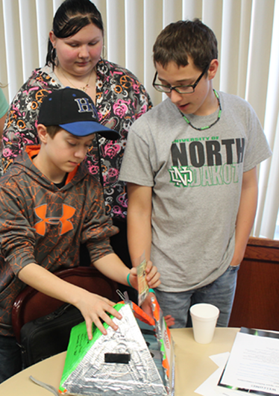
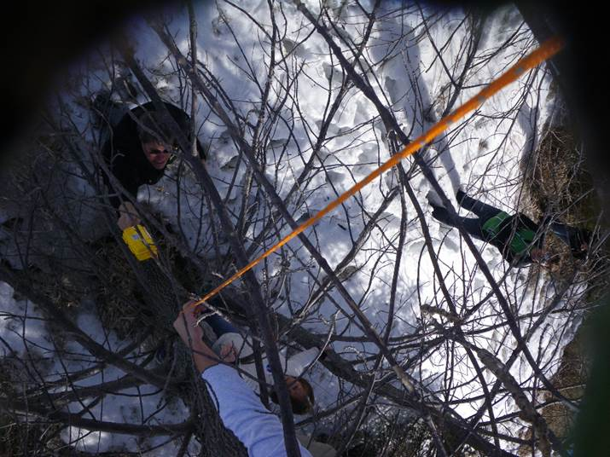
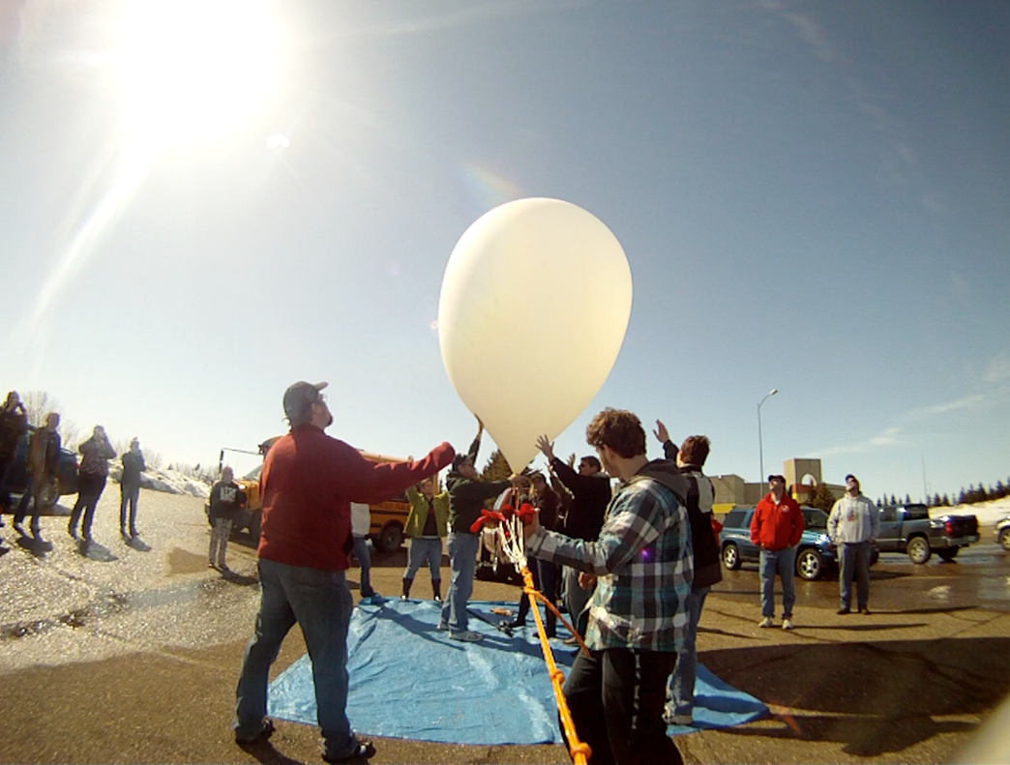
High Altitude Ballooning
Near-Space Balloon Competition
Grades 6-12, statewide, year-long, periodic design reviews

Slide 17
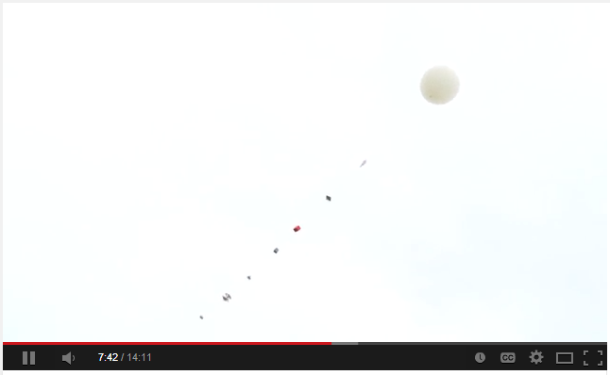
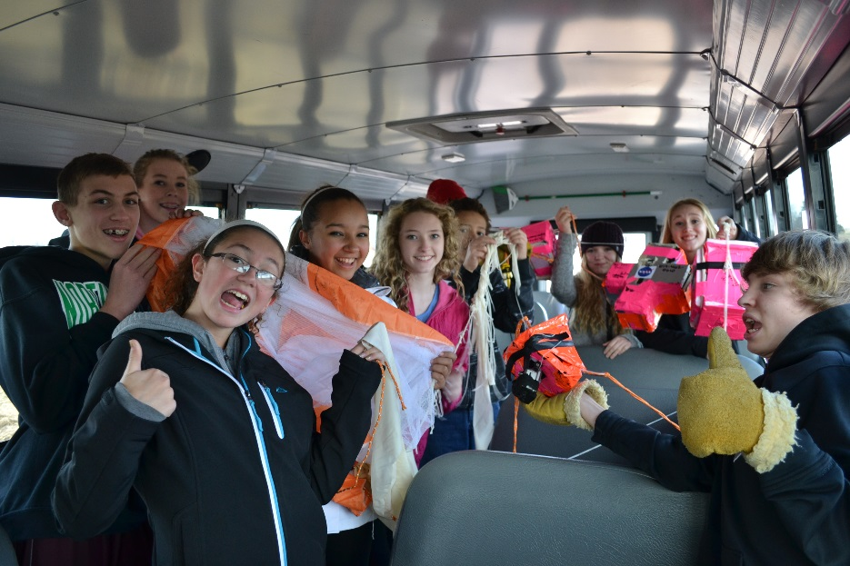
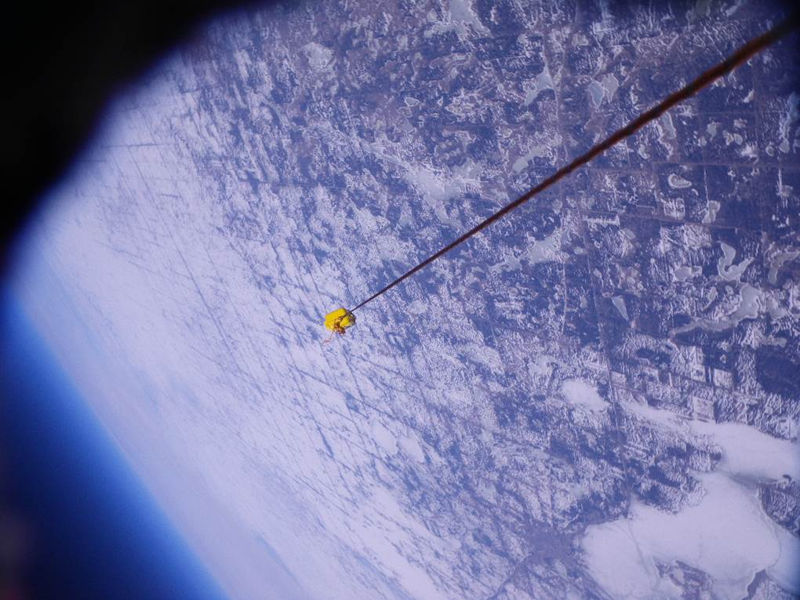
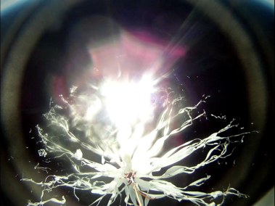
High Altitude Ballooning
June 24, 2014 – Afternoon Educators Workshop
At UND!

Slide 18
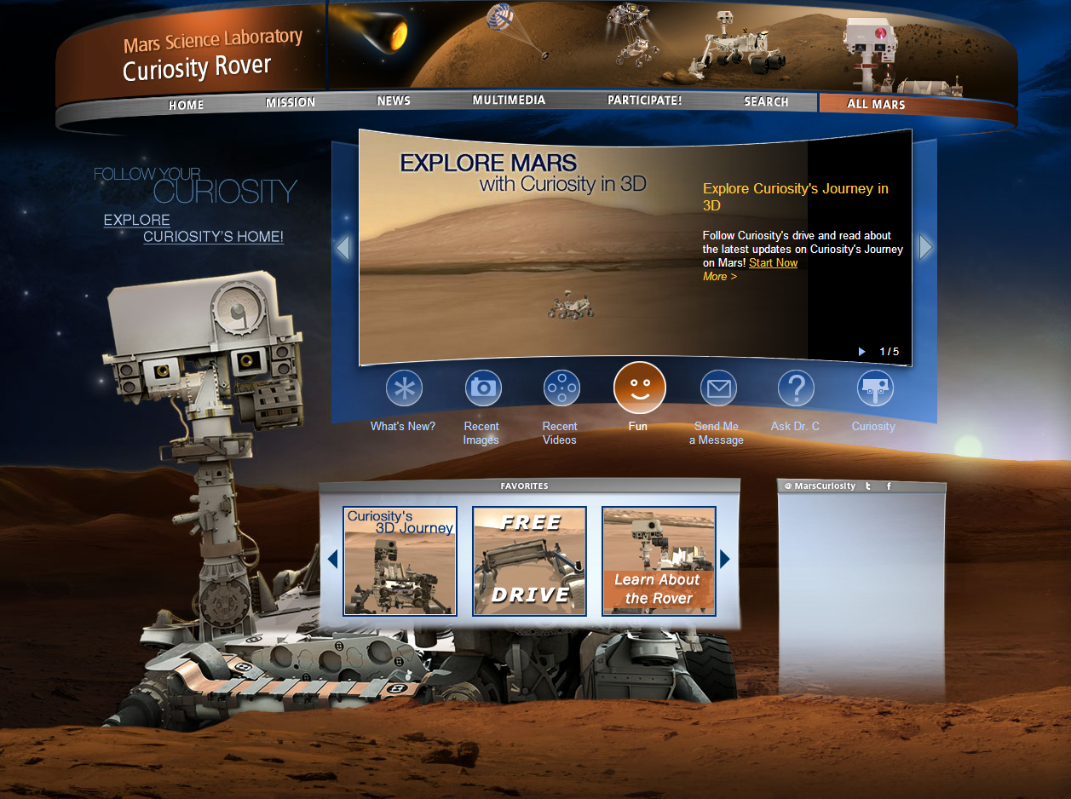
Mars Curiosity Rover
http://mars.jpl.nasa.gov/drc/

Slide 19
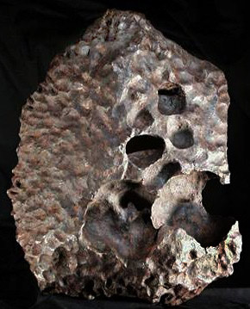
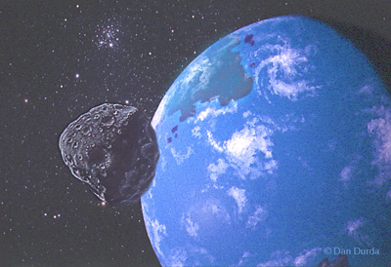
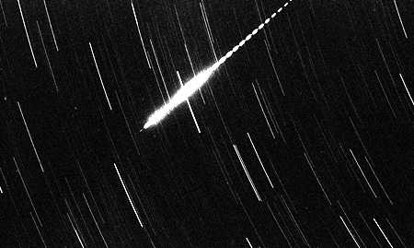
Space Rocks Defined
Meteoroid: Small (less than 10 meters) rock/metallic object IN SPACE
Meteor: The light produced when a meteoroid ENTERS THE ATMOSPHERE (sometimes called a “shooting star”)
Meteorite: A natural rock/metallic object from space that has fallen to EARTH’S SURFACE
A METEORITE which is a part of the meteoroid that survived atmospheric entry and reached the ground.
A METEOROID approaching the Earth.
A METEOR formed by a meteoroid entering the atmosphere at high velocity.

Slide 20
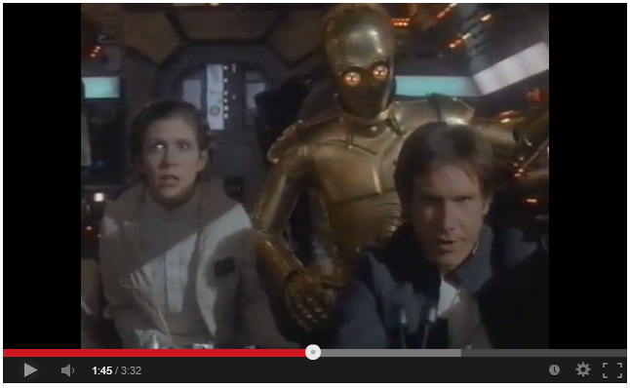
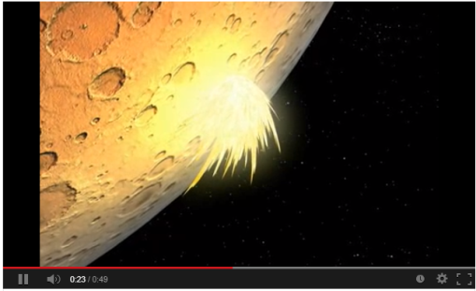
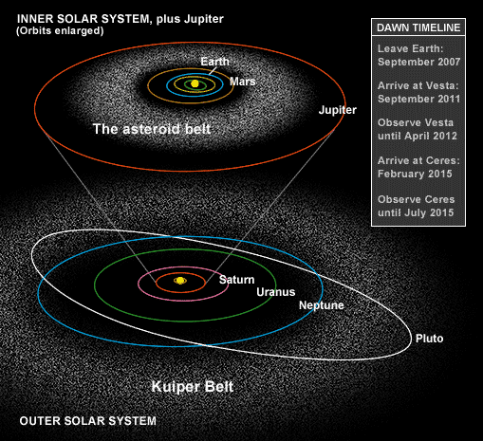
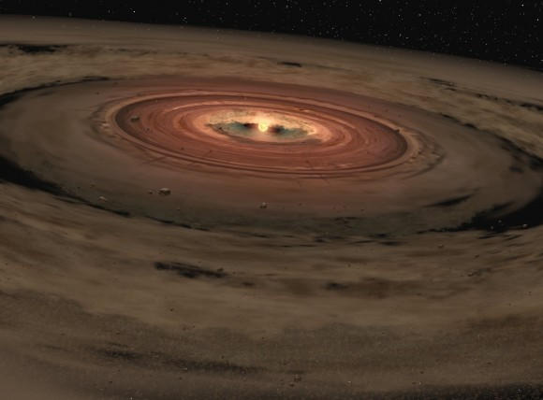
Space Rocks Defined
Where do they come from?
Why study space rocks?
Samples of the early Solar System
Meteor Showers (Comet Tails)
Impacts!! – Planetary Protection

Slide 21
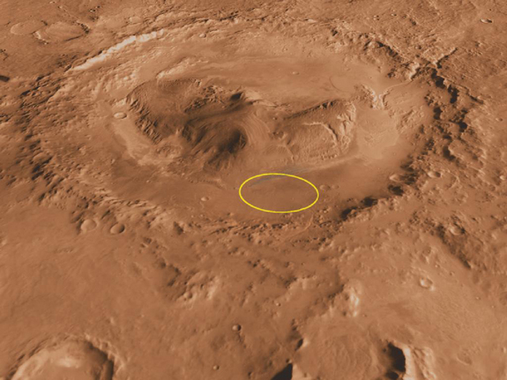
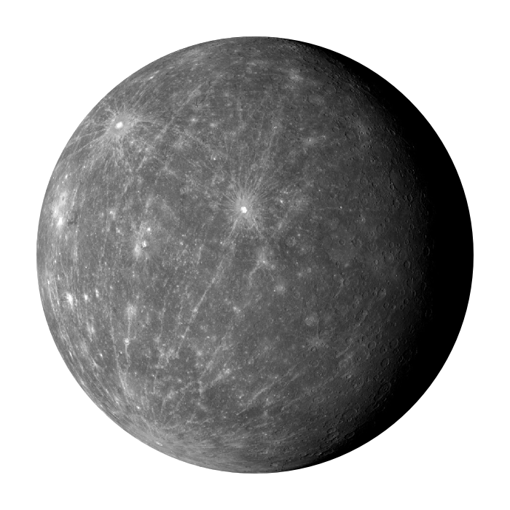
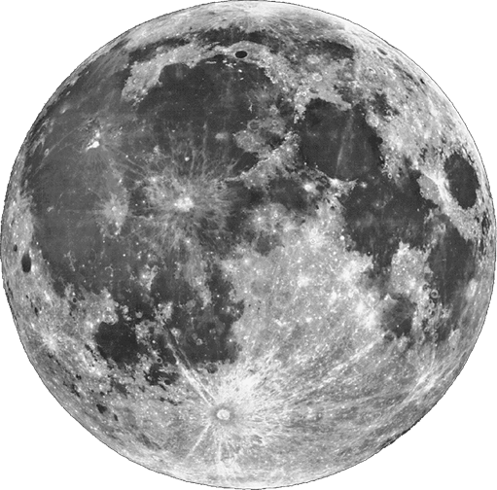
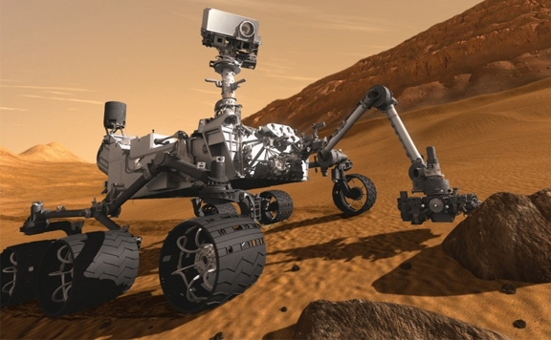
Impacts in Our Solar System
Mercury, Moon, Mars
Gale Crater and Curiosity Rover

Slide 22
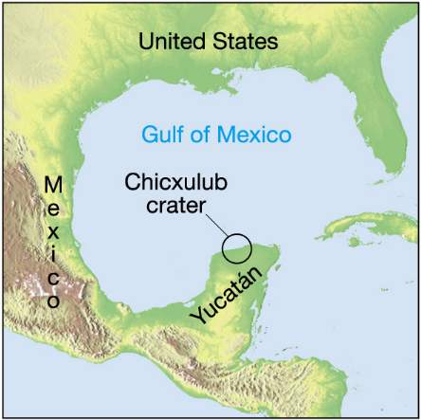
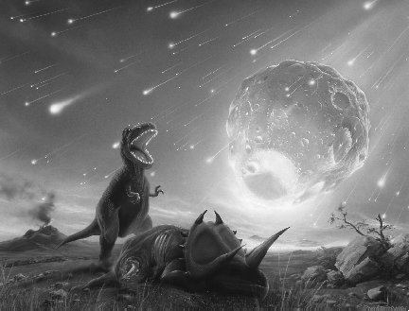
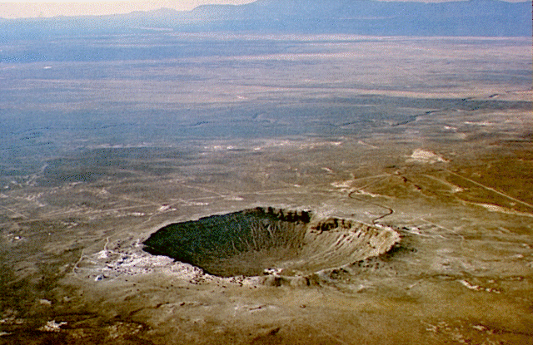
Impacts on Earth
Meteor Crater (Arizona) was formed by the impact of an ~50 meter iron asteroid ~50,000 years ago
1 km

Slide 23
Peekskill Meteorite (12.4 kg) and 1980 Chevrolet Malibu
October 9, 1992 – Peekskill, NY
Michelle Knapp - 18 yr old, HS senior
When police arrived on the scene, they filed a report for criminal mischief by a very strong male.
The smell of gas from the punctured gas tank prompted the fire department to investigate, at which time they found the meteorite.

Slide 24
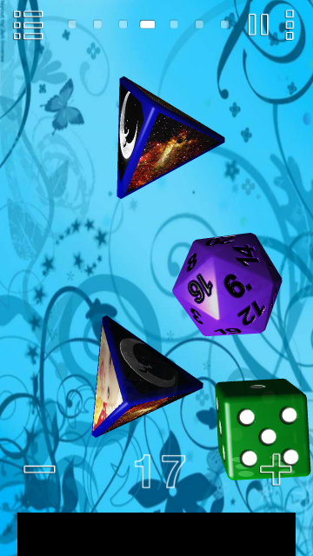
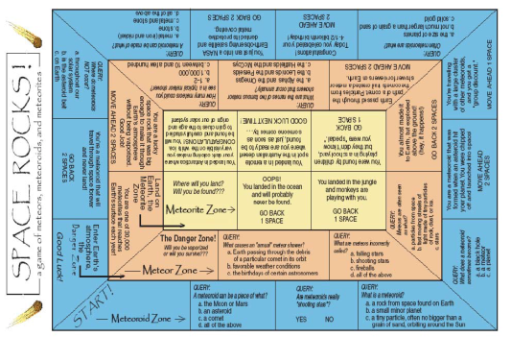
Space Rocks! Board Game
Dice App: “Prime Dice”
Game Rules
Make each board game space into an 8.5x11, and tape up around the classroom for a “life size” version of the game
Meteor Zone and Meteorite Zone

