Slide 1
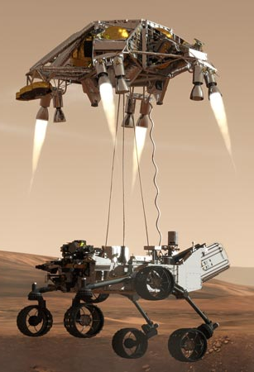
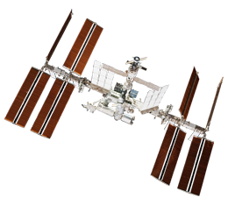
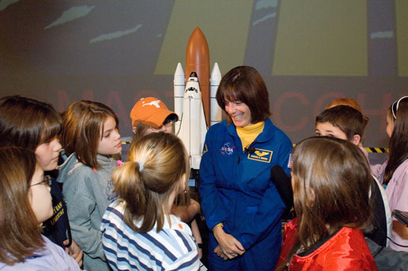
Educator Resources in Space Sciences
Caitlin Nolby
North Dakota Space Grant Consortium

Slide 2
Strange New Planet
Work in NASA teams to collect data to plan missions and explore new worlds!
How Kepler Works
Sort students by NASA center
Assign student roles
“How to Land on a Comet”

Slide 3
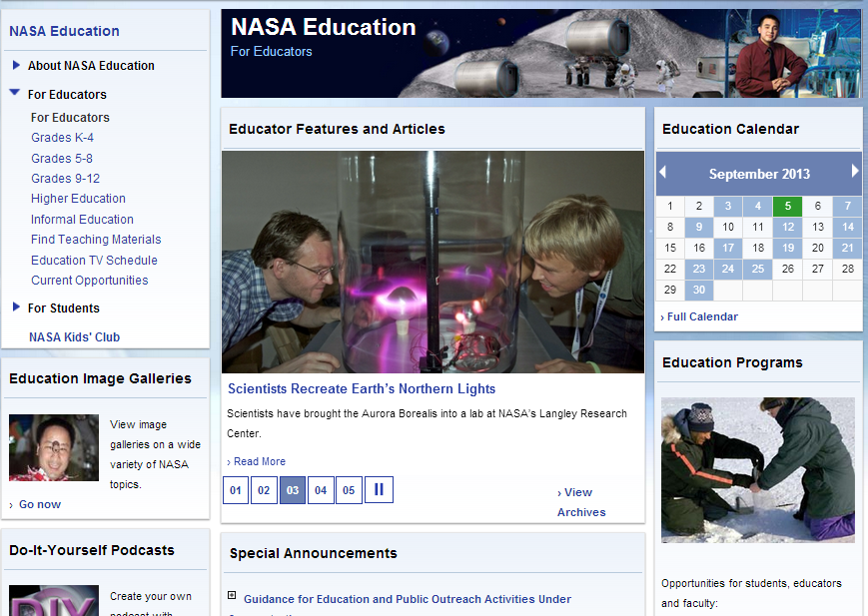
NASA Education
Can search for materials by subject and grade level

Slide 4
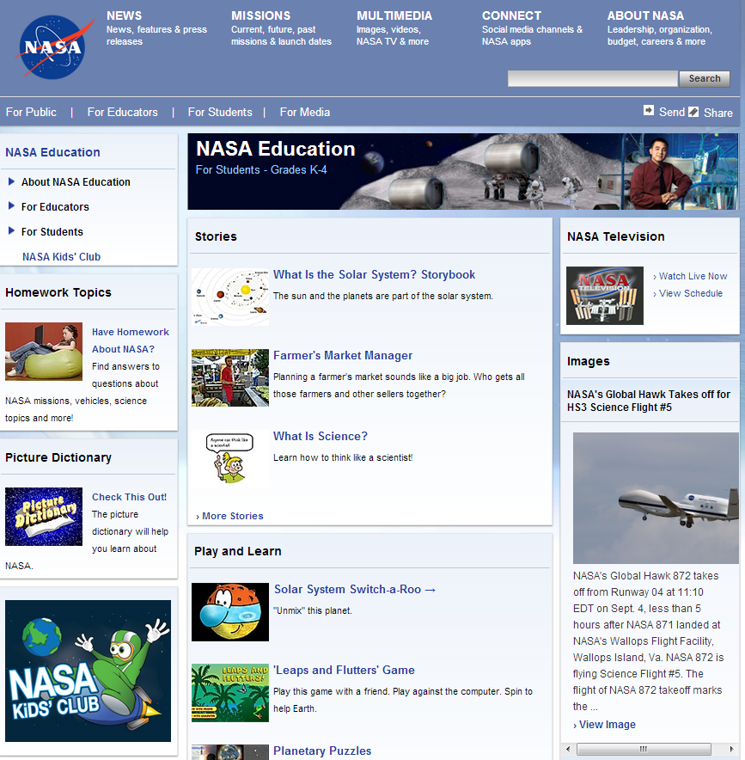
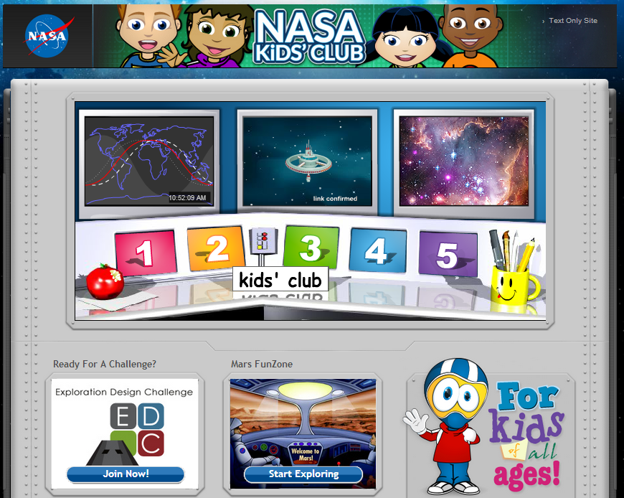
NASA for Students

Slide 5
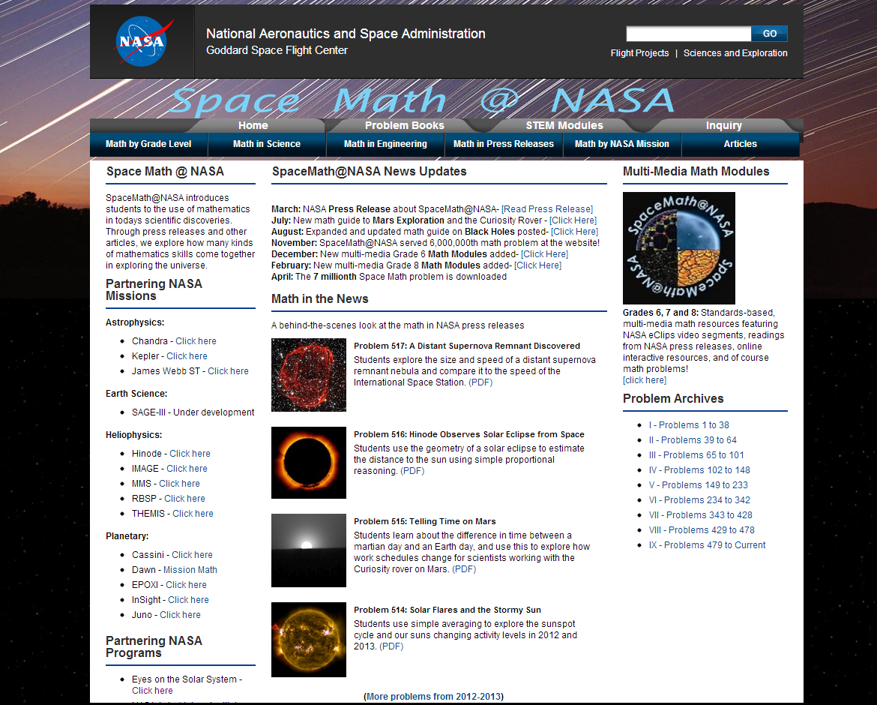
Space Math at NASA

Slide 6
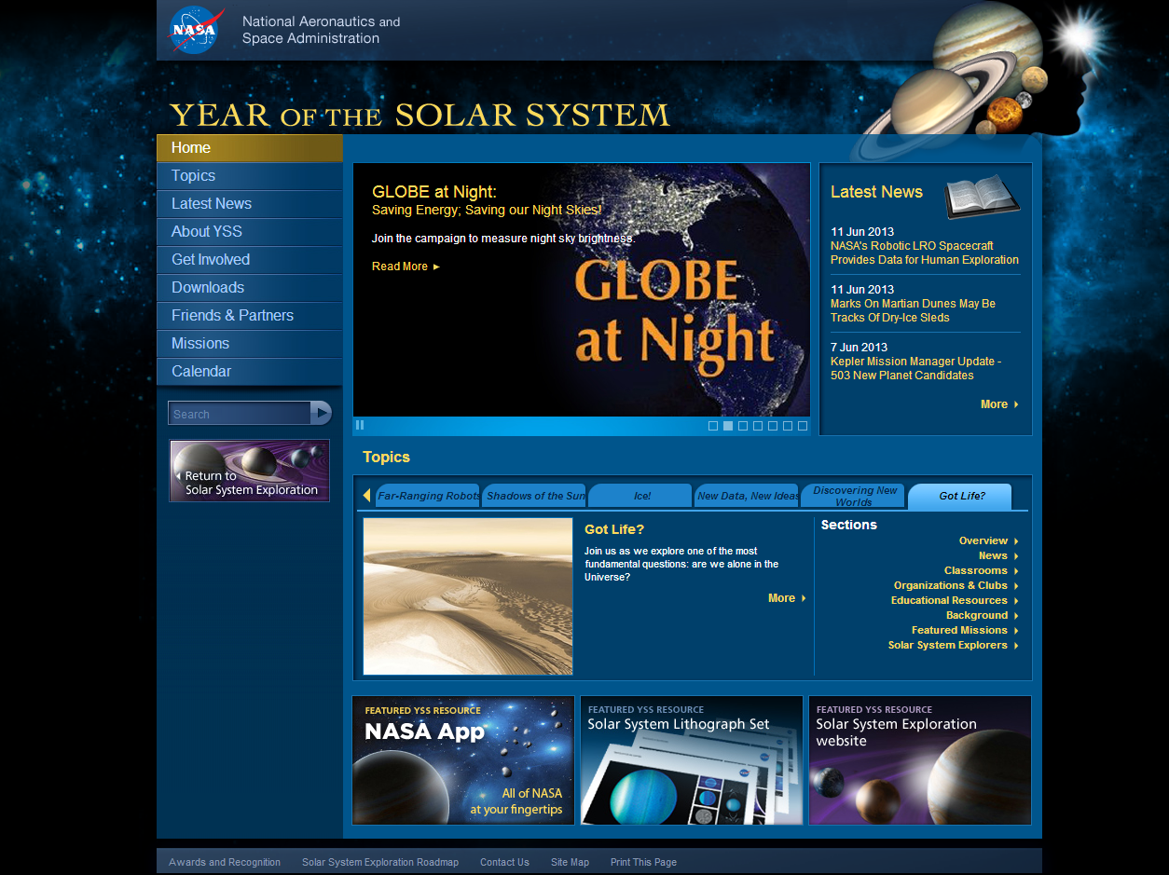
Year of the Solar System

Slide 7
International Space Station - Live!

Slide 8
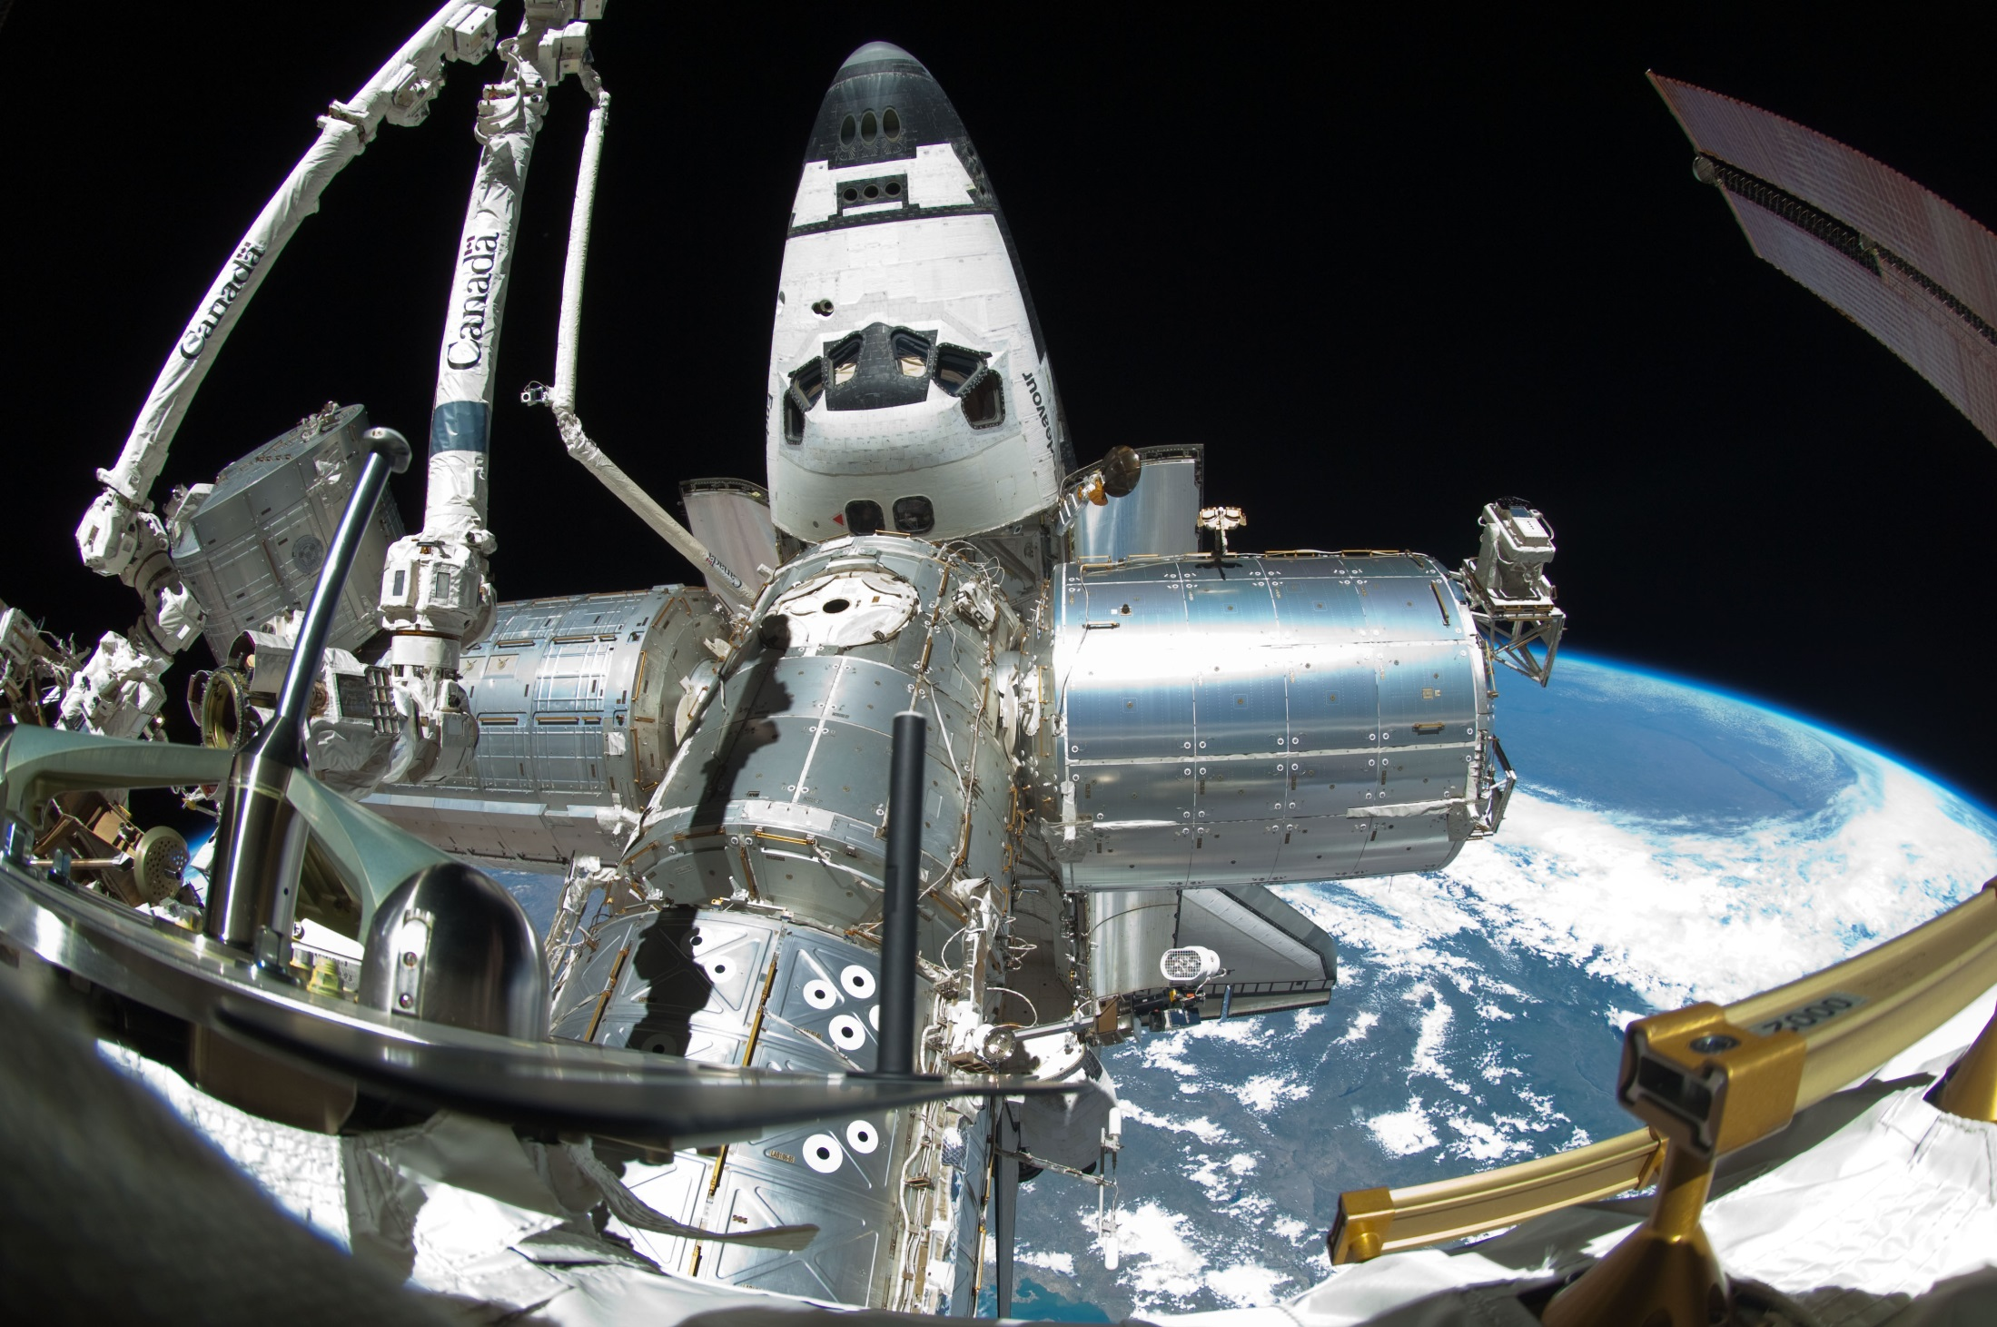
Spot the Station

Slide 9
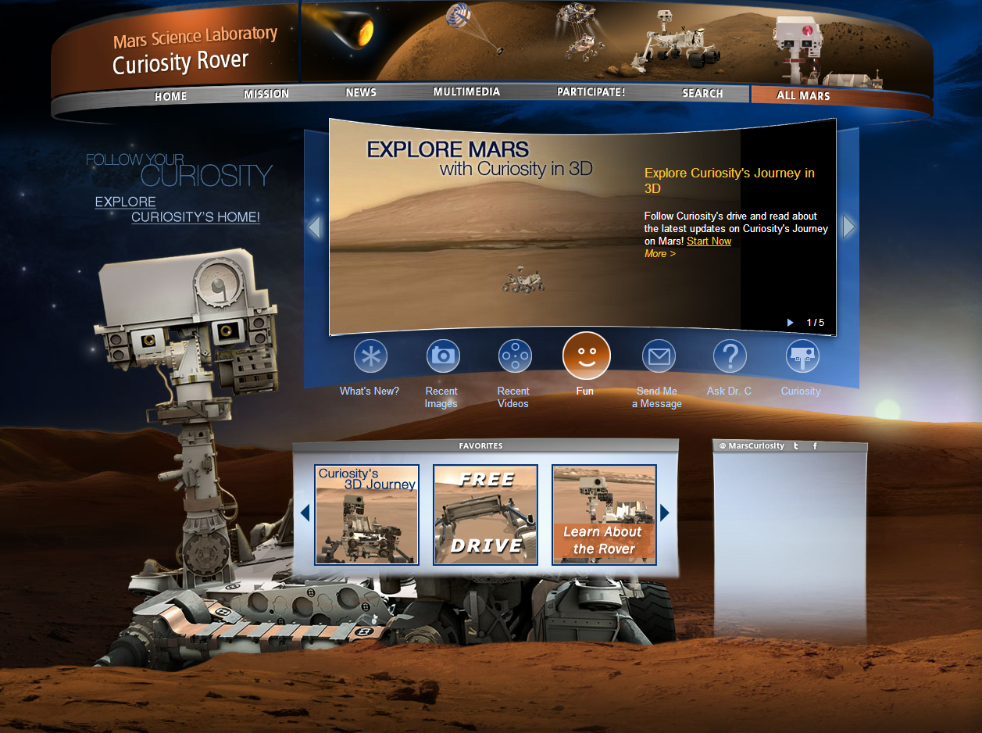
Mars Curiosity Rover

Slide 10
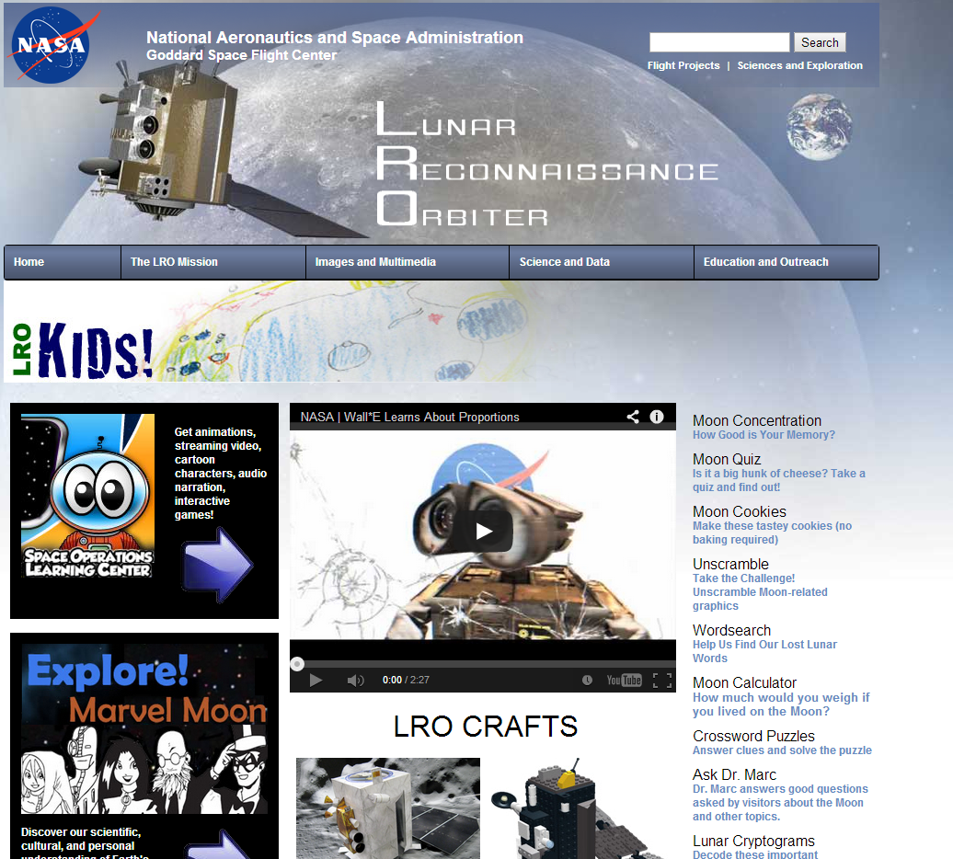
NASA – Lunar Reconnaissance Orbiter

Slide 11
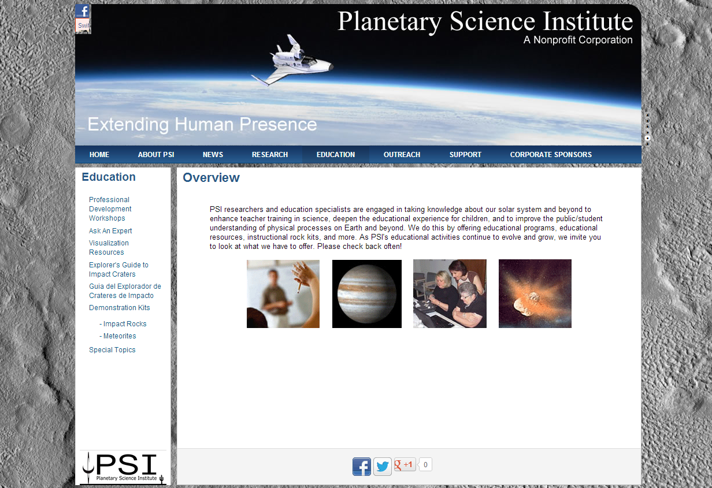
Planetary Science Institute

Slide 12
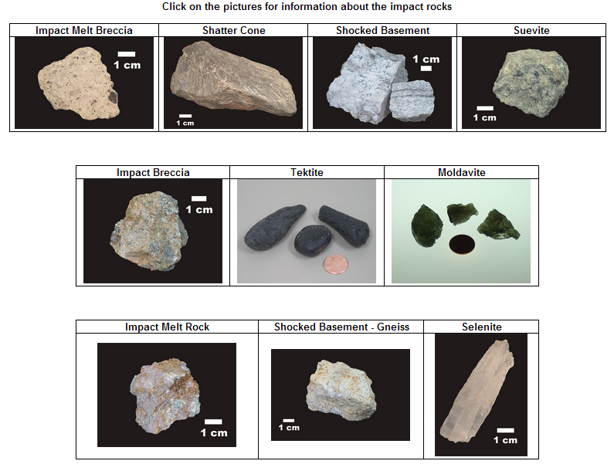
Planetary Science Institute

Slide 13
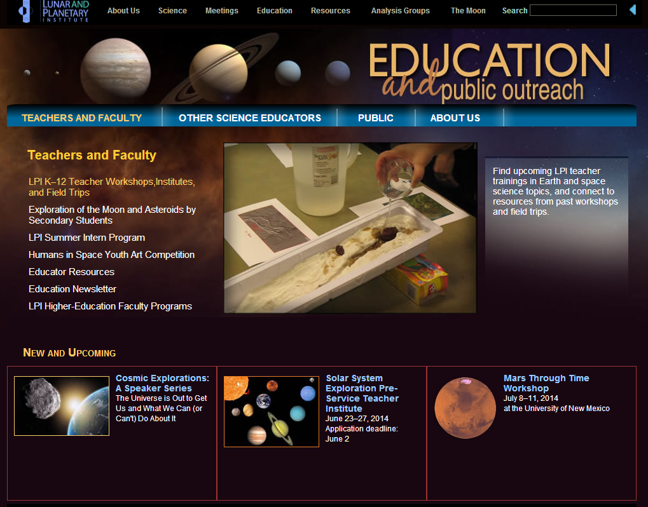
Lunar and Planetary Institute

Slide 14
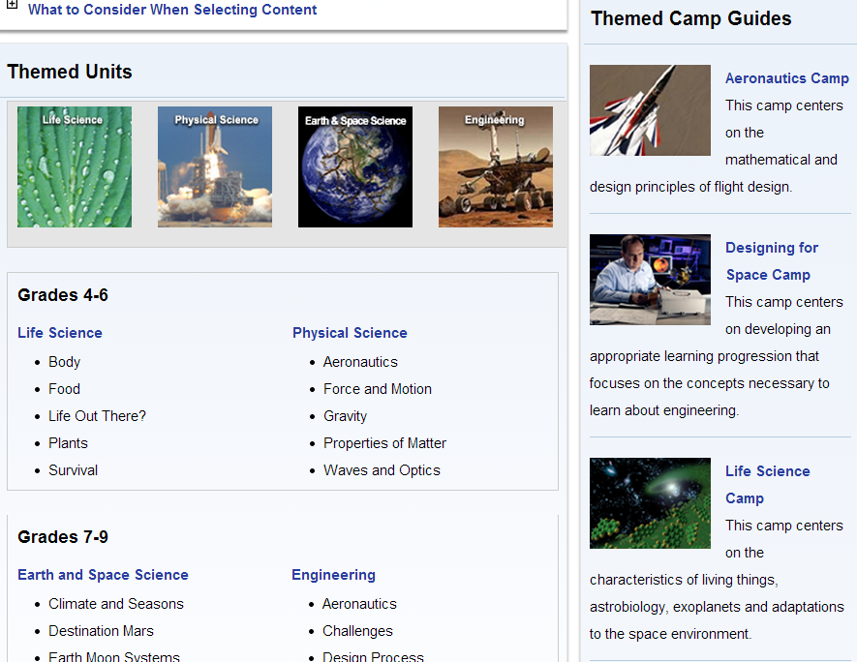
NASA Summer of Innovation

Slide 15
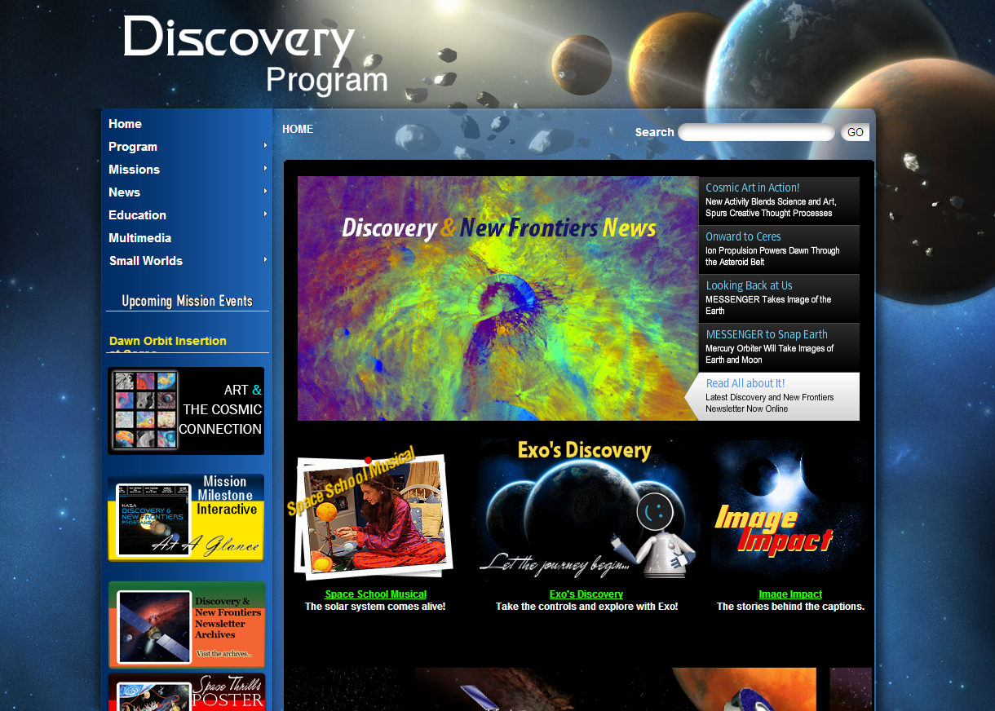
NASA Discovery Program

Slide 16
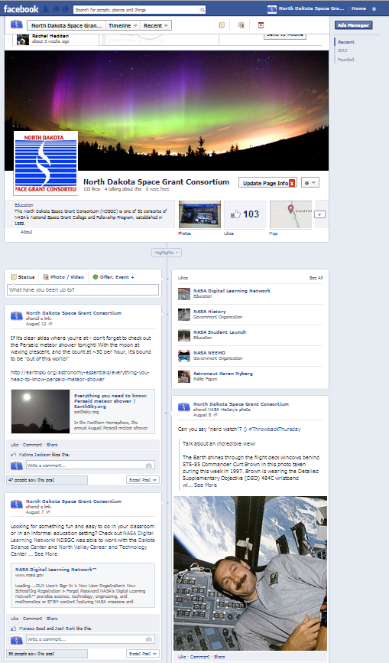
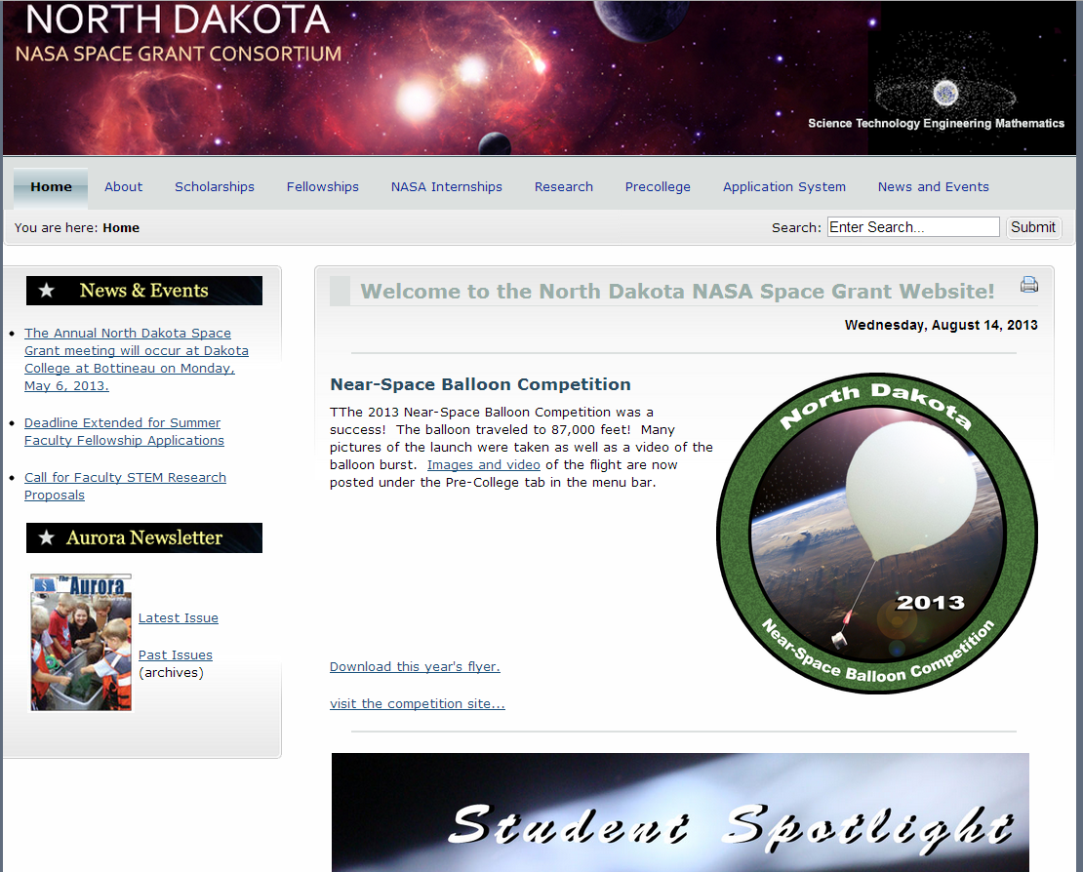
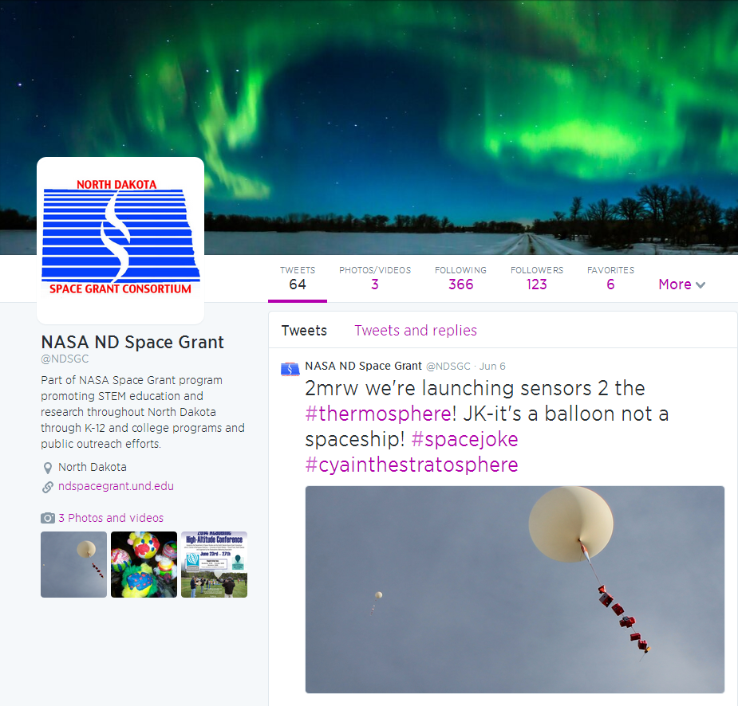
North Dakota Space Grant

Slide 17
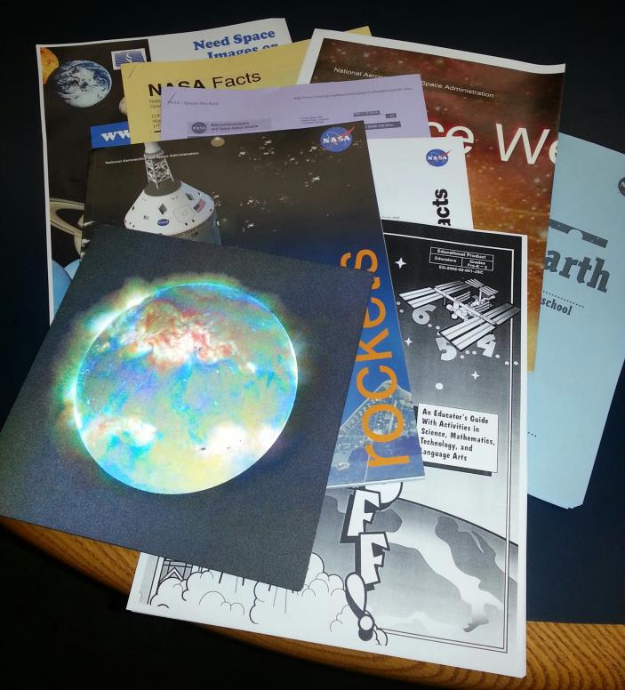
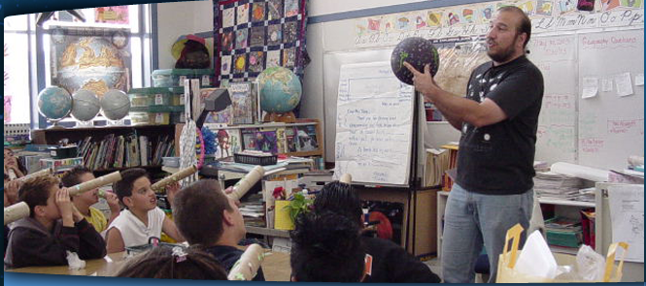
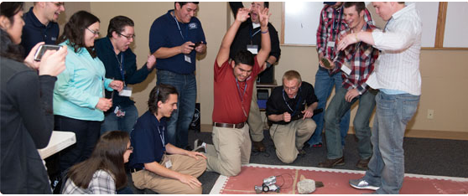
NDSGC K-12 Educator Email Listserv!
Workshop opportunities
New STEM education resources for the classroom
NASA student contests/team competitions
Professional Development opportunities
Emails ~once a week

Slide 18
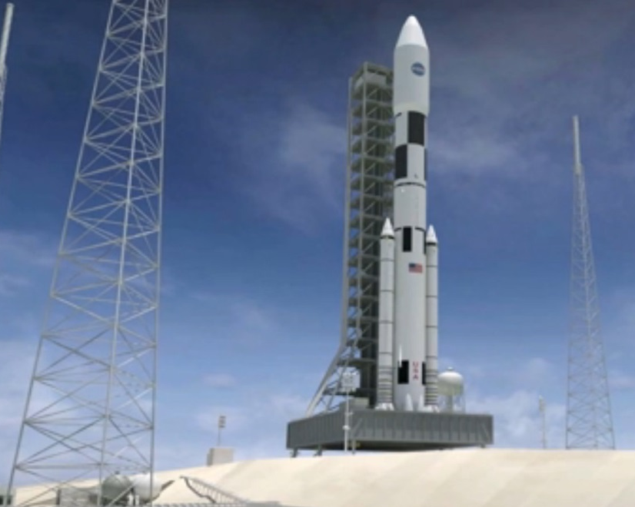
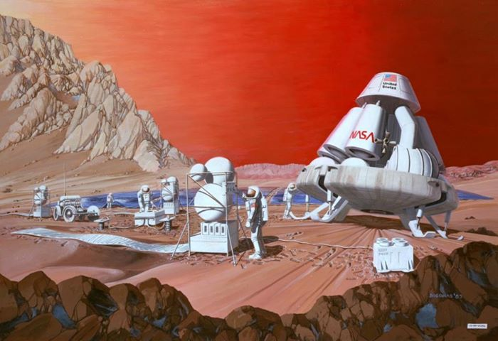
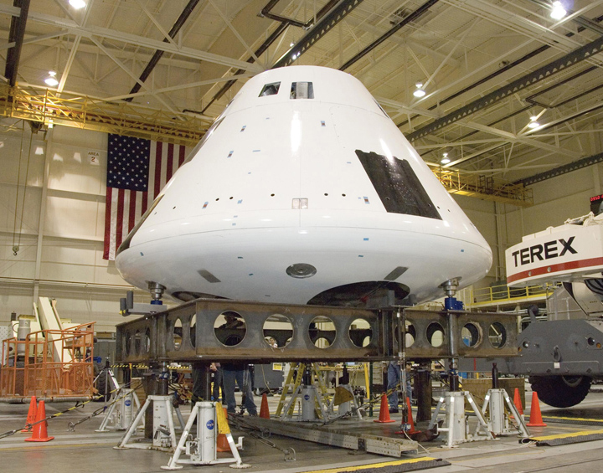
Future Space Exploration
Manned mission to an asteroid?
Return to Moon?
Manned mission to Mars?
NASA Space Launch System (SLS), Orion (Multi-purpose crew vehicle)

