Slide 1
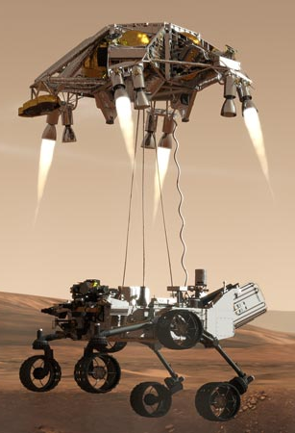
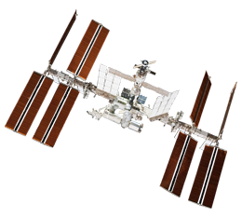
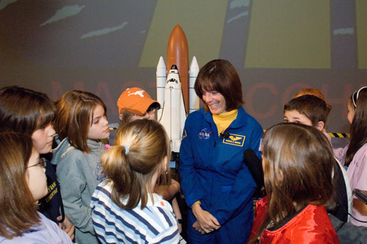
Educator Resources in Space Sciences
Caitlin Nolby and Marissa Saad
North Dakota Space Grant Consortium

Slide 2
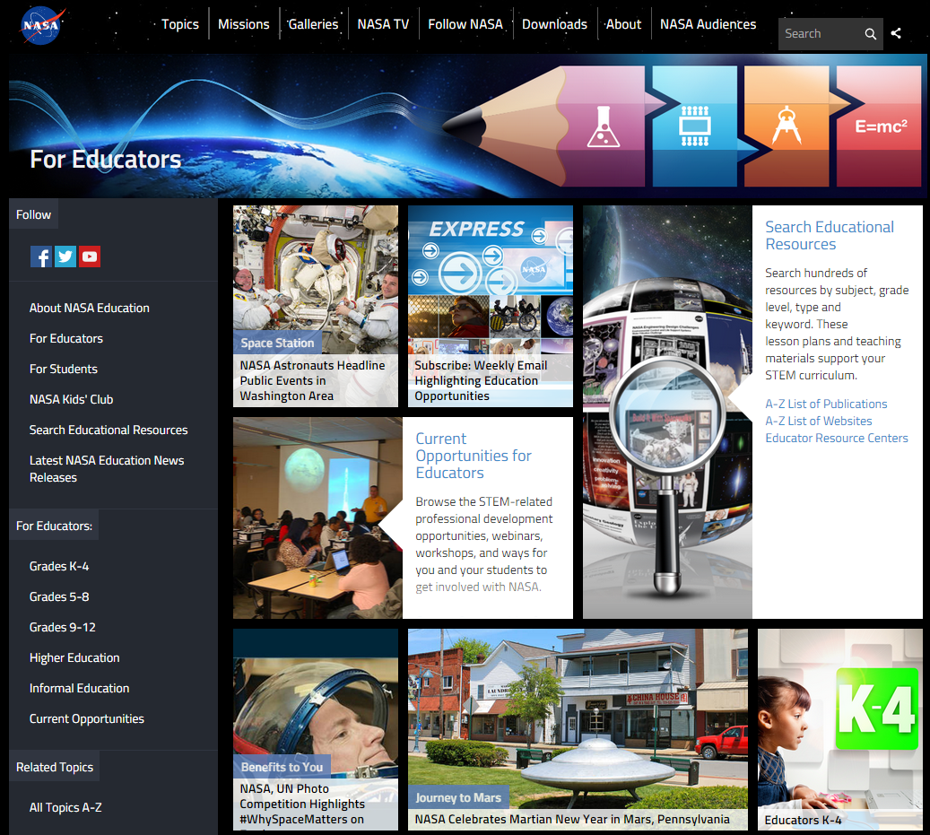
NASA Education

Slide 3
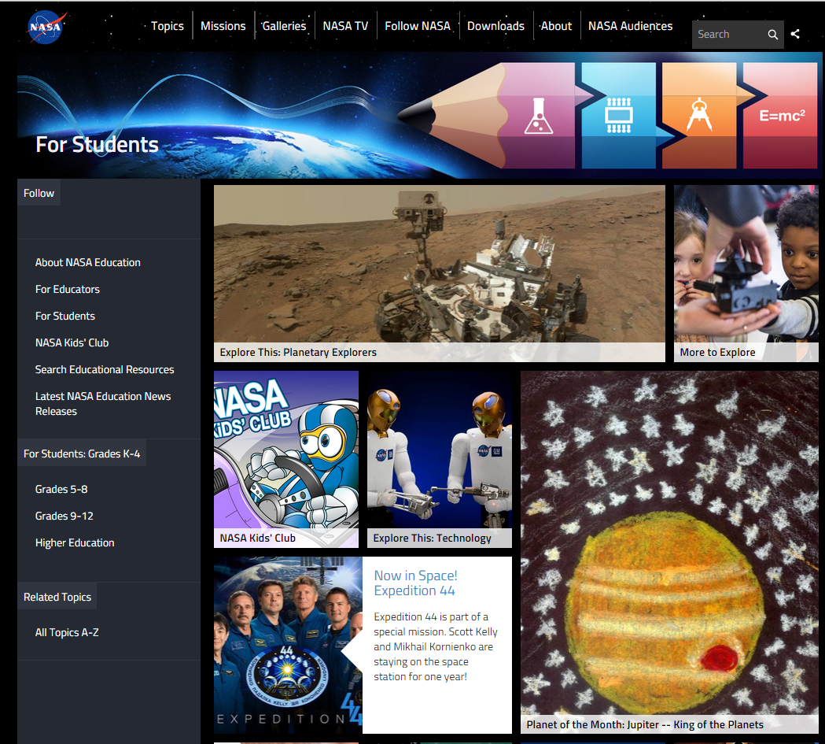
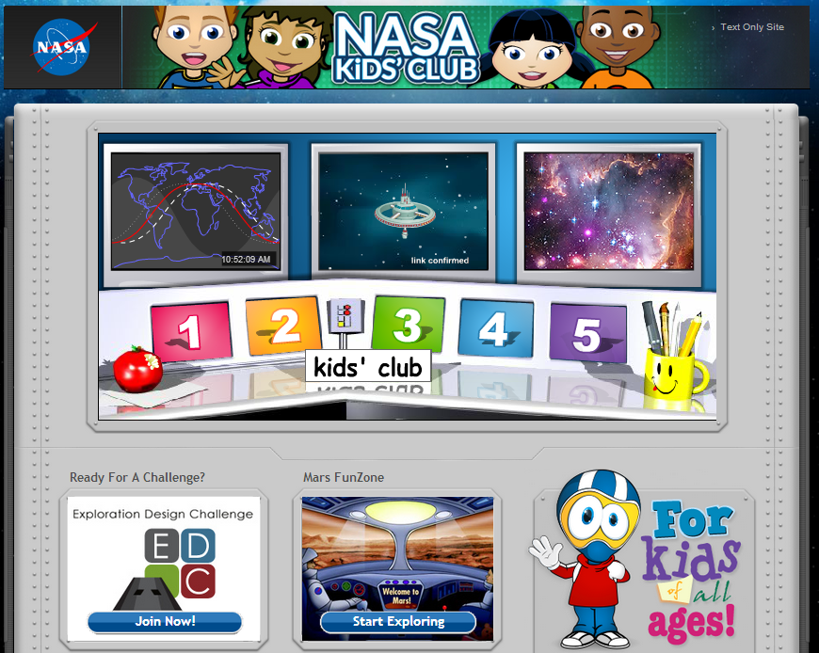
NASA for Students

Slide 4
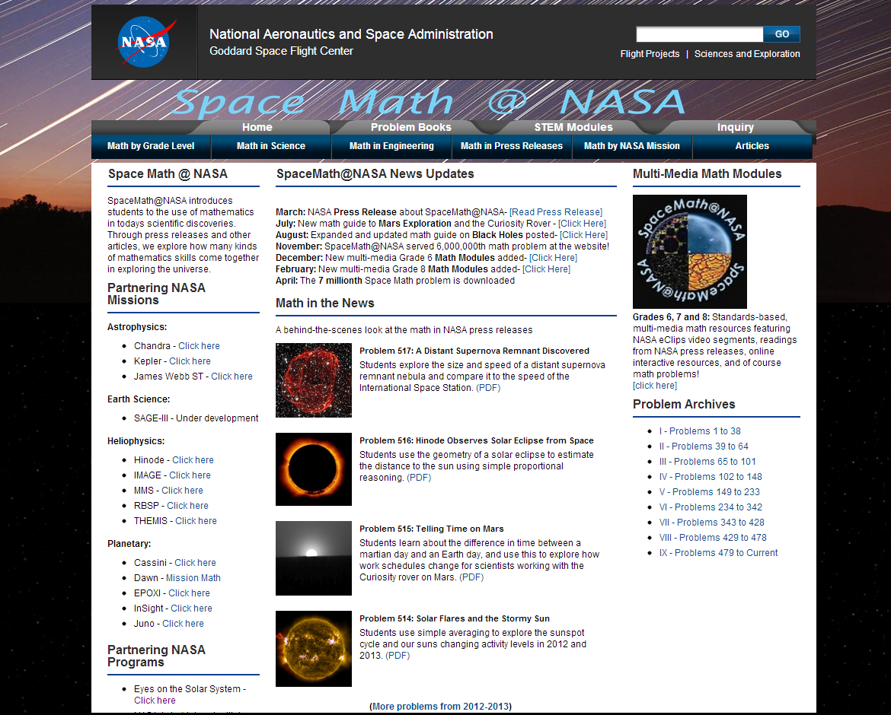
Space Math at NASA

Slide 5
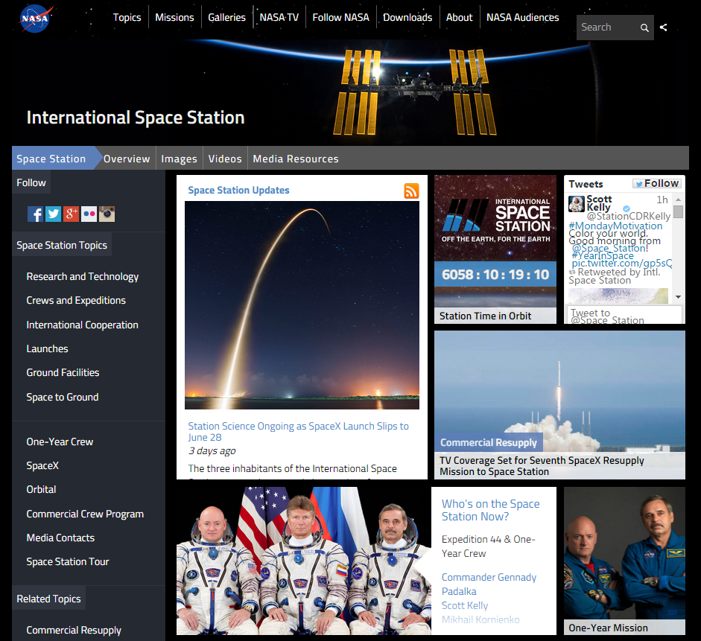
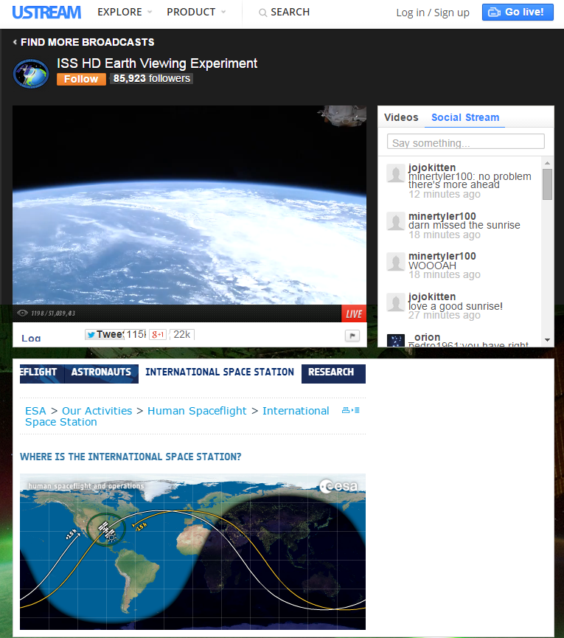
International Space Station - Live!

Slide 6
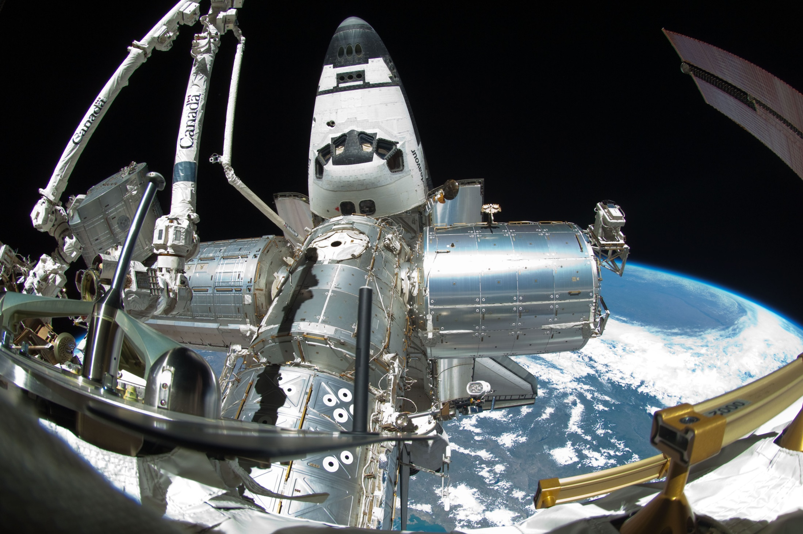
Spot the Station

Slide 7
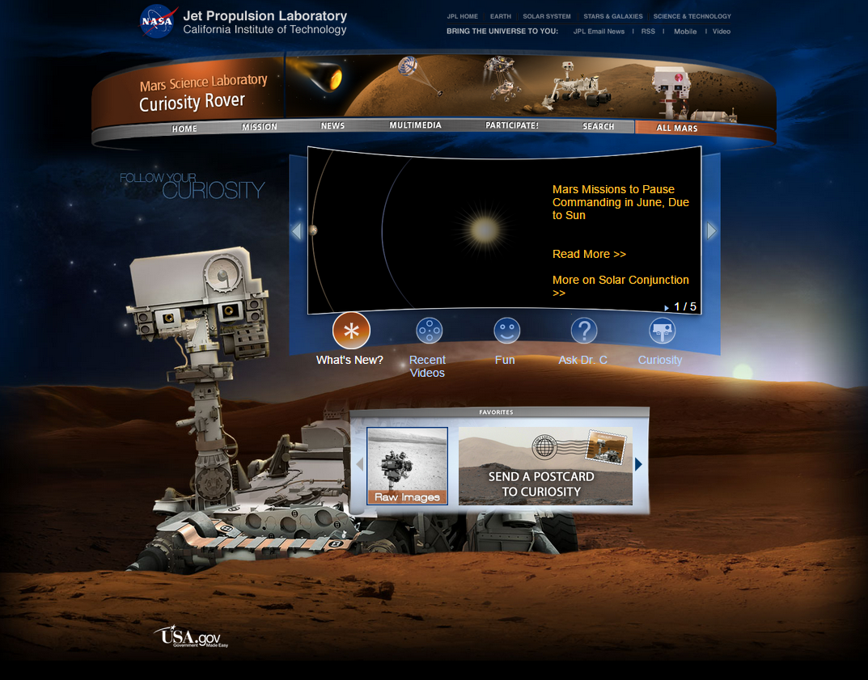
Mars Curiosity Rover

Slide 8
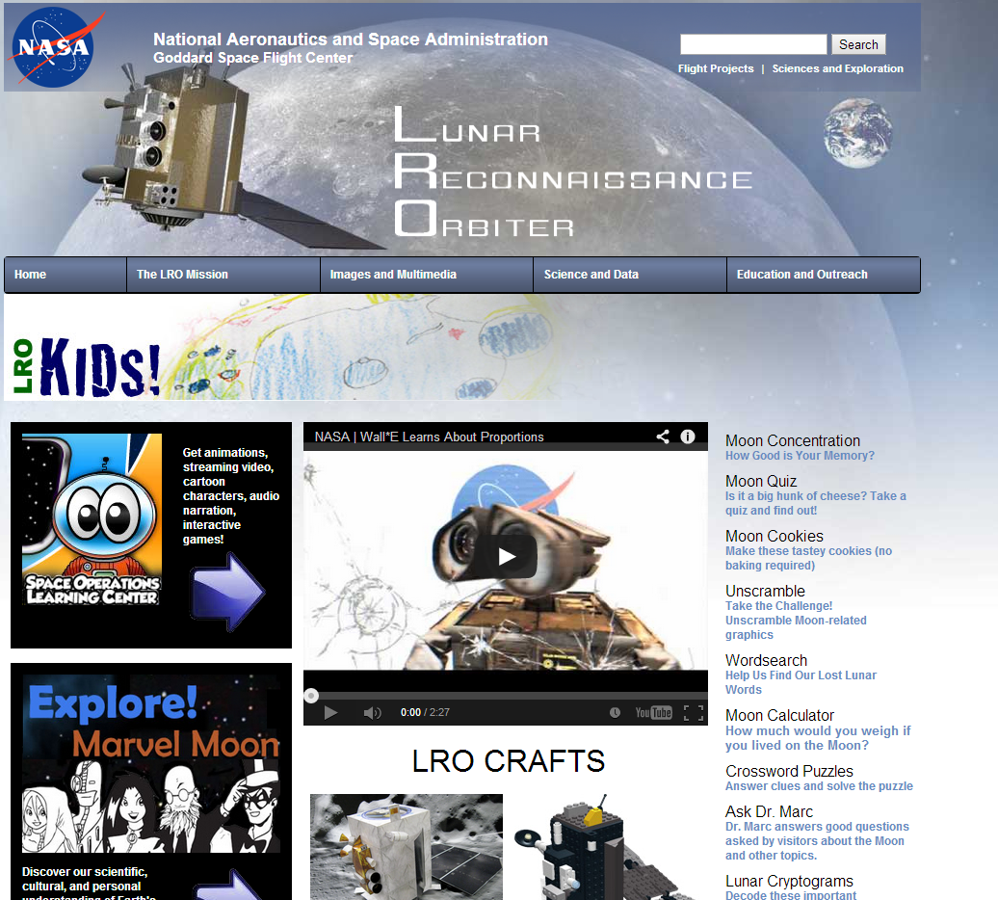
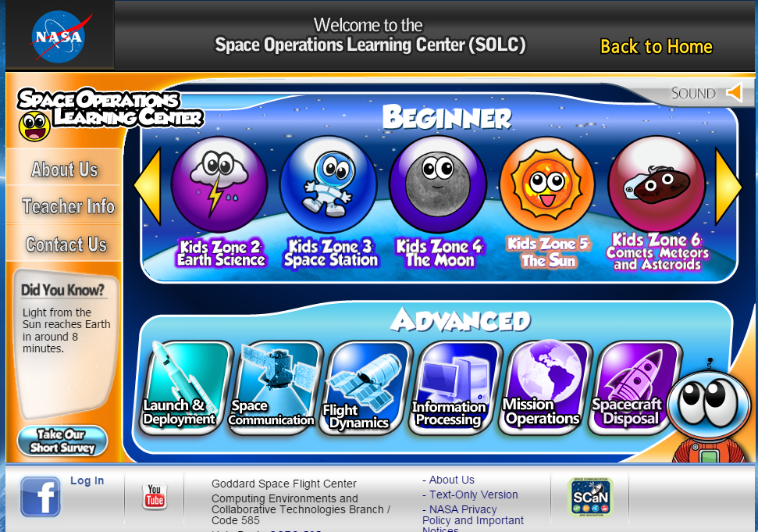
NASA – Lunar Reconnaissance Orbiter

Slide 9
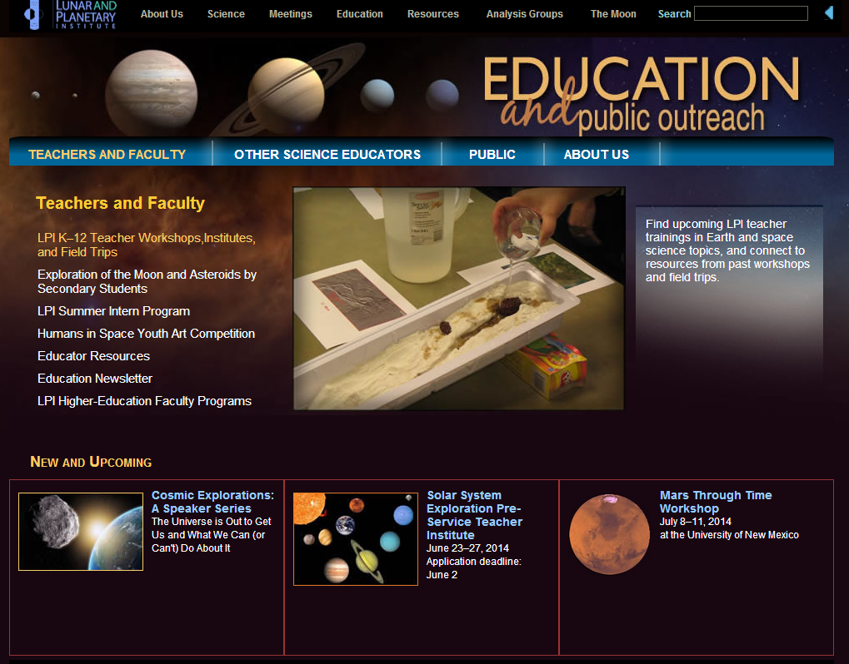
Lunar and Planetary Institute

Slide 10
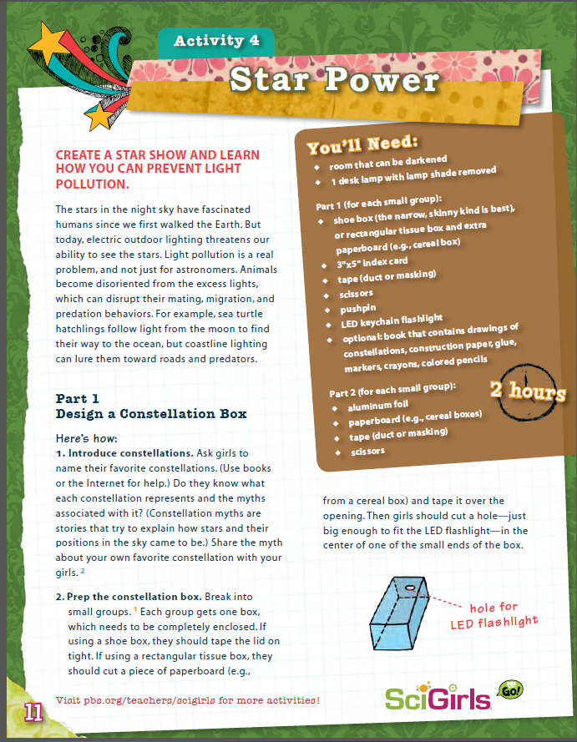
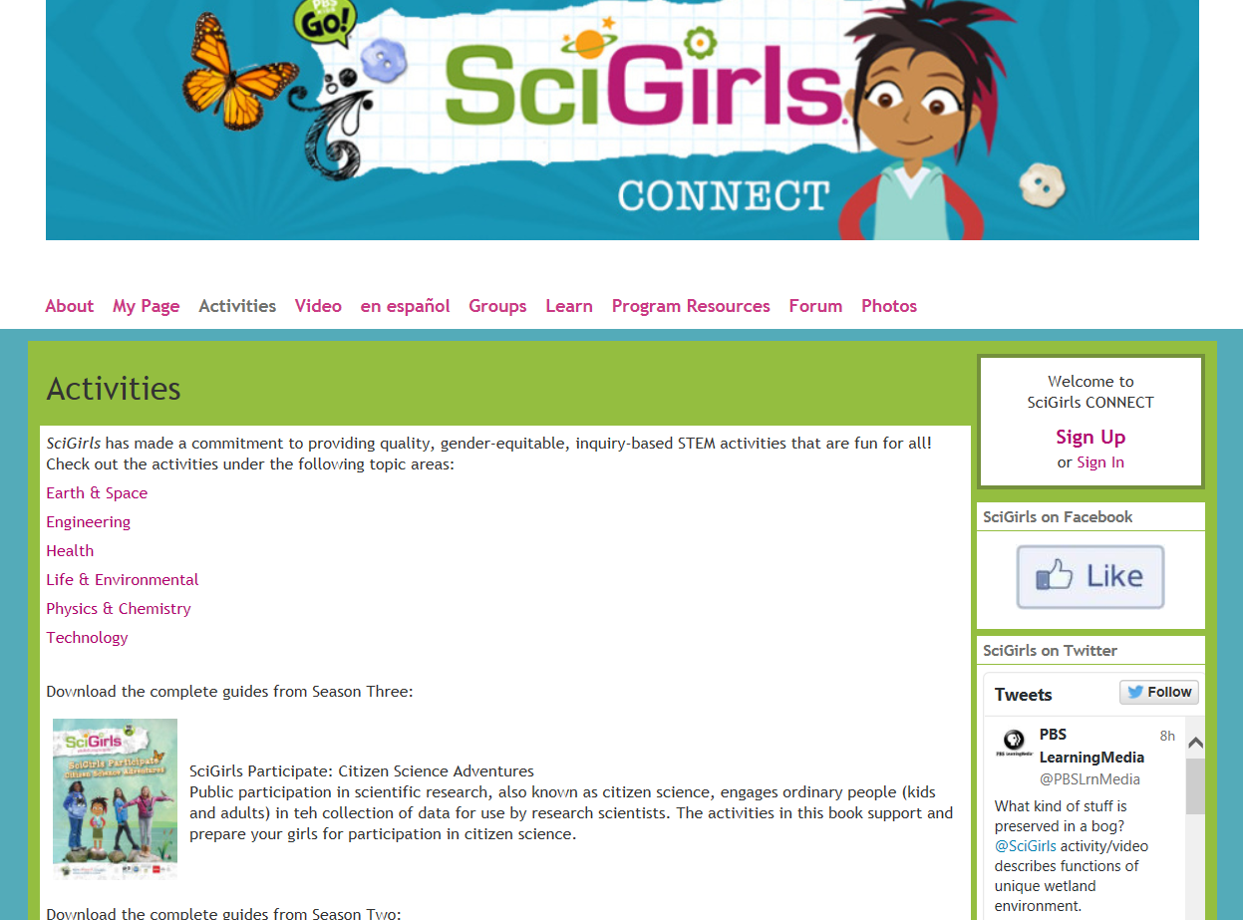
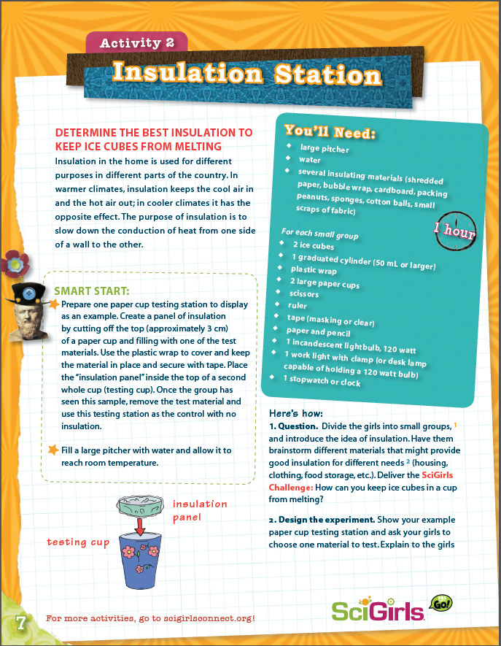
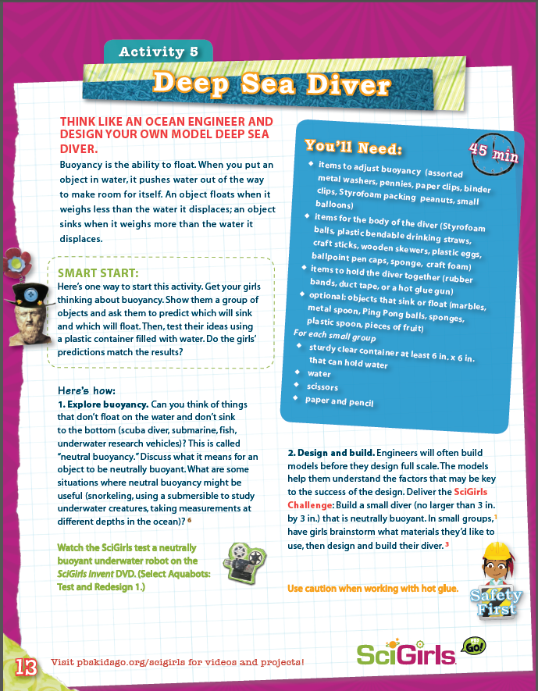
SciGirls Activities

Slide 11
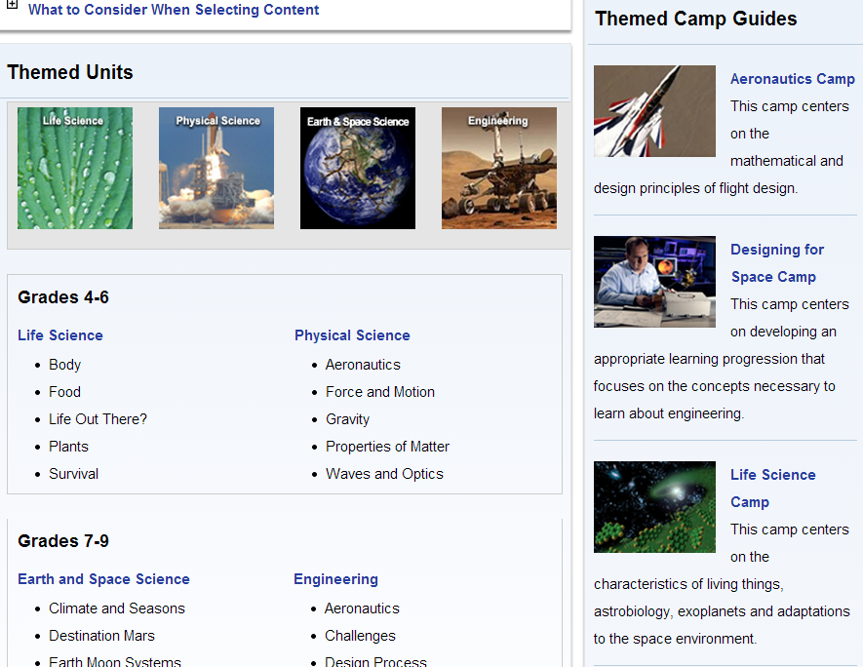
NASA Summer of Innovation

Slide 12
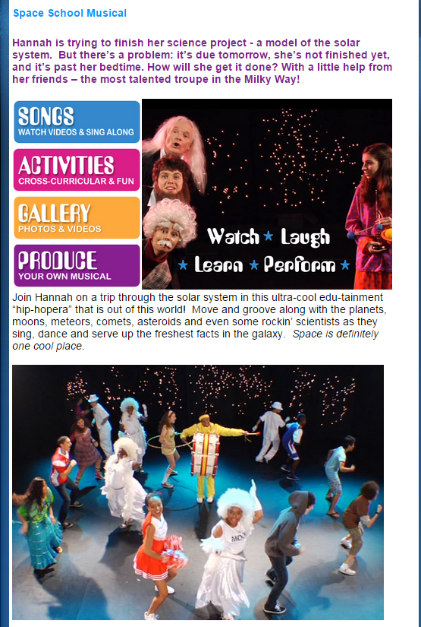
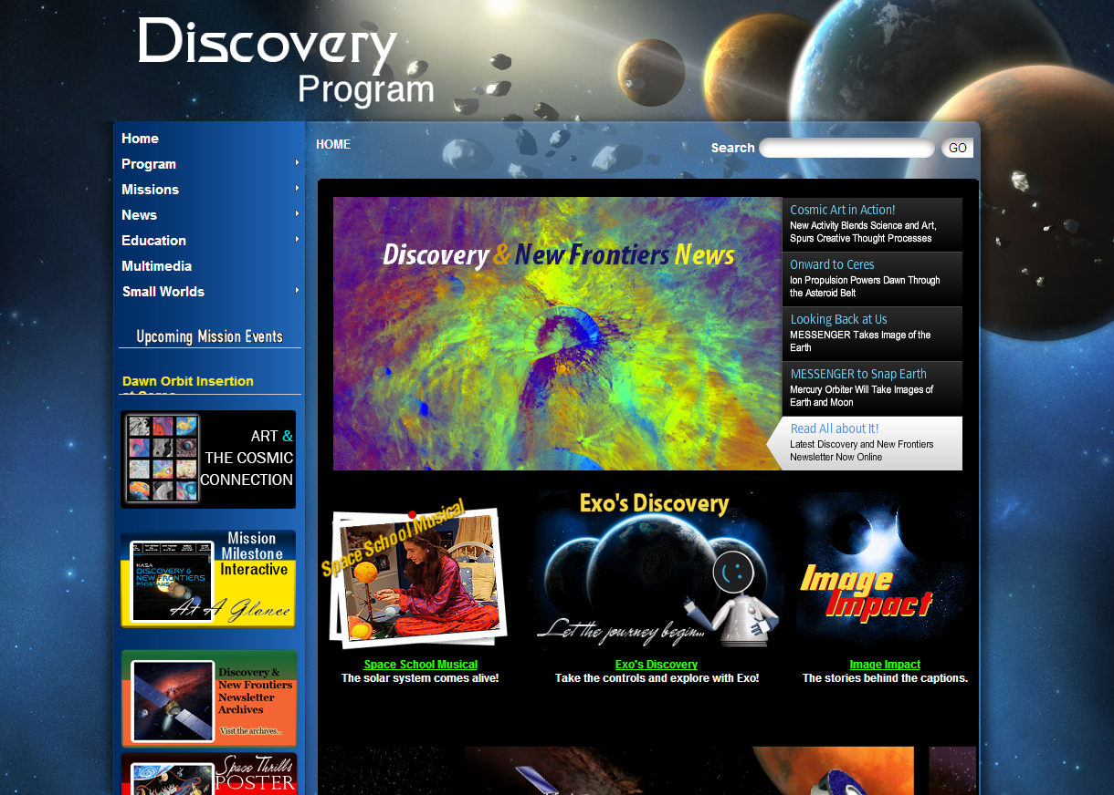
NASA Discovery Program

Slide 13
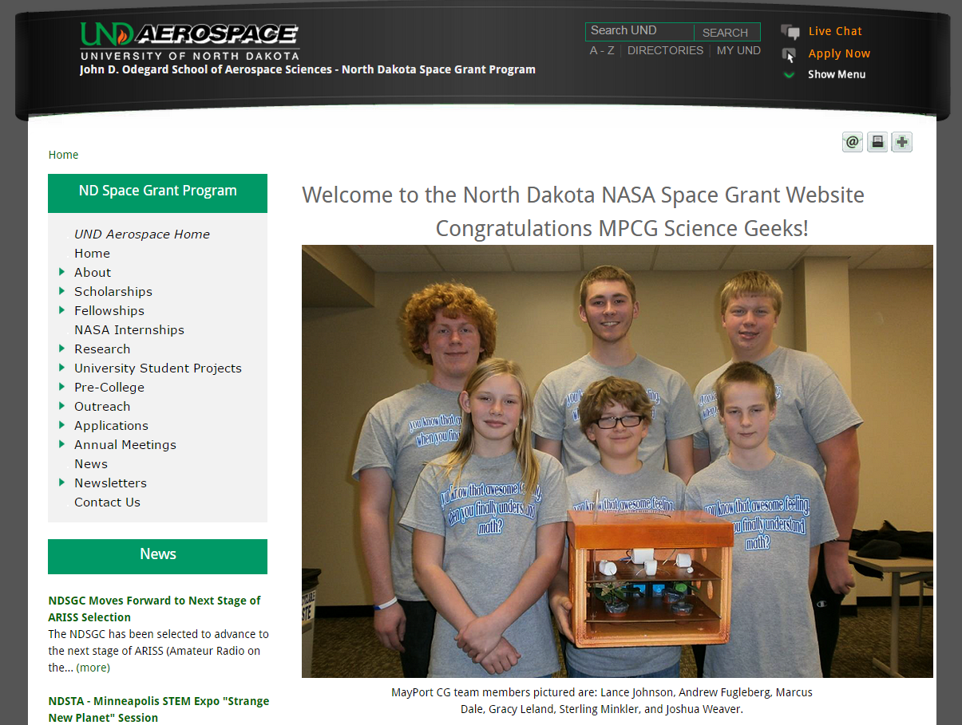
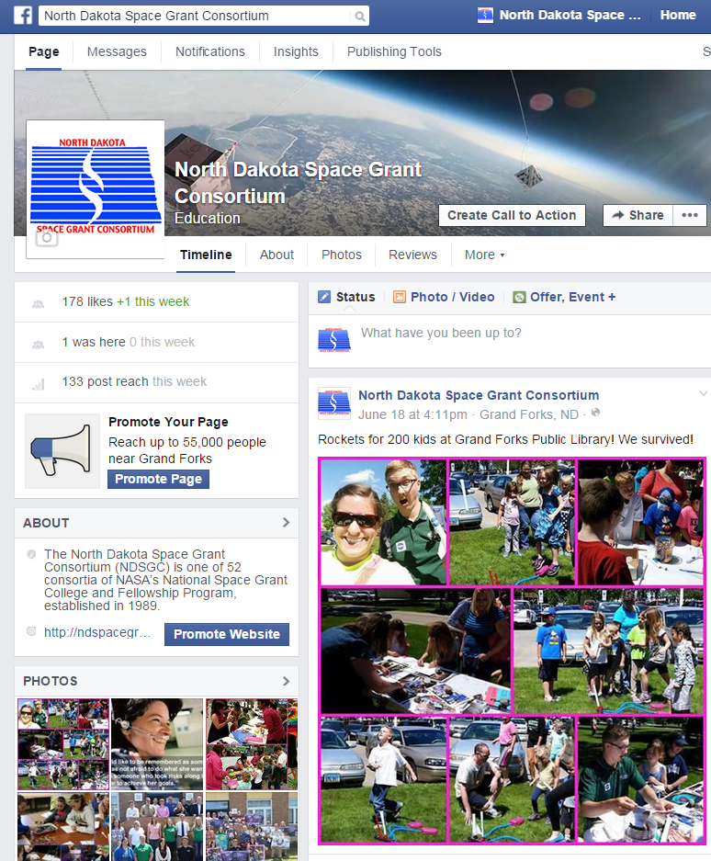
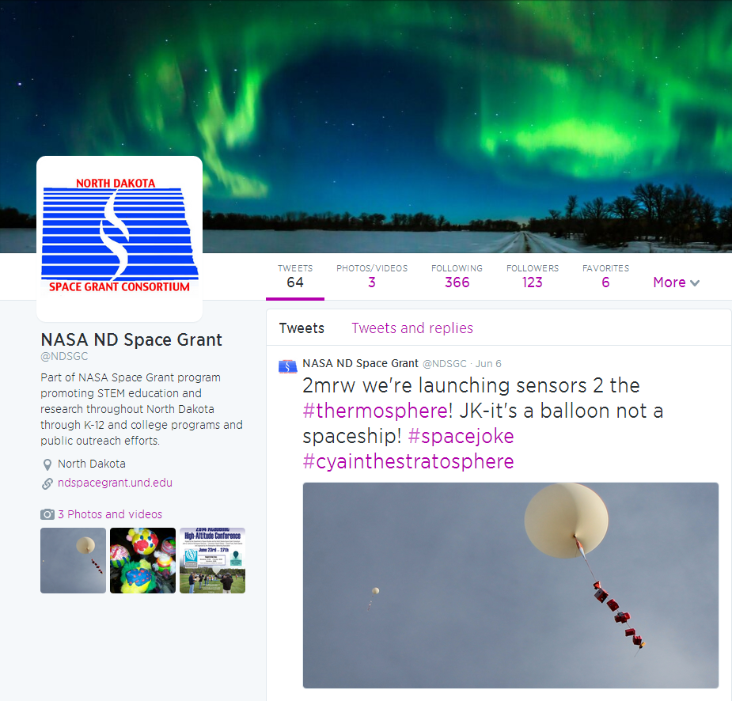
North Dakota Space Grant

Slide 14
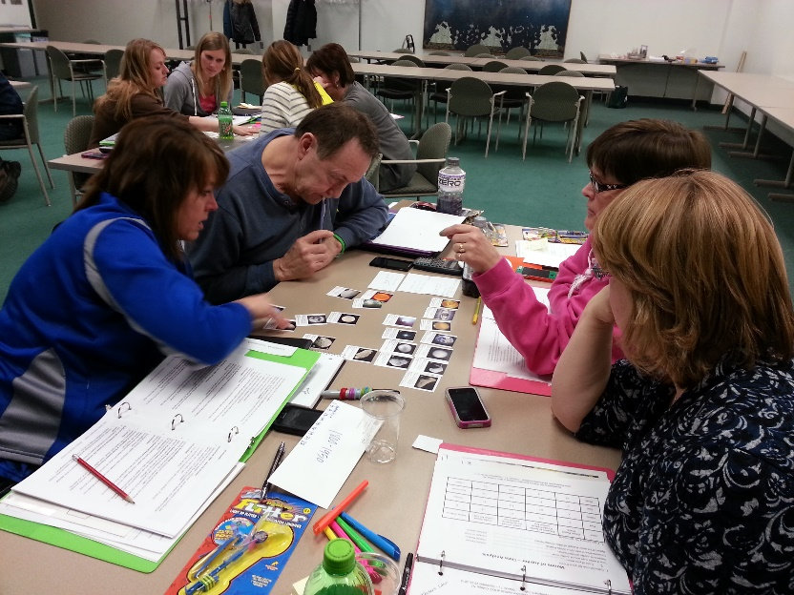
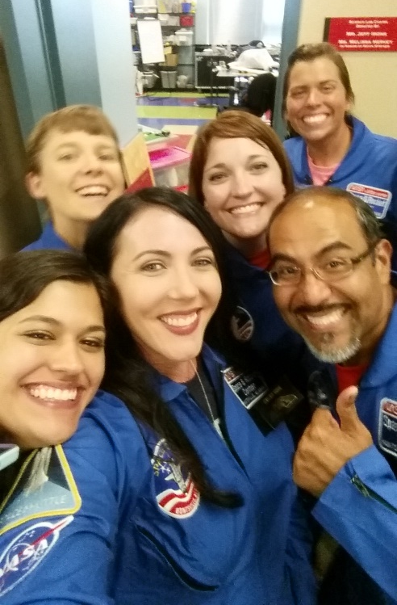
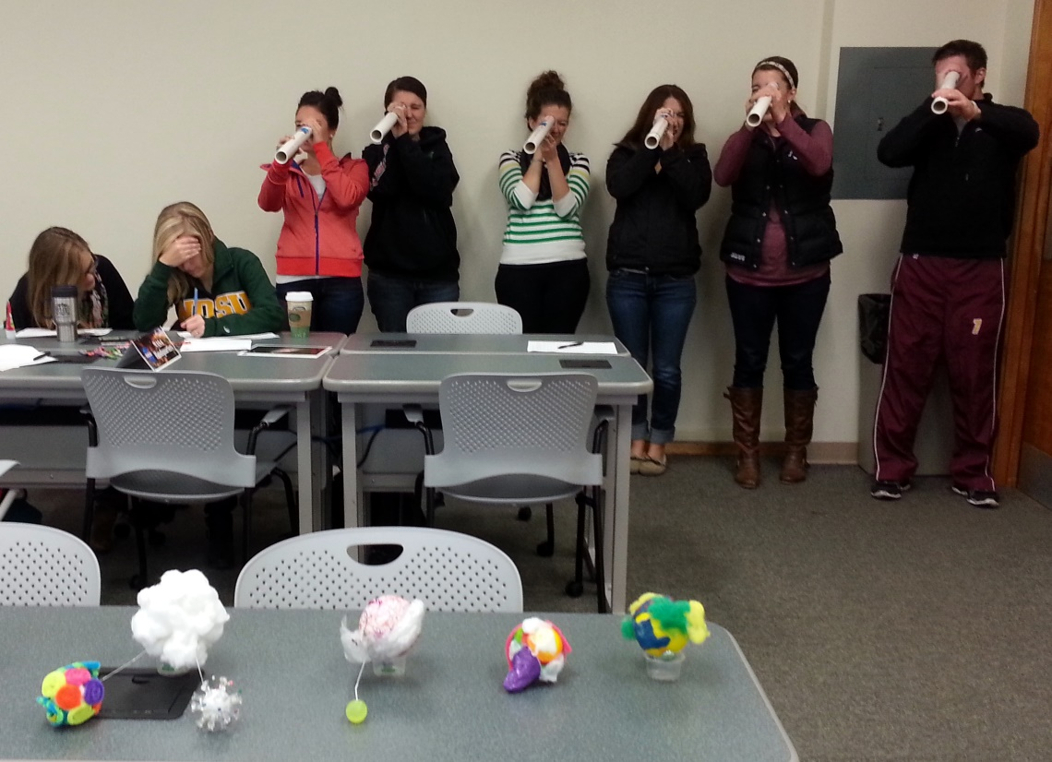
NDSGC K-12 Educator Email Listserv
Workshop opportunities
New STEM education resources for the classroom
NASA student contests/team competitions
Professional Development opportunities
Emails ~once a week

Slide 16
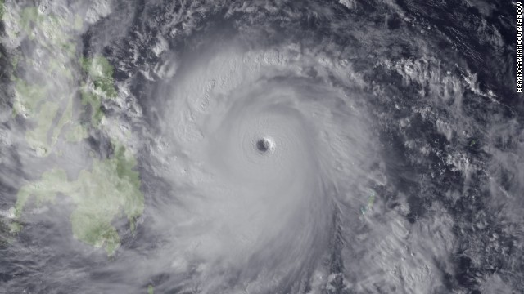
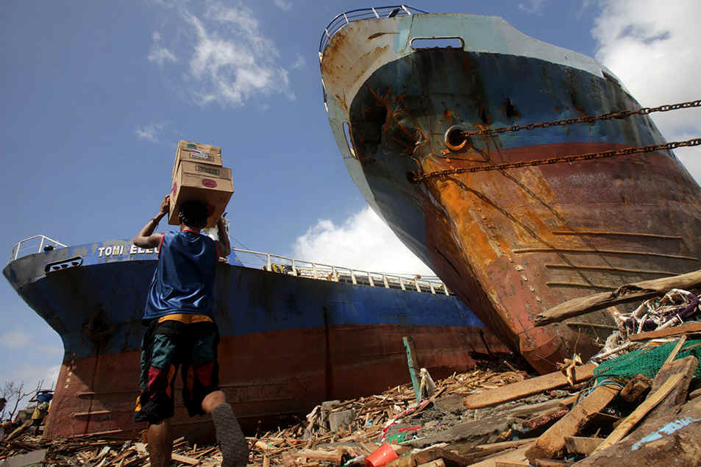
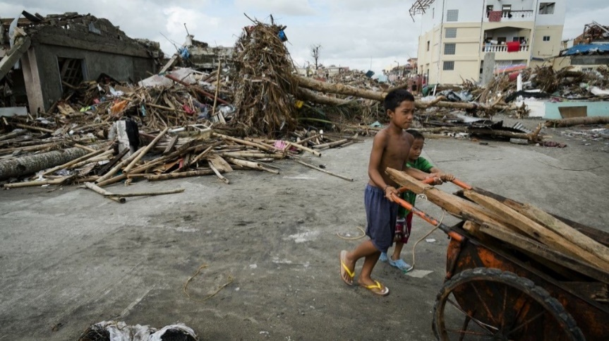
People need your help!
Philippines
2013 Typhoon Haiyan
Bridges are gone, harbors are destroyed, roads
have disappeared. Communication is gone.

Slide 17
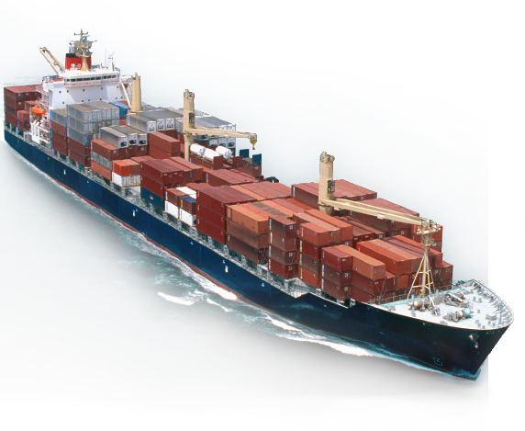
Ships are on the way but will not arrive for several
more days.
Airplanes and helicopters cannot land because the
runways are destroyed
Its up to you!

Slide 18
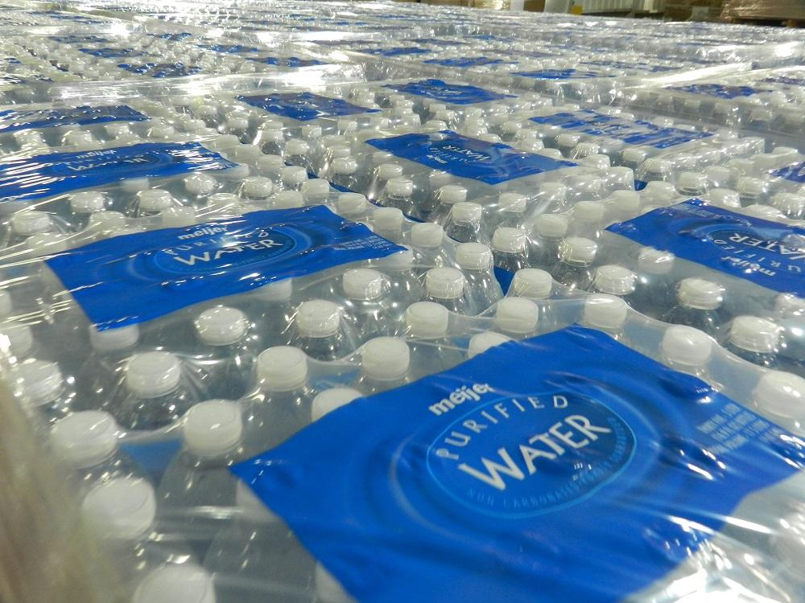
What do the citizens need?

Slide 19
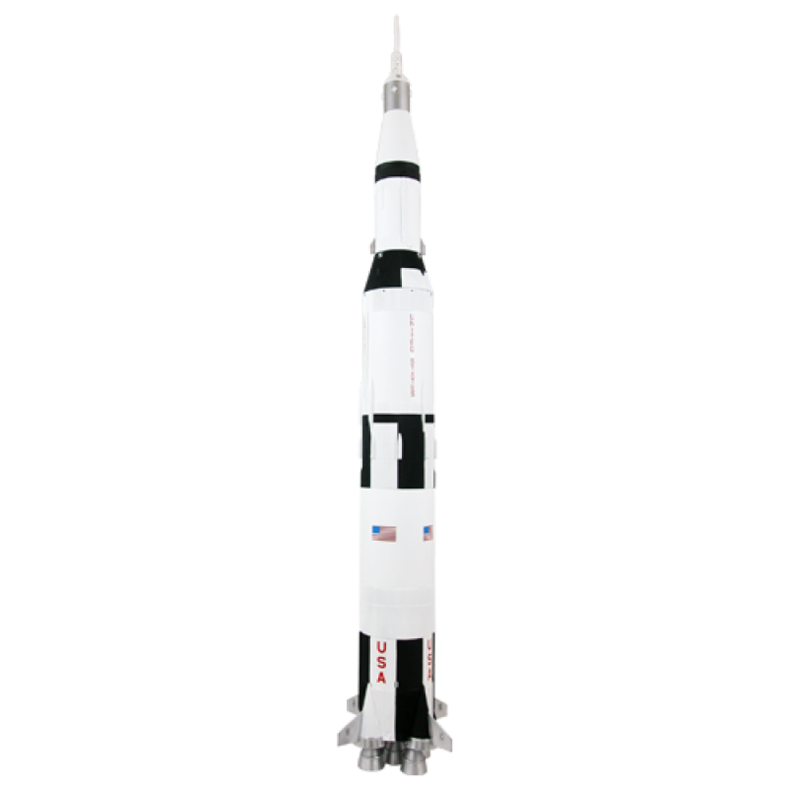
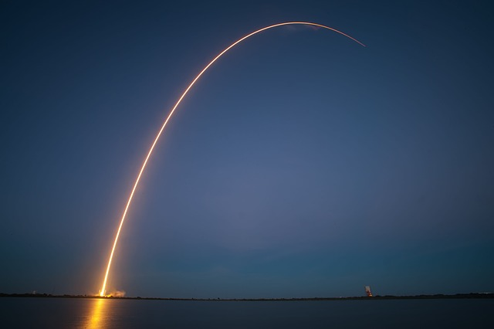
Your Task!
In your groups, chose a NASA center!
Design your own rockets and supplies to save the civilians.
Think about:
What shapes are the most sleek and aerodynamic?
How will gravity affect your design?
How are you going to protect your payload?

Slide 20
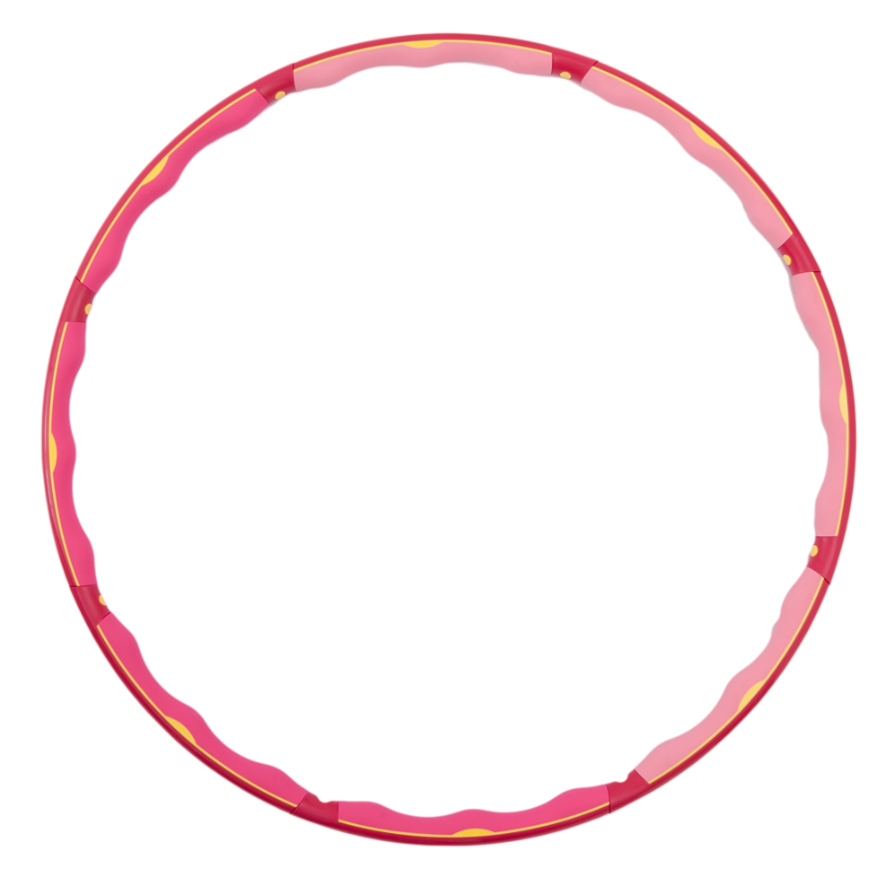
Blast your rockets to the island!
Help us!

Slide 22
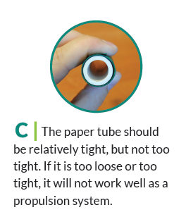
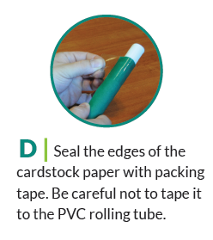

Slide 23
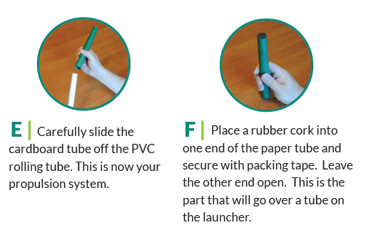

Slide 24
Good Luck!
Help us!

Slide 25
Discussion
Alter the difficulty level
Elementary school students prefer their own rockets
Significance? Why are we doing this?

