Slide 1
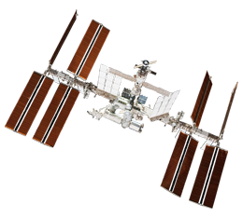
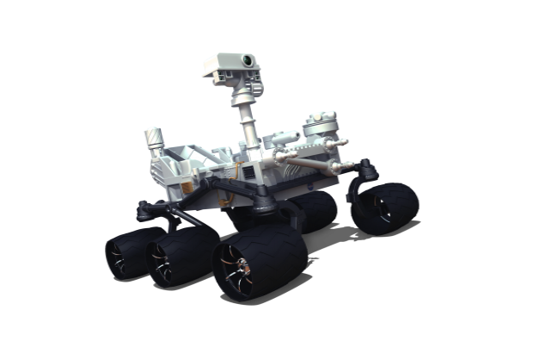
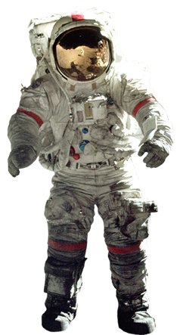
Mission to Mars and NASA Educator Resources
Caitlin Nolby and Marissa Saad
North Dakota Space Grant Consortium

Slide 2
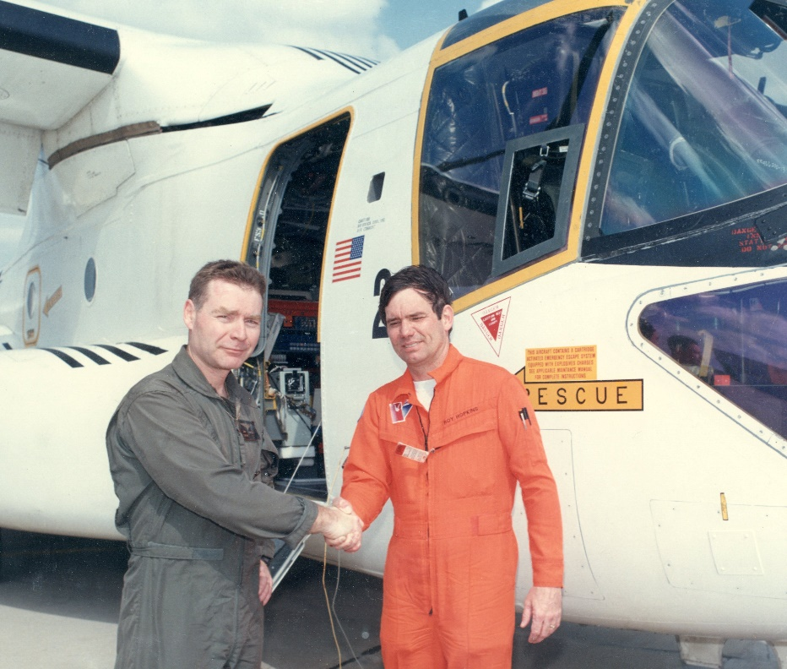
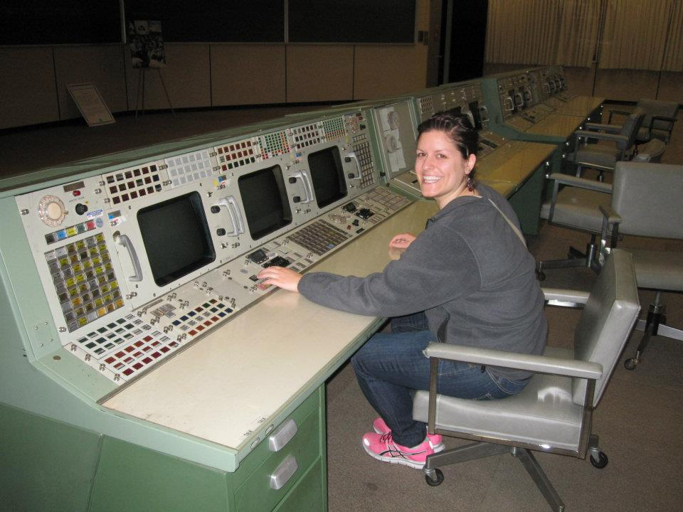
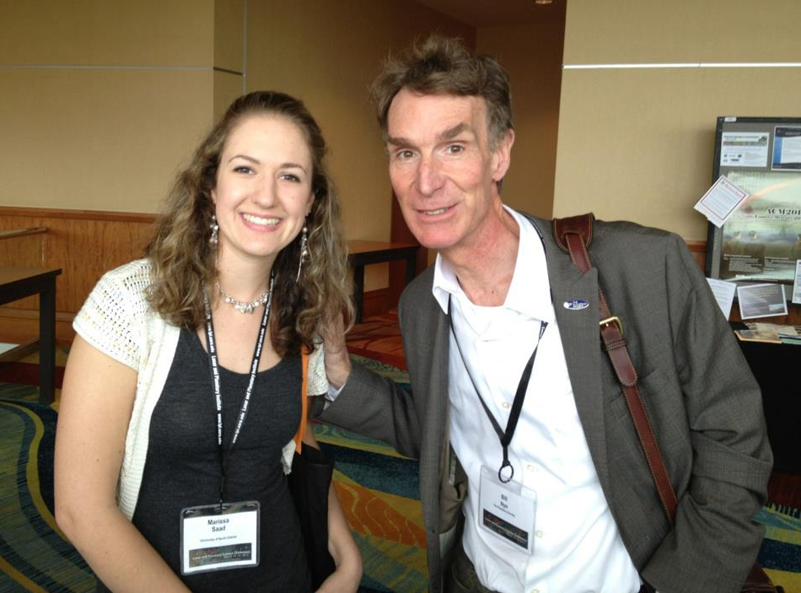
Meet the Space Grant Team!
Director of Space Grant, Jim Casler
Deputy Director, Caitlin Nolby
Coordinator, Marissa Saad

Slide 3
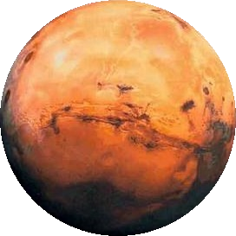
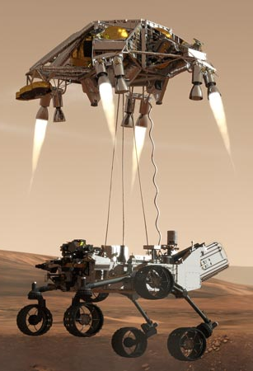
Workshop goals
You will be able to:
Confidently conduct today’s activities in the classroom.
Better understand concepts regarding space sciences.
Effectively communicate in teams to successfully complete a mission to Mars.
Save Mark Watney!
Create a neutrally buoyant object to be used by astronauts in the NBL.
Understand how YOU can get involved with NASA in ND!

Slide 4
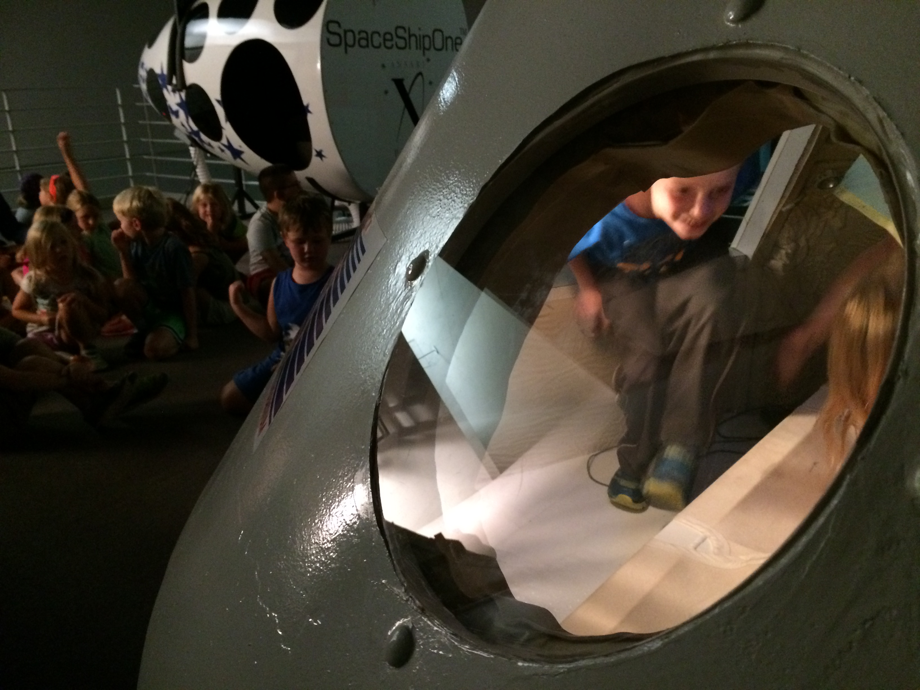
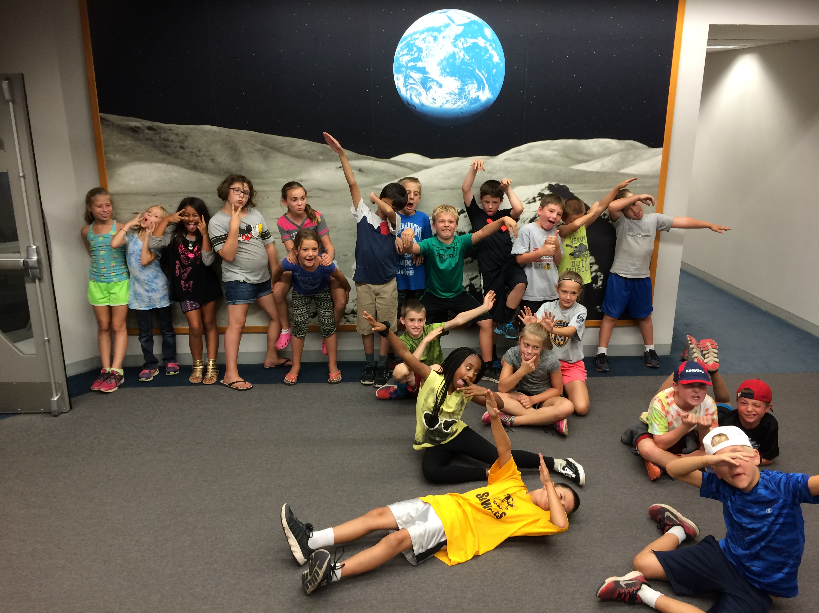
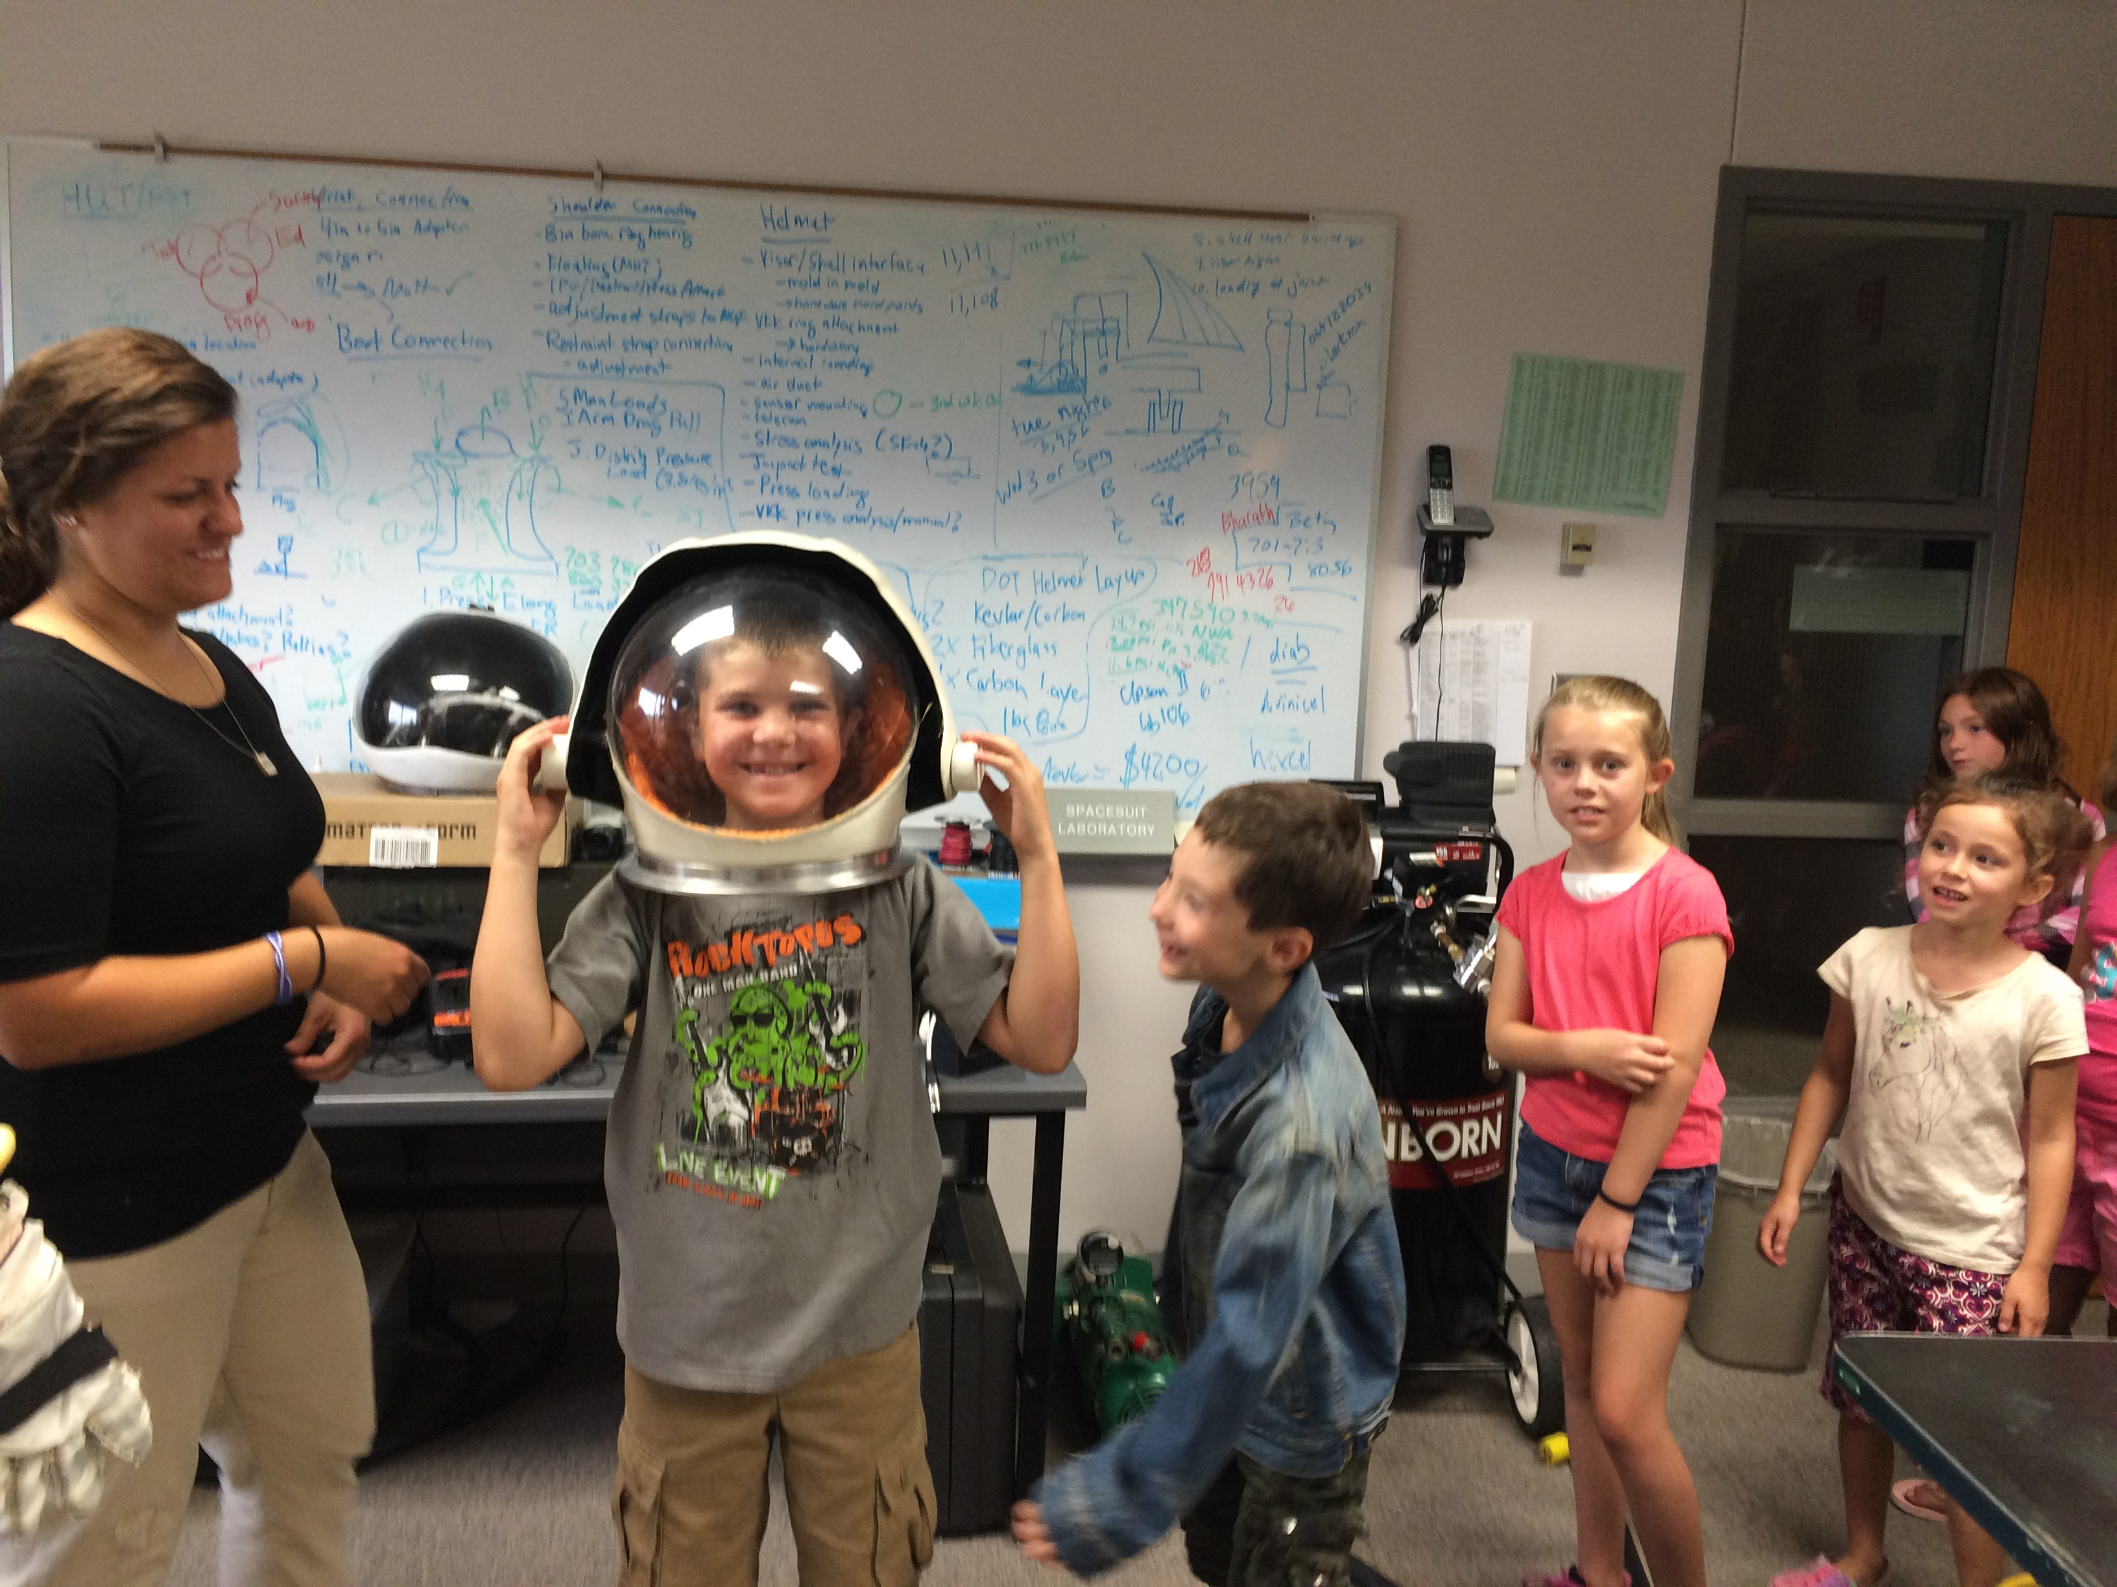
HSFL Tours for Kids (Afterwards)

Slide 5
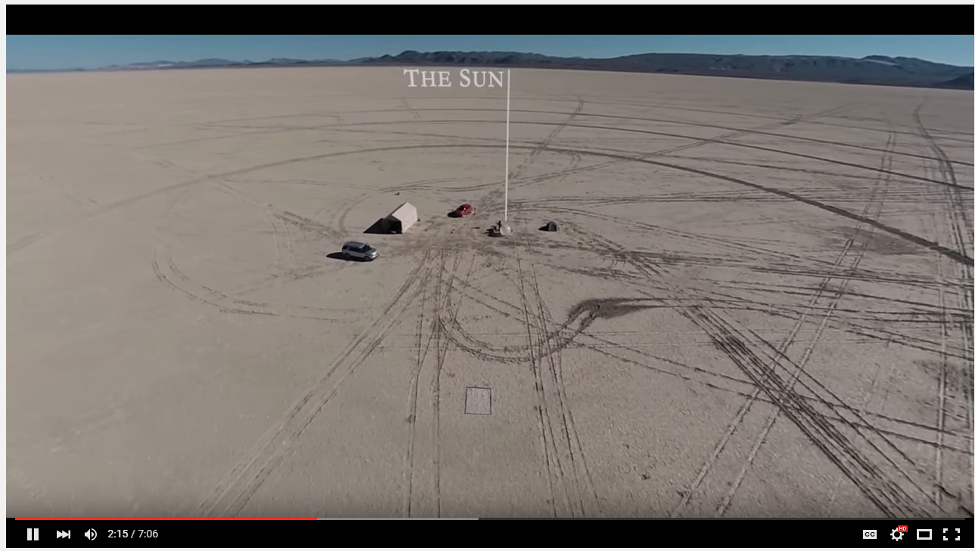
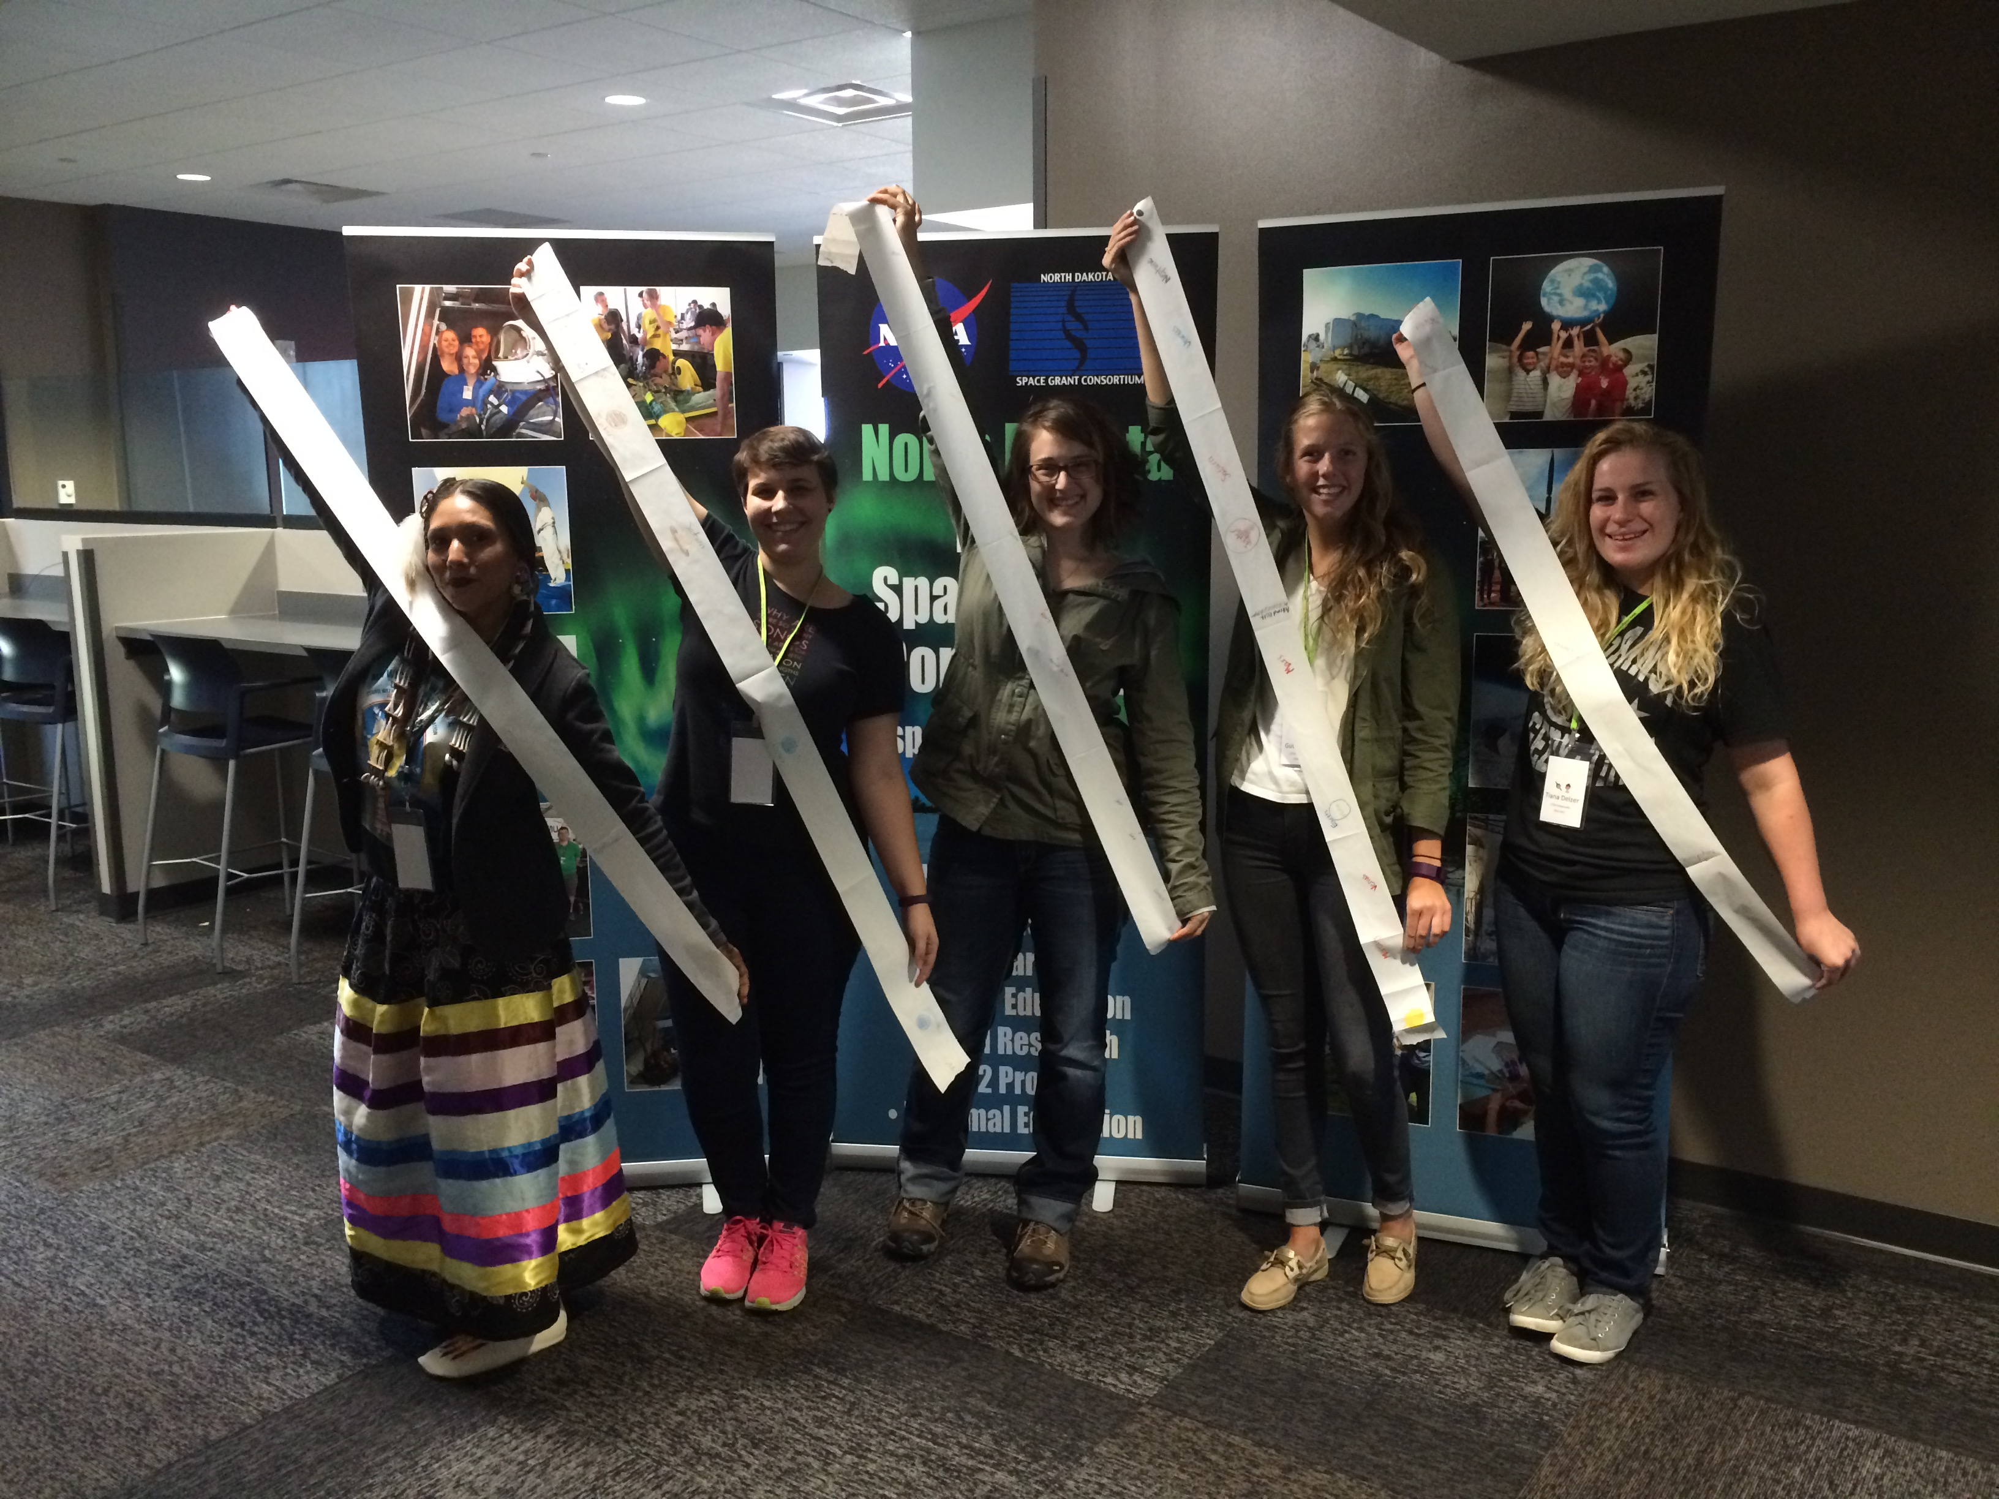
Pocket Solar System

Slide 6
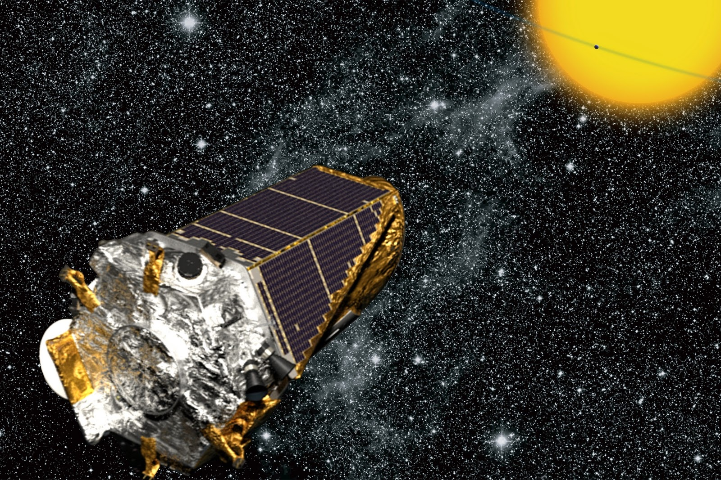
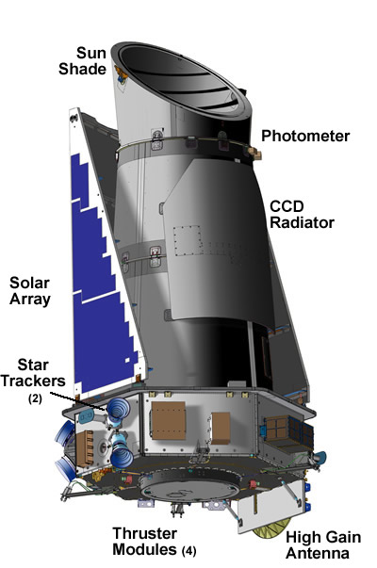
Strange New Planet
Work in NASA teams to collect data to plan missions and explore new worlds!
How Kepler Works
NASA Spacecrafts
Sort students by NASA Center
Assign student roles

Slide 7
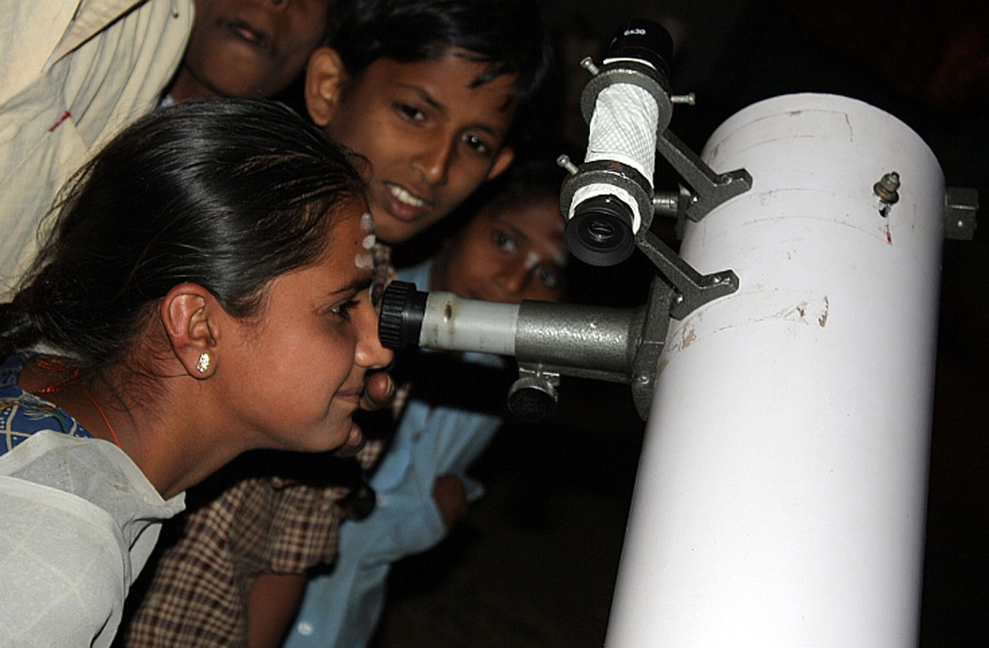
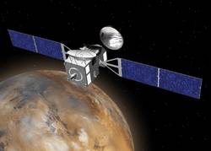
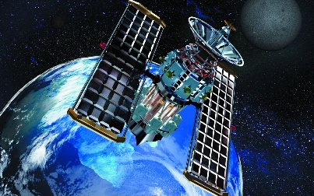
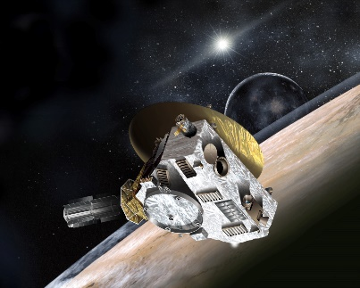
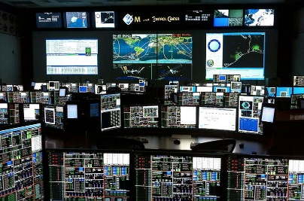
Your Role on the NASA Team
Astronomer
1
2
Orbiter
4
Flyby Spacecraft
Mission Control
3
5
Satellite

Slide 8
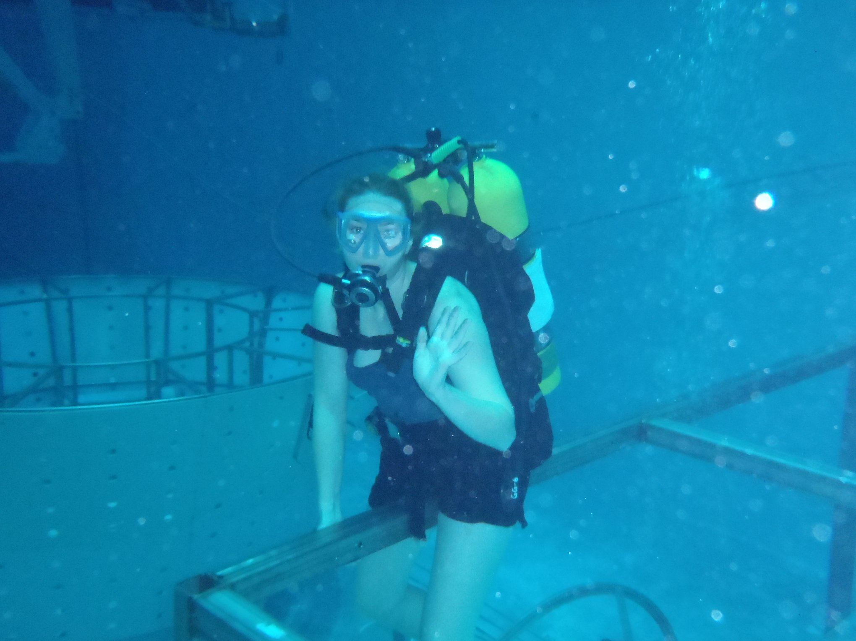
Deep Sea Diver
Eryn Beisner, a UND alumna

Slide 9
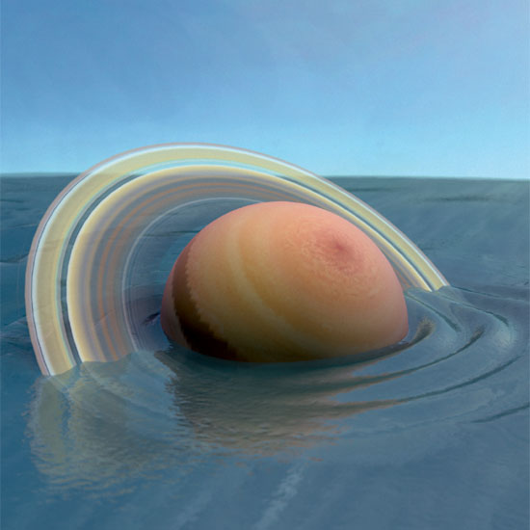
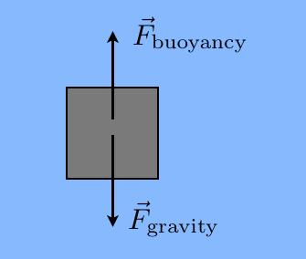
SCIGIRLS DEEP SEA DIVER
What does it mean to be neutrally buoyant?
Balancing act between forces
Densities are equal
Which planet would “float” in a giant pool of water?

Slide 10
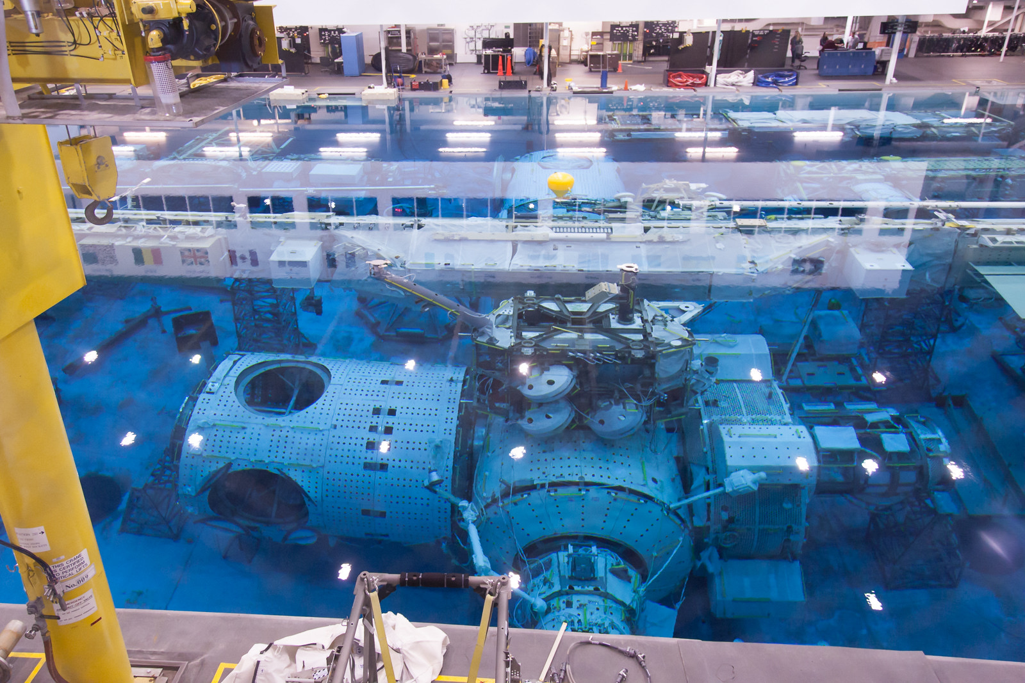

Slide 11
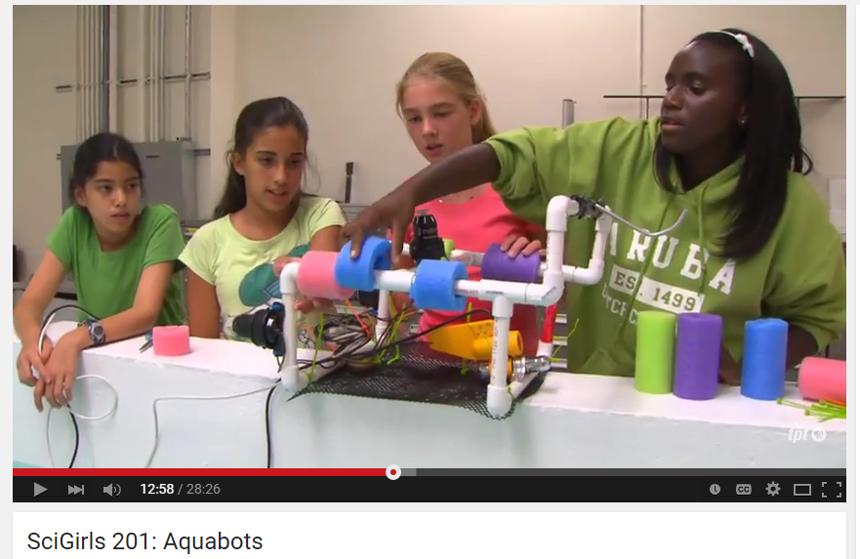
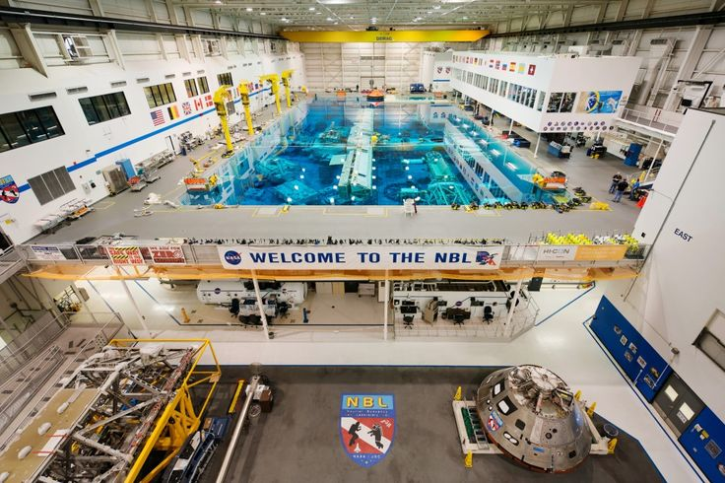
SCIGIRLS DEEP SEA DIVER
Season 2, episode 1: Aquabots
Challenge: NASA is currently preparing for long-duration spaceflight to Mars and needs to practice procedures in the NBL. They need to select a contractor to design and build neutrally buoyant tools for training.
Make predictions on given materials
Design your “deep sea diver”
Collaborative Design Review

Slide 12
materials budget
1 Mini Rubber Band | $50,000 |  | 1 Square Inch Sponge | $200,000
1 Regular/Large Rubber Band | $100,000 |  | 1 Mancala Piece | $100,000
3 inches of Duct Tape | $1,500,000 |  | 1 Small Styrofoam Ball | $200,000
3 inches of Masking Tape | $1,000,000 |  | 1 Medium Styrofoam Ball | $500,000
1 Paper Dixie Cup | $3,000,000 |  | 1 Large Styrofoam Ball | $1,000,000
1 Plastic Cup | $4,000,000 |  | 1 Pink Plastic Ball | $300,000
1 Plastic Lid | $2,000,000 |  | 1 Balloon | $1,000,000
1 Pipe Cleaner | $500,000 |  | 1 Mini Clothespin | $50,000
1 Foam Shape | $4,000,000 |  | 1 Small Binder Clip | $200,000
1 Straw | $500,000 |  | 1 Medium Binder Clip | $300,000
1 Popsicle Stick | $1,000,000 |  | 1 Large Binder Clip | $500,000
1 Mini Popsicle Stick | $500,000 |  | 1 Paperclip | $50,000
1 Plastic Spoon | $800,000 |  | 1 Washer | $50,000
12 inches of String | $600,000

Slide 13
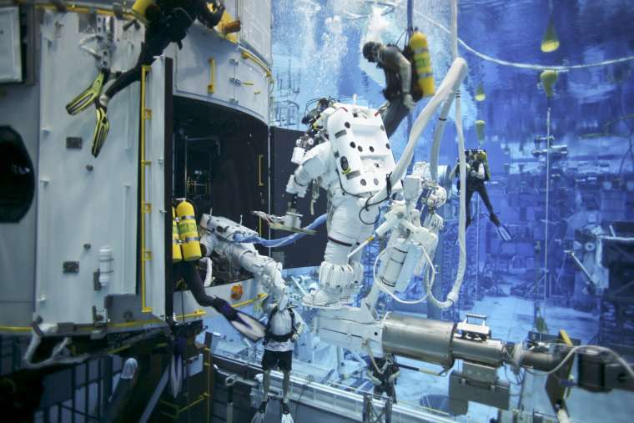
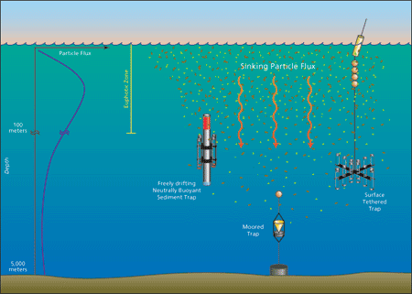
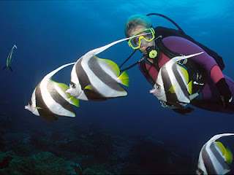
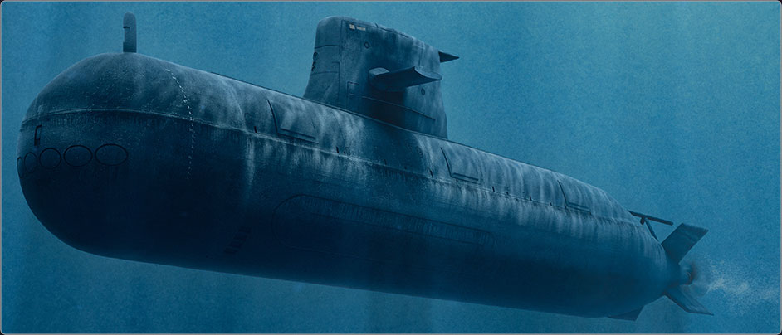
REFLECTION
What worked? Materials?
Other applications?
Scuba divers
Submarines
Fish
Science! –Taking ocean measurements

Slide 14
How can you get involved?
NASA Resources (K-12)
North Dakota funding and opportunities
STEM Ambassador Program
Future Professional Development as a ND teacher

Slide 15
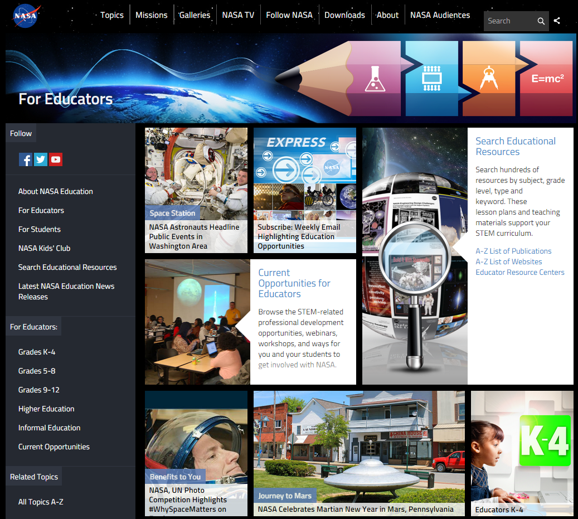
NASA Education

Slide 16
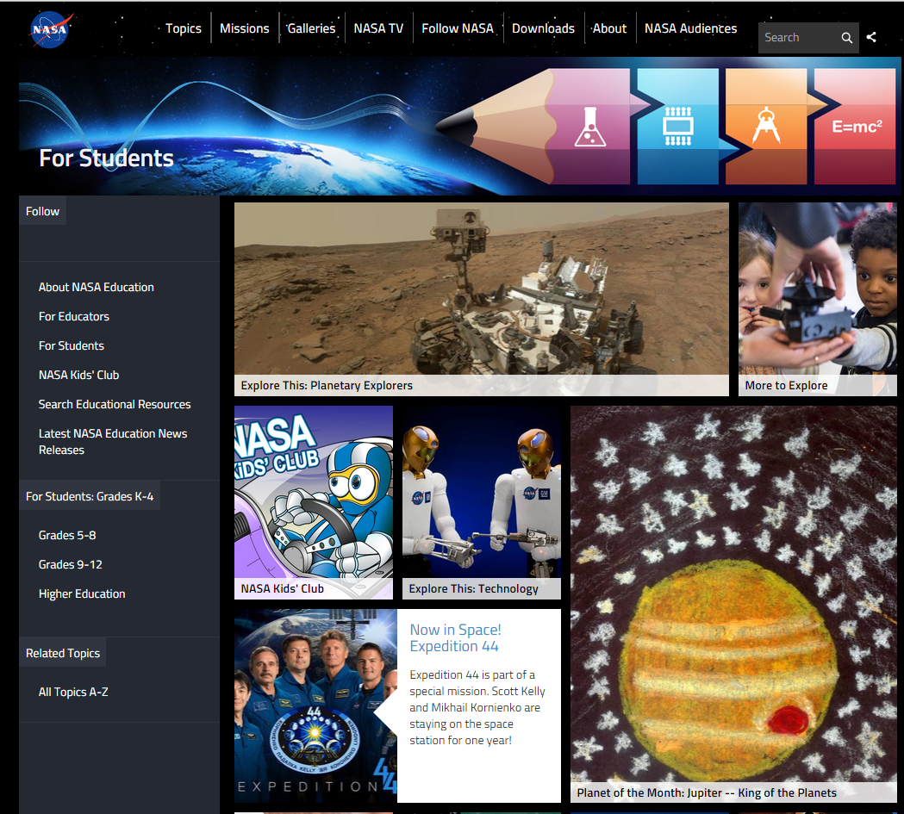
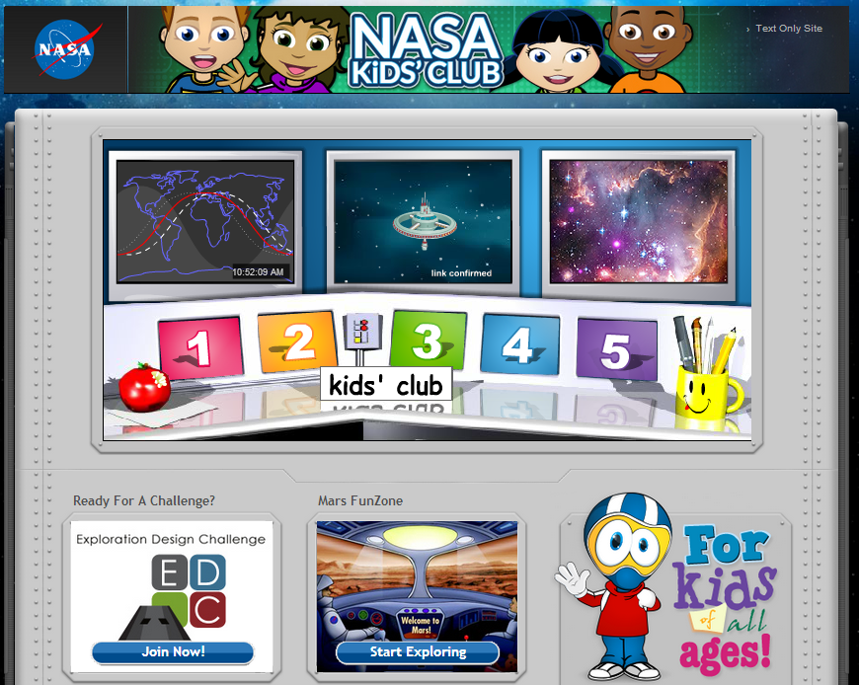
NASA for Students

Slide 17
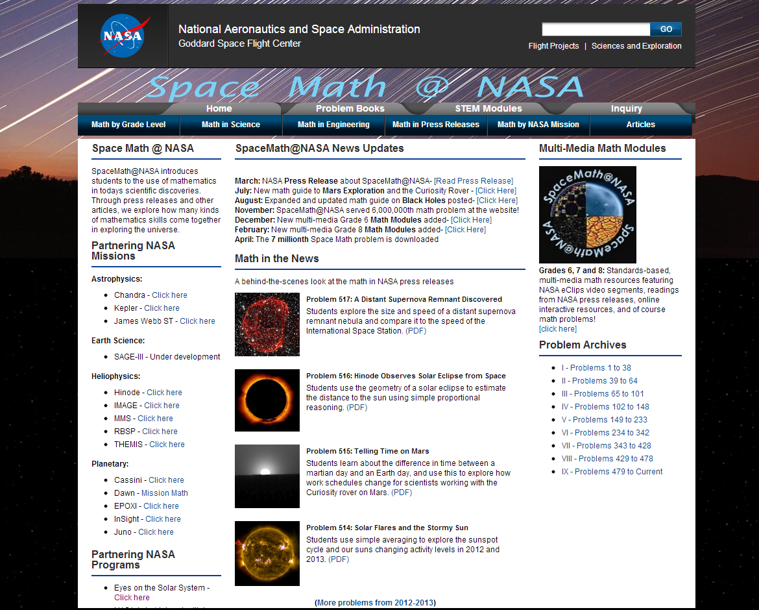
Space Math at NASA

Slide 18
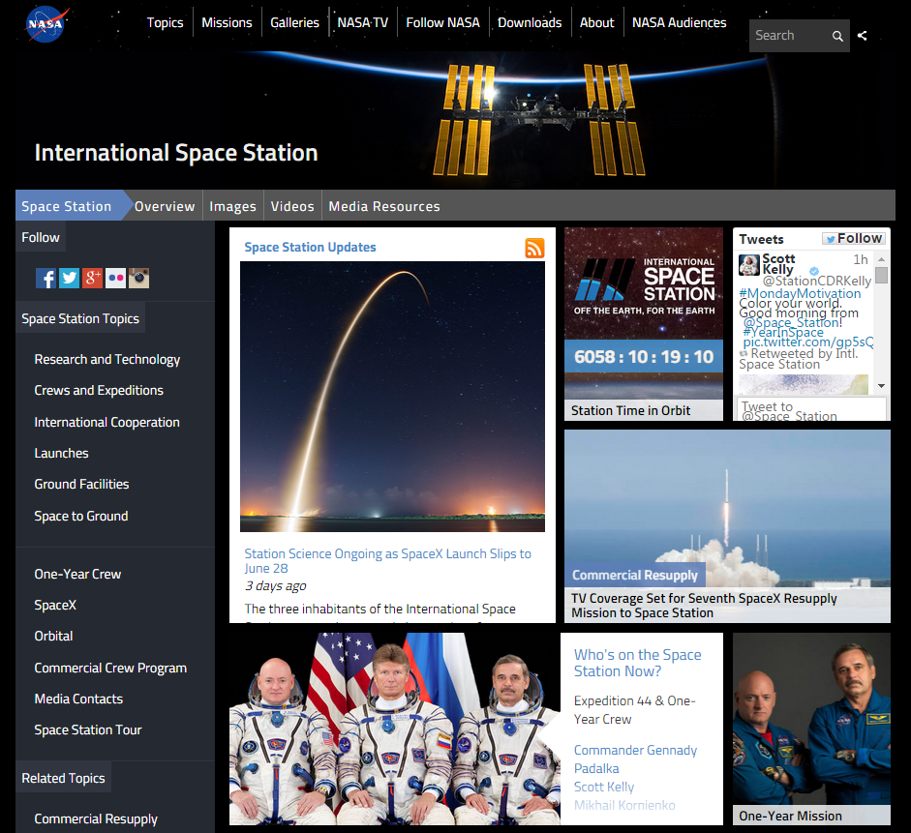
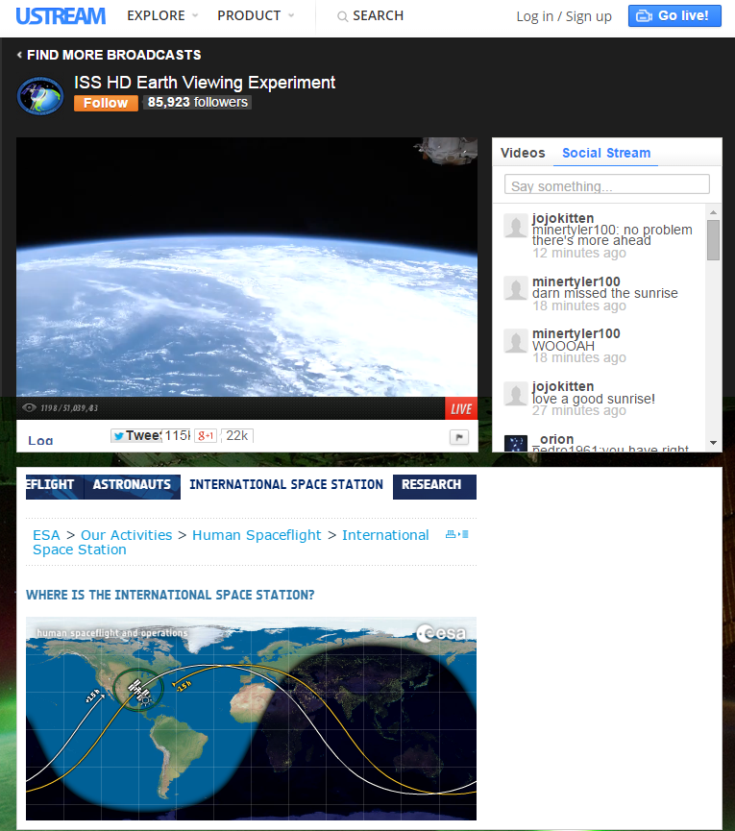
International Space Station - Live!

Slide 19
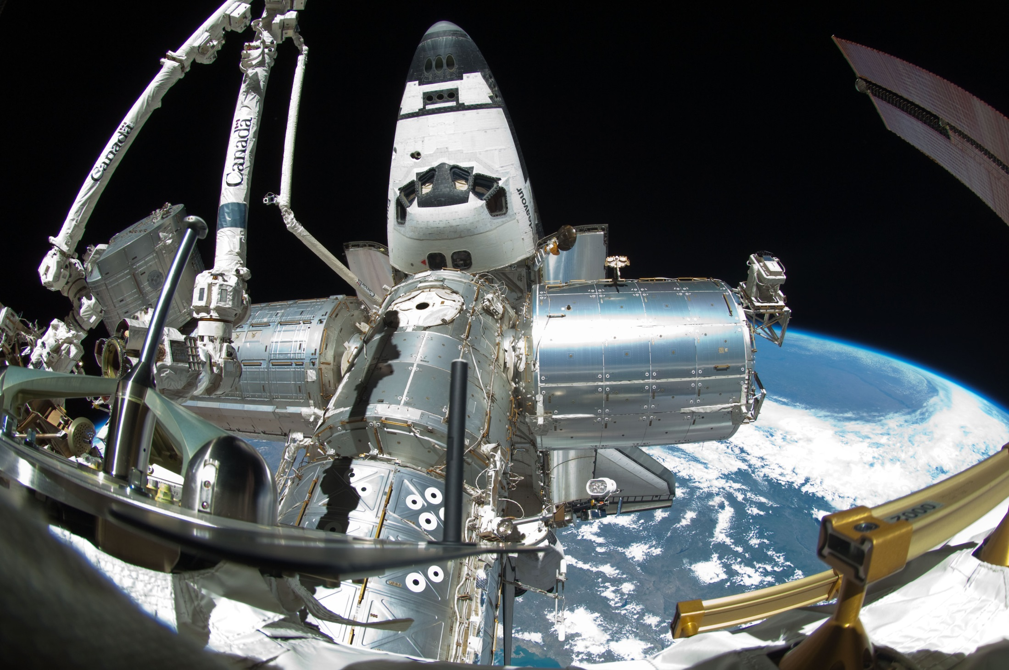
Spot the Station

Slide 20
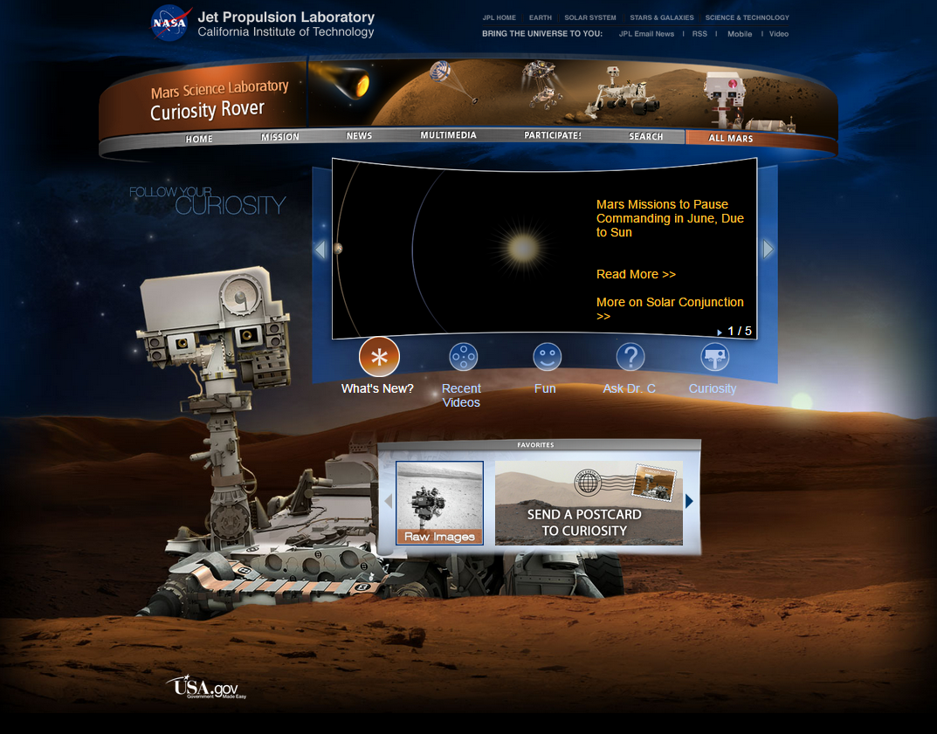
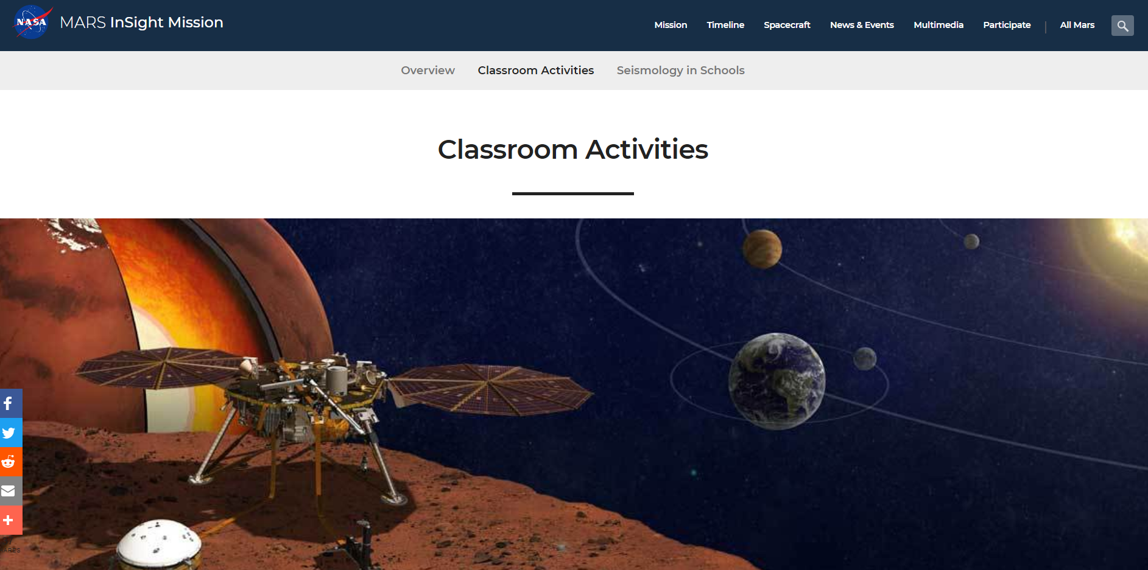
Mars Curiosity Rover
and now… the Insight Rover!

Slide 21
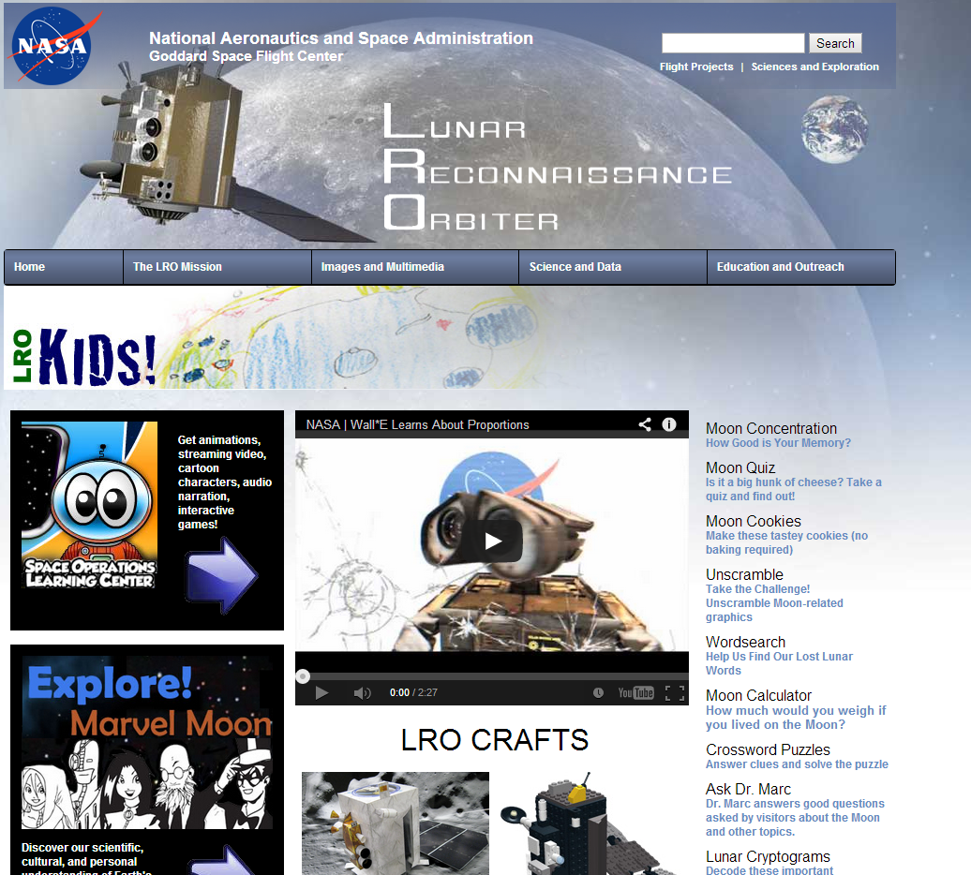
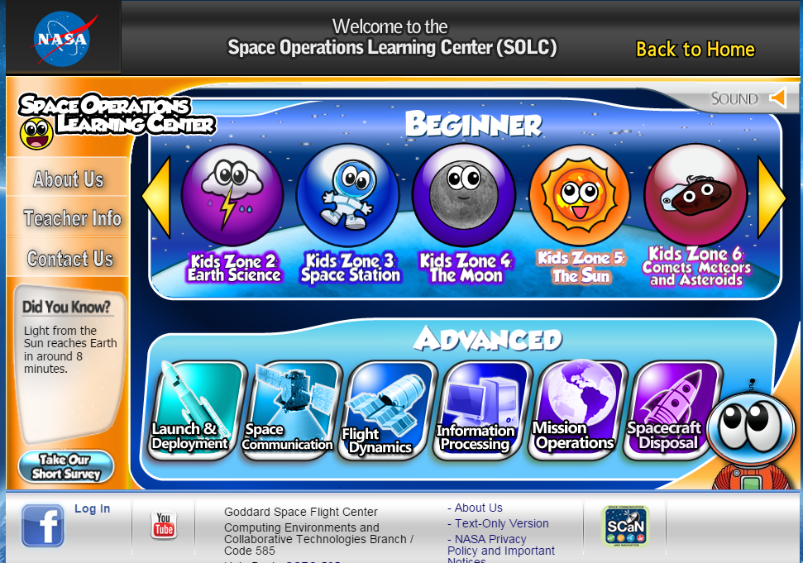
NASA – Lunar Reconnaissance Orbiter

Slide 22
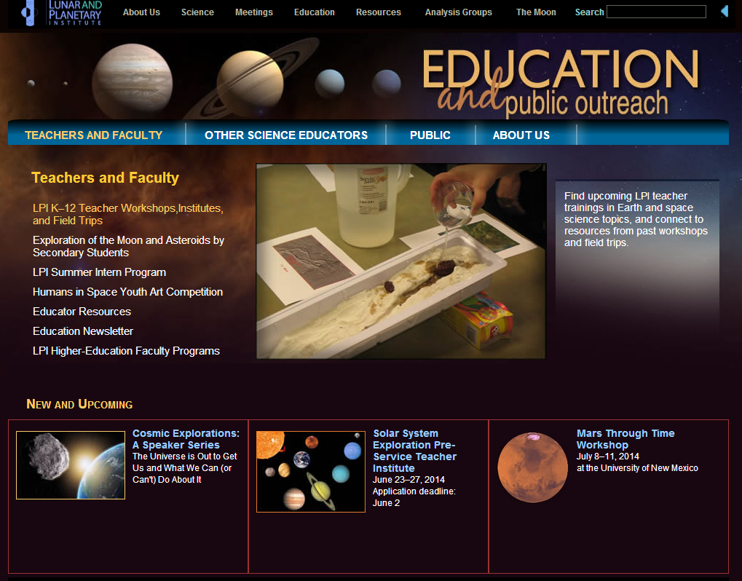
Lunar and Planetary Institute

Slide 23
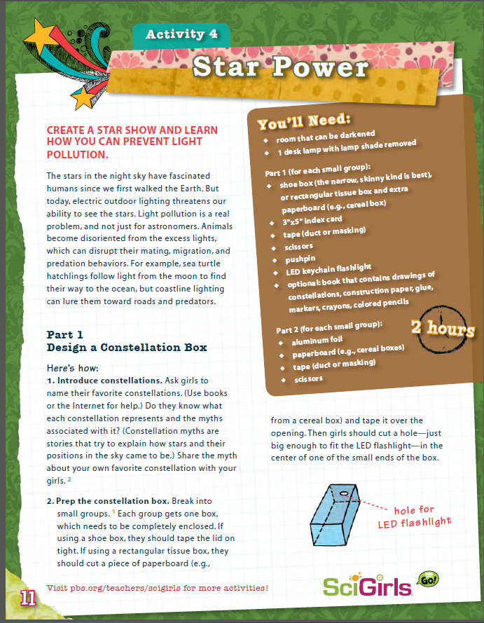
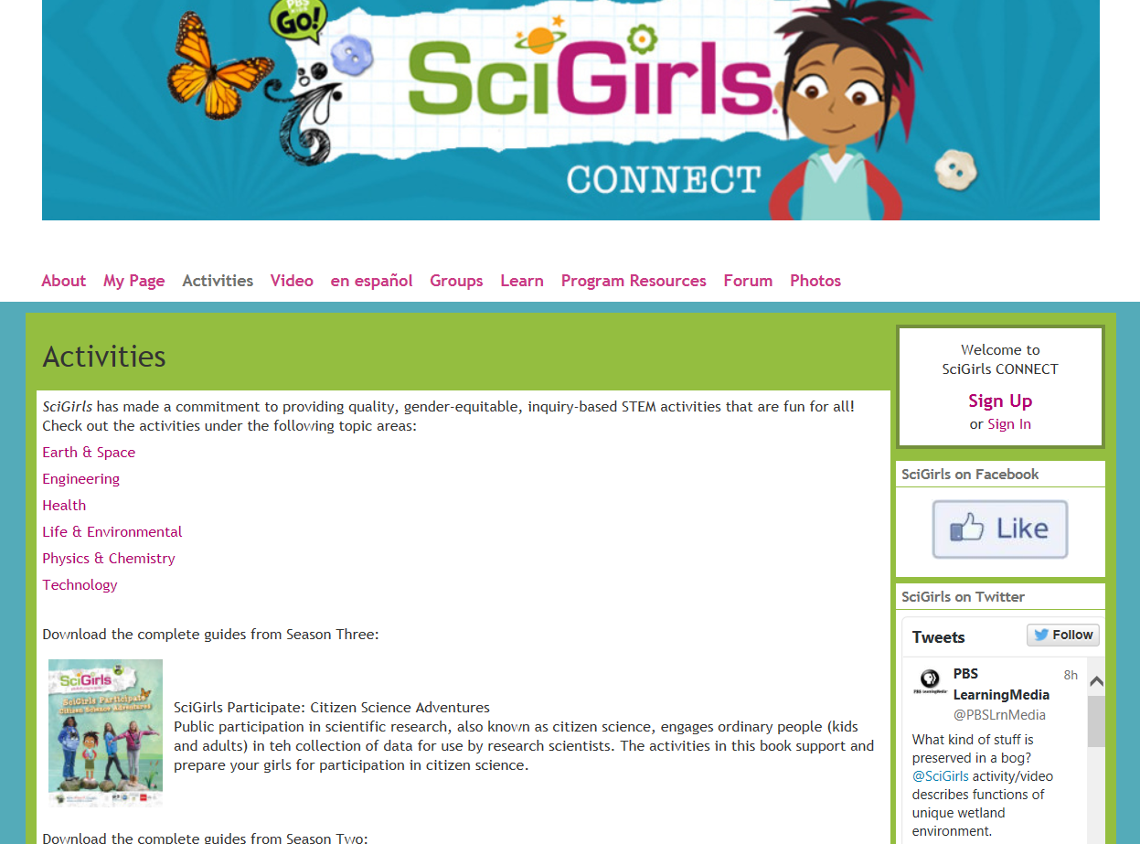
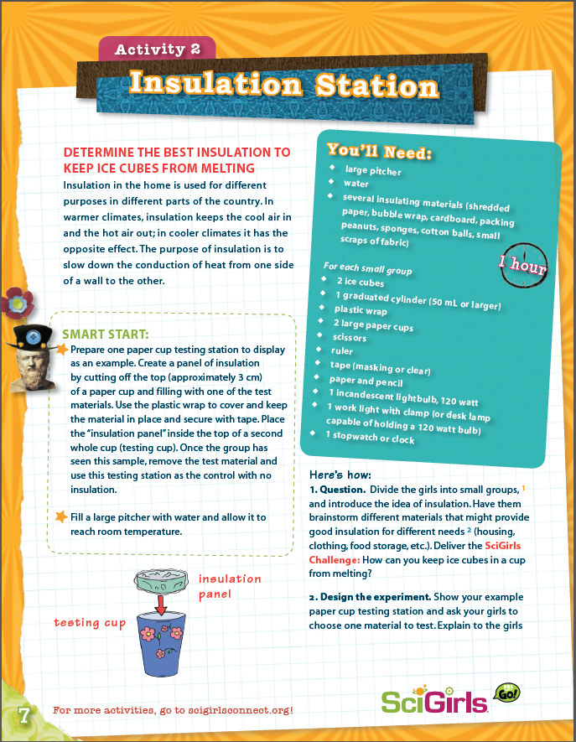
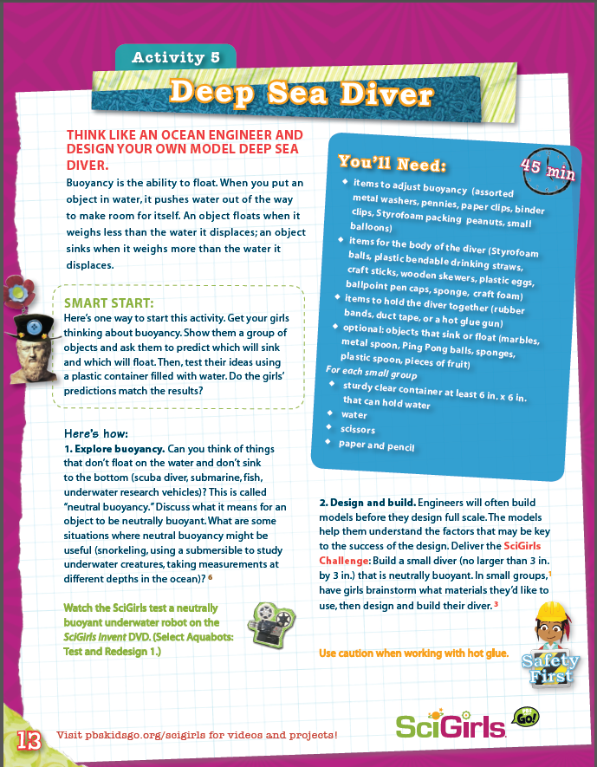
SciGirls Activities

Slide 24
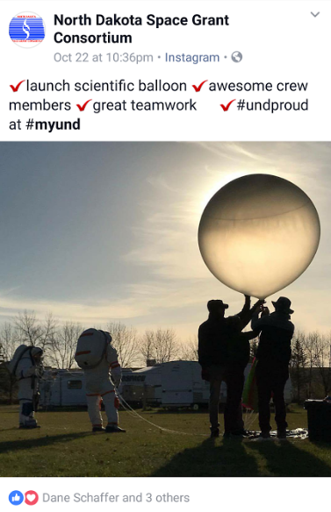
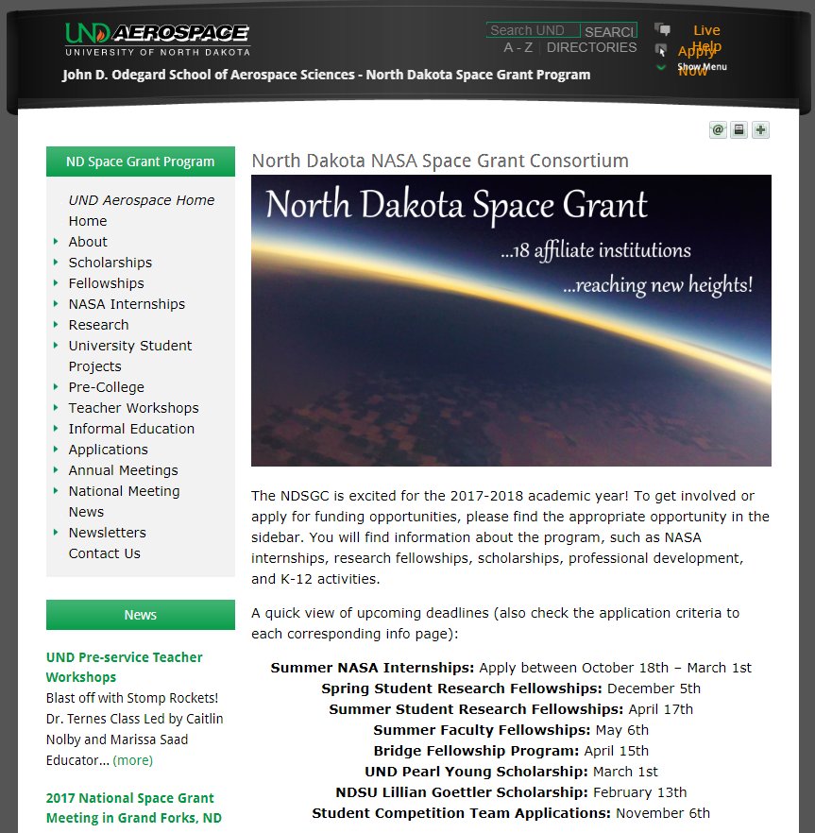
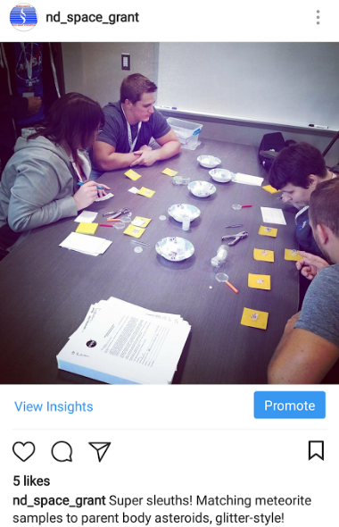
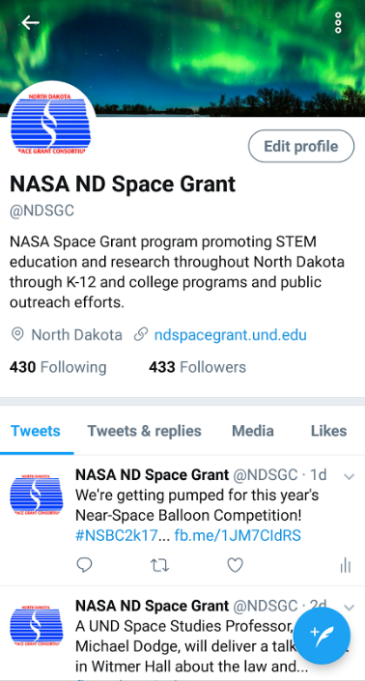
NDspacegrant.und.edu

Slide 25
NDSGC K-12 Educator Email Listserv
Workshop opportunities
New STEM education resources for the classroom
NASA student contests/team competitions
Professional Development opportunities
Emails ~once a week

Slide 26
STEM Ambassador Program
May 31st application deadline
$12/hour to conduct K-12 visits, informal education sessions, lesson plan prepping, or any other STEM engagement activities.
School comes first – flexible schedule!
Anywhere in ND, from your own local area!
Training session at UND (lesson plans, hands-on activities, take home materials).
Some events are scheduled through Space Grant. Most are whatever you find!
Some events have been:
ISS Calls (2016, 2019 TBD)
Total Solar Eclipse classroom visits
K-12 visits with the NDSGC Team
Near-Space Balloon Competition judging and facilitation
Super Science Day (GF)
Marketplace for Kids (all over ND)
Water Festival (Bottineau)
Girl scouts, boy scouts
FIRST Lego League, FIRST Robotics

Slide 27
Please fill out a quick survey
https://und.qualtrics.com/jfe/form/SV_1ZylfLa4dVilxDT
http://tinyurl.com/y4qxv3cl
This helps us for our NASA reporting, so thank you!

