Slide 1
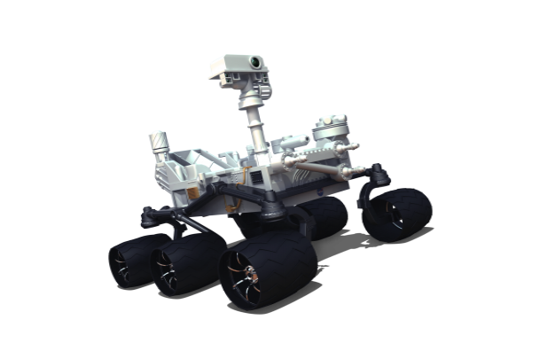
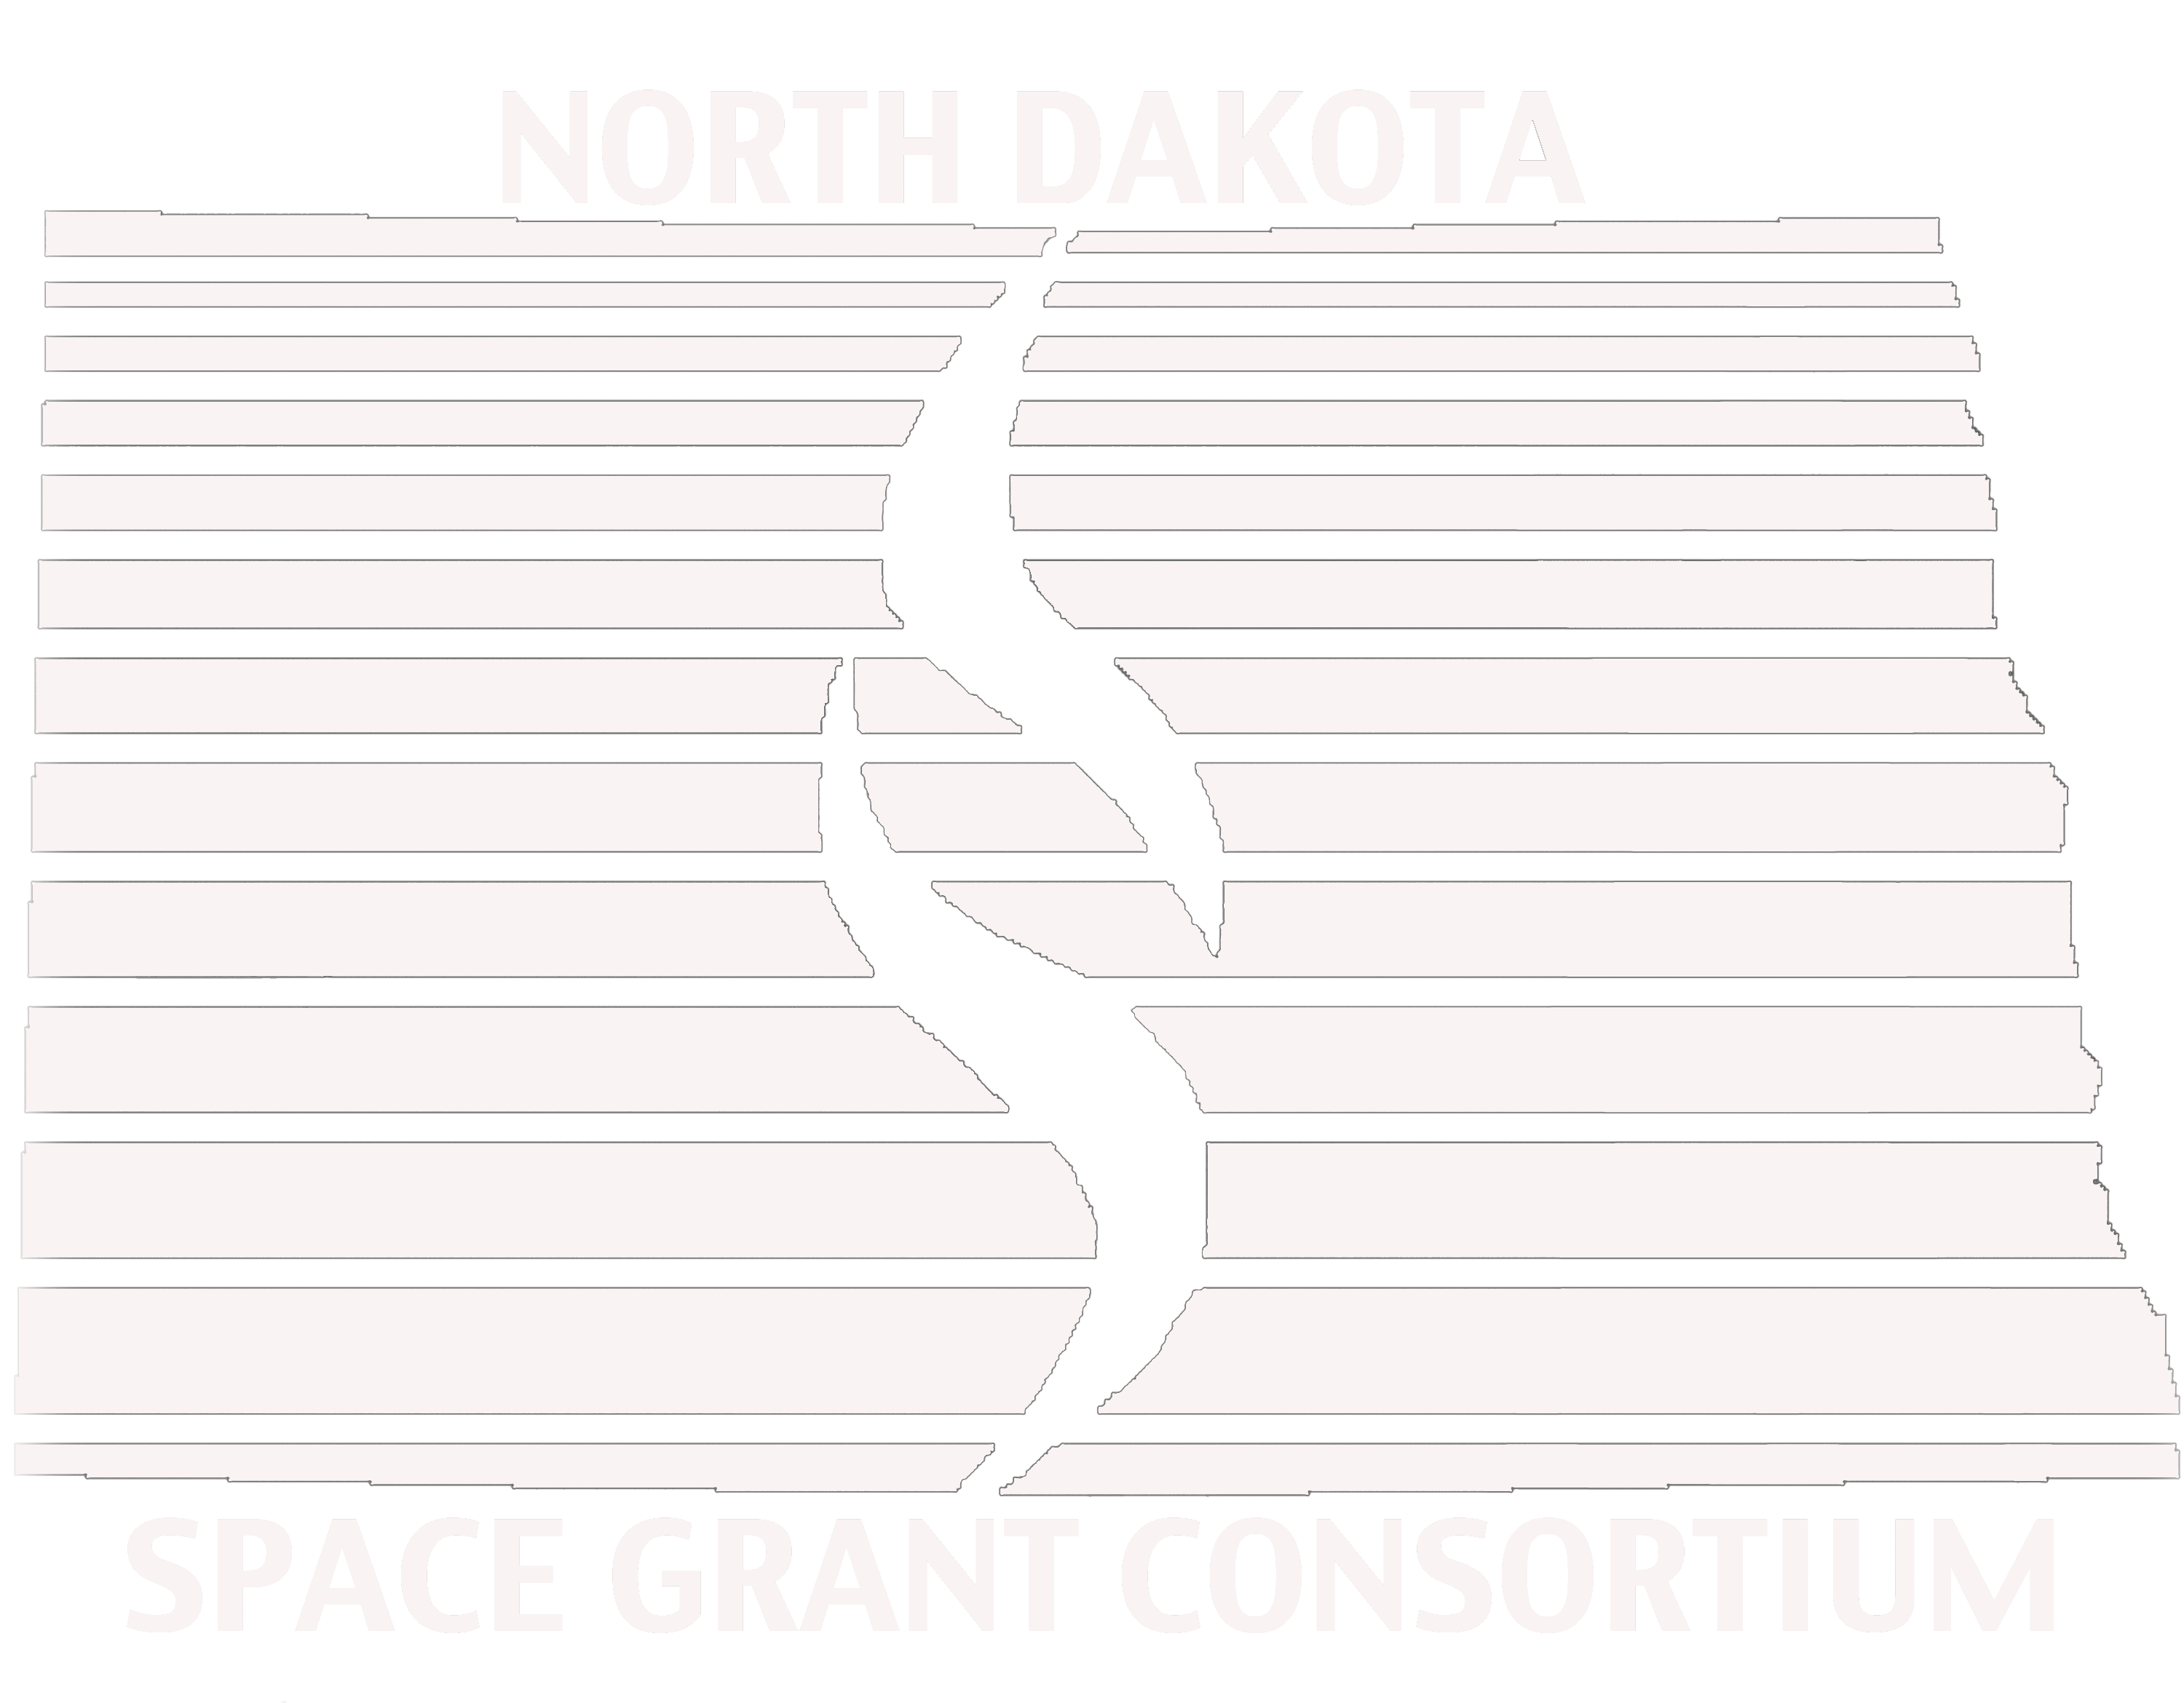
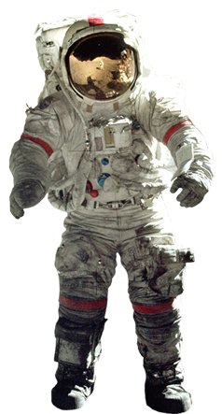
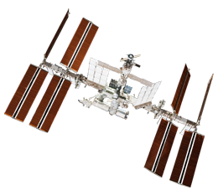
Mars mission and nasa educator resources
Caitlin Nolby, cnolby@space.edu
Marissa saad, msaad@space.edu
North Dakota Space Grant Consortium

Slide 2
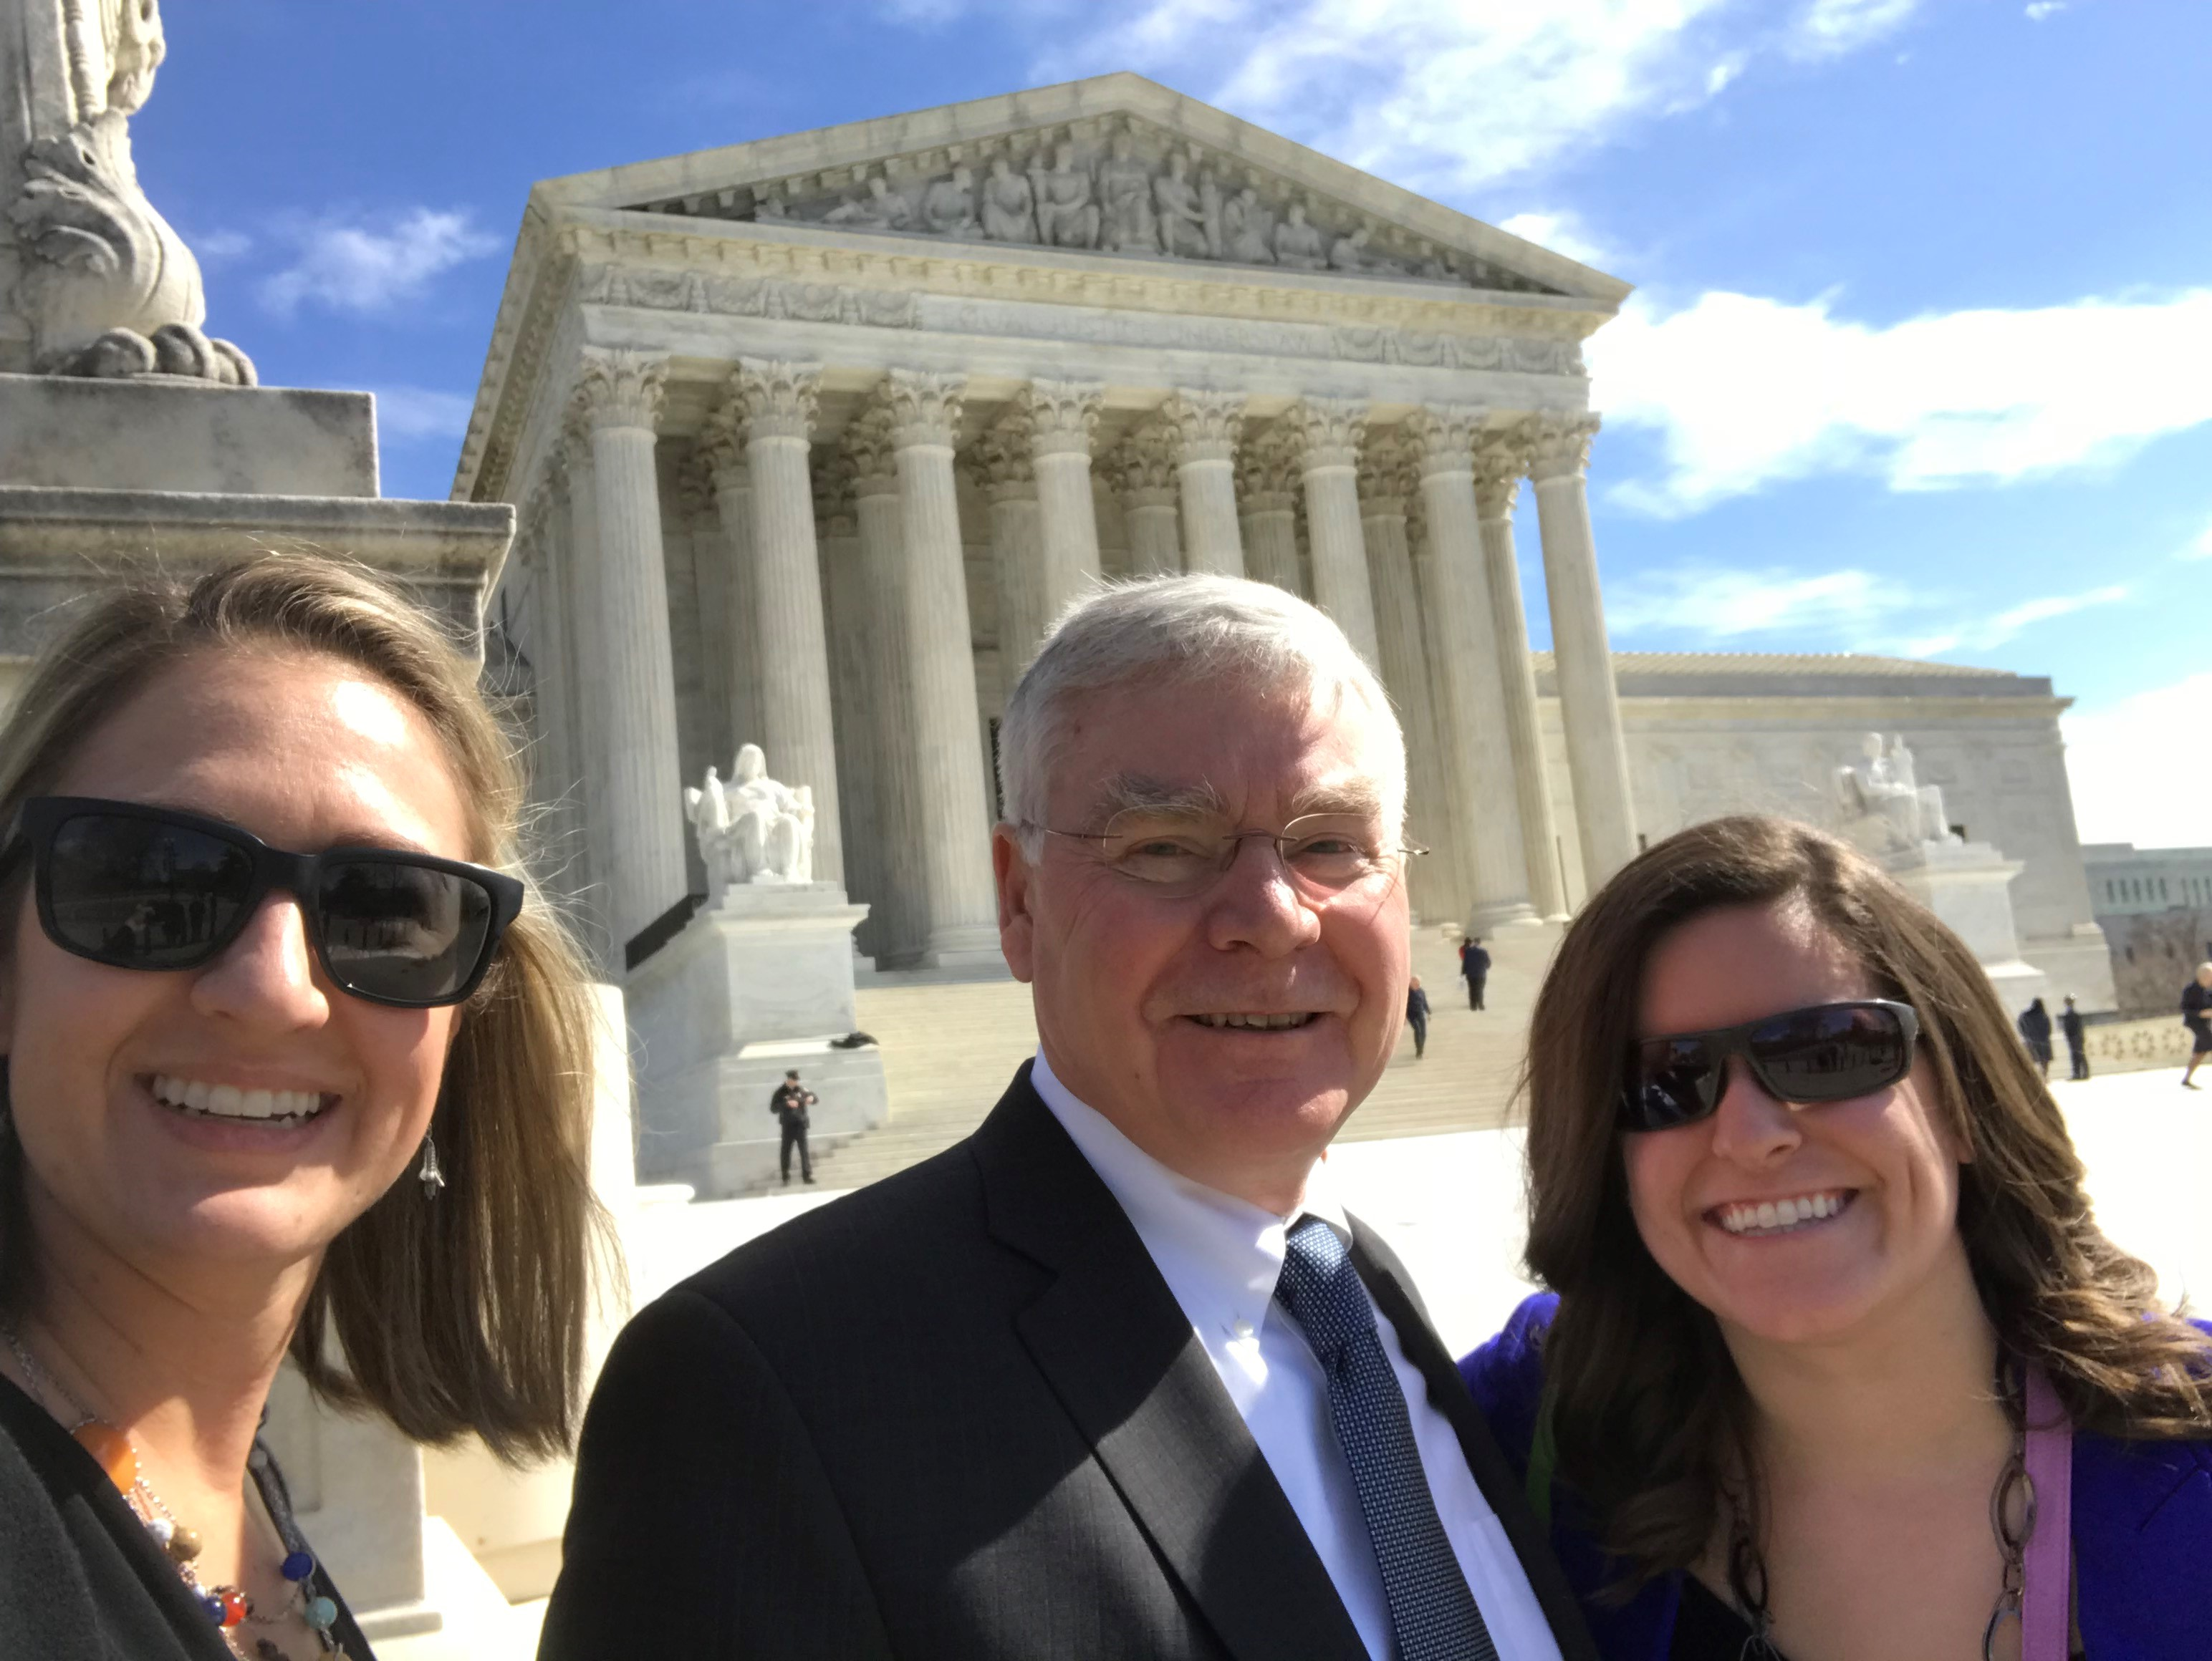
Meet the space grant team!
Director, Jim Casler
Deputy Director, Caitlin Nolby
Coordinator, Marissa Saad
Come visit us at UND, in the Space Studies Department in Clifford Hall!

Slide 3
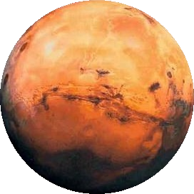
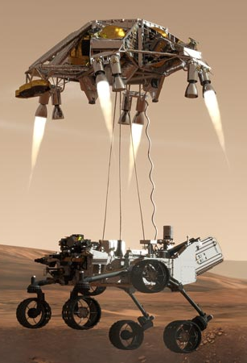
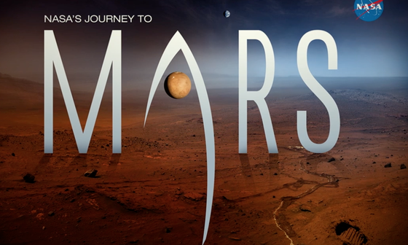
Workshop goals
You will be able to:
Confidently conduct today’s activities in your own classroom.
Better understand concepts regarding space sciences.
Effectively communicate in teams to successfully complete a mission to Mars.
Save Mark Watney!

Slide 4
Rockets to the rescue!

Slide 5
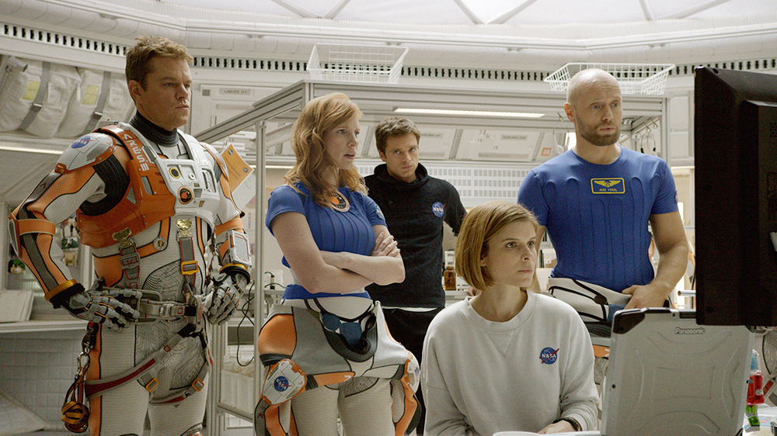

Slide 6
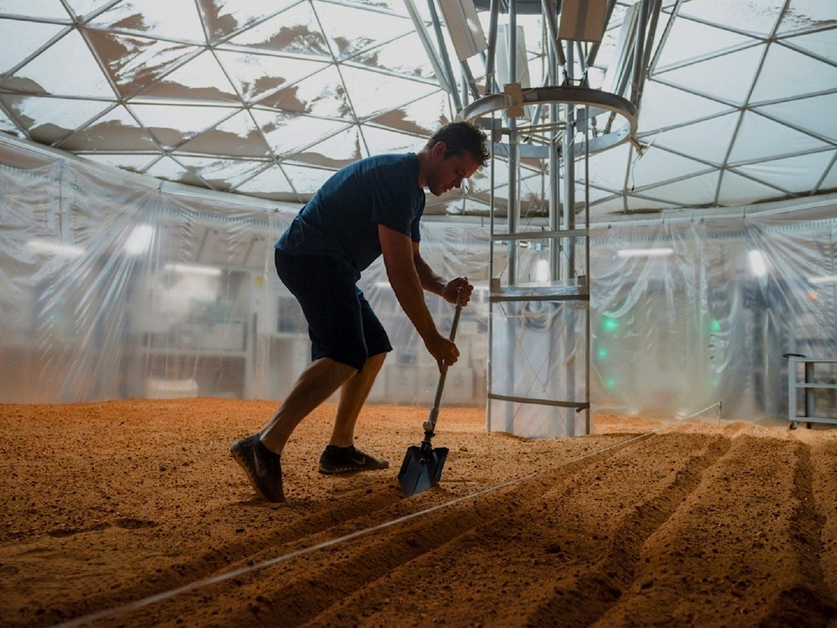

Slide 7
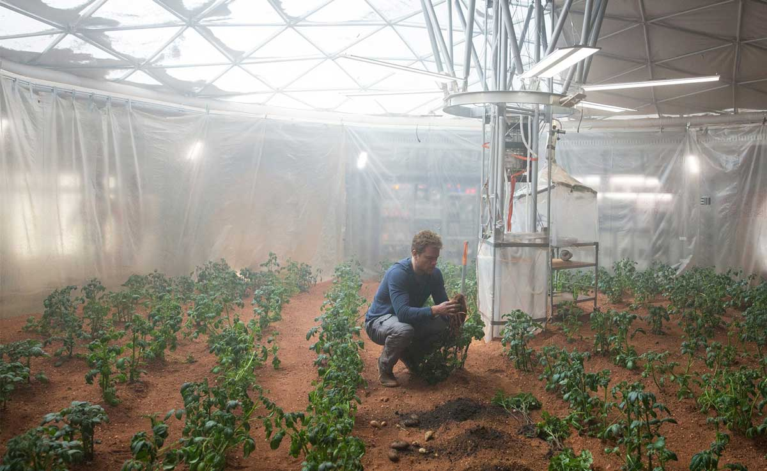

Slide 8
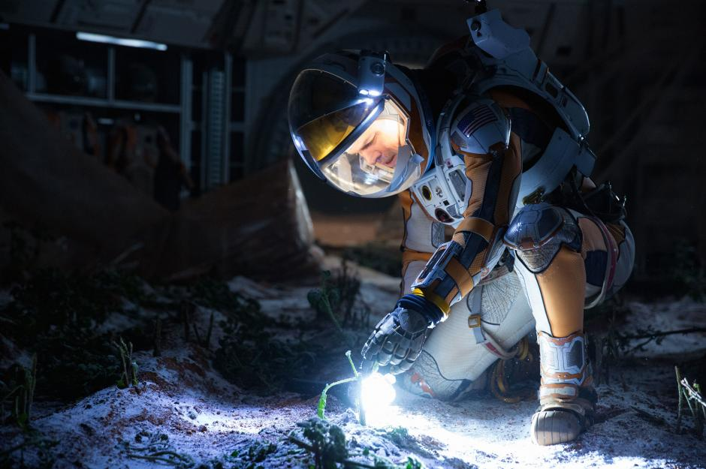

Slide 9
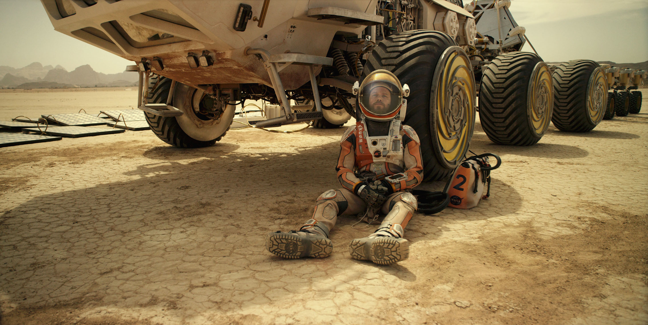
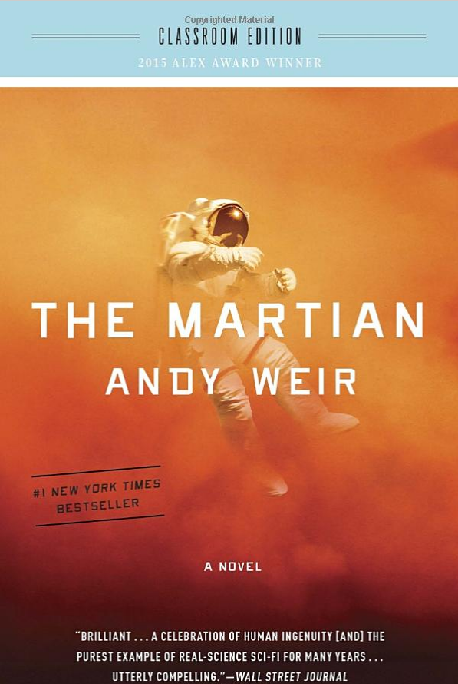
Classroom-appropriate novel (not the movie!)

Slide 10
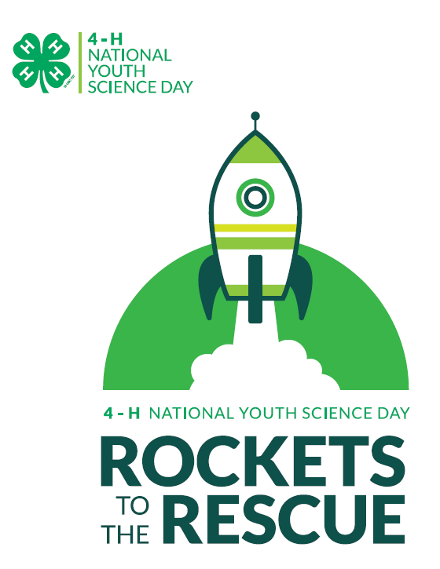
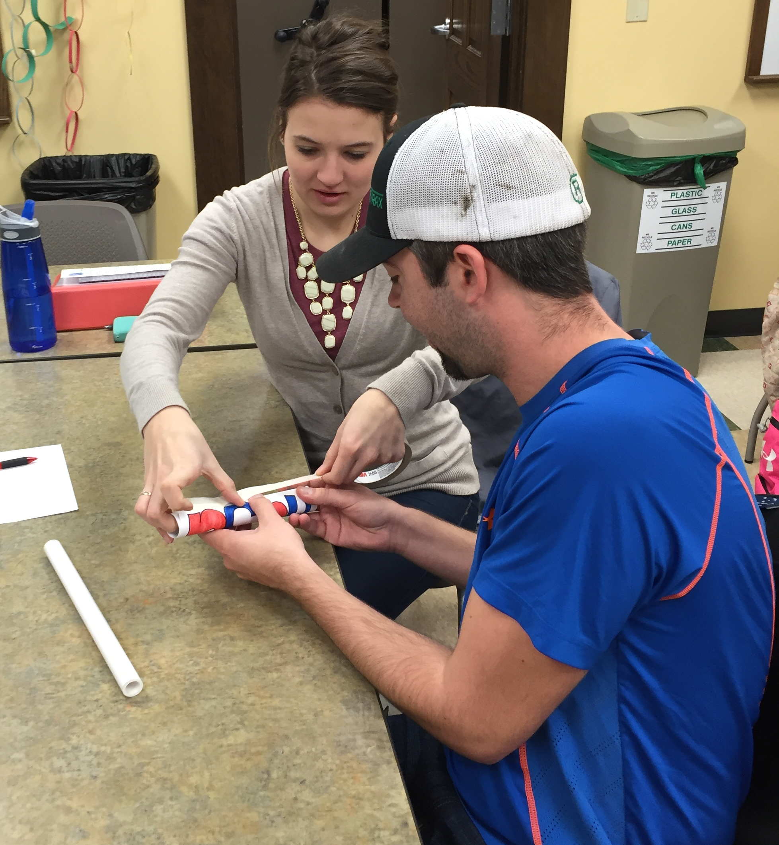
Rockets to the Rescue
Goal: Build and launch a rocket, keep your payload intact, and save Mark Watney!
Launch your payload to Mars!
What will be your team’s strategy?

Slide 11
Rockets to the rescue Critical Thinking Questions
Was your rocket successful?
Take a look at other teams’ designs. What materials did they use? Did their results differ from yours? Describe the outcomes.
How did gravity affect your design?
What should scientists consider when selecting materials? (think of sizes, weight, composition of the atmosphere, etc.)
Extra consideration: Integrate this activity into the classroom – add budgets, weight restrictions, competition between NASA centers, etc.
What shapes were the most aerodynamic? Are these necessarily the best designs?

Slide 12
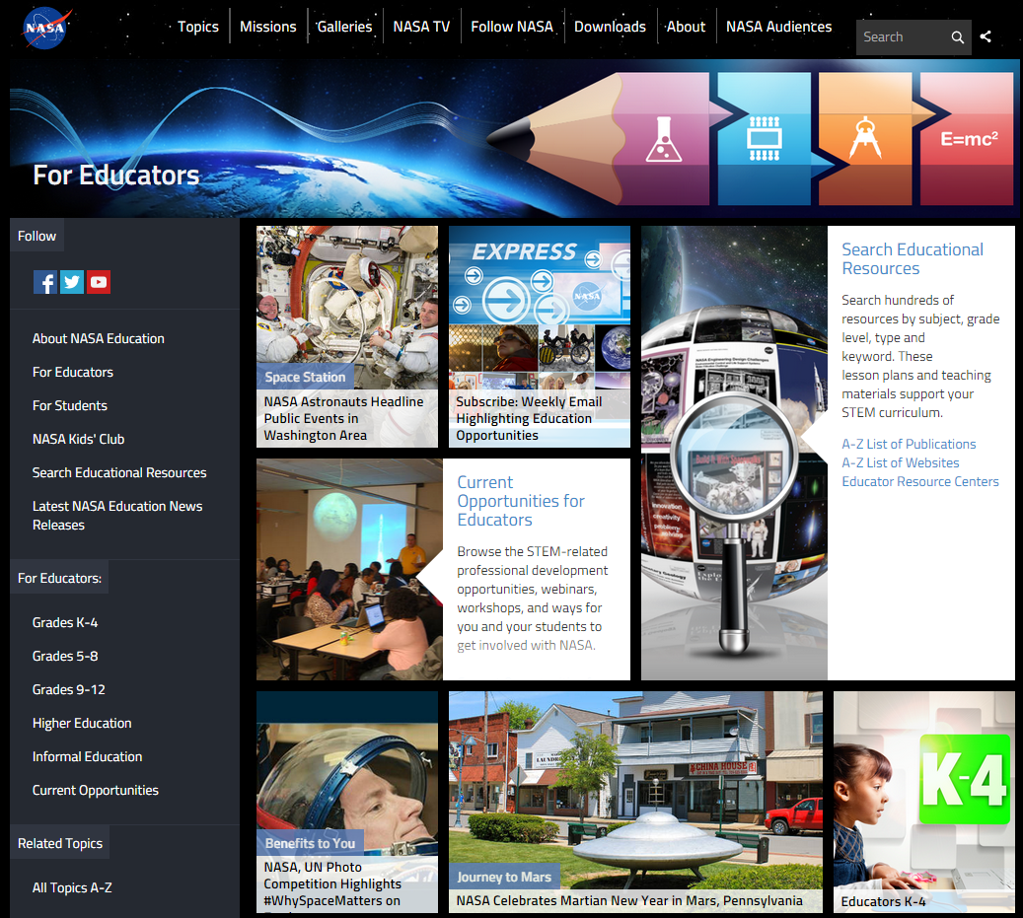
NASA Education

Slide 13
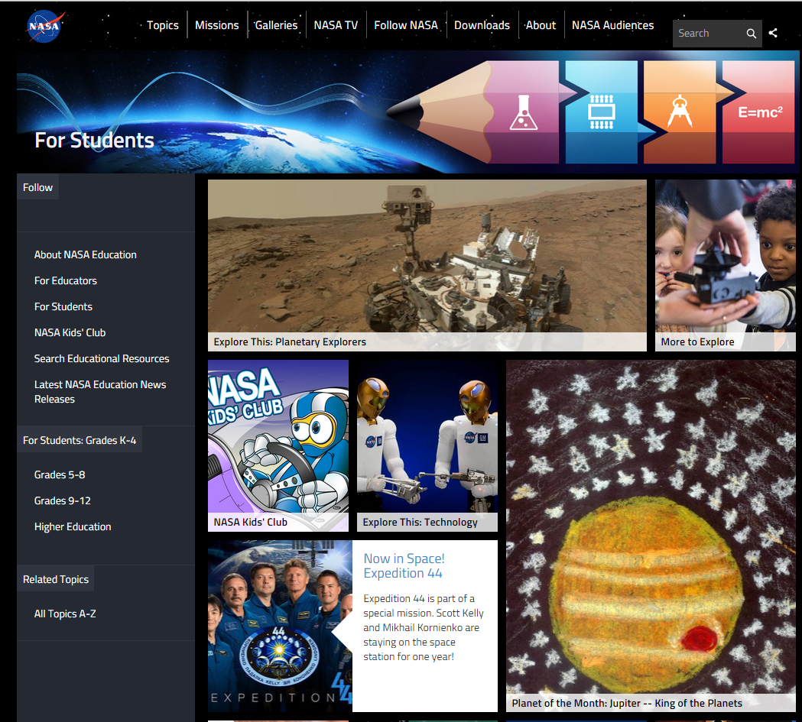
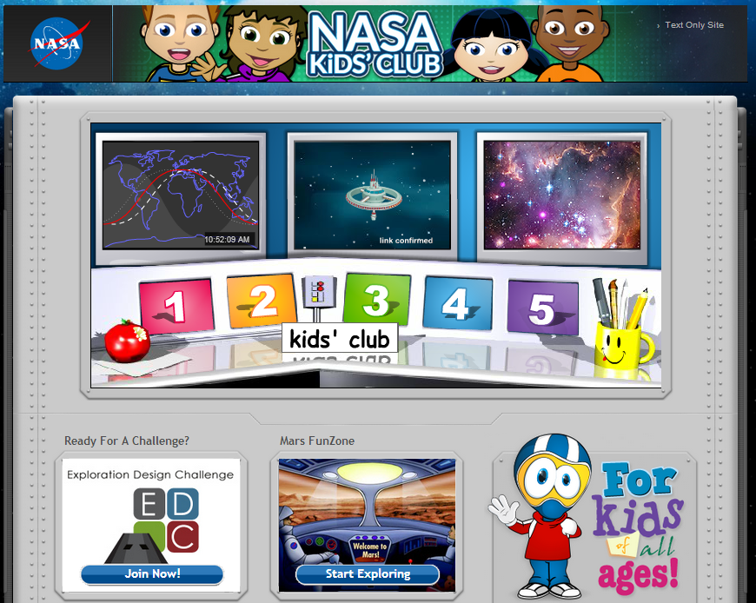
NASA for Students

Slide 14
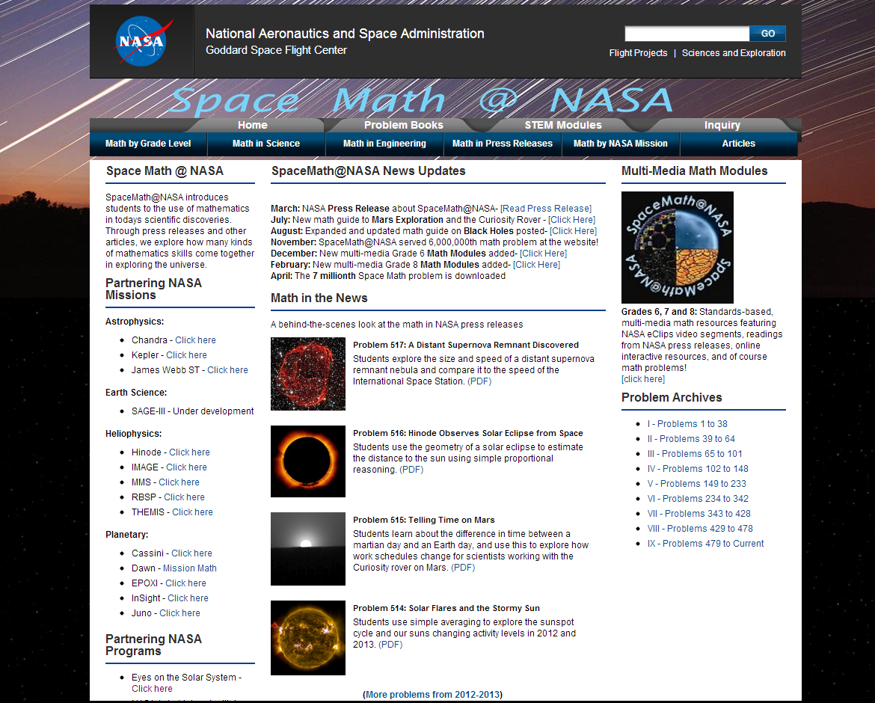
Space Math at NASA

Slide 15
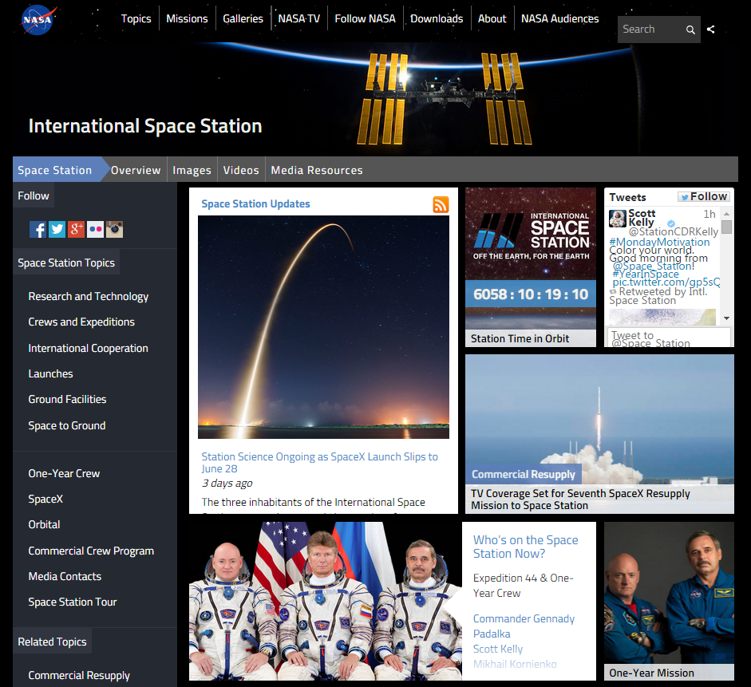
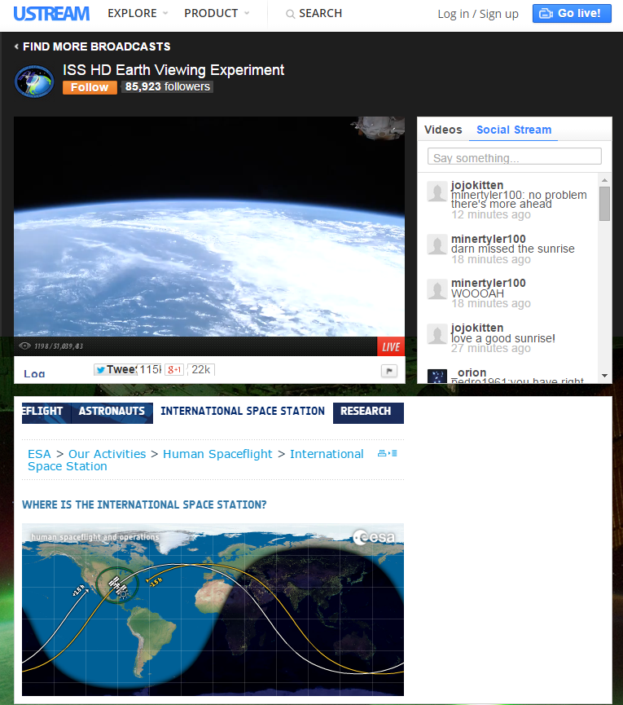
International Space Station - Live!

Slide 16
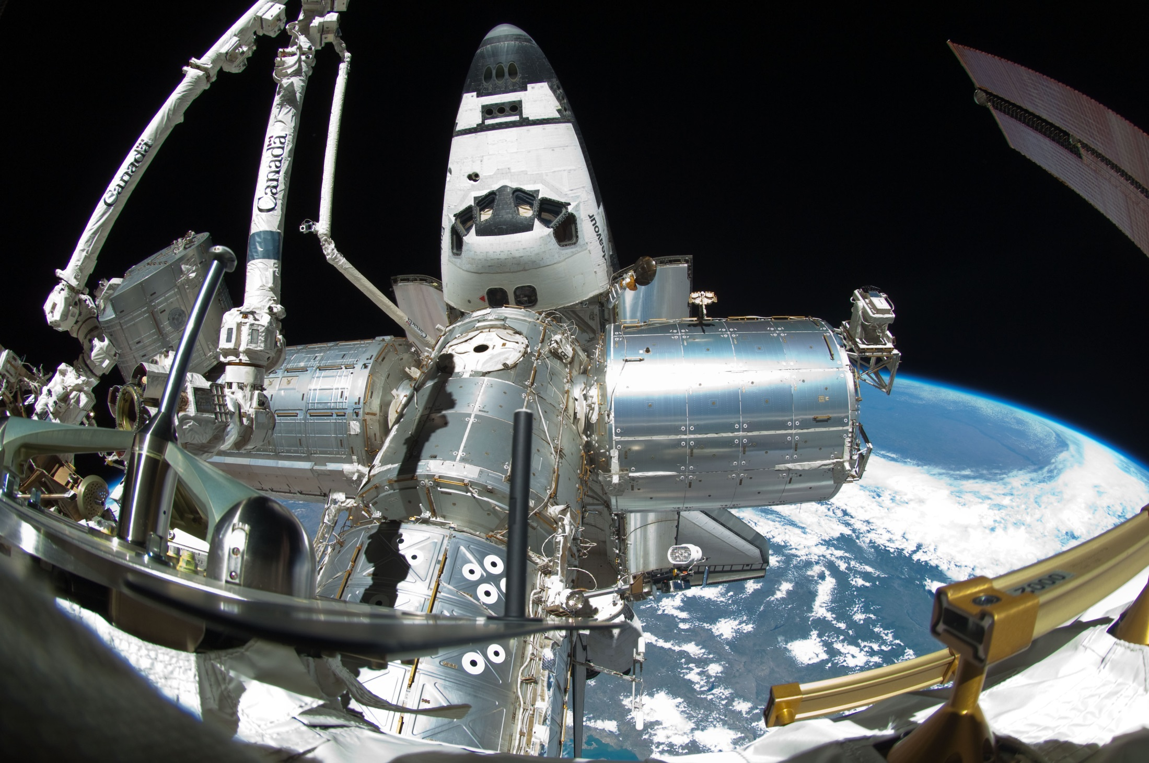
Spot the Station

Slide 17
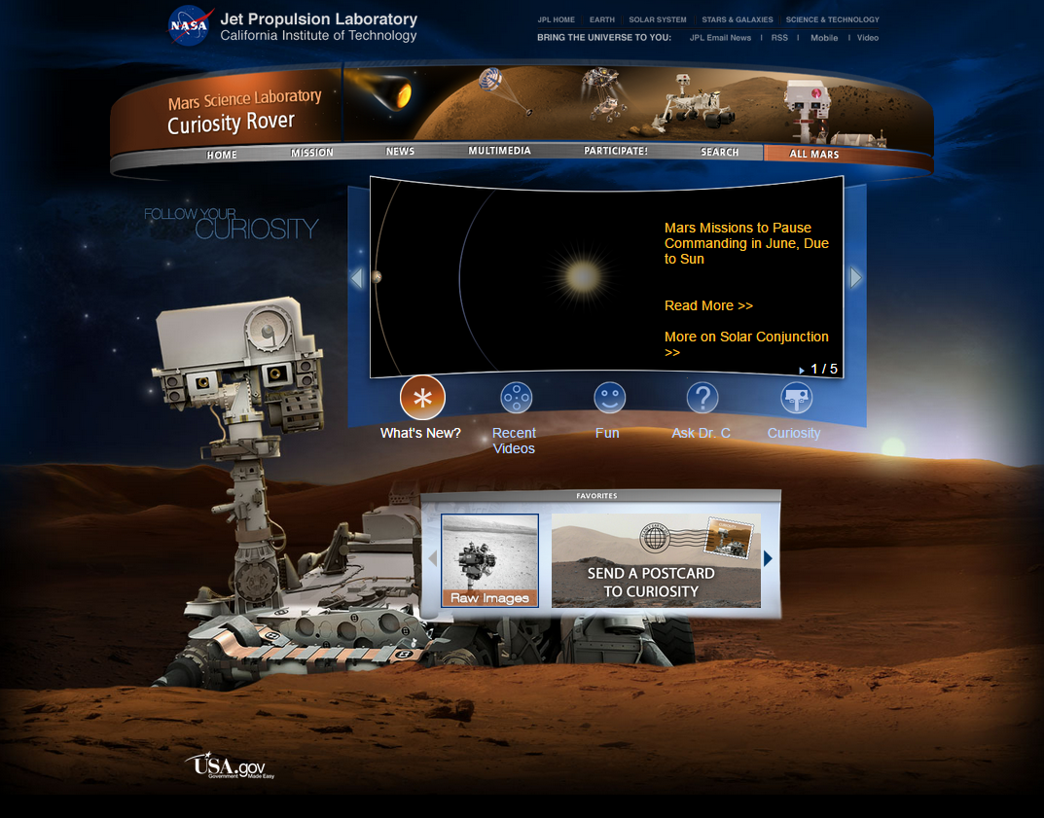
Mars Curiosity Rover

Slide 18
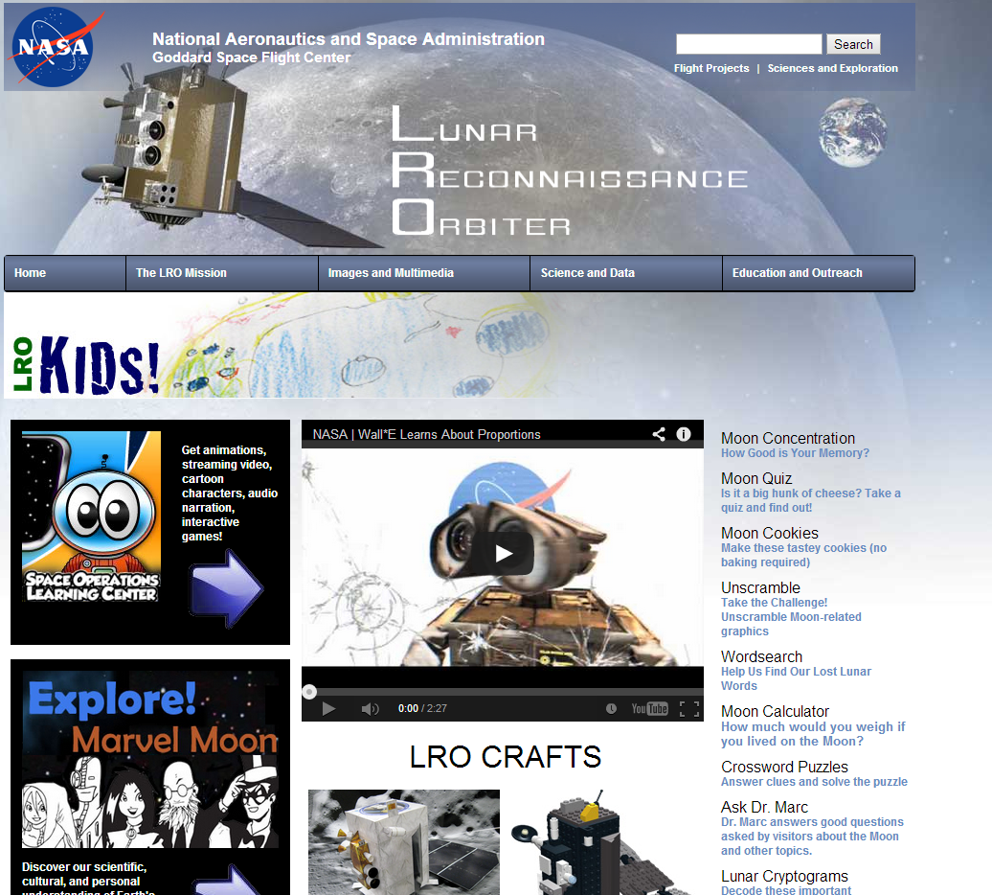
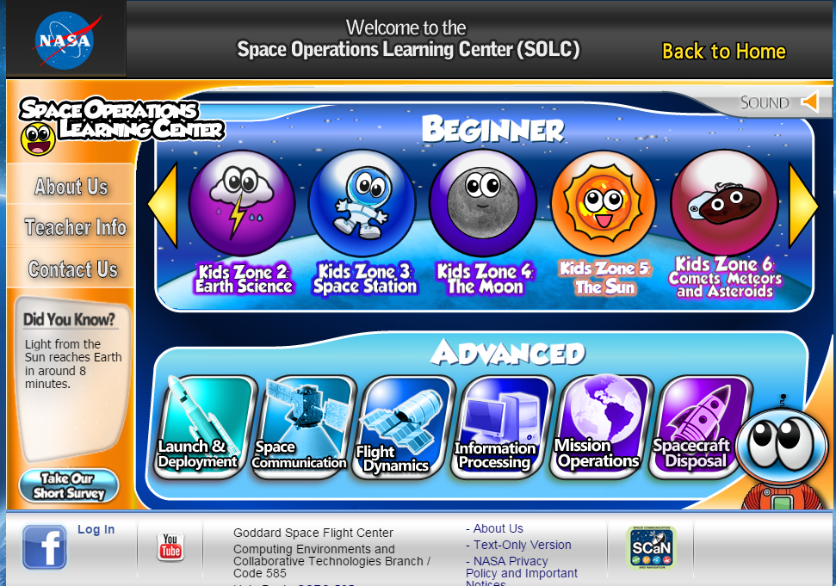
NASA – Lunar Reconnaissance Orbiter

Slide 19
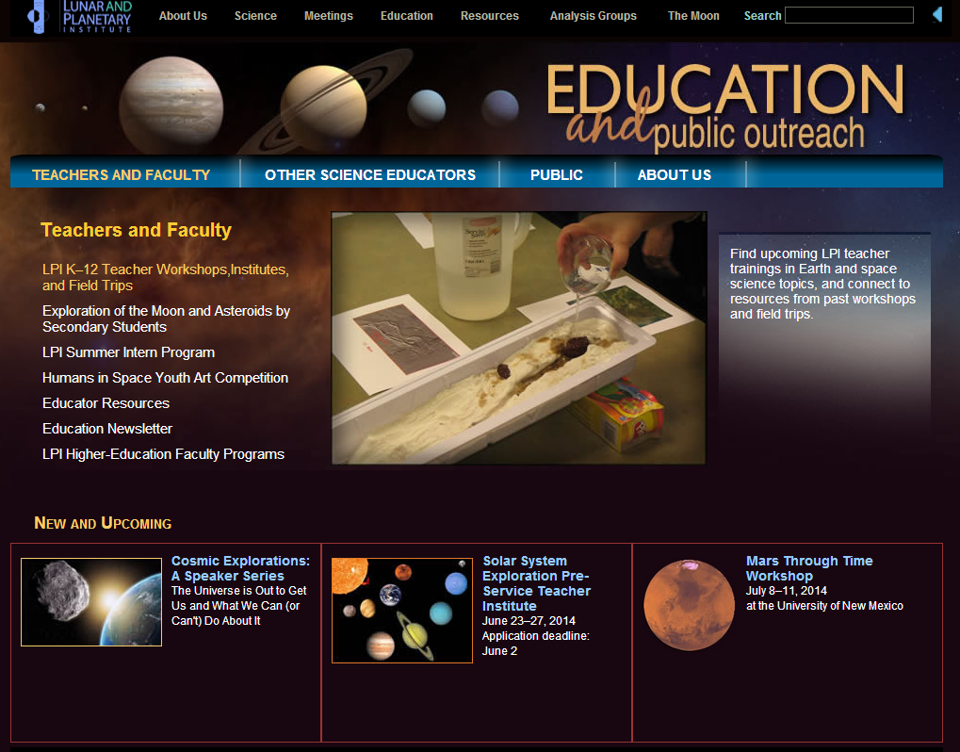
Lunar and Planetary Institute

Slide 20
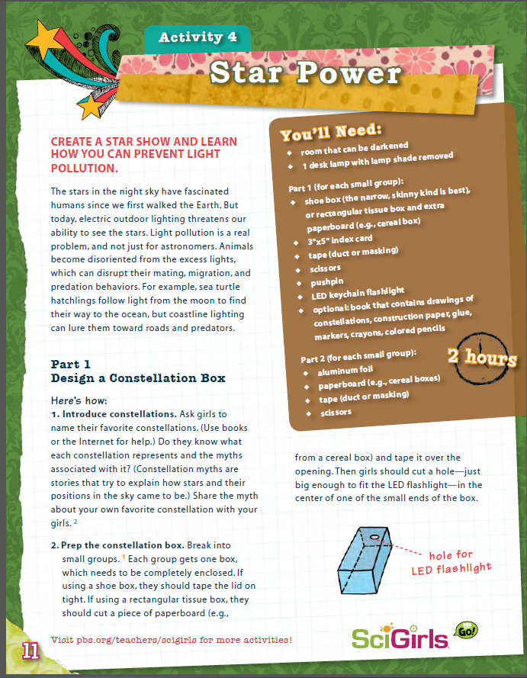
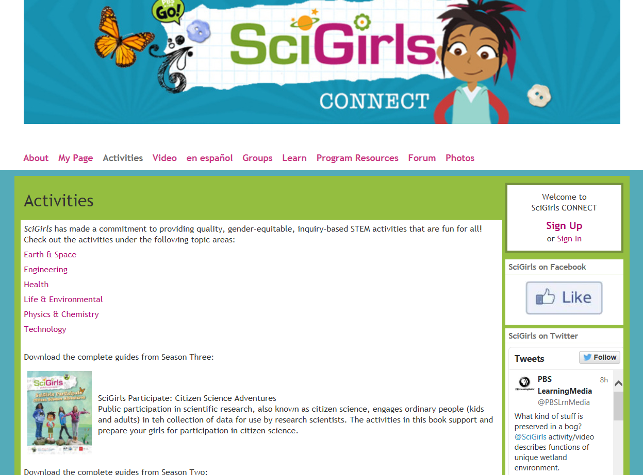
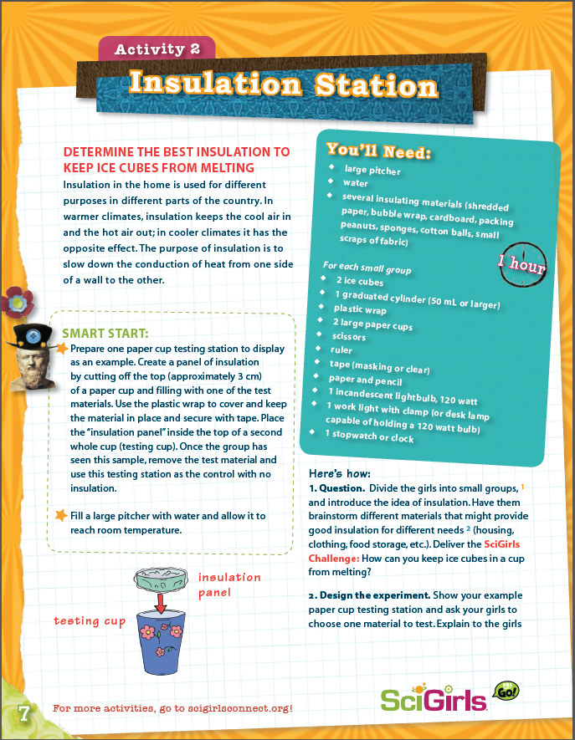
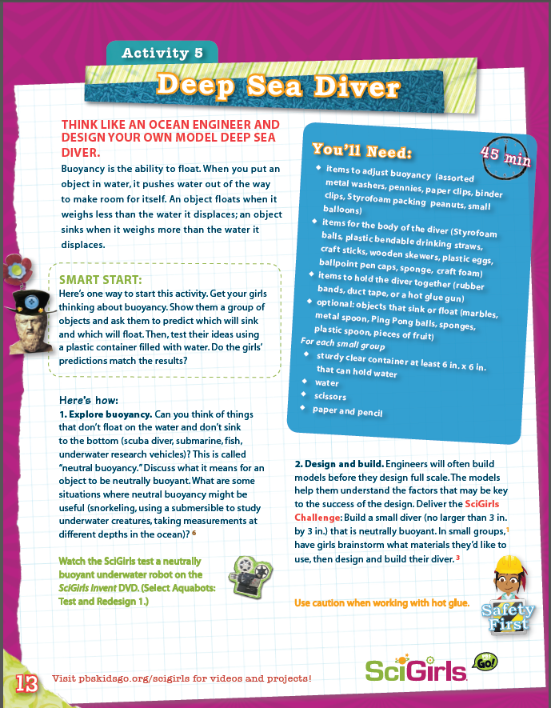
SciGirls Activities

Slide 21
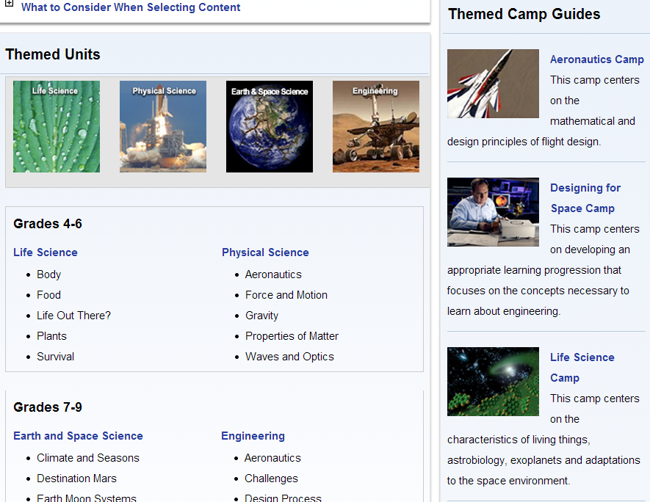
NASA Summer of Innovation

Slide 22
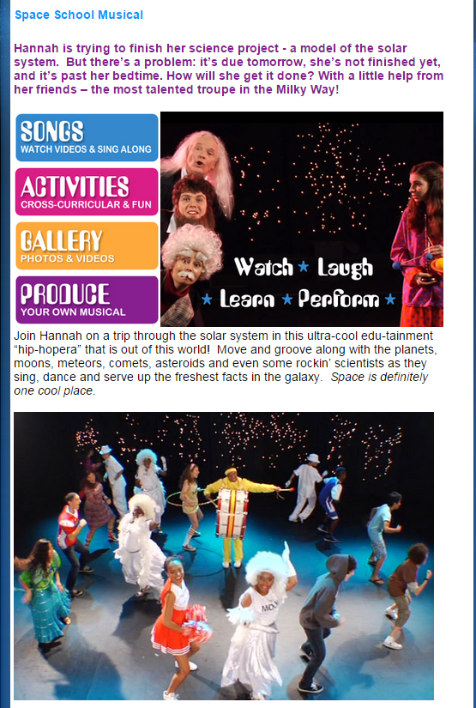
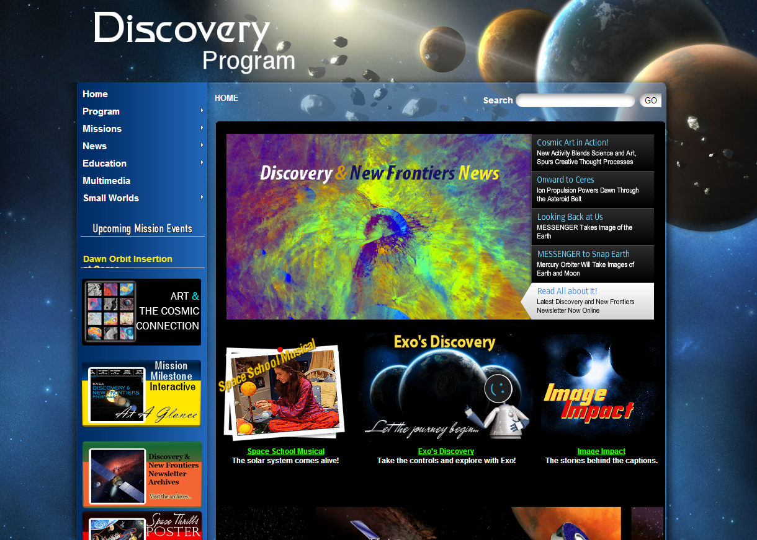
NASA Discovery Program

Slide 23
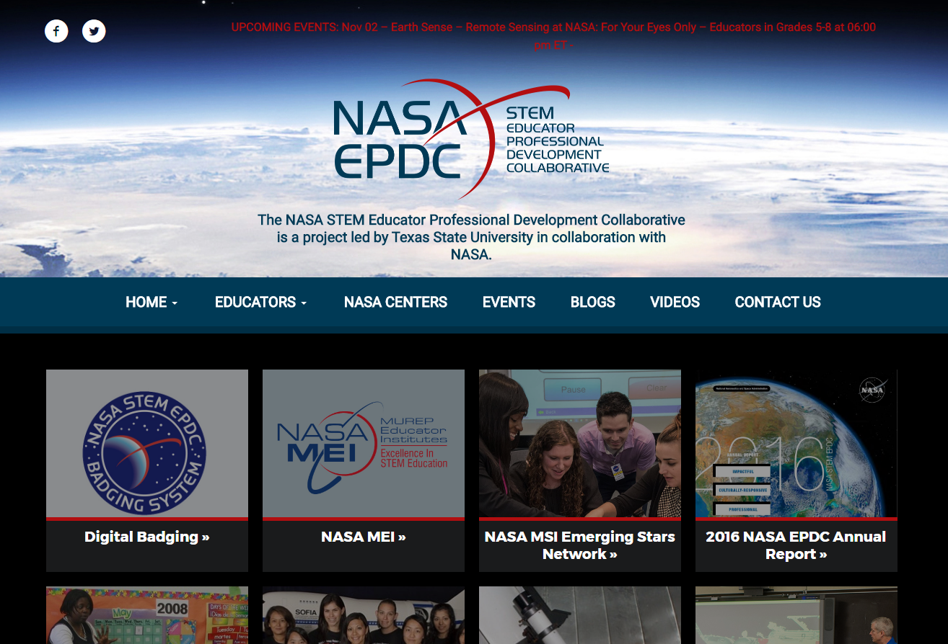
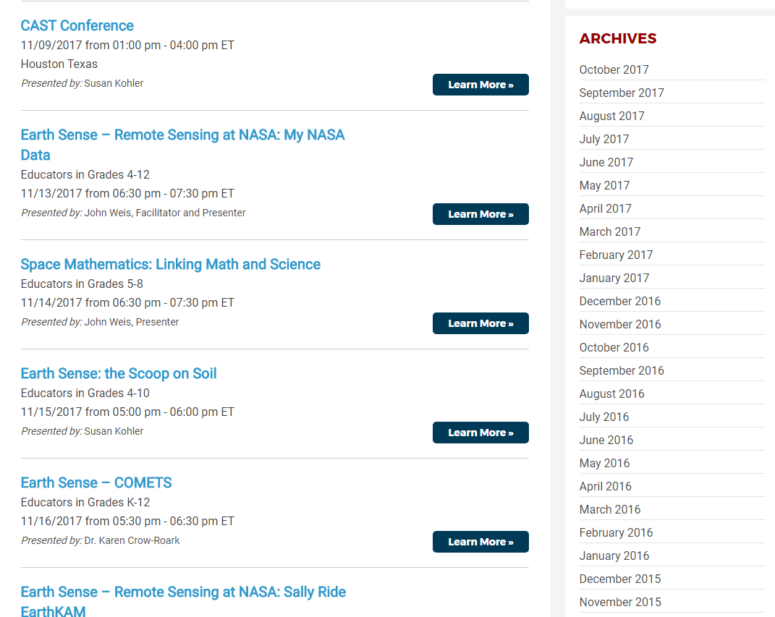
NASA Educator Professional Development Collaborative

Slide 24
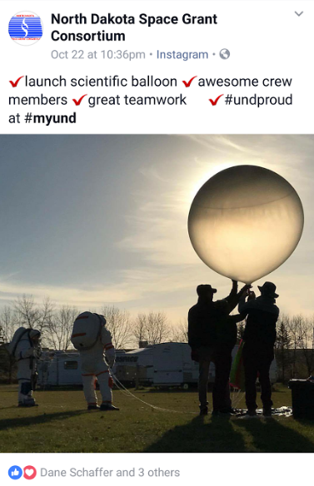
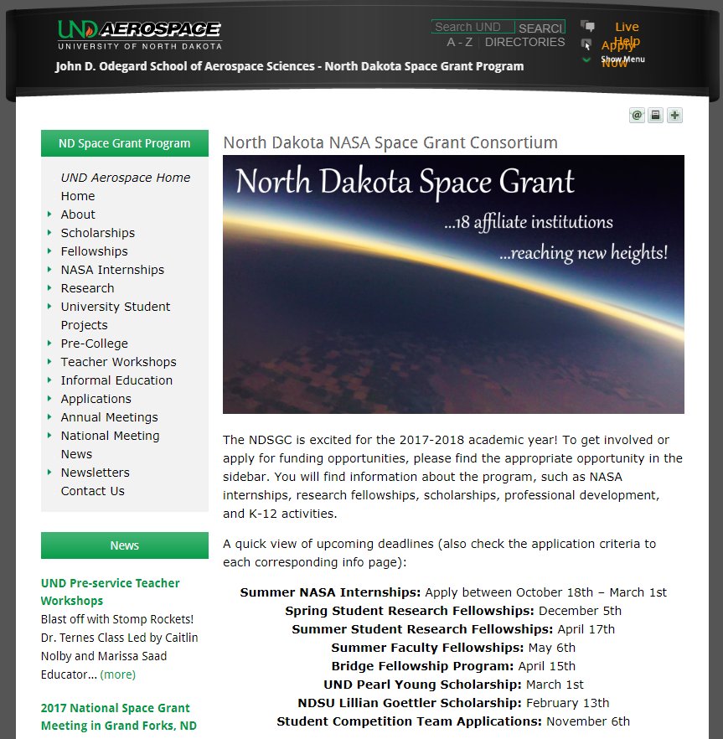
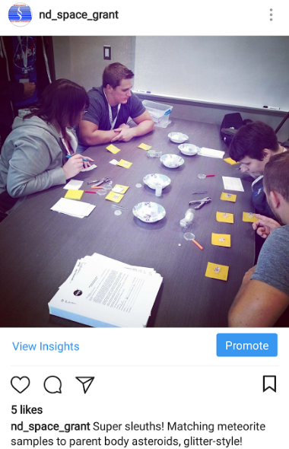
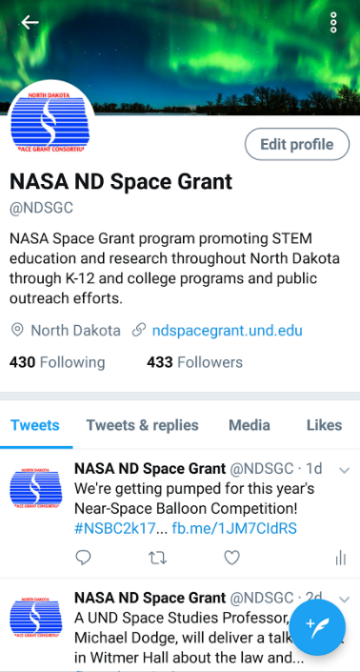
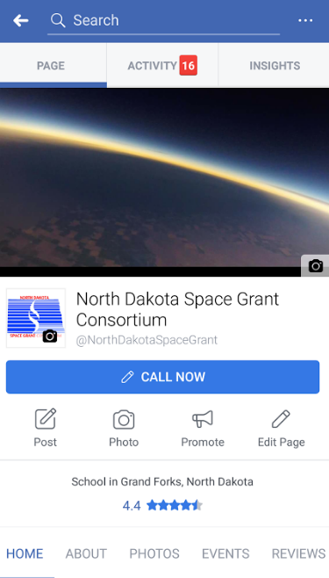
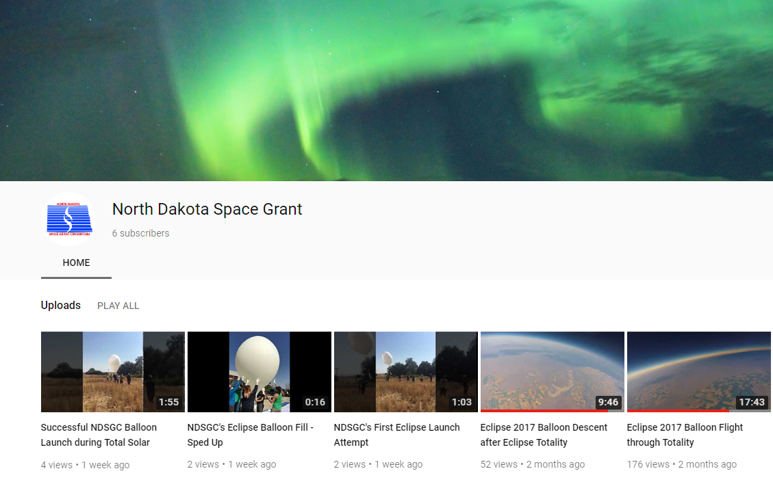
NDspacegrant.und.edu

Slide 25
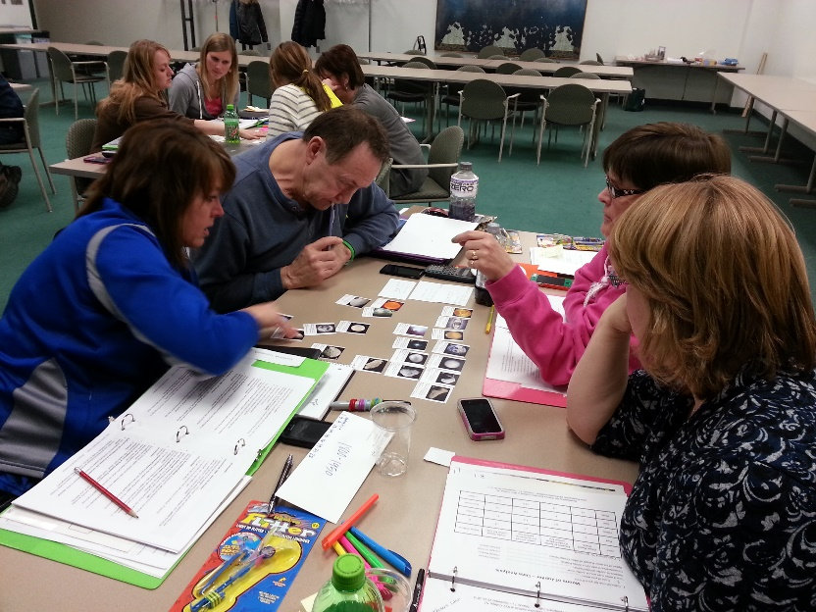
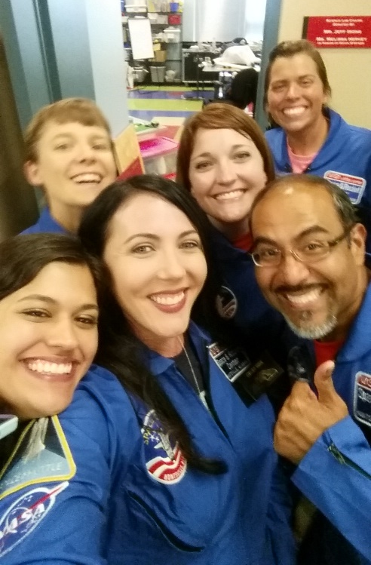
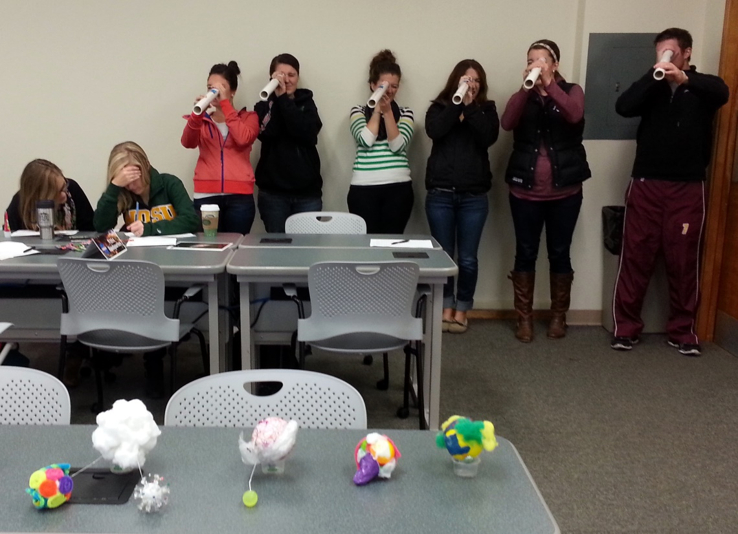
NDSGC K-12 Educator Email Listserv
Workshop opportunities
New STEM education resources for the classroom
NASA student contests/team competitions
Professional Development opportunities
Emails ~once a week

Slide 26
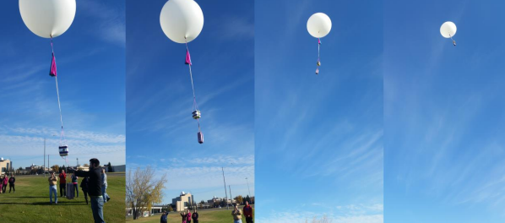
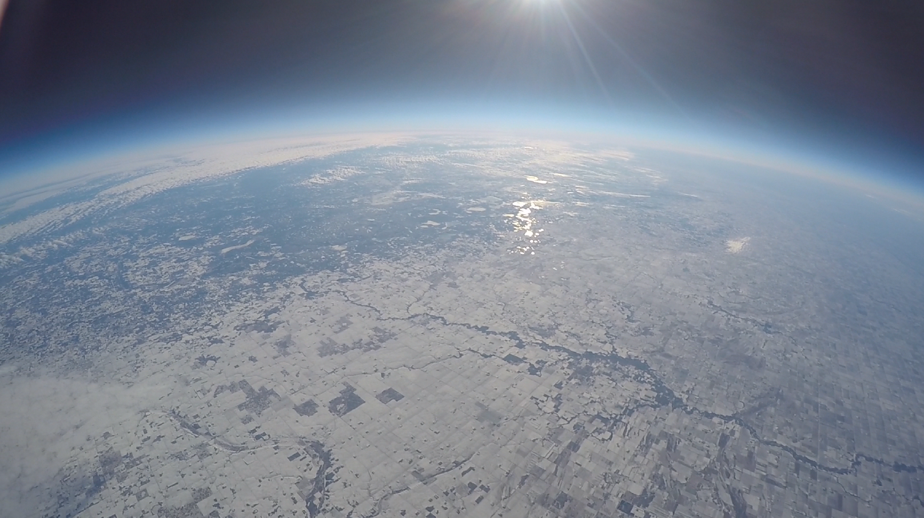
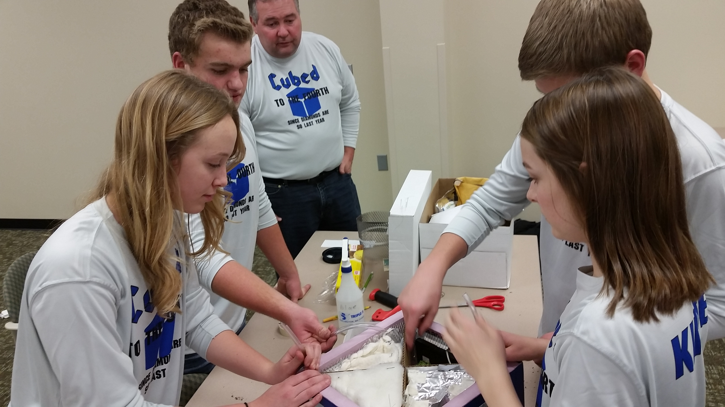
Near-space balloon competition
Annual competition each fall semester
Open to student teams grades 6-12
Middle and high school students create their own science/engineering project
Launches on a 1500-gram balloon, reaching 100,000 feet
http://blogs.und.edu/nsbc

Slide 27
Mars mission and nasa educator resources
Caitlin Nolby, cnolby@space.edu
Marissa saad, msaad@space.edu
North Dakota Space Grant Consortium

