Slide 1
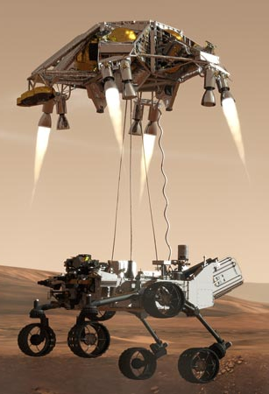
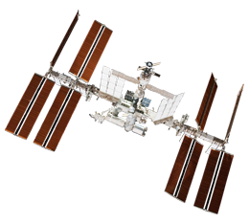
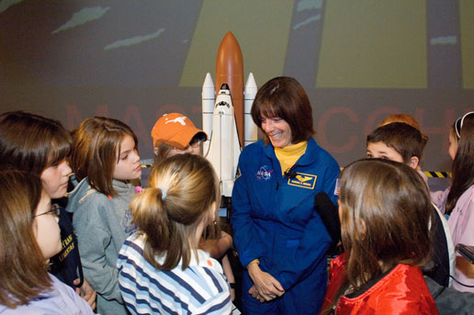
Educator Resources in Space Sciences
Caitlin Nolby
North Dakota Space Grant Consortium

Slide 2
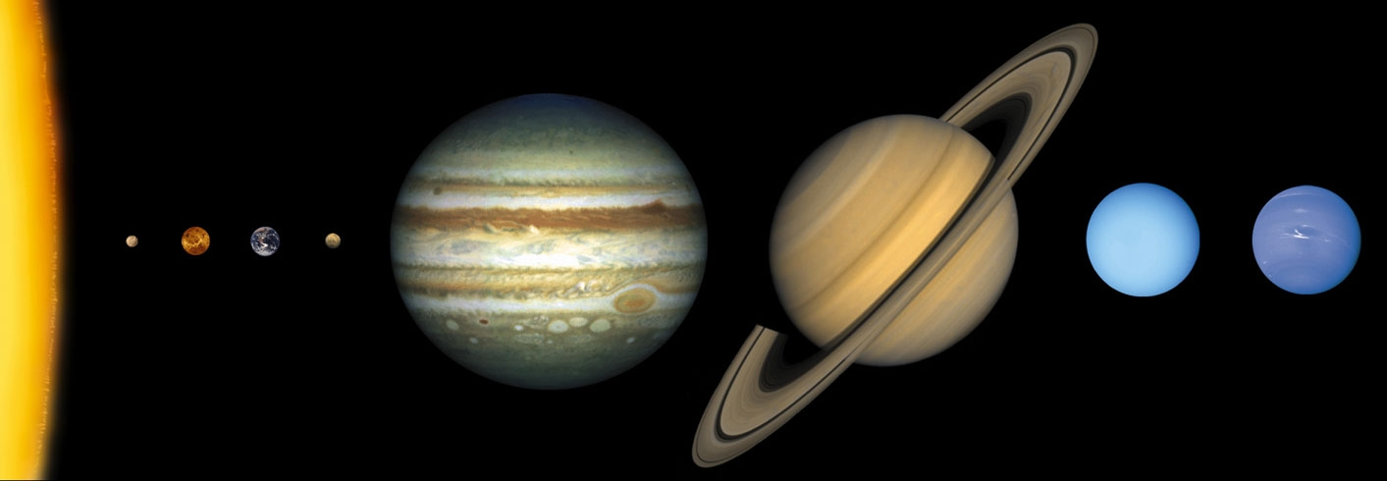
Pocket Solar System
http://www.exploratorium.edu/ronh/solar_system/

Slide 3
Strange New Planet
Work in NASA teams to collect data to plan missions and explore new worlds!
http://kepler.nasa.gov/multimedia/Interactives/HowKeplerDiscoversPlanetsElementary/#
Sort students by NASA center
Assign student roles

Slide 4
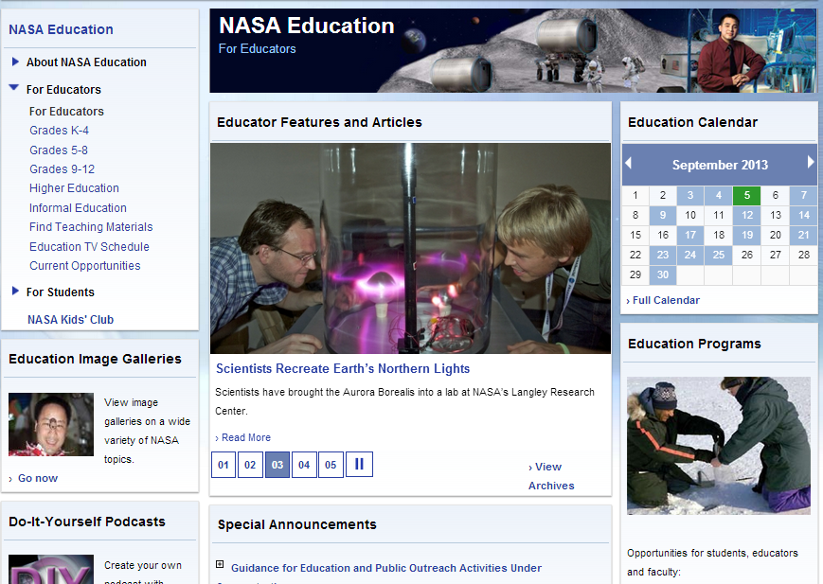
NASA Education
Can search for materials by subject and grade level

Slide 5
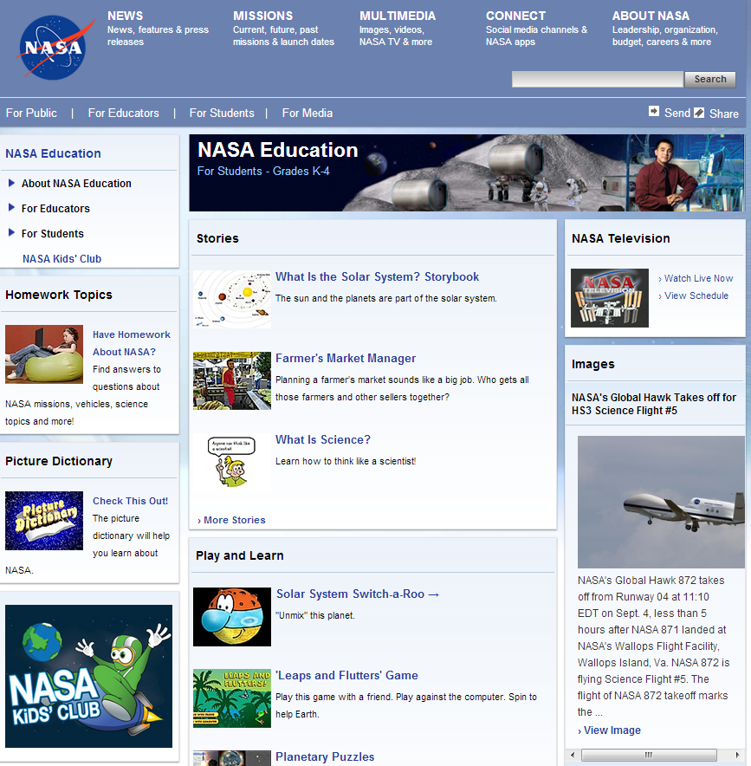
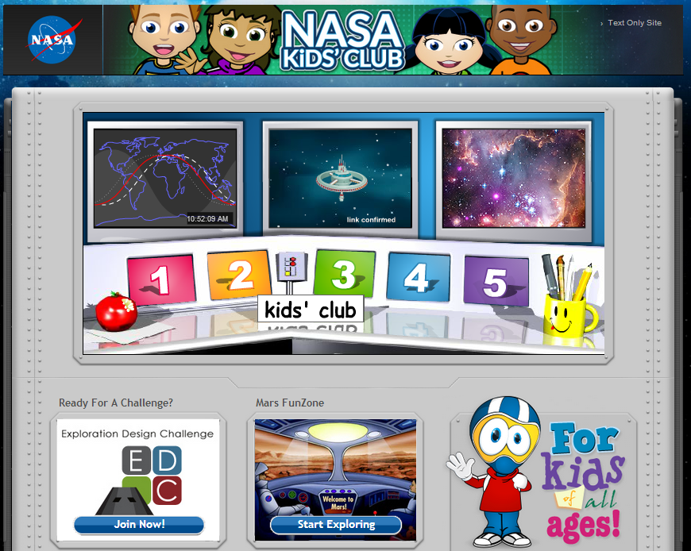
NASA for Students

Slide 6
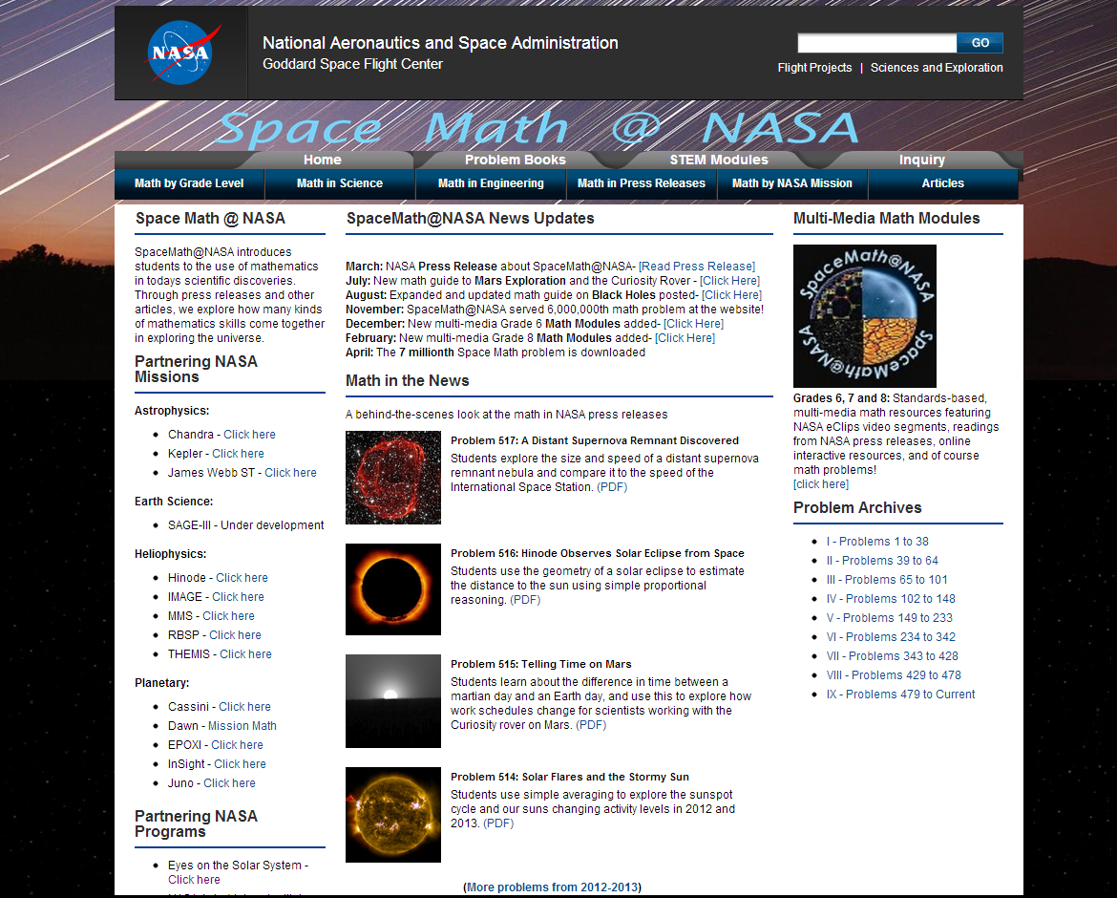
Space Math at NASA

Slide 7
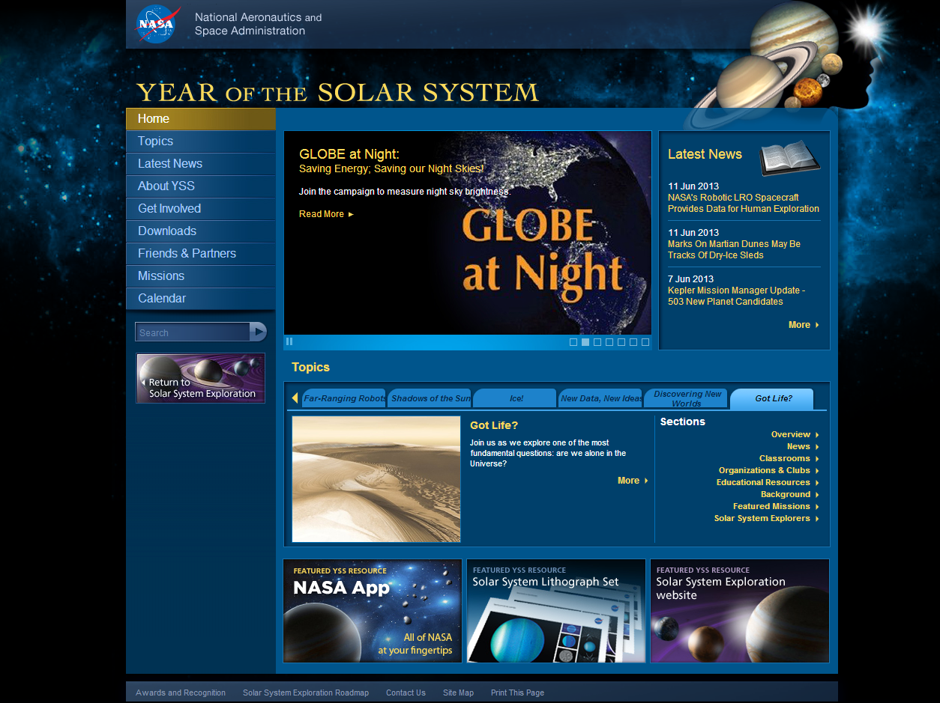
Year of the Solar System

Slide 8
International Space Station - Live!

Slide 9
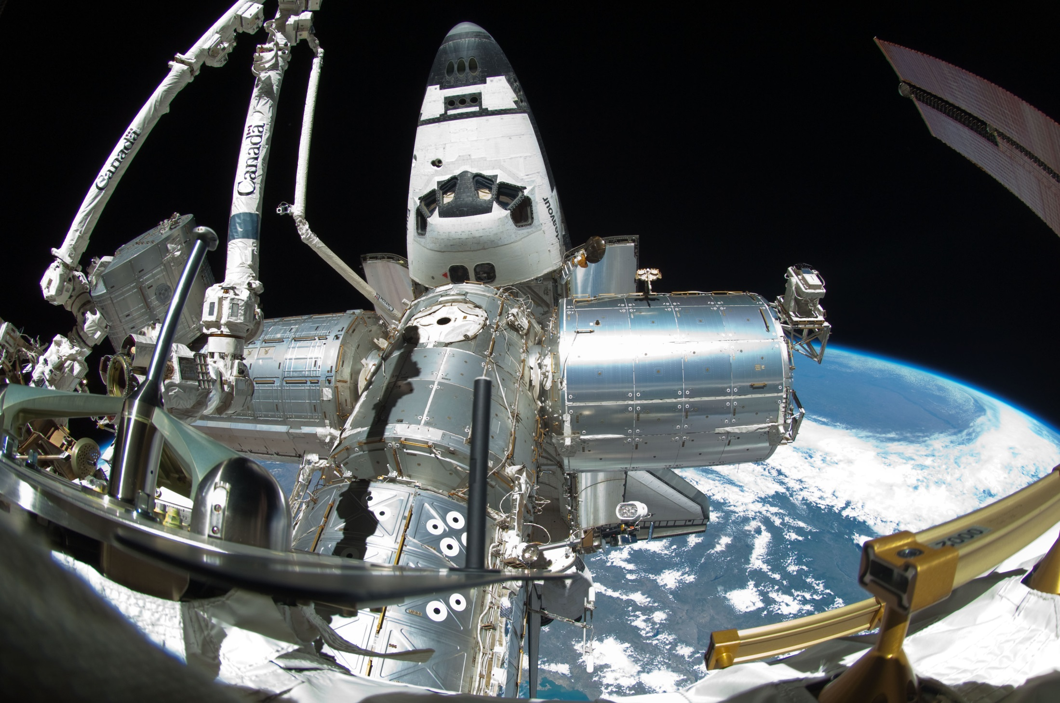
Spot the Station

Slide 10
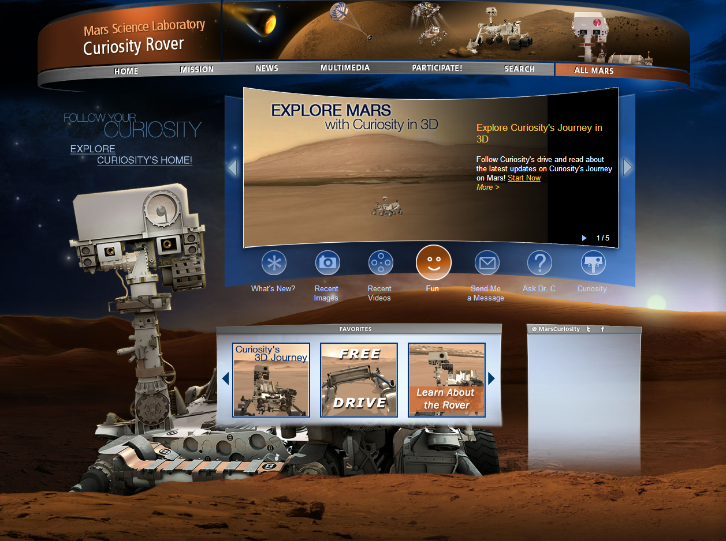
Mars Curiosity Rover

Slide 11
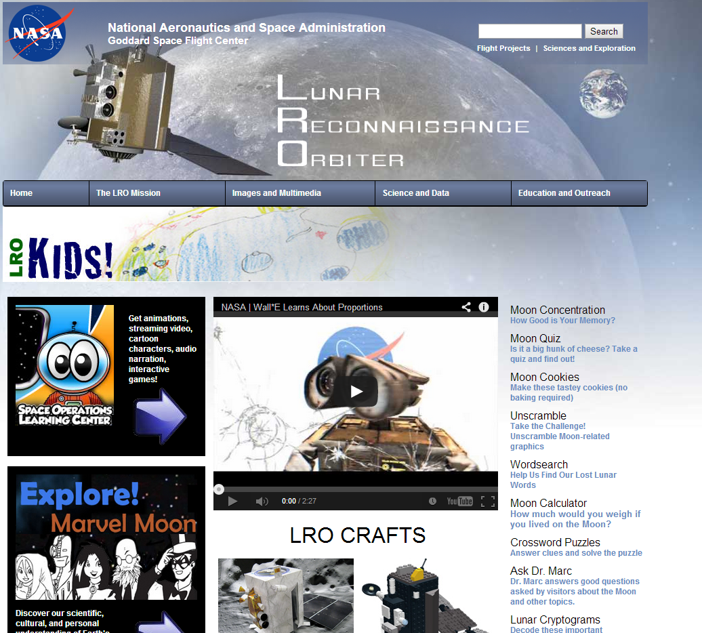
NASA – Lunar Reconnaissance Orbiter

Slide 12
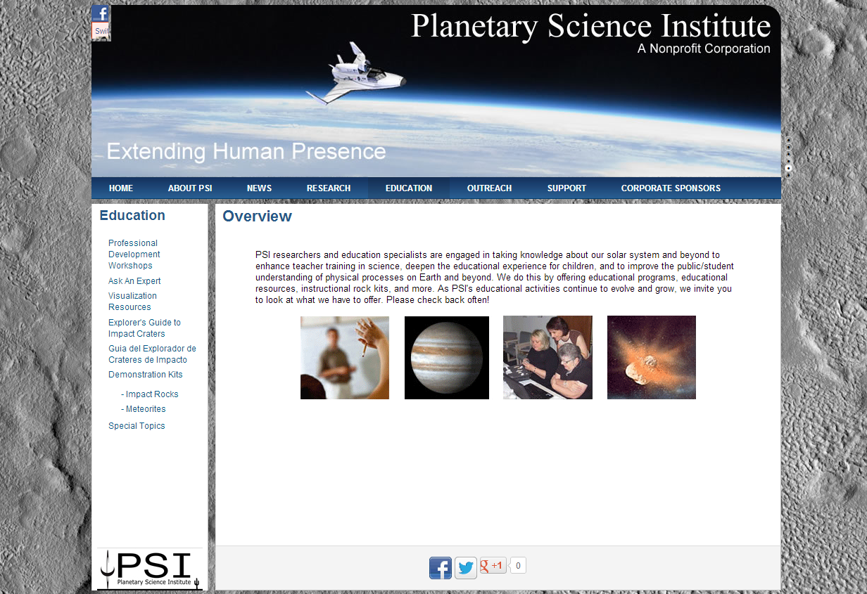
Planetary Science Institute

Slide 13
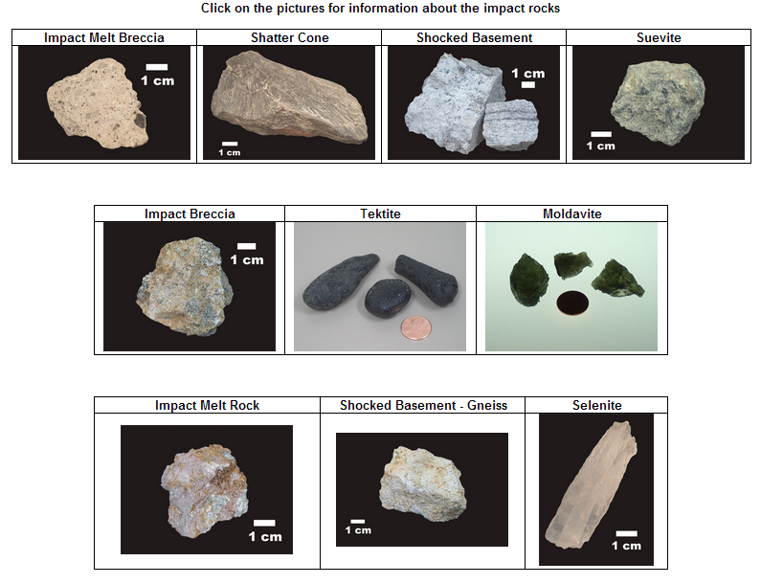
Planetary Science Institute

Slide 14
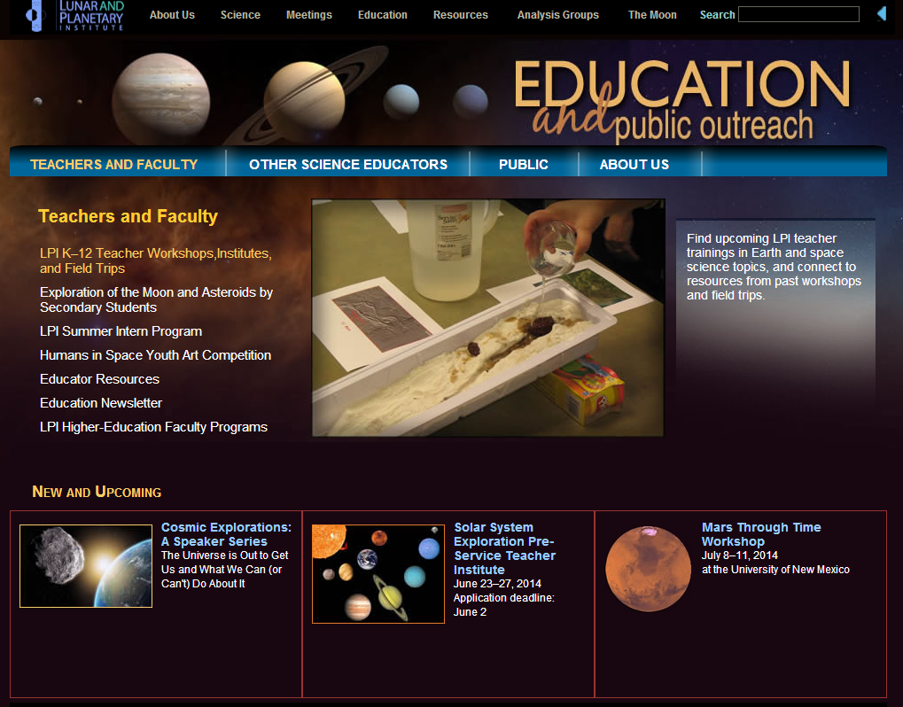
Lunar and Planetary Institute

Slide 15
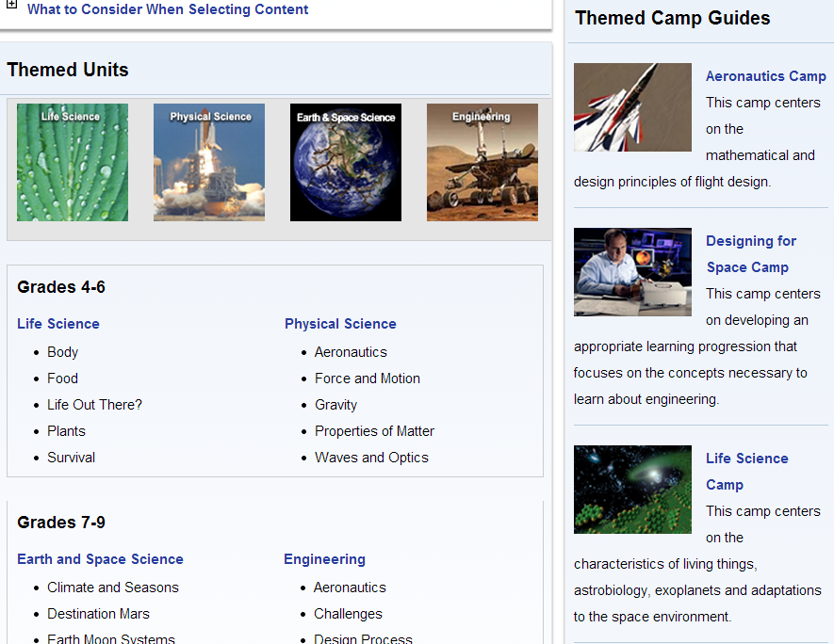
NASA Summer of Innovation

Slide 16
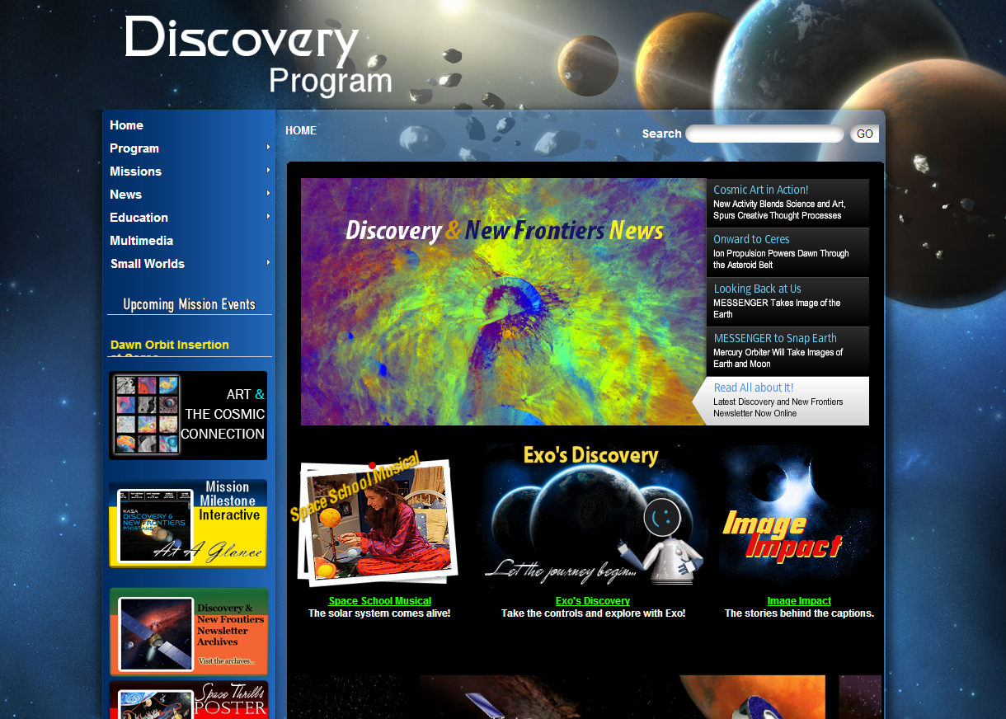
NASA Discovery Program

Slide 17
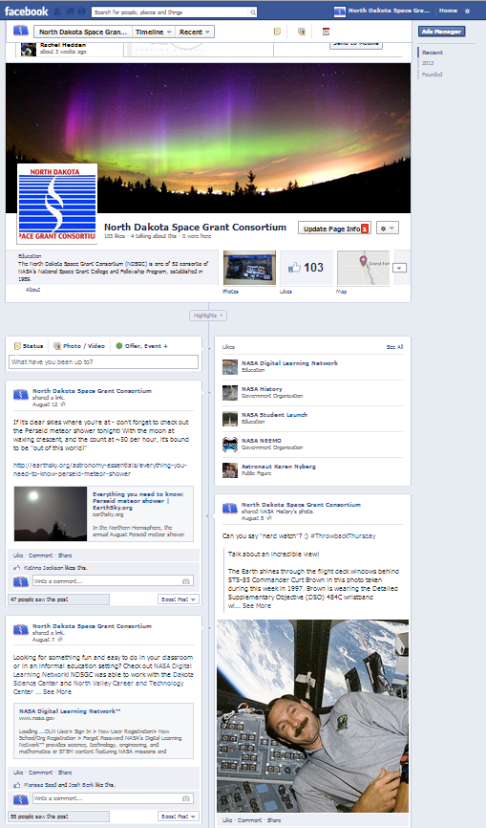
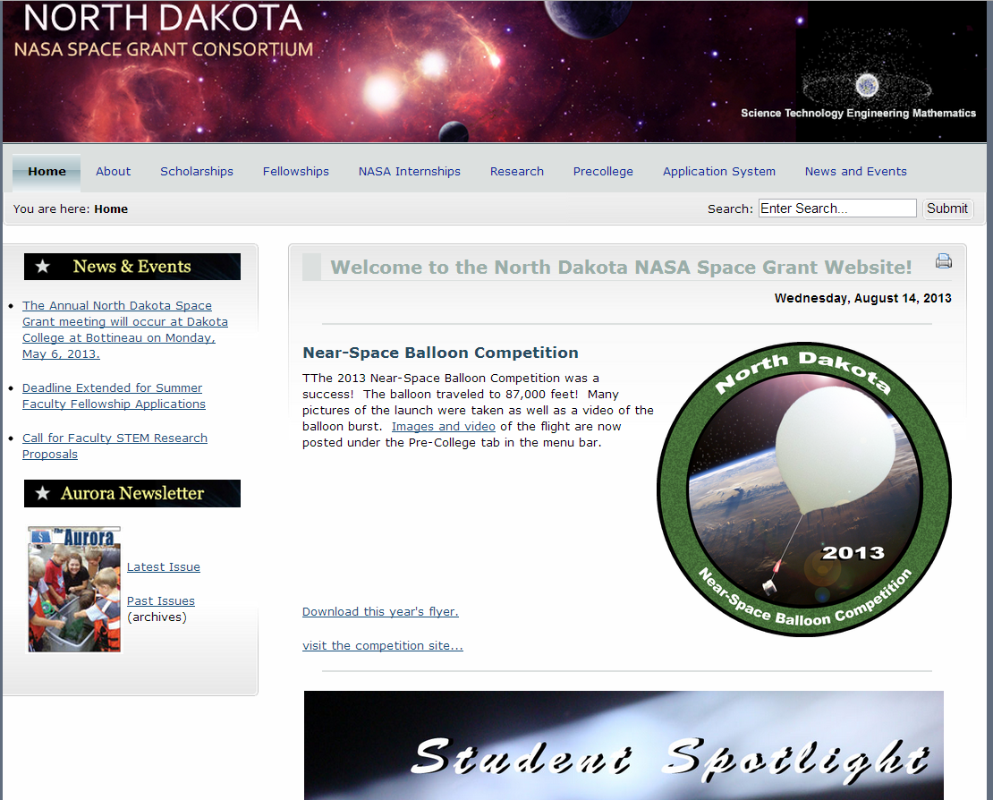
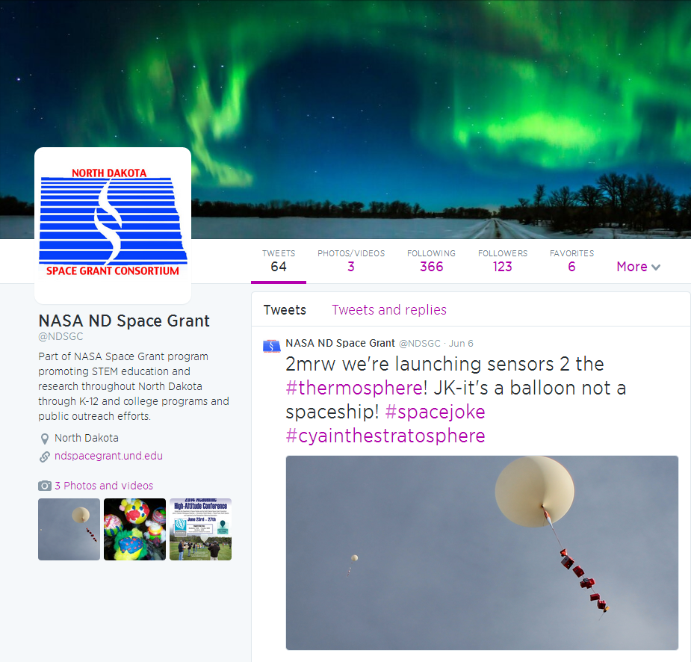
North Dakota Space Grant

Slide 18
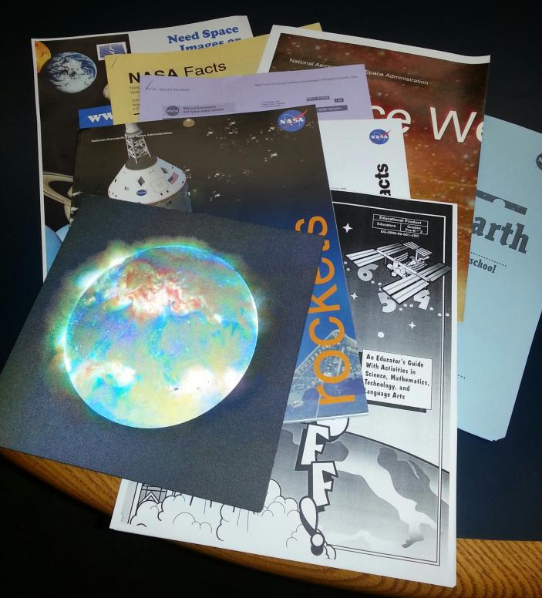
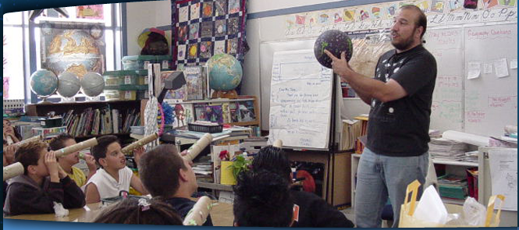
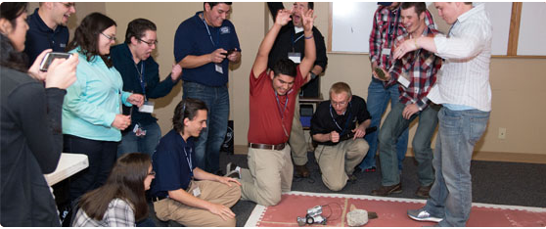
NDSGC K-12 Educator Email Listserv!
Workshop opportunities
New STEM education resources for the classroom
NASA student contests/team competitions
Professional Development opportunities
Emails ~once a week

Slide 19
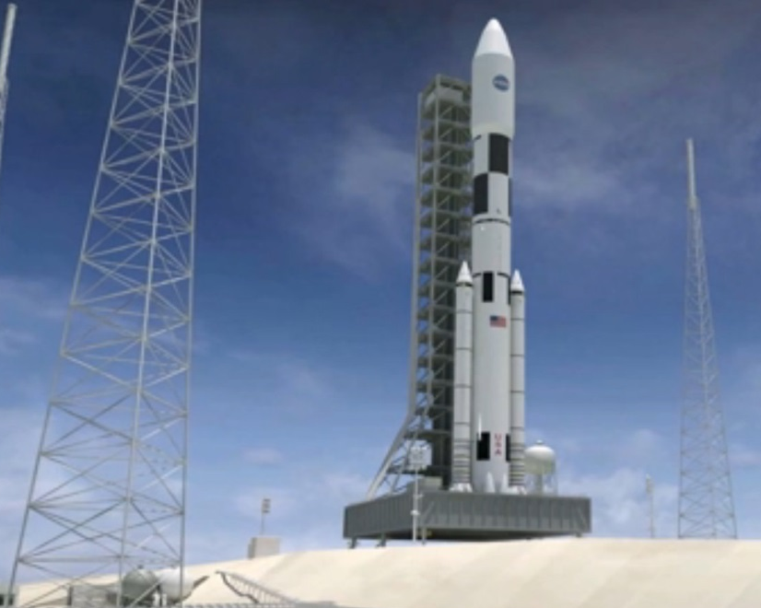
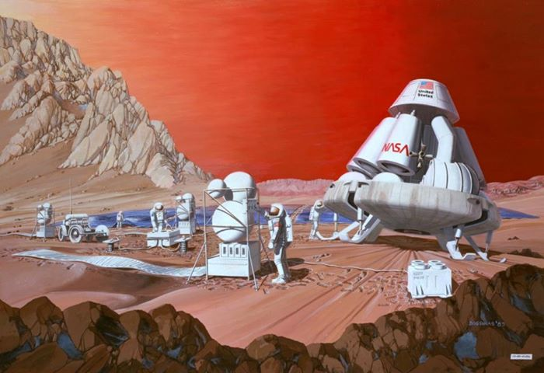
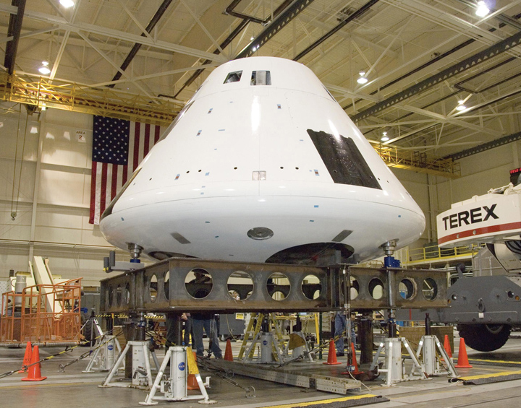
Future Space Exploration
Manned mission to an asteroid?
Return to Moon?
Manned mission to Mars?
NASA Space Launch System (SLS), Orion (Multi-purpose crew vehicle)

