Slide 1
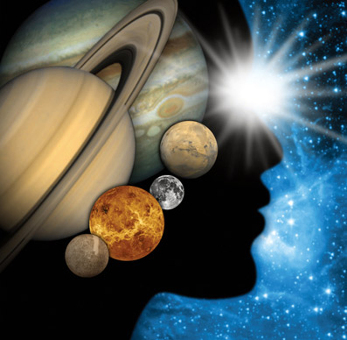
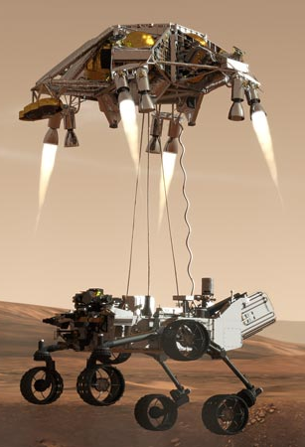
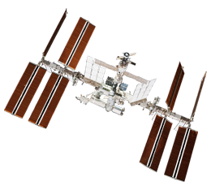
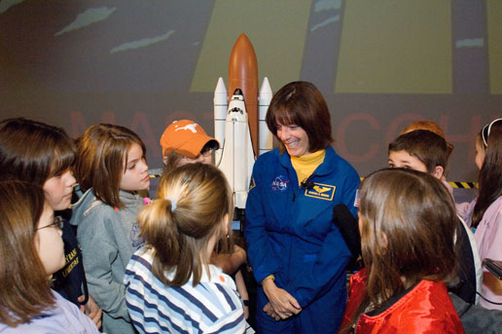
Educator Resources in Space Sciences
Caitlin Nolby and Marissa Saad
North Dakota Space Grant Consortium

Slide 2
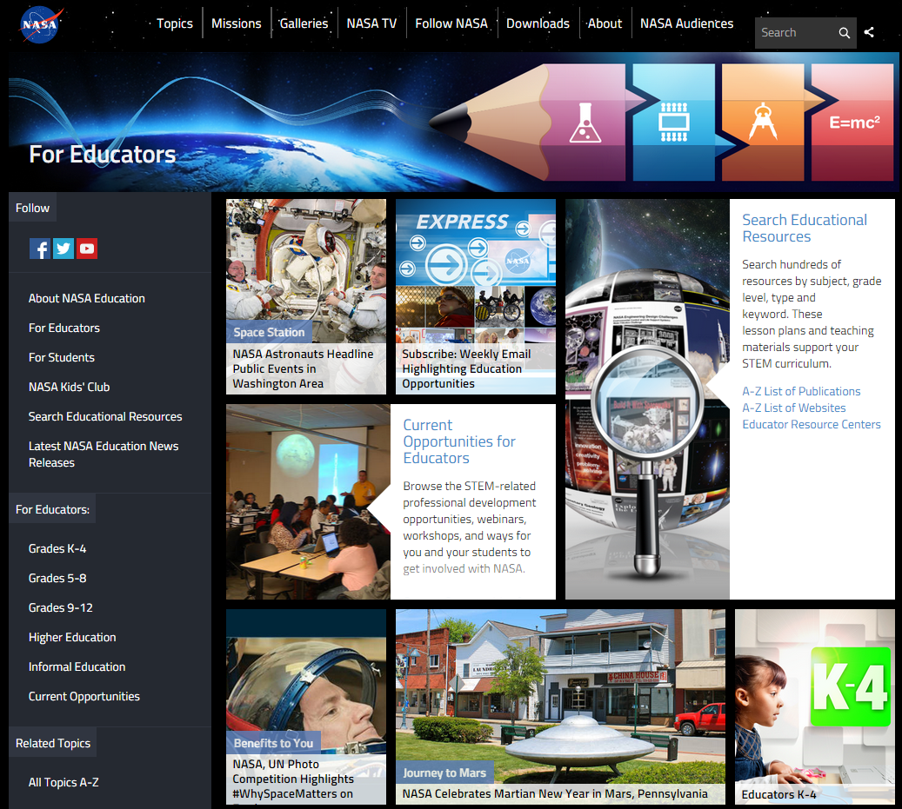
NASA Education

Slide 3
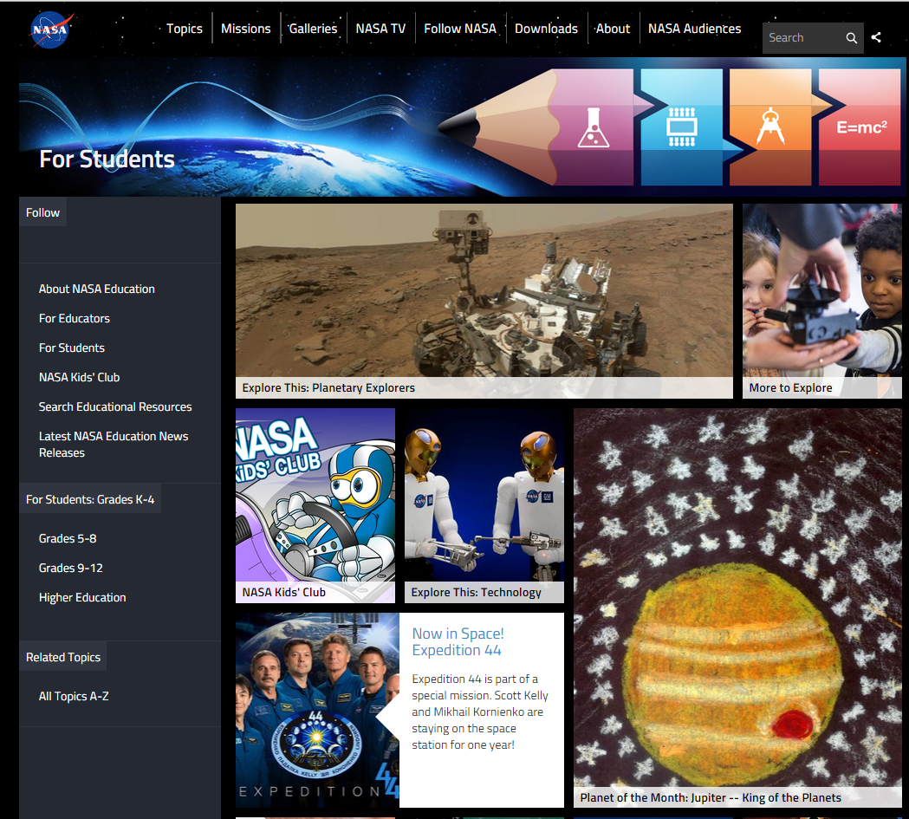
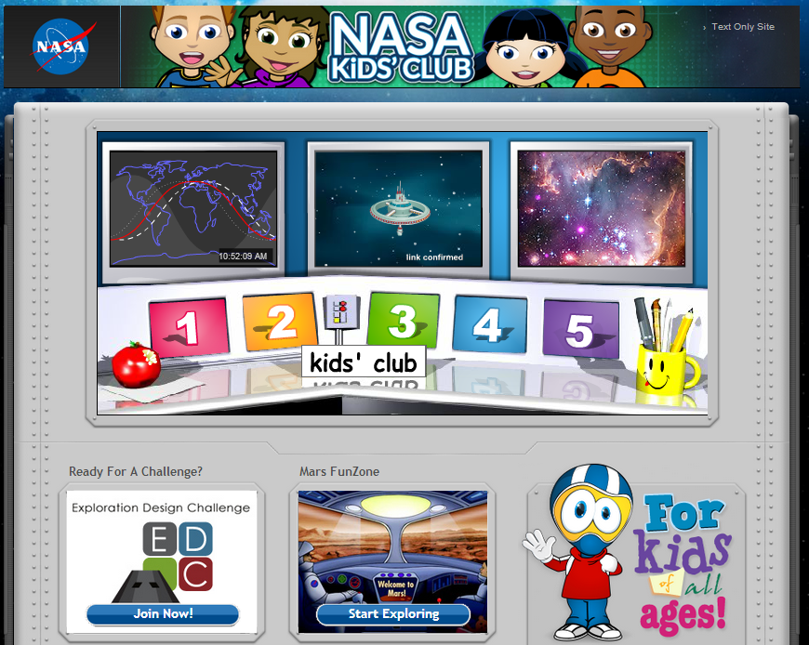
NASA for Students

Slide 4
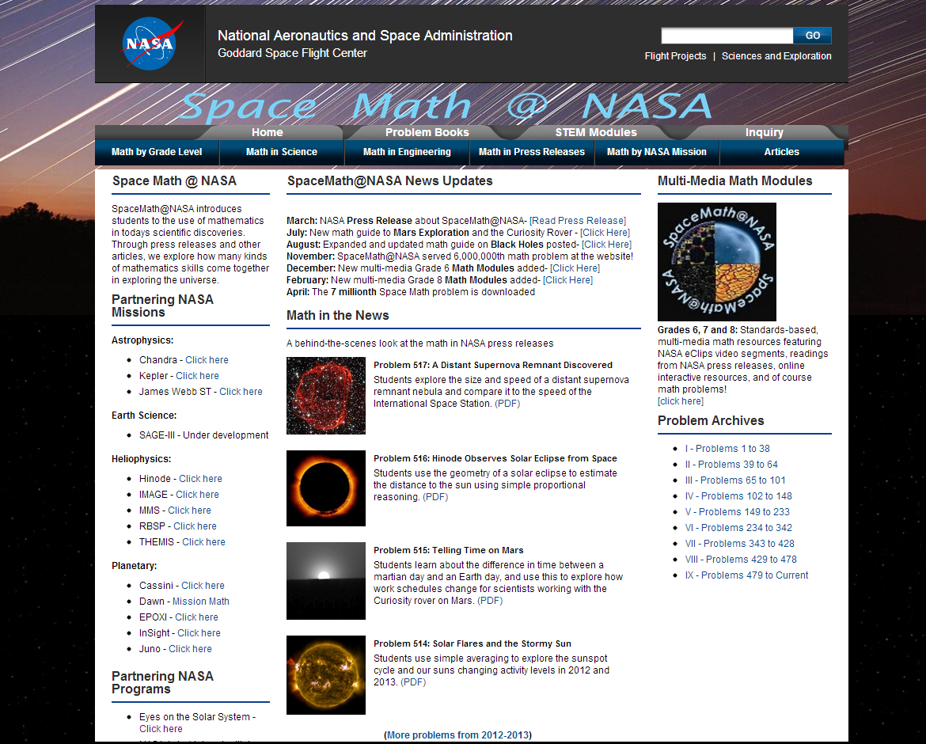
Space Math at NASA

Slide 5
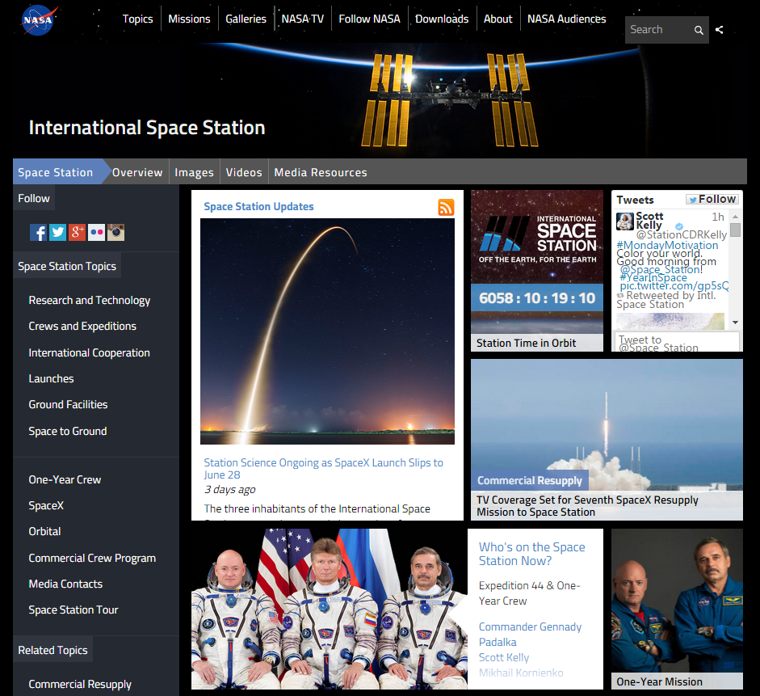
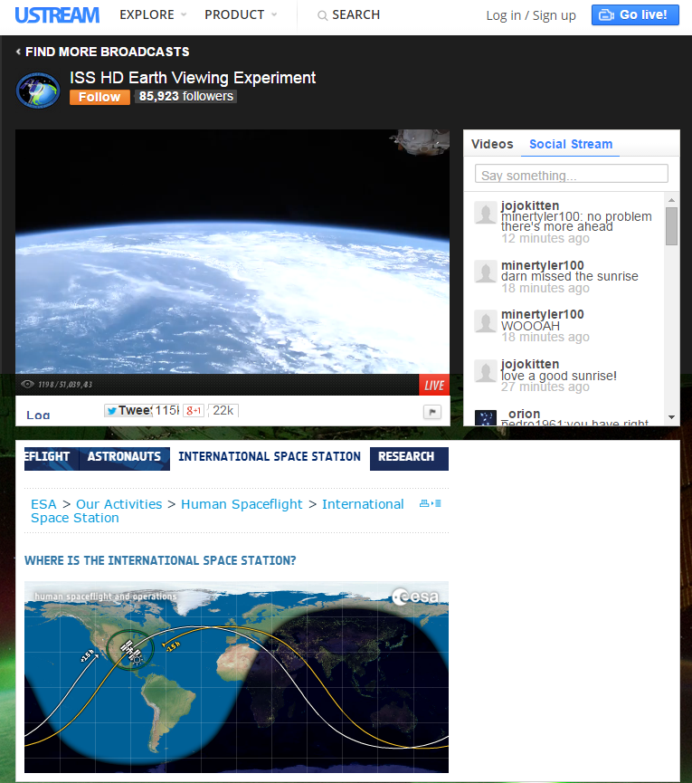
International Space Station - Live!

Slide 6
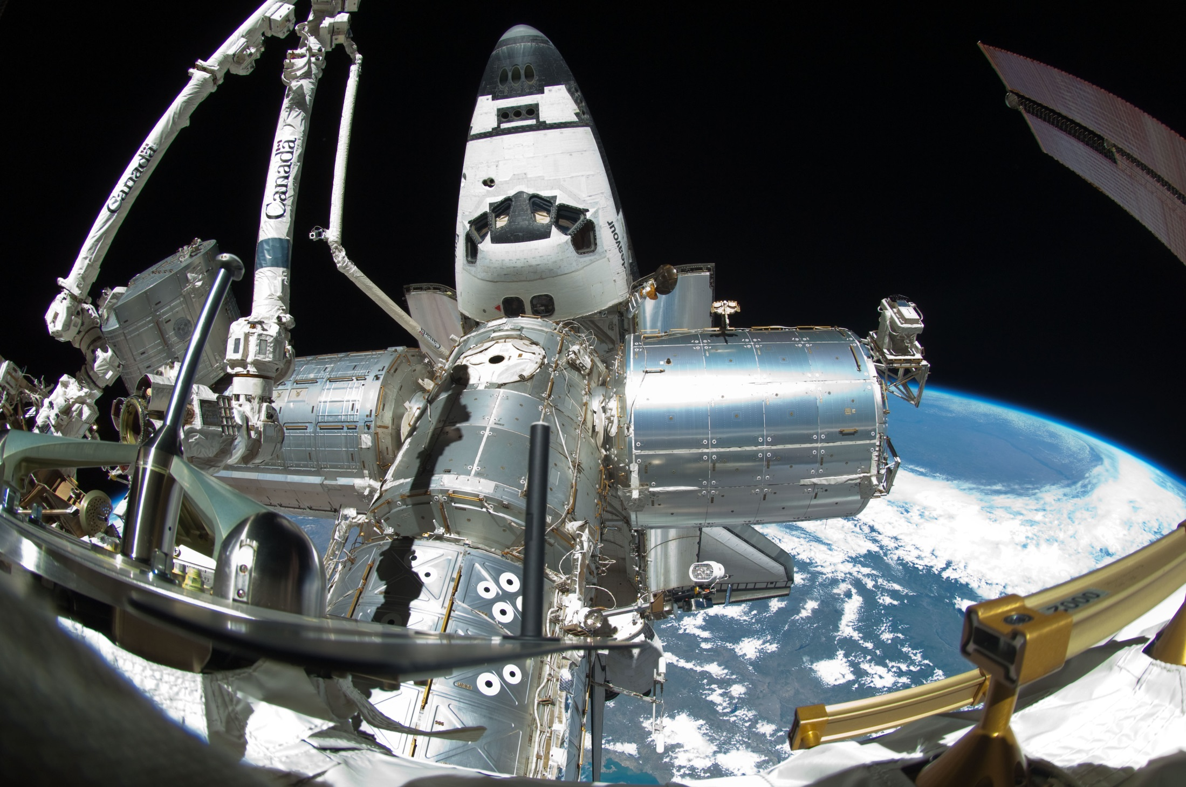
Spot the Station

Slide 7
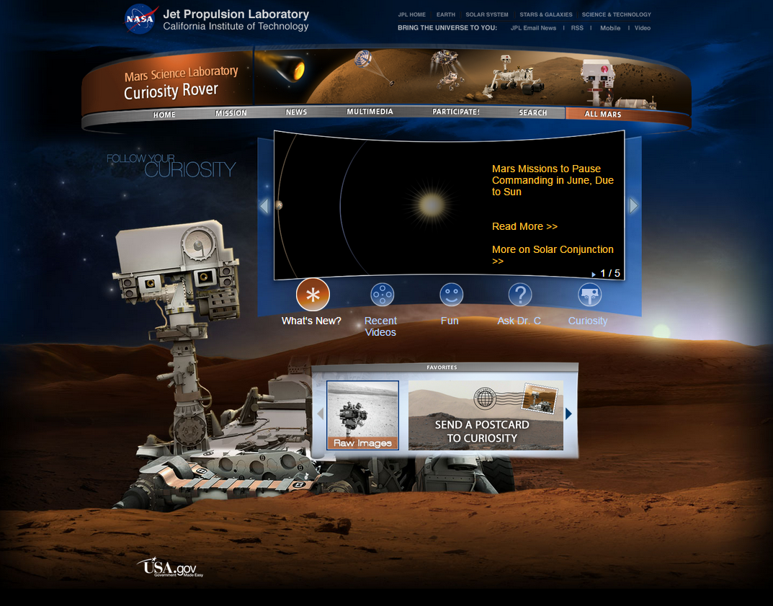
Mars Curiosity Rover

Slide 8
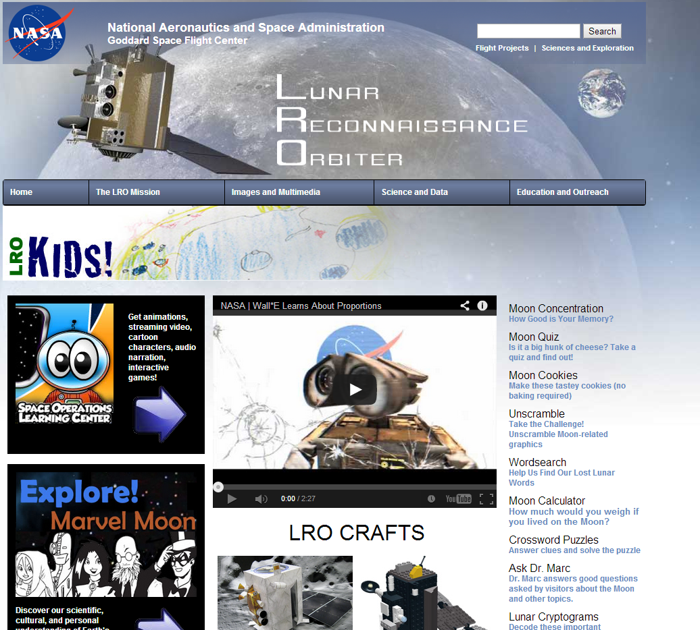
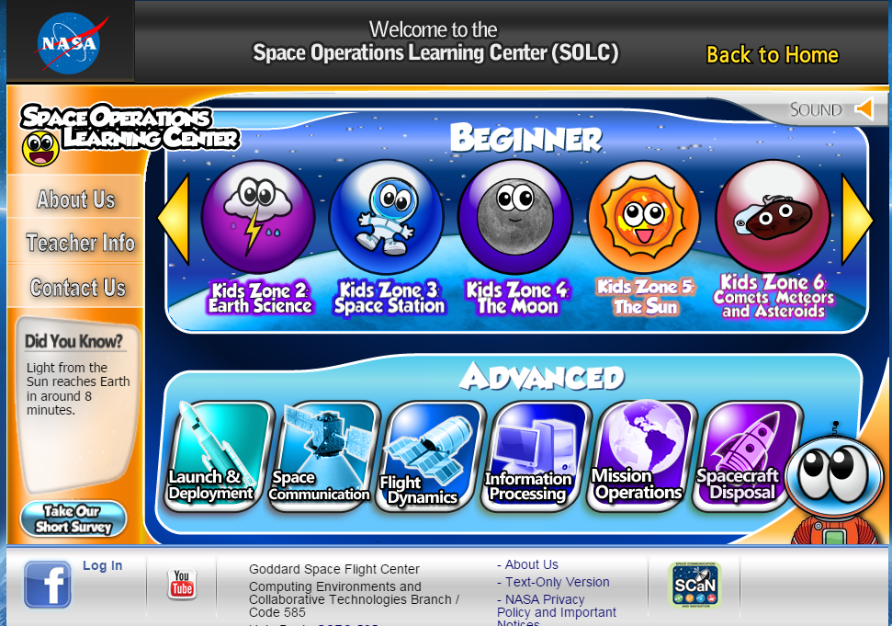
NASA – Lunar Reconnaissance Orbiter

Slide 9
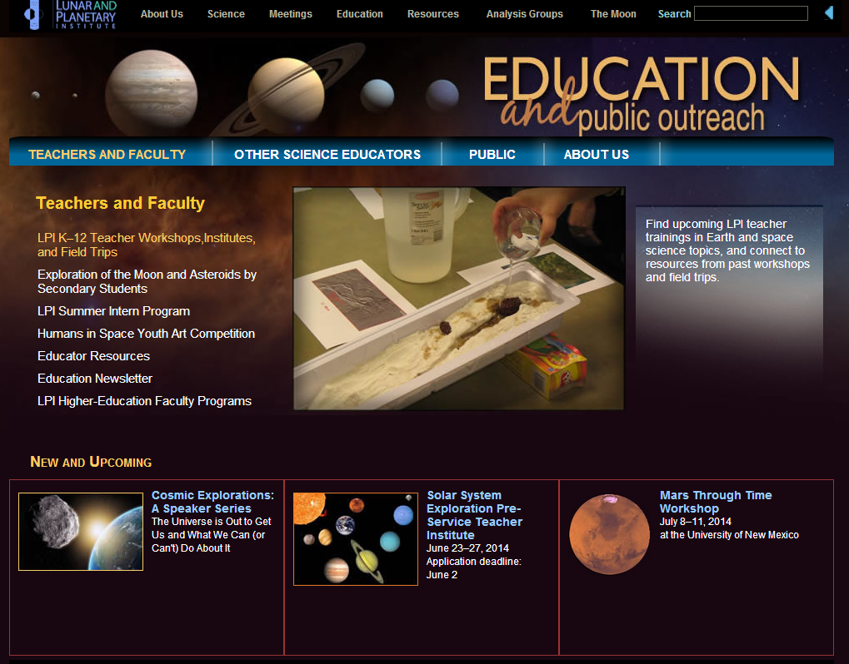
Lunar and Planetary Institute

Slide 10
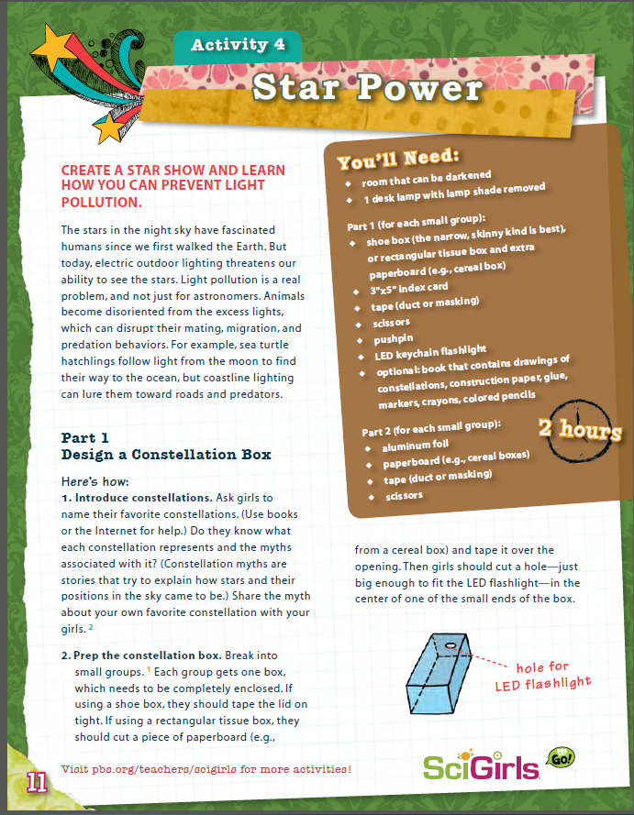
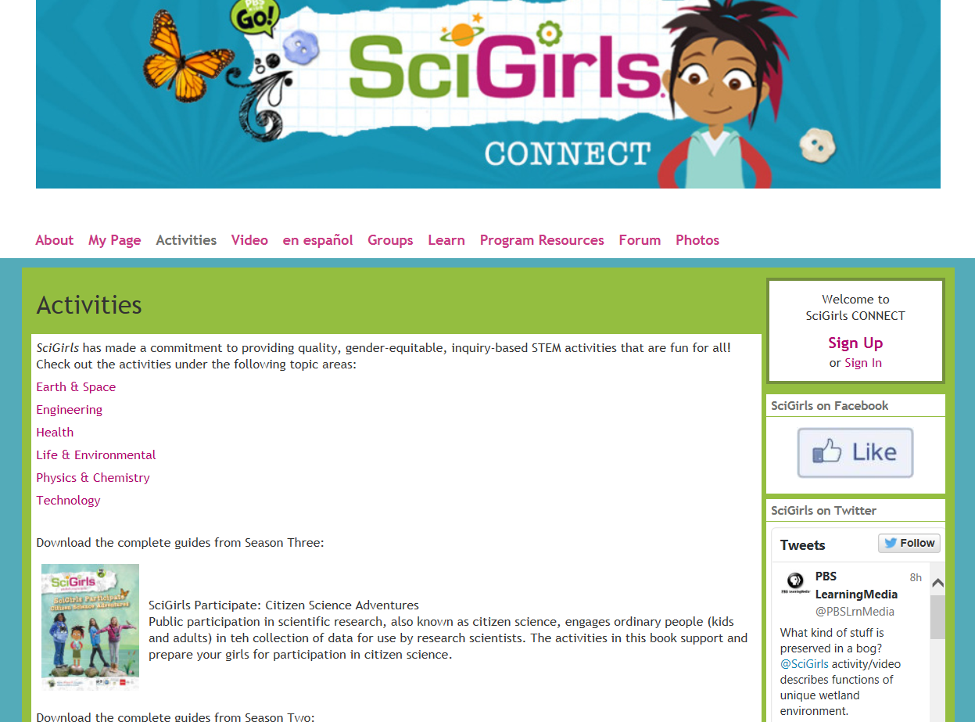
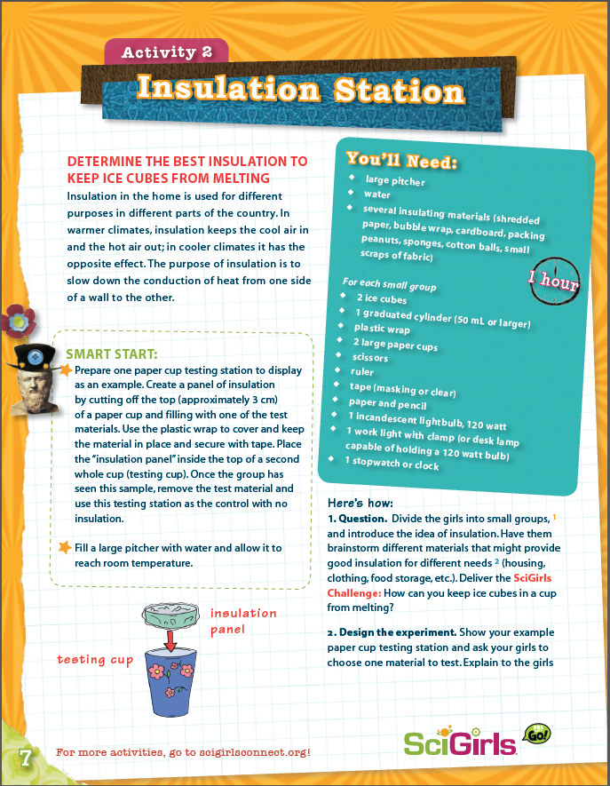
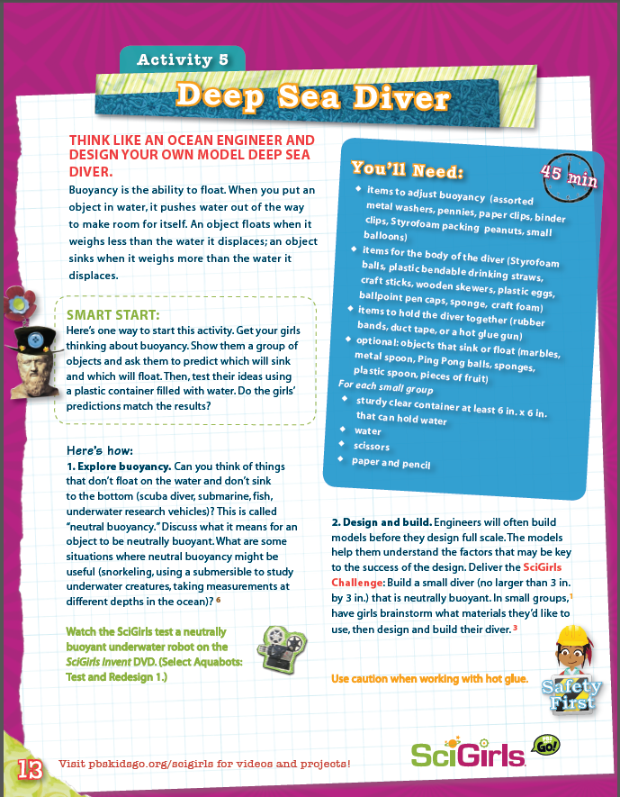
SciGirls Activities

Slide 11
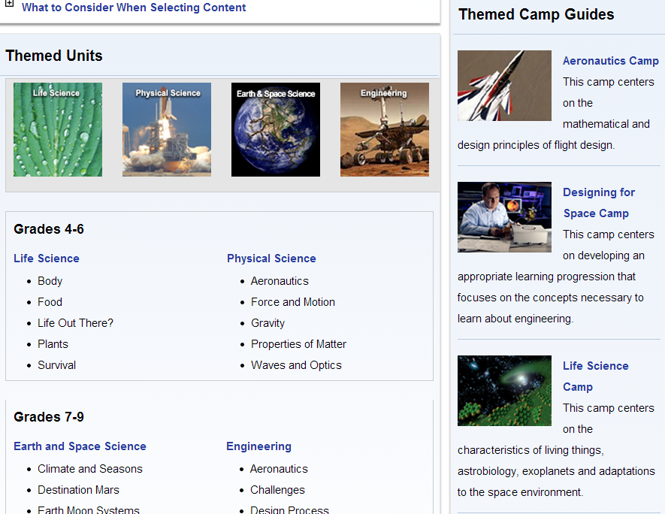
NASA Summer of Innovation

Slide 12
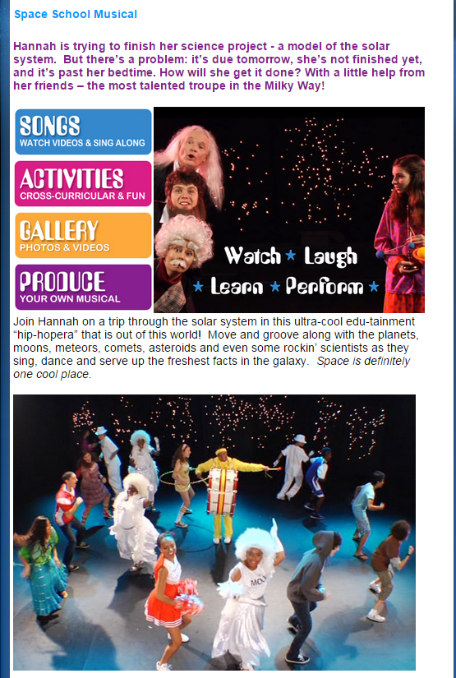
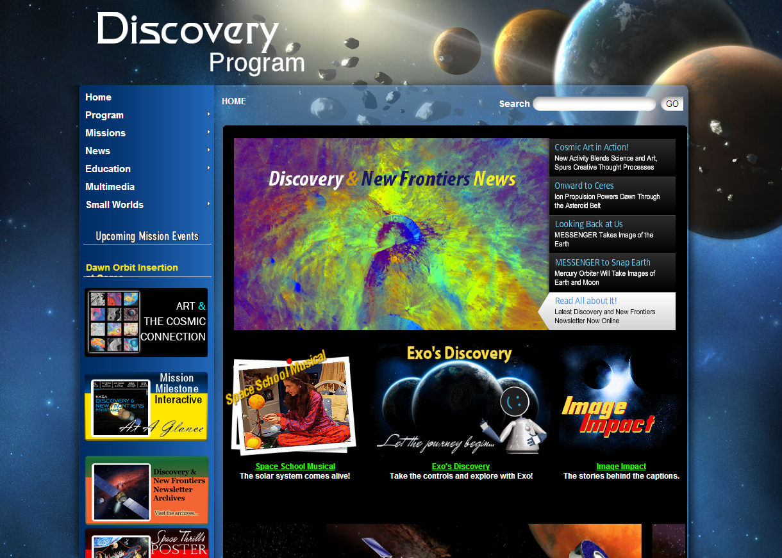
NASA Discovery Program

Slide 13
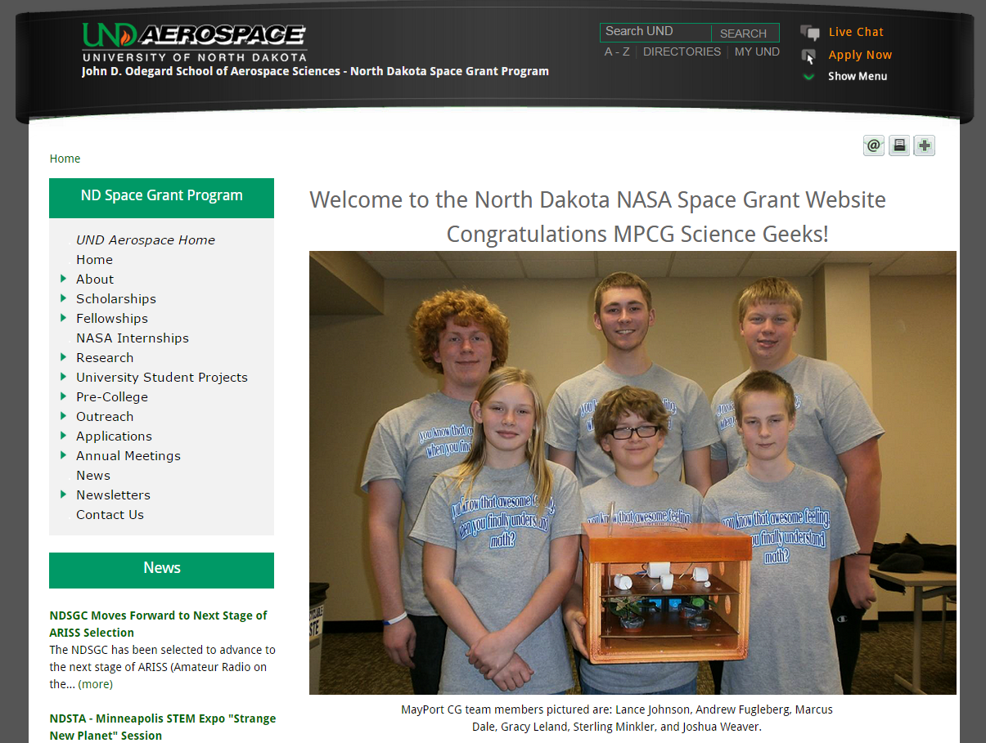
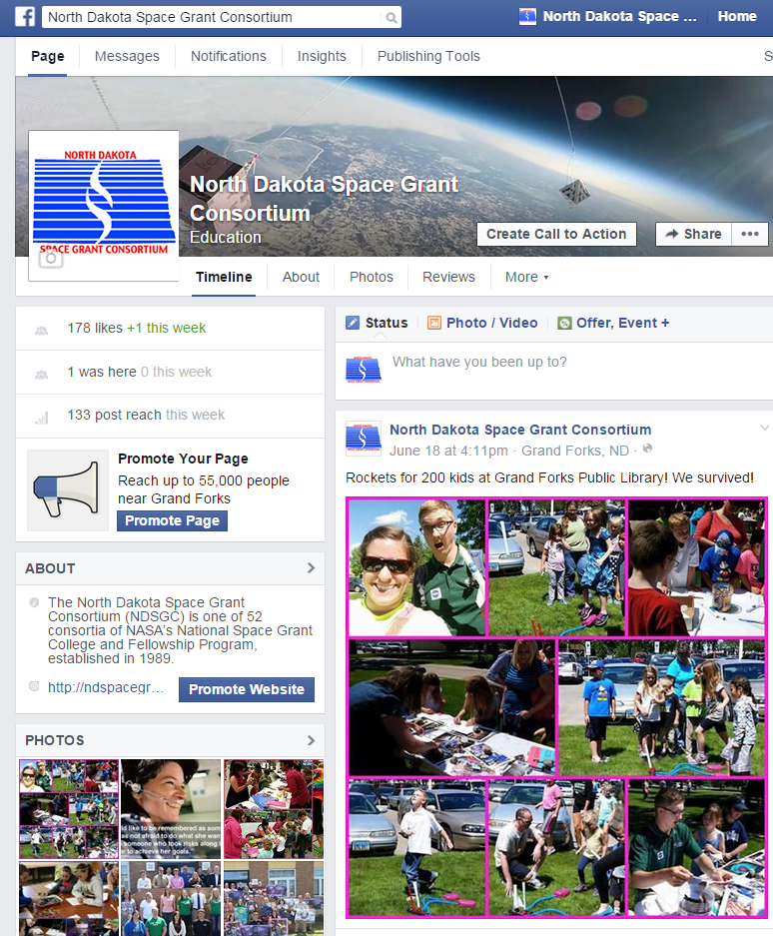
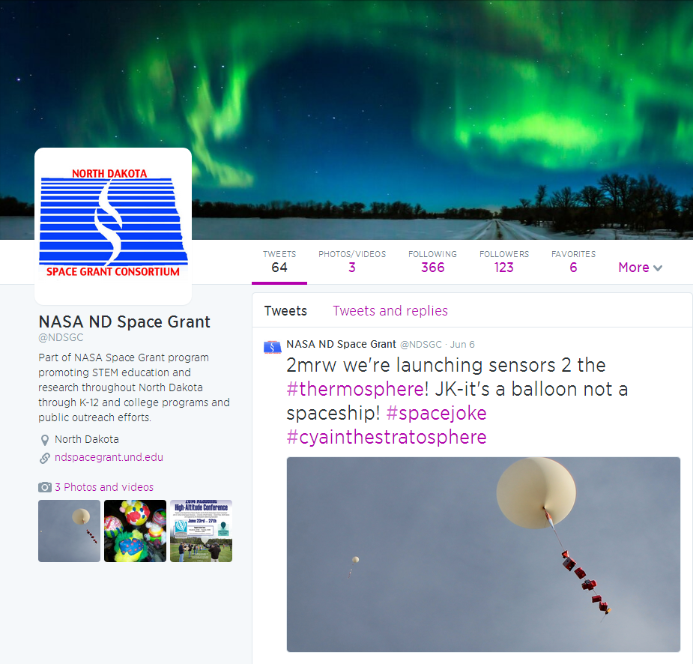
North Dakota Space Grant

Slide 14
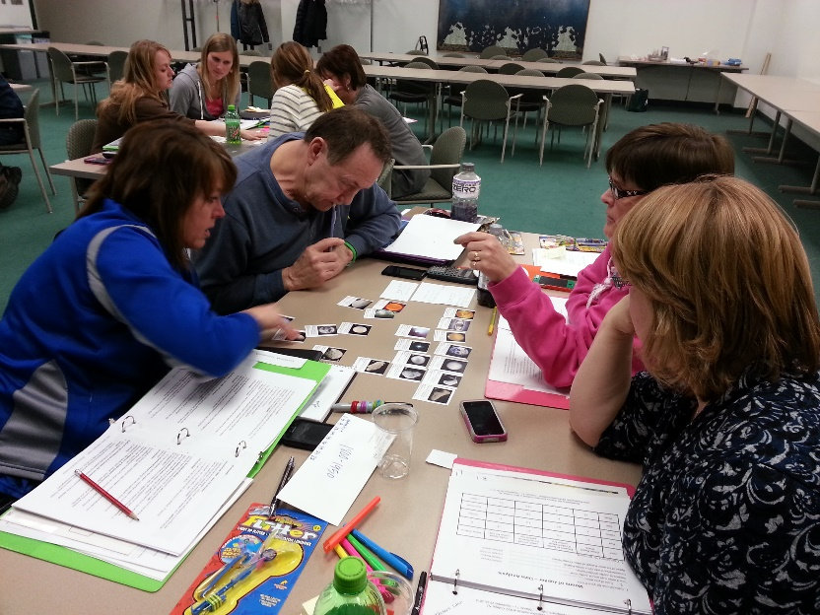
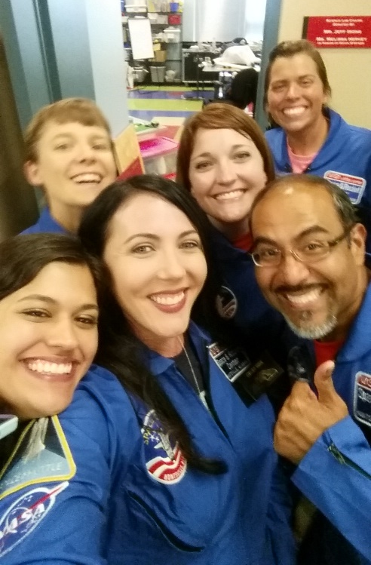
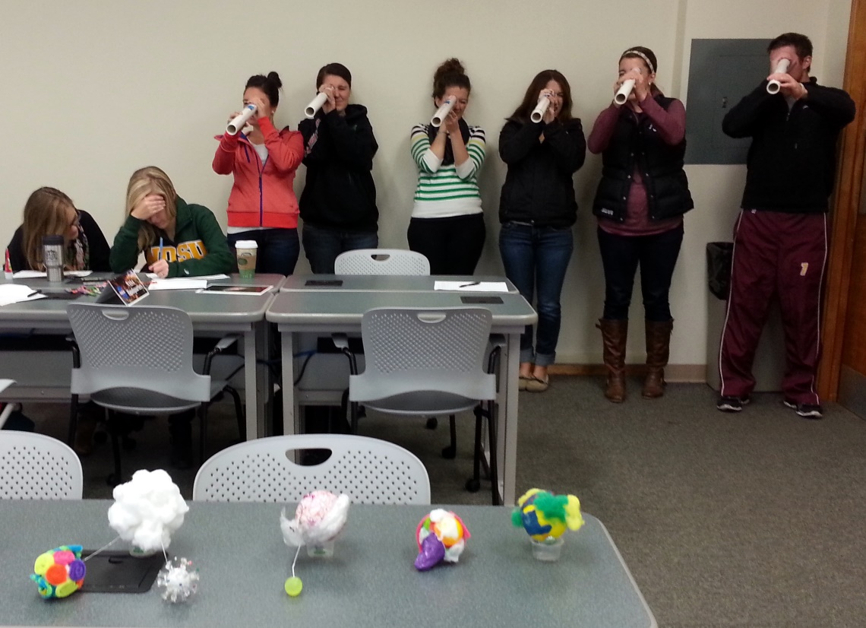
NDSGC K-12 Educator Email Listserv
Workshop opportunities
New STEM education resources for the classroom
NASA student contests/team competitions
Professional Development opportunities
Emails ~once a week

Slide 15
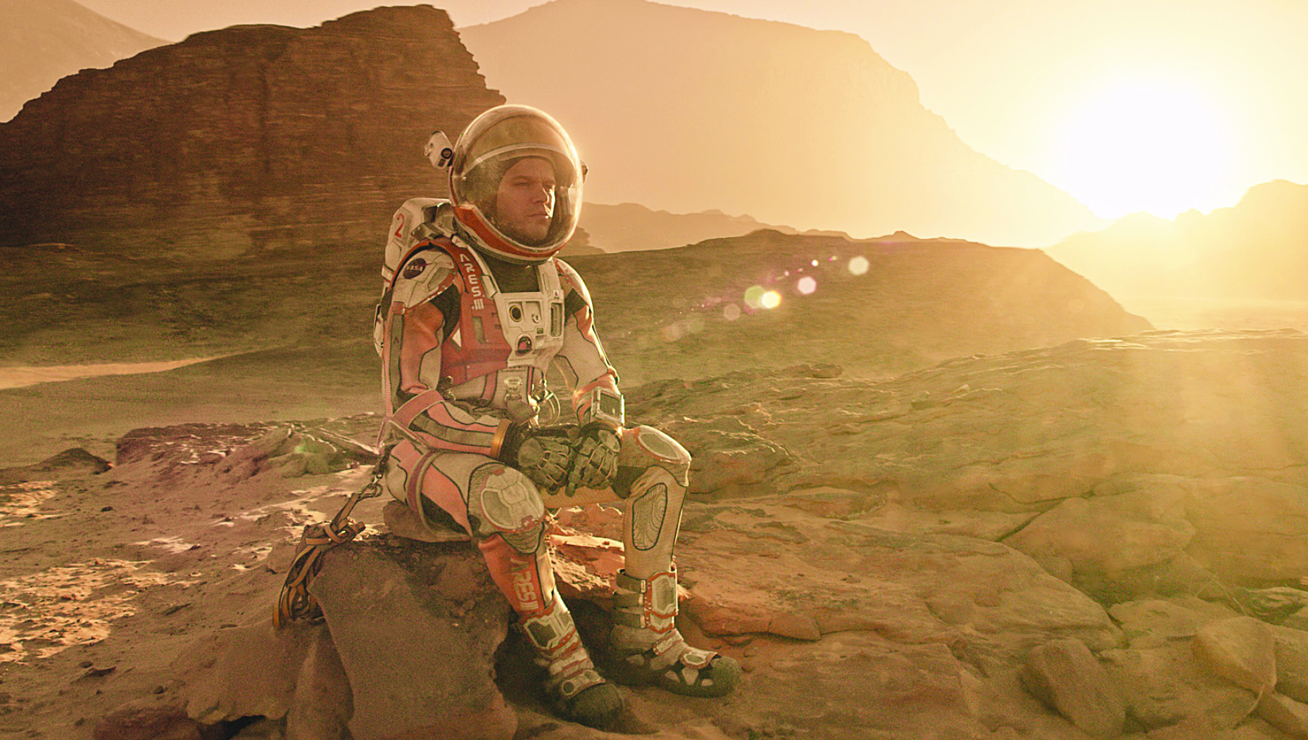

Slide 16
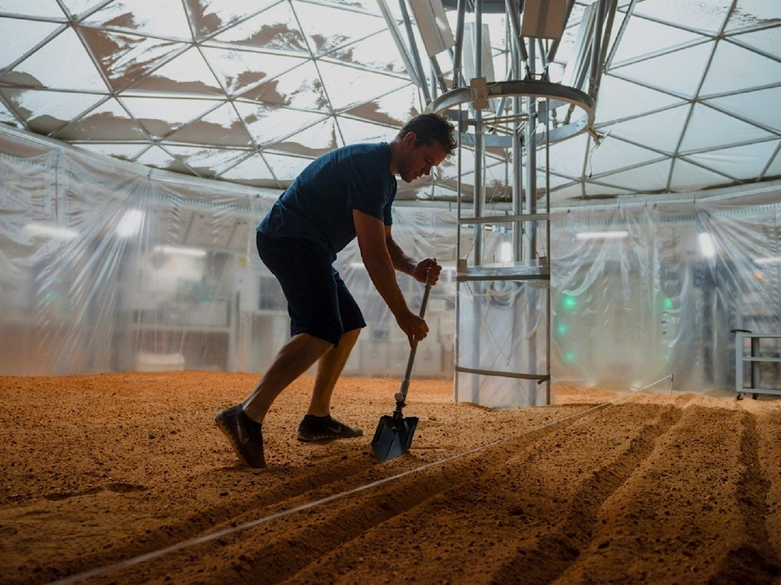

Slide 17
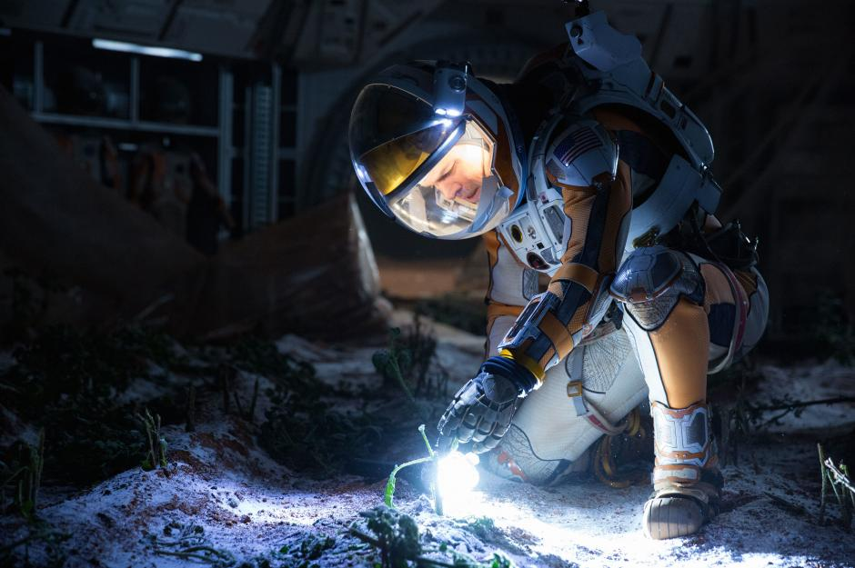

Slide 18
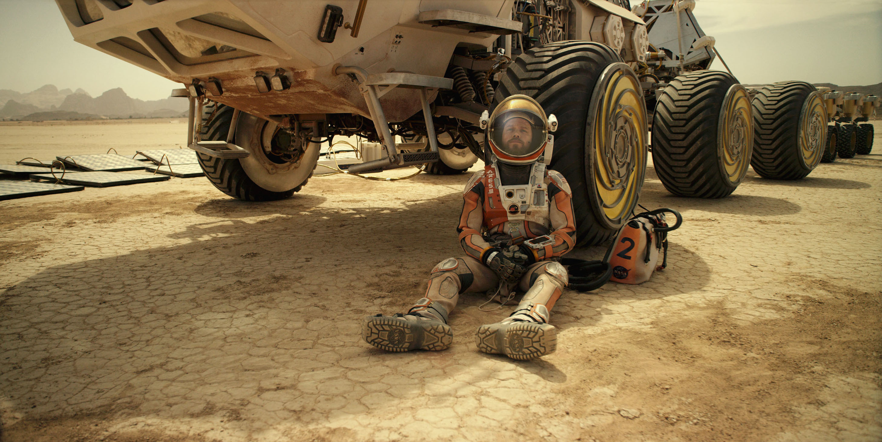

Slide 19
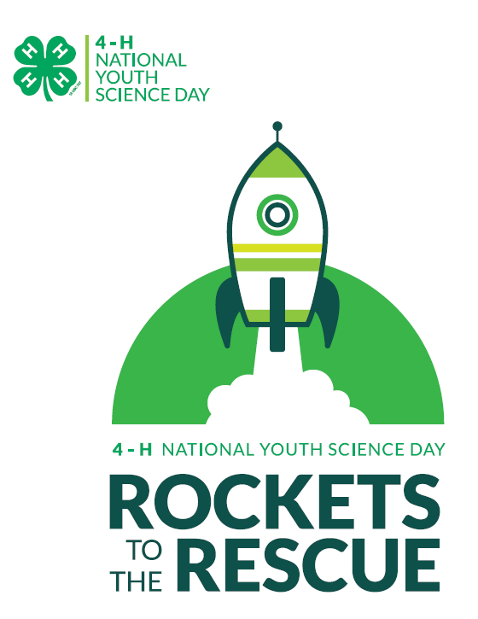
Rockets to the Rescue
Goal = Build and launch a rocket, keep your payload intact, and save Mark Watney!
Let’s check out Zaption!
http://zapt.io/tvvfujuu
Launch your payload to Mars!
What will be your team’s strategy?

Slide 20
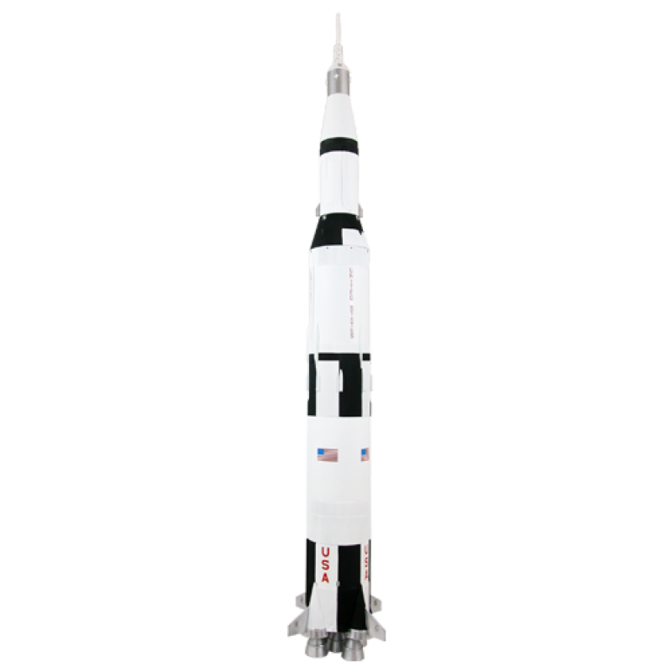
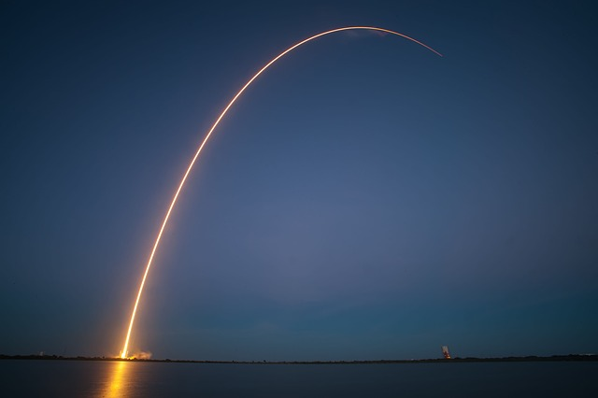
Your Task!
In your groups, chose a NASA center!
Design your own rockets and payload containers to save Mark Watney!
Think about:
What shapes are the most sleek and aerodynamic?
How will gravity affect your design?
How are you going to protect your payload?

Slide 21
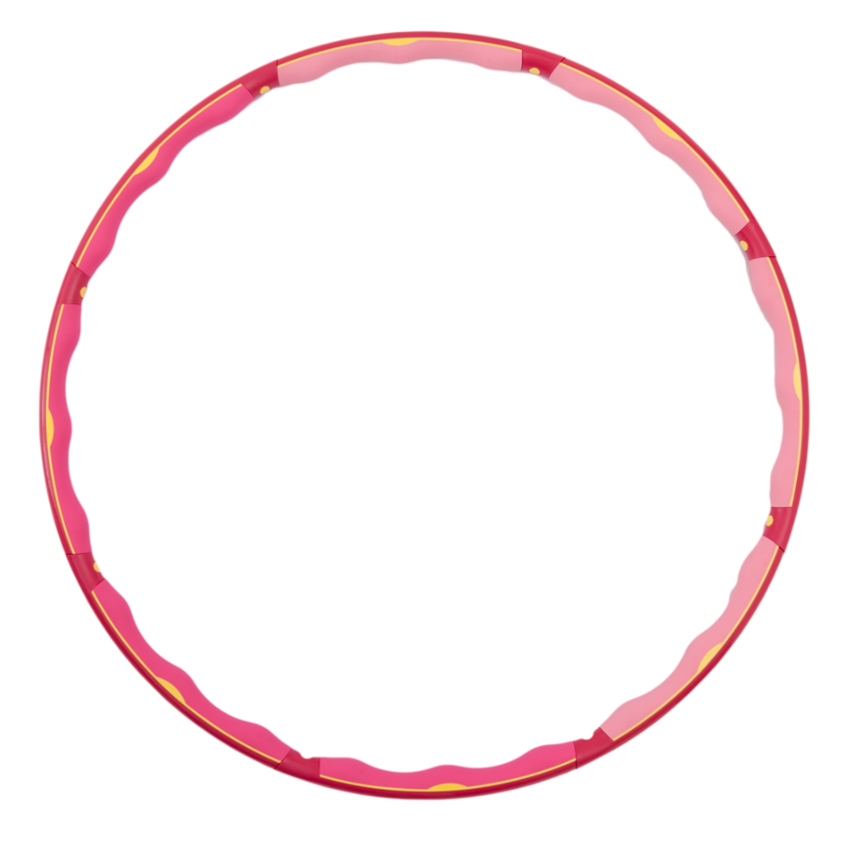
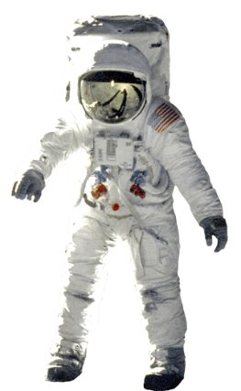
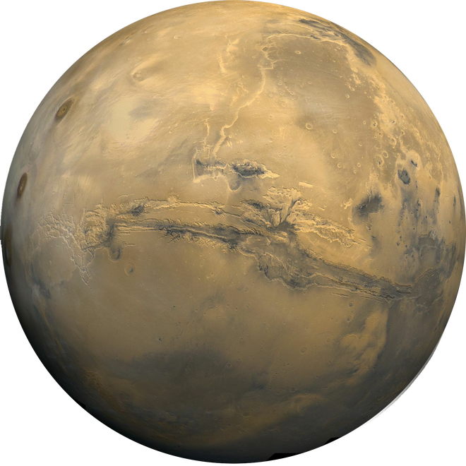
Blast your rockets to Mars!
I’m hungry!

Slide 23
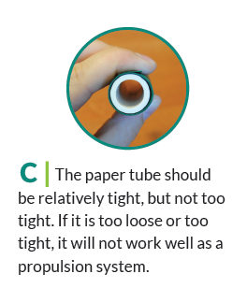
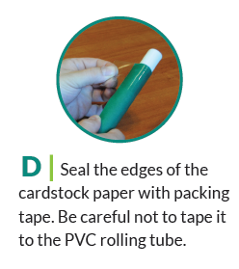

Slide 24
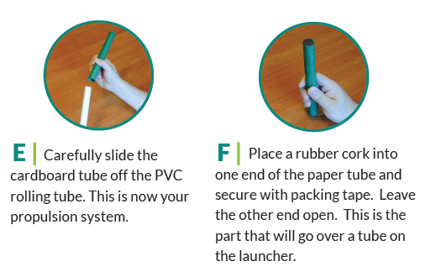

Slide 25
Discussion
How can we alter the difficulty level?
Can you think of other payload materials?
Elementary school students prefer their own rockets
How does this activity benefit students?

