Slide 1
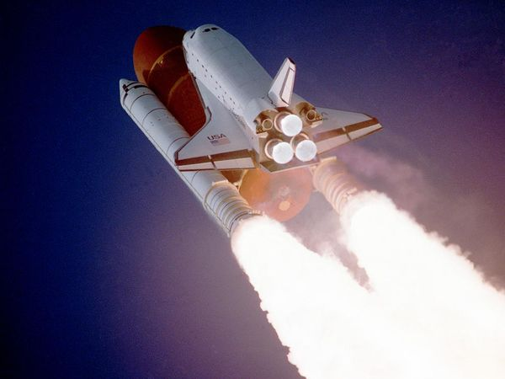
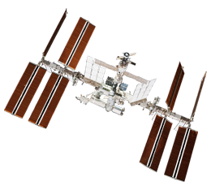
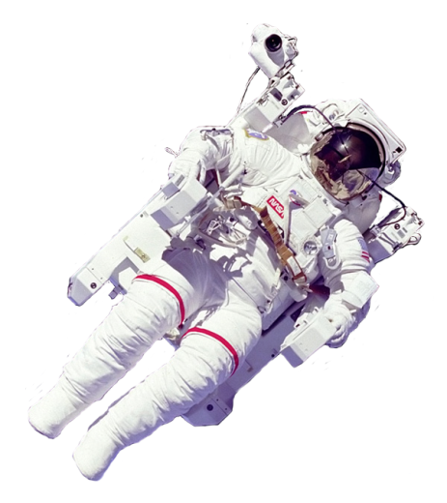
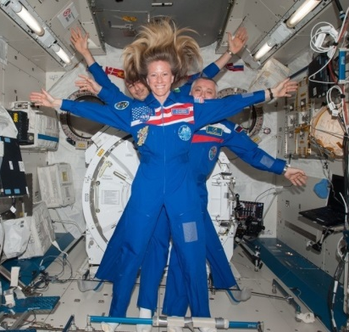
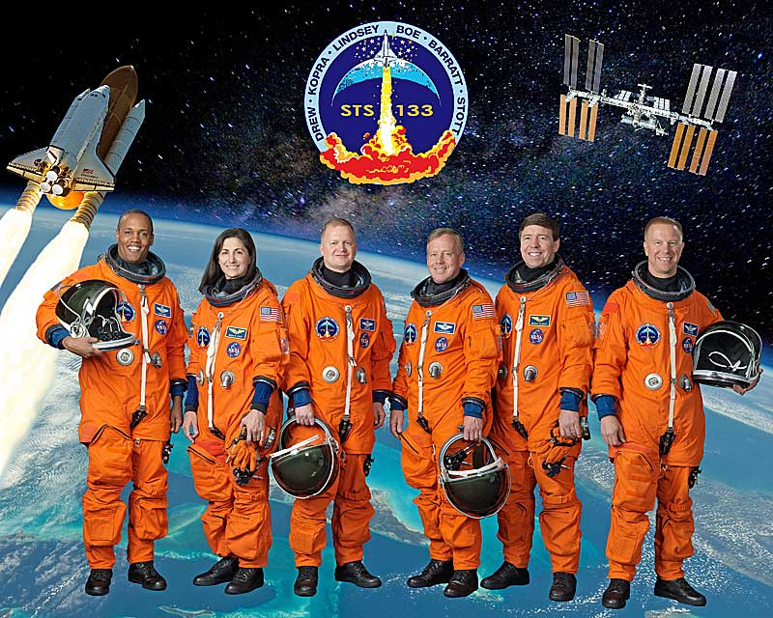
NASA and Human Space Exploration Radiation!
Caitlin Nolby
Space Studies Department, UND
North Dakota Space Grant Consortium

Slide 2
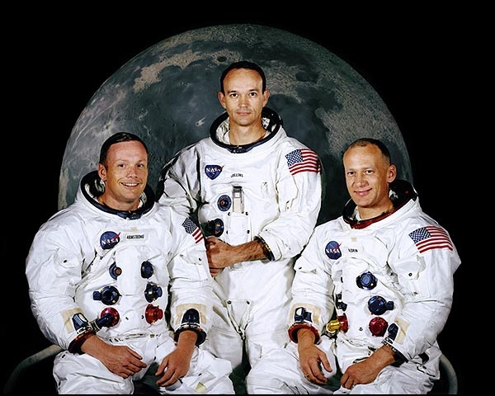
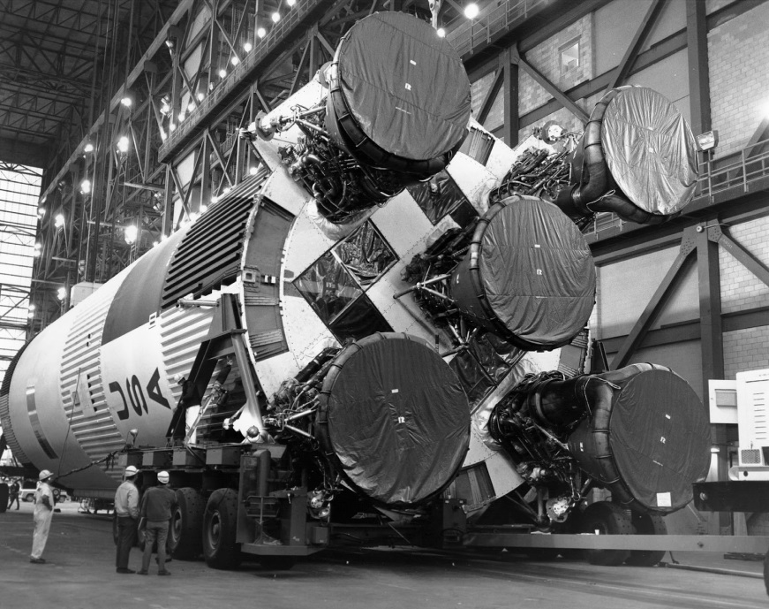
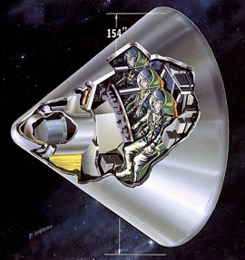
Apollo Program
Apollo 11 was the first manned-lunar landing. When?
Landing: July 20, 1969. Who?
Neil Armstrong, Buzz Aldrin, Michael Collins
Saturn V Rocket: 36 stories tall
How many men walked on the Moon?
12! One geologist (Harrison “Jack” Schmitt)
How much moon rock?
842 pounds!
http://www.youtube.com/watch?v=8V9quPcNWZE
http://www.youtube.com/watch?v=MU0Rgpdujzo
http://www.youtube.com/watch?v=ZP7AVBdJYOg\
http://www.youtube.com/watch?v=f-FxhCZold0
http://www.youtube.com/watch?v=cOdzhQS_MMw&feature=endscreen&NR=1

Slide 3
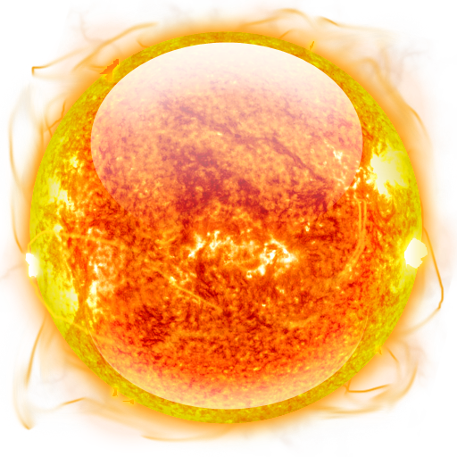
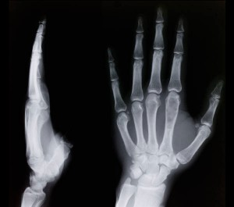
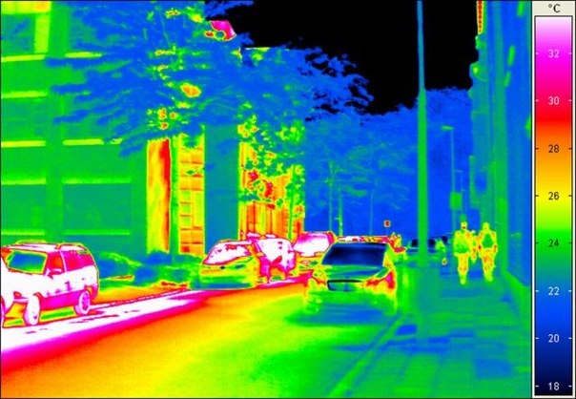
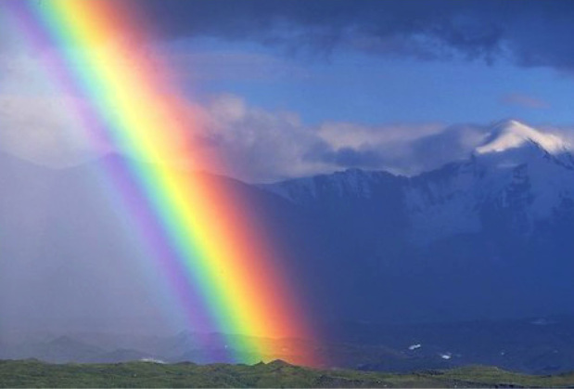
What is Radiation?
Where does it come from?
What do we get from the Sun?
Energy – waves and particles
Is all light the same?
X-rays
Visible Light
Infrared
Notes:
Heat, light, helps plants grow, vitamin D,

Slide 4
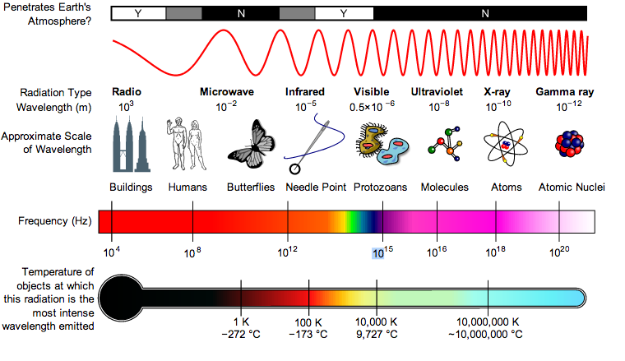
Electromagnetic Spectrum
Notes:
Heat, light, helps plants grow, vitamin D,

Slide 5
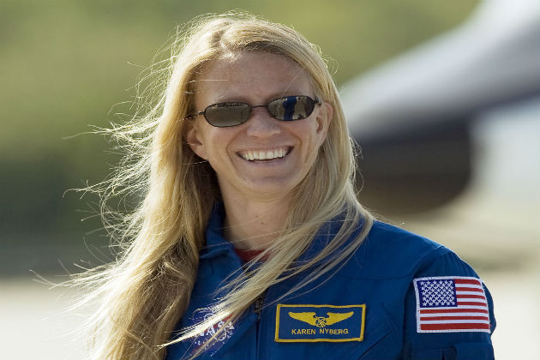
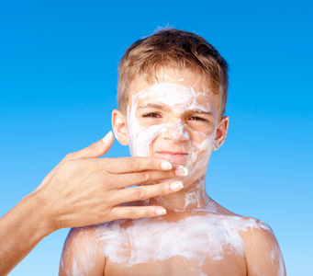
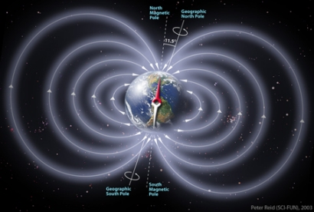
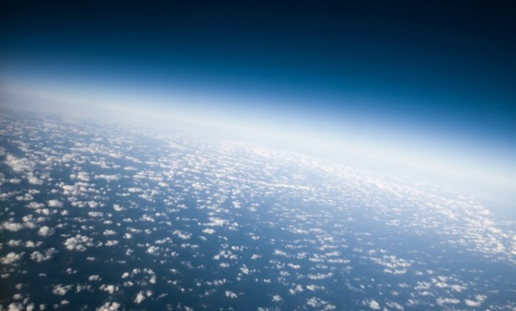
Ultraviolet Radiation
Can be good – Vitamin D!
Too much can be harmful
How do we stay safe?
Does Earth protect us?
Ozone Layer absorbs UV
?
Sunglasses!
Sunscreen!
Magnetic Field!
Atmosphere!
Notes:
Good: healthy bones and immune system
Bad: sunburn, skin cancer, wrinkly skin…

Slide 6
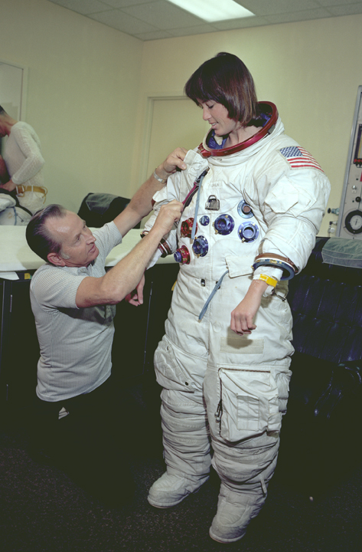
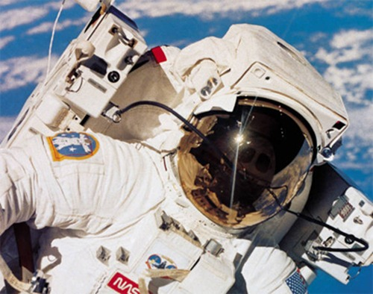
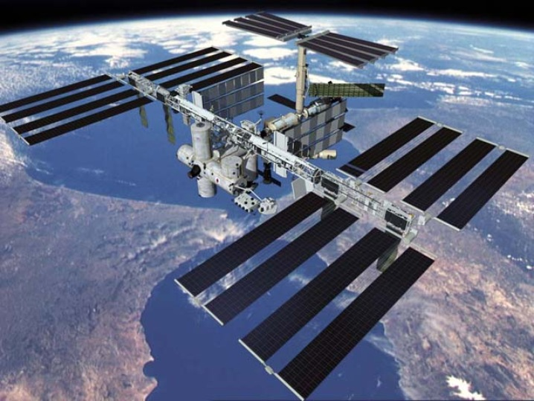
Radiation in Space
Wear Spacesuits
No atmosphere – so what do astronauts do?
Visors
Live in stations

Slide 7
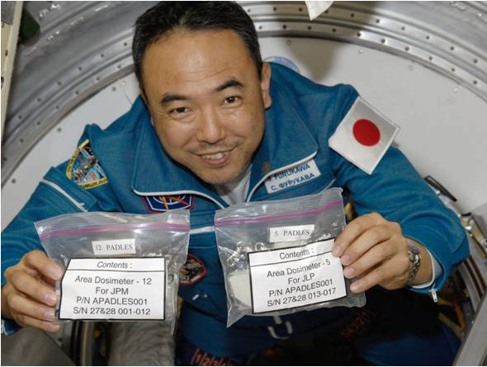
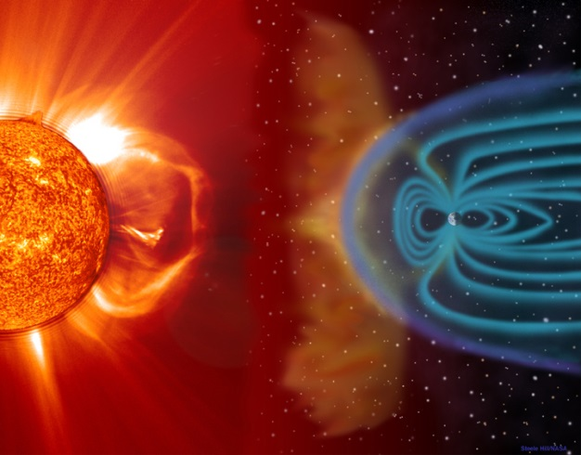
Radiation in Space
Even with all of this protection, some radiation gets through
Each day = 8 chest X-rays!
10x’s what we experience on Earth
Astronauts wear dosimeters
High energy X-rays
Gamma Rays
Cosmic Rays
Notes:
harmful to immune system, astronauts become susceptible to infection, once they reach certain levels – they do not continue to work in space

Slide 8
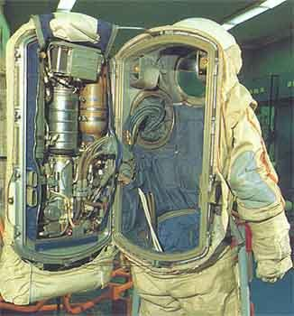
Spacesuit Requirements
In Space… | So, spacesuits have…
There is no air to breathe
Oxygen tanks!

Slide 9
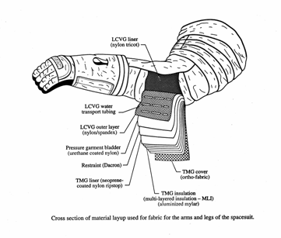
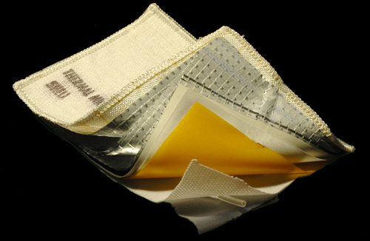
Spacesuit Requirements
In Space… | So, spacesuits have…
There is no air pressure to
keep blood from boiling and
gases in the body from
expanding
A pressure layer to keep
body fluids and gases in
their proper state

Slide 10
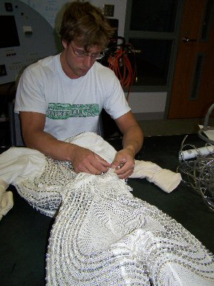
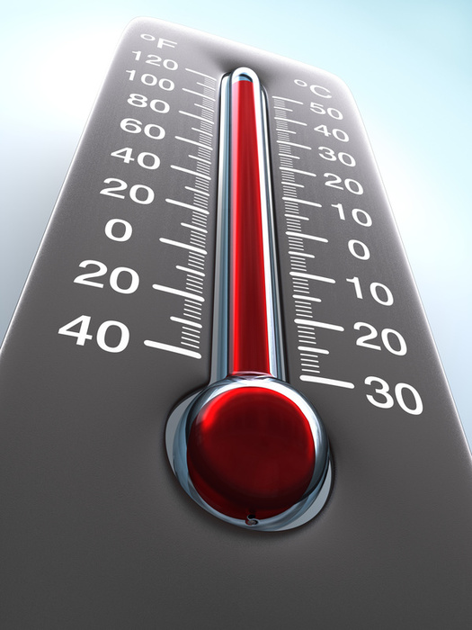
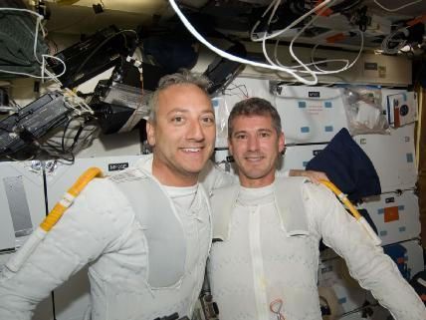
Spacesuit Requirements
In Space… | So, spacesuits have…
Temperatures can reach
250 °F!
A layer with tubes
through which water flows
and cools the body

Slide 11
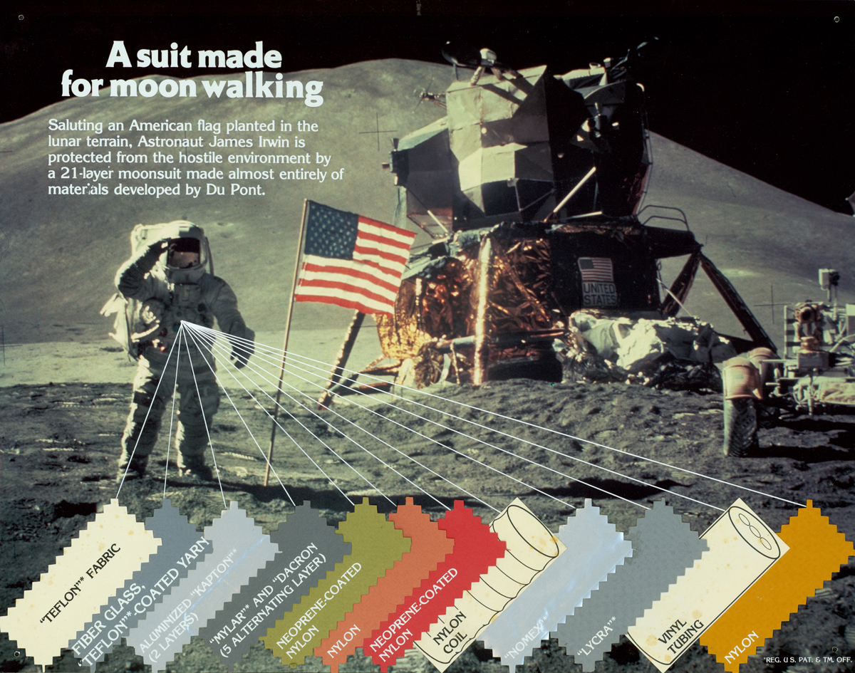
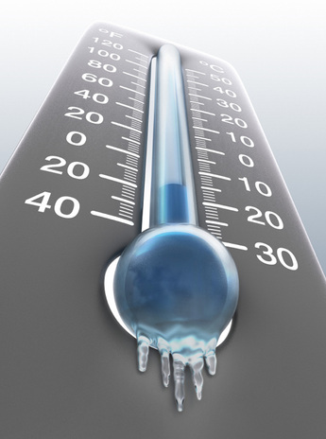
Spacesuit Requirements
In Space… | So, spacesuits have…
Temperatures can also
go down to -250 °F!
Layers to insulate the body
from cool temperatures

Slide 12
Spacesuit Requirements
In Space… | So, spacesuits have…
Tiny, high-speed rocks
called micrometeoroids
can injure astronauts
Several layers of protective
materials to prevent damage
from micrometeoroids

Slide 13
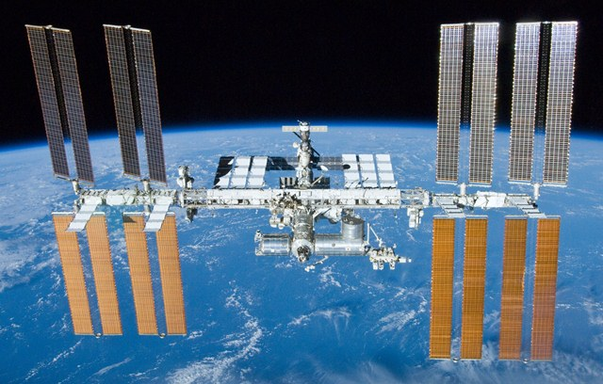
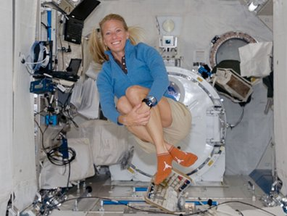
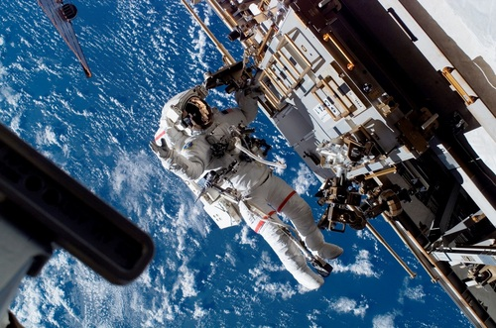
International Space Station
In-orbit construction began 1998
Continuously crewed since November 2000
Space Shuttle missions delivered equipment and parts
How high and how fast?
Orbits the Earth at 230 miles up, (~Grand Forks to Minot)
One orbit every 90 minutes
Karen Nyberg: graduate of UND
Spot the Station Website
http://spotthestation.nasa.gov/

Slide 14
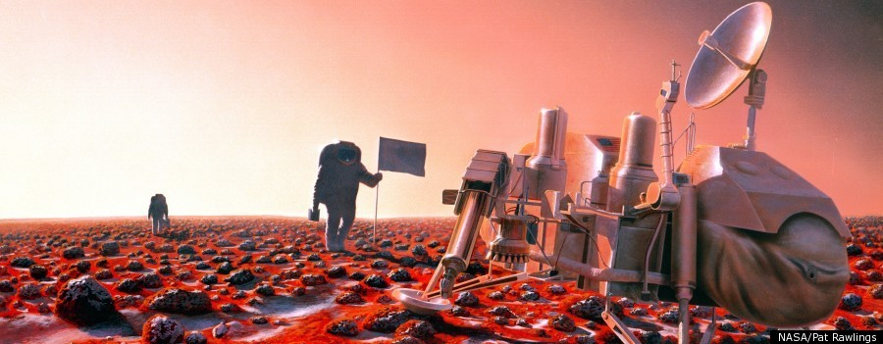
Activity
It is your job to build a new space suit for NASA astronauts on their way to Mars!
You must test out which material best blocks UV radiation!

