Slide 1
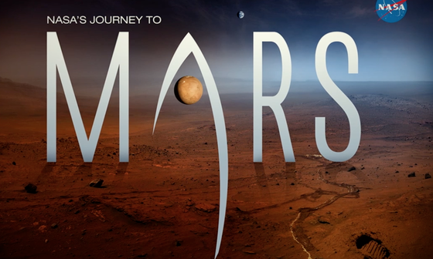
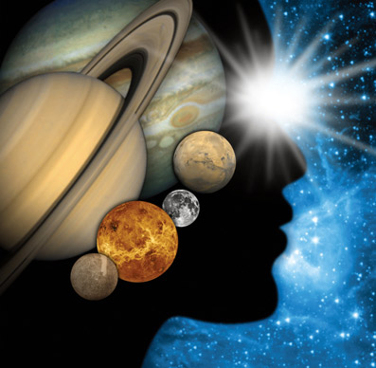
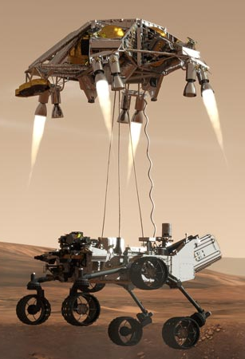
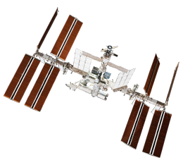
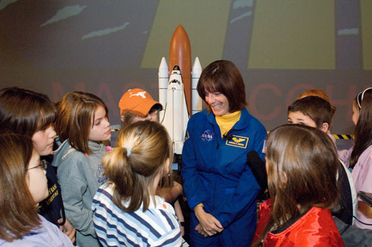
Bristle Bots to the Rescue!
Caitlin Nolby and Marissa Saad
North Dakota Space Grant Consortium

Slide 2
What are solar panels? How do they help us?
What are rovers?

Slide 3
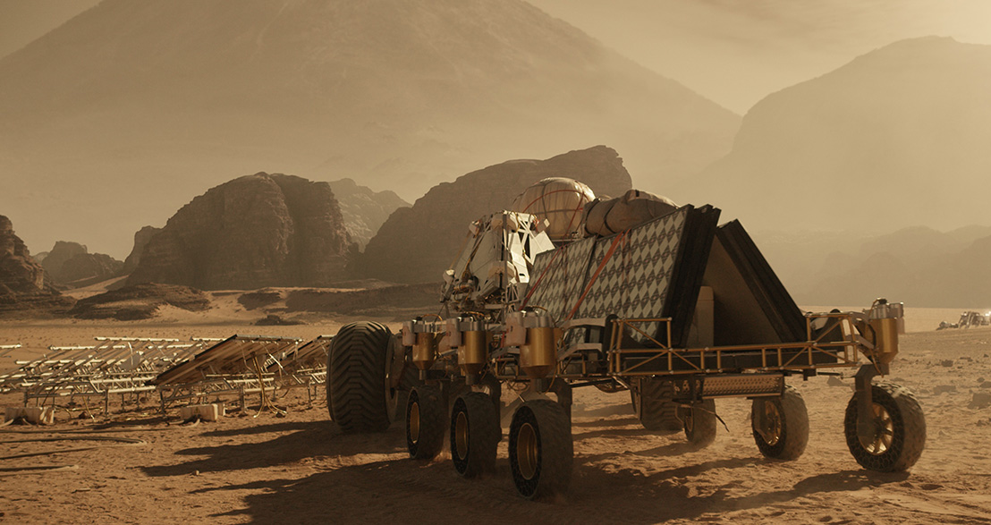

Slide 4
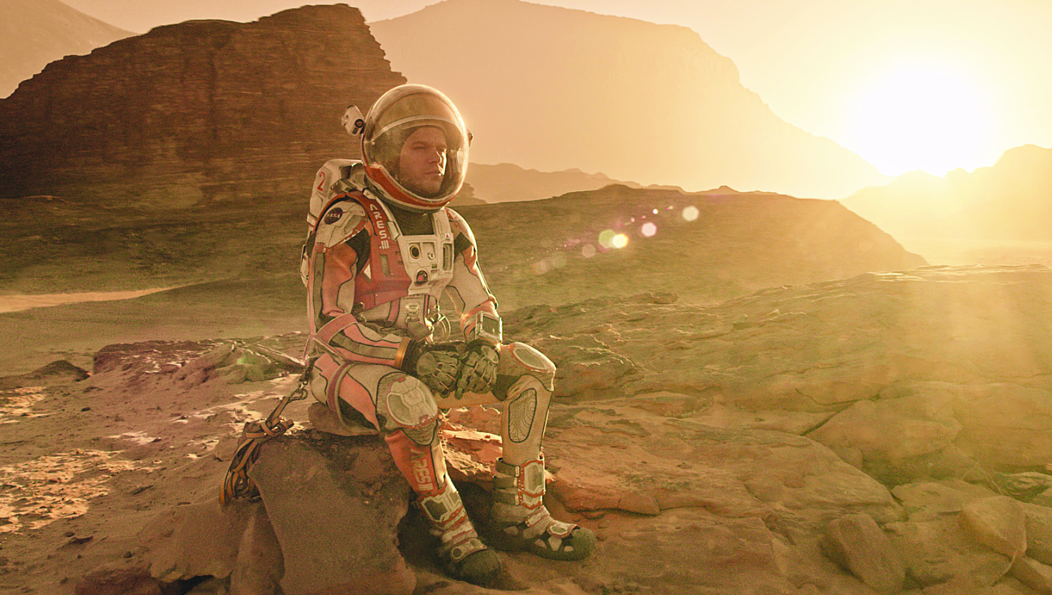

Slide 5
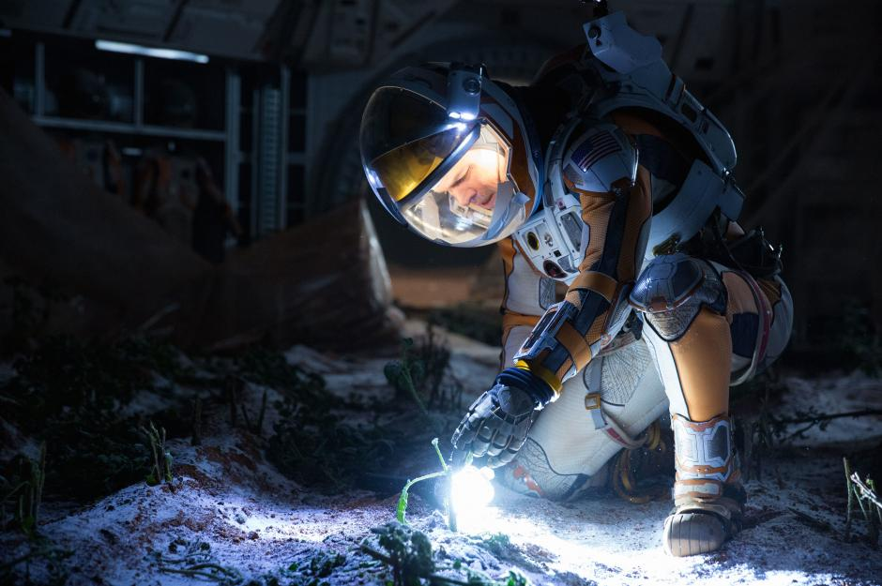

Slide 6
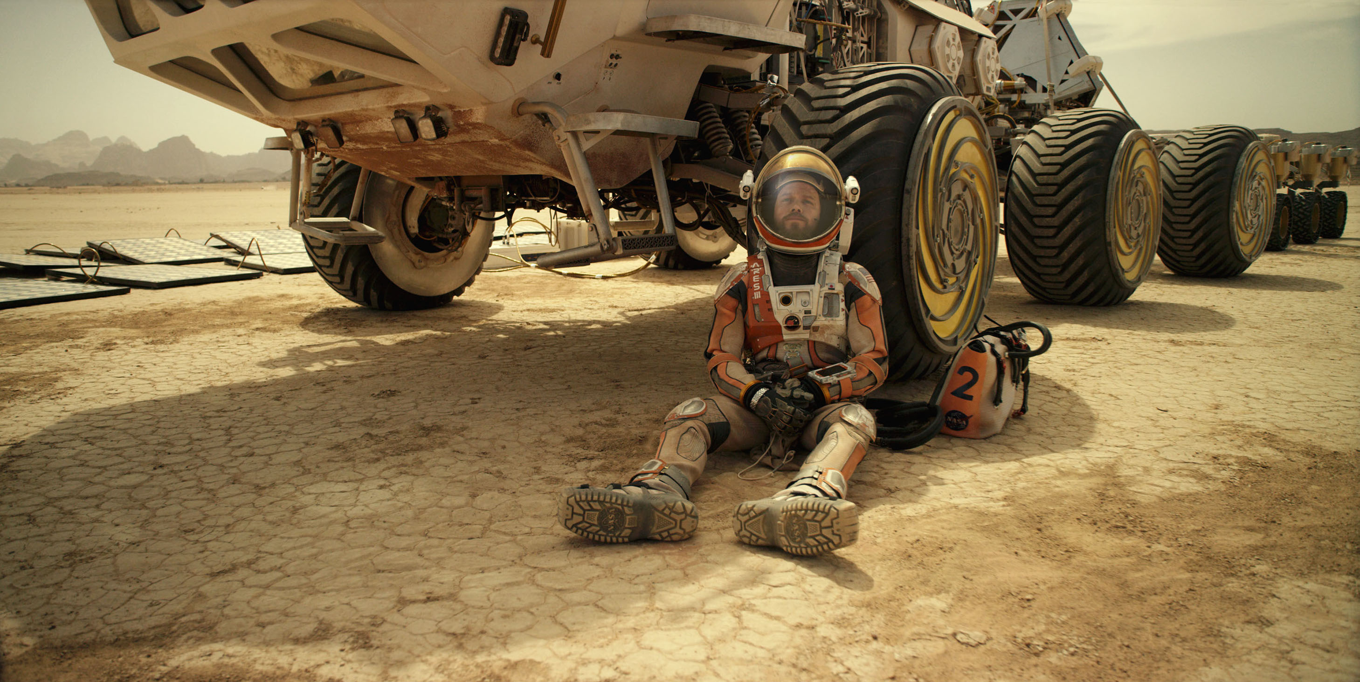

Slide 7
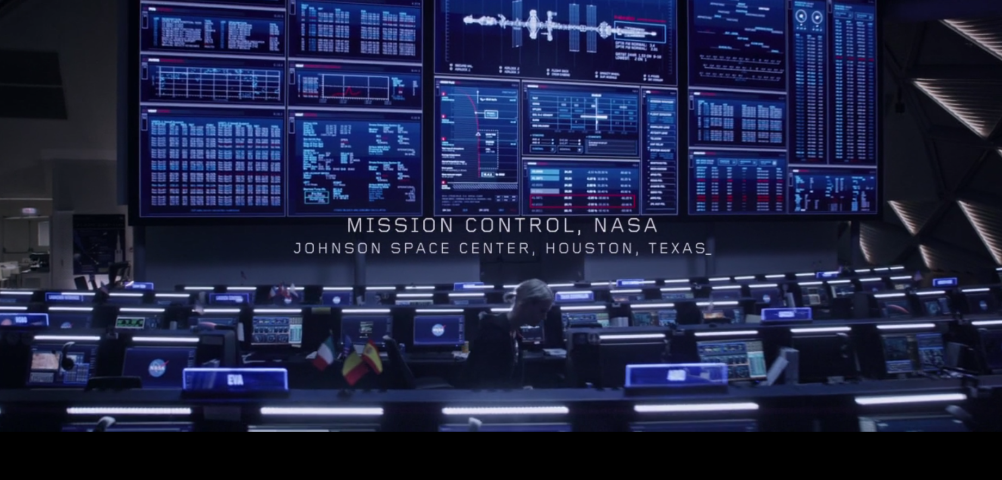
31:27

Slide 8
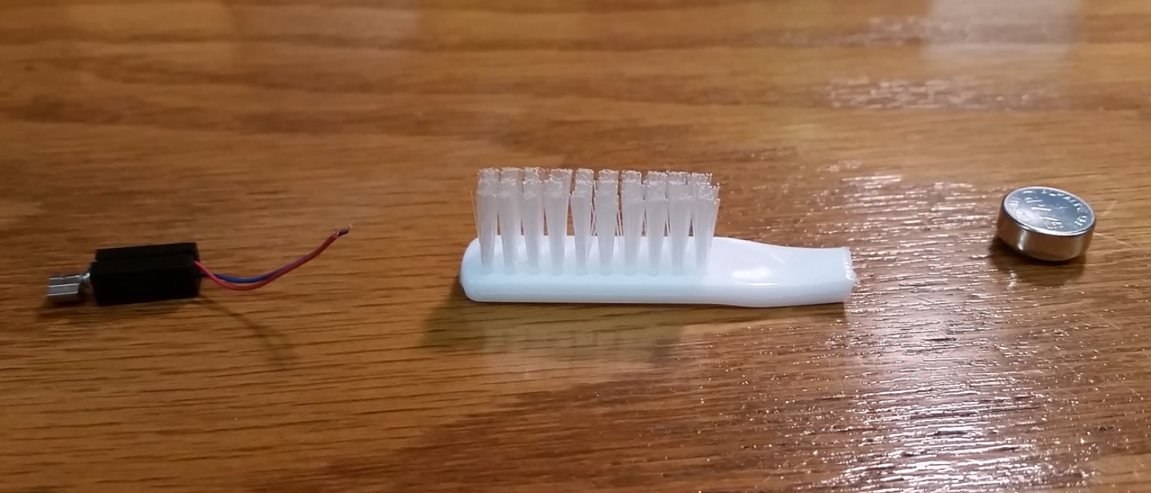
The body of your rover
Motor
Battery
Toothbrush Head

Slide 9
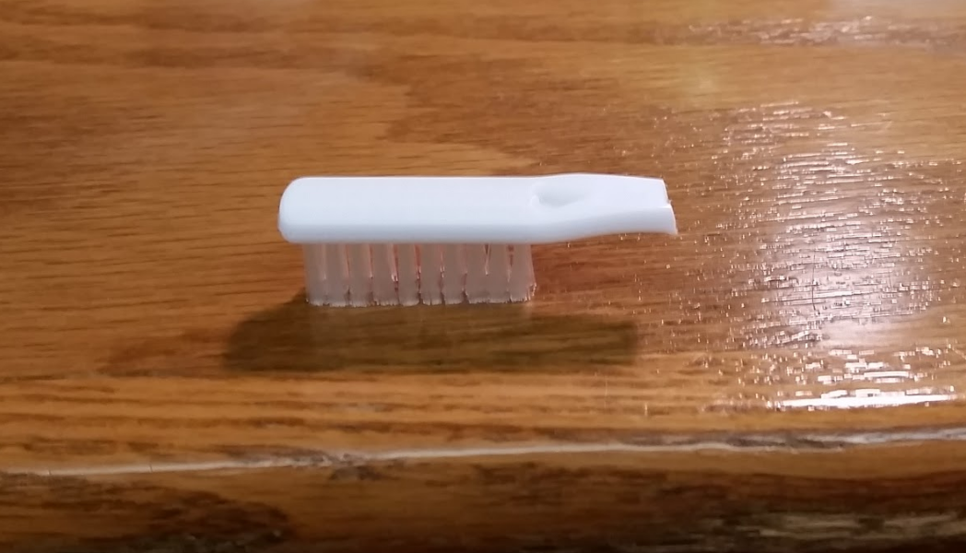
Bristles: Up or Down?

Slide 10
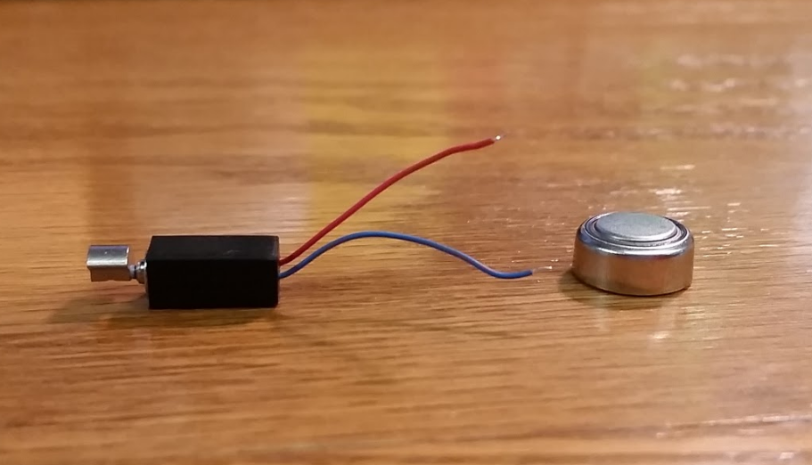
How do you power your rover?
Motor
Battery

Slide 11
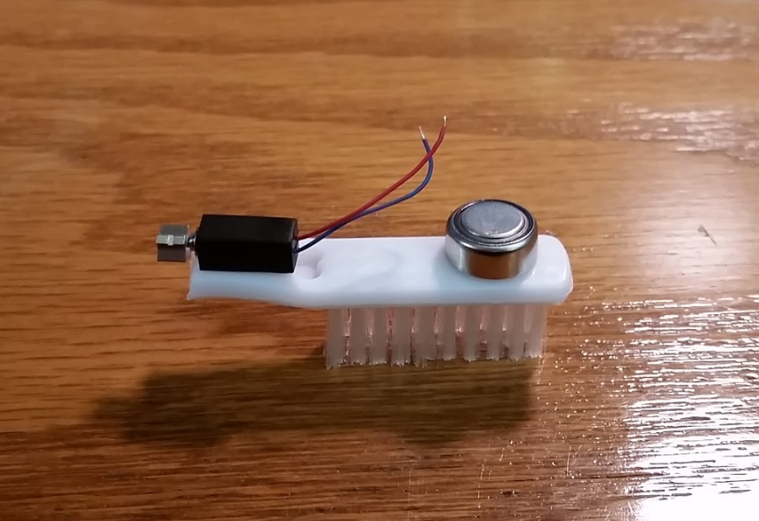

Slide 12
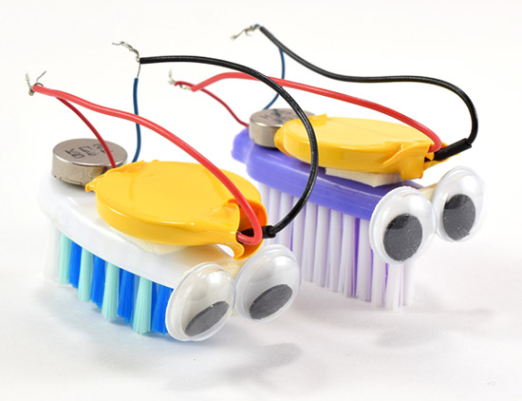
We explored… Now lets explain!
How does this relate to your electromagnetism unit?
What else could you integrate with this lesson?
Any modifications?
What are some of the more challenging aspects (for elementary school students)?
Which designs were most successful?
How might this relate to young students’ lives?
Why solar panels? Can students relate to these?
What can we improve for next time?
Any additional materials?

Slide 13
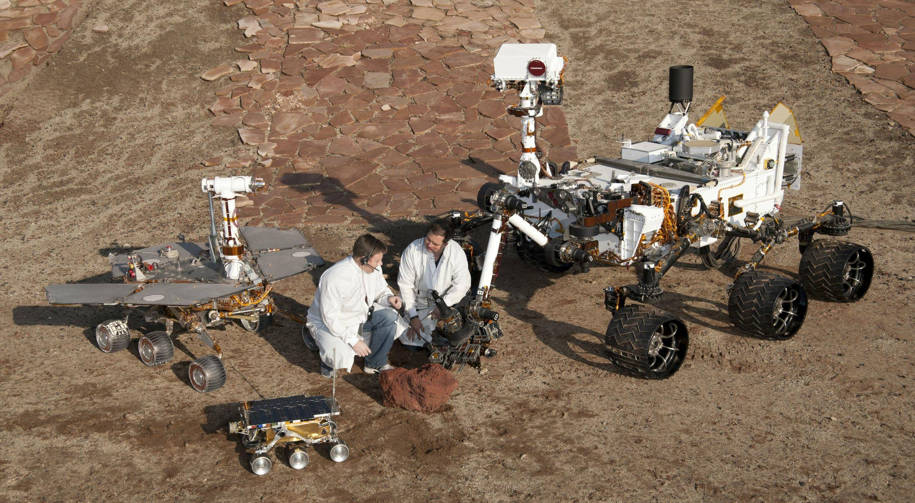
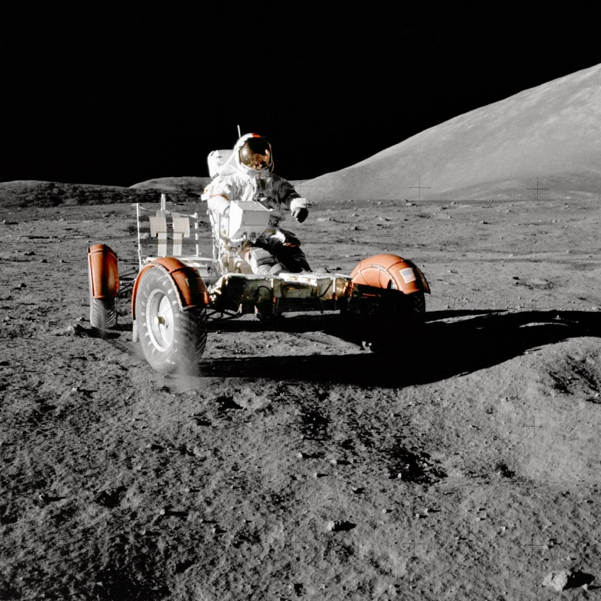
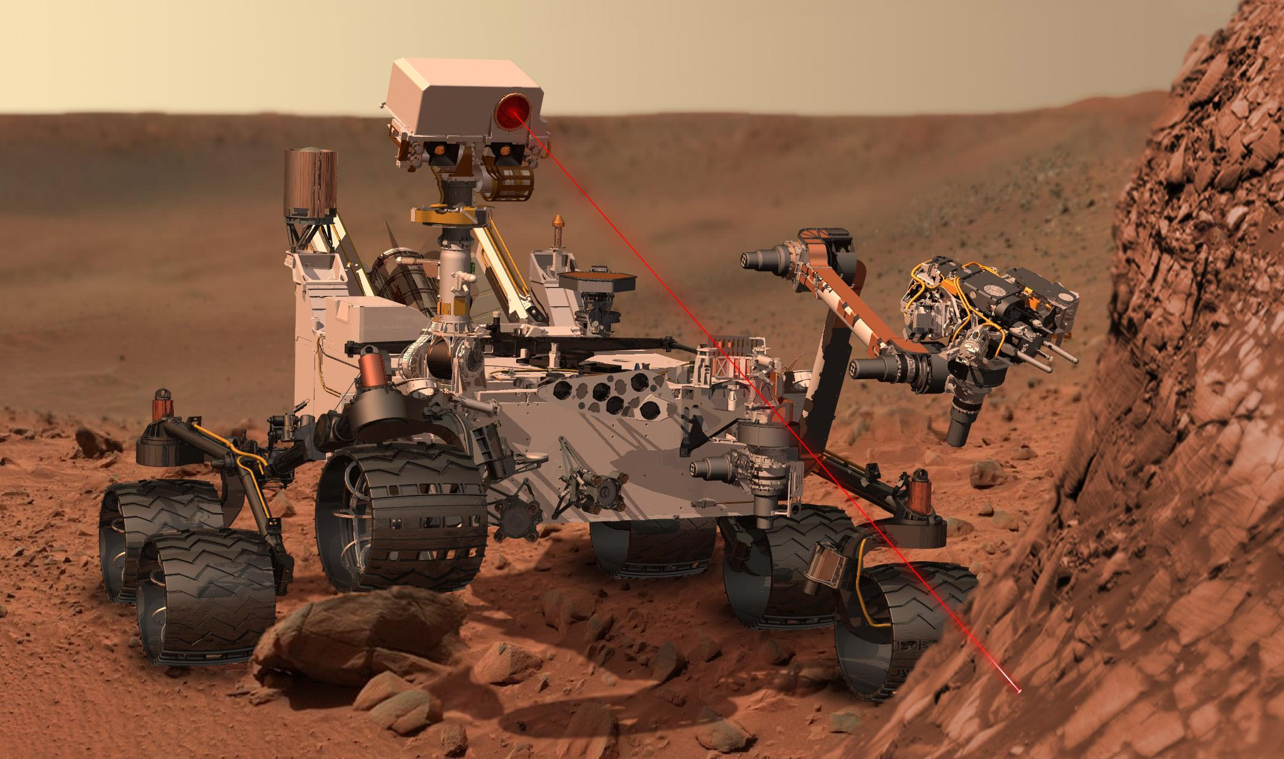
How can students relate to rovers?
Mars, Moon, remote RC cars, drones, Roomba, etc.\
Student designed rover cleaning demo
Mars Rover Test Drive: Send Rhett & Link to Mars

Slide 14
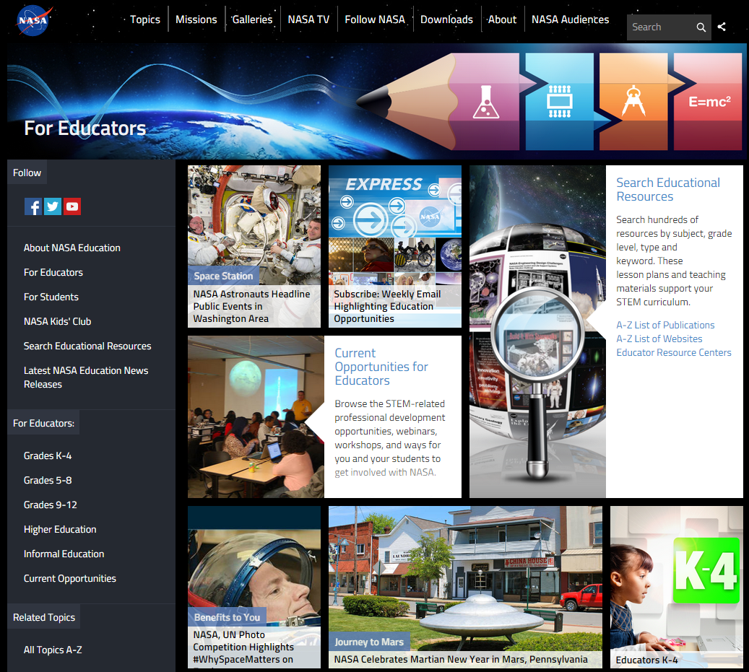
NASA Education

Slide 15
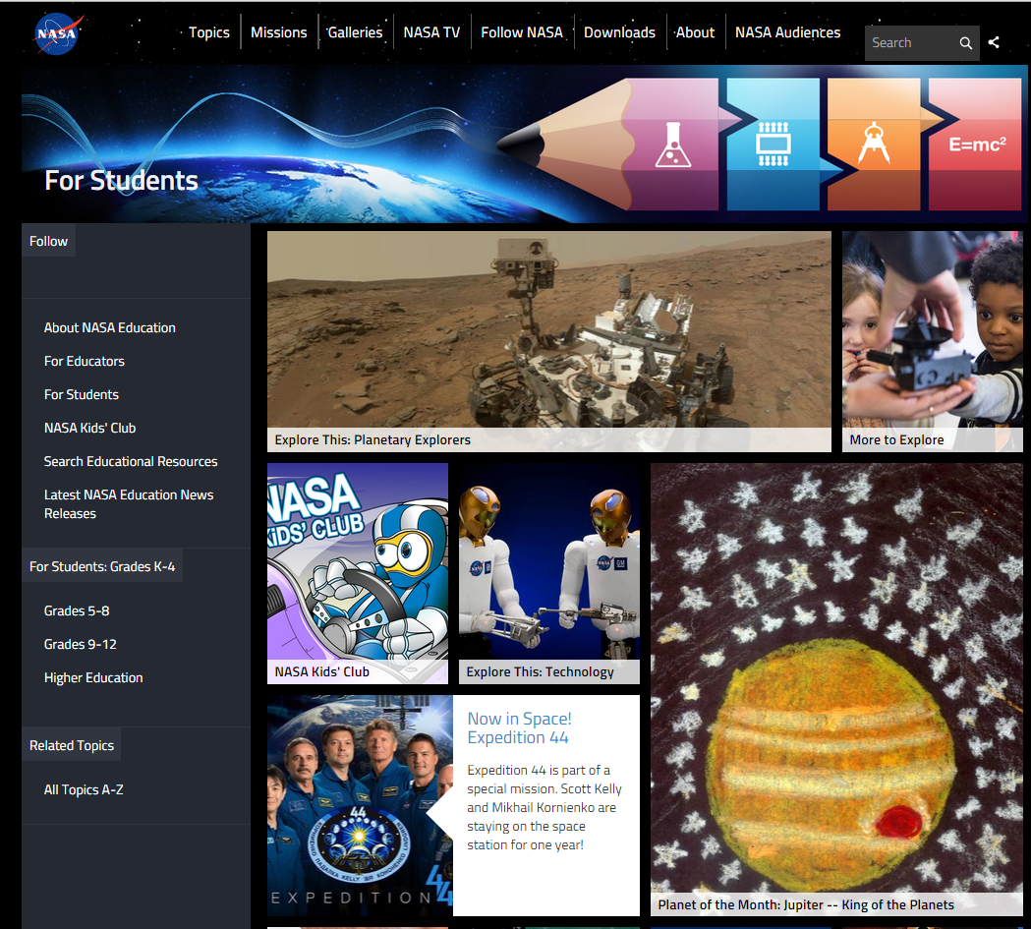
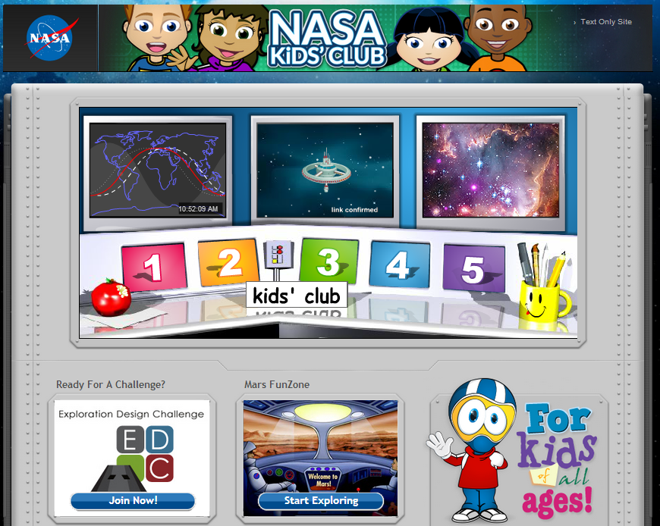
NASA for Students

Slide 16
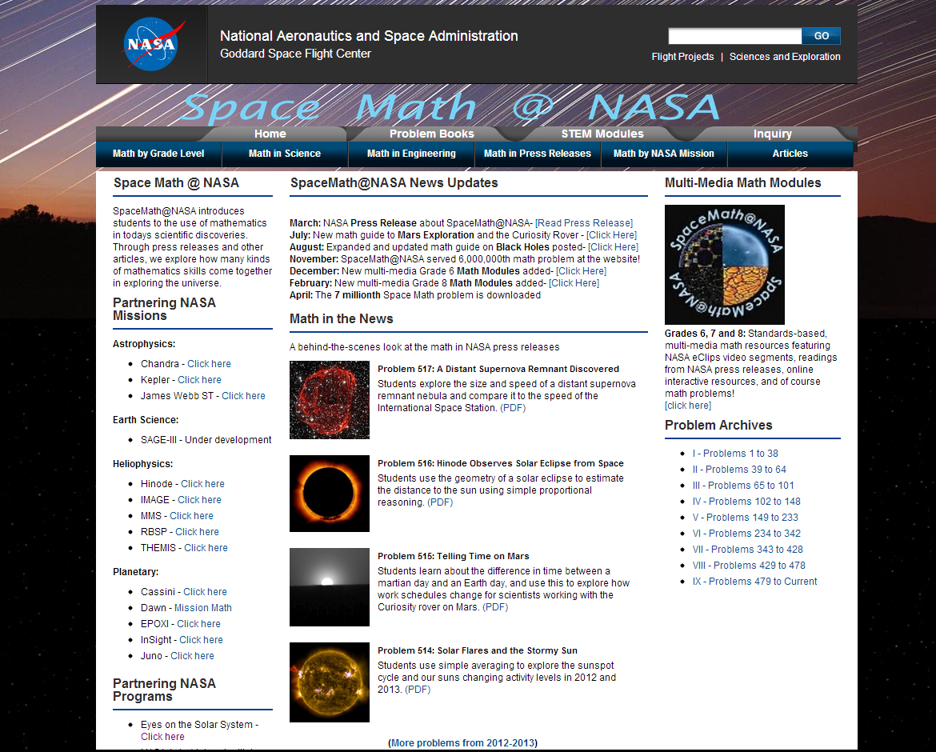
Space Math at NASA

Slide 17
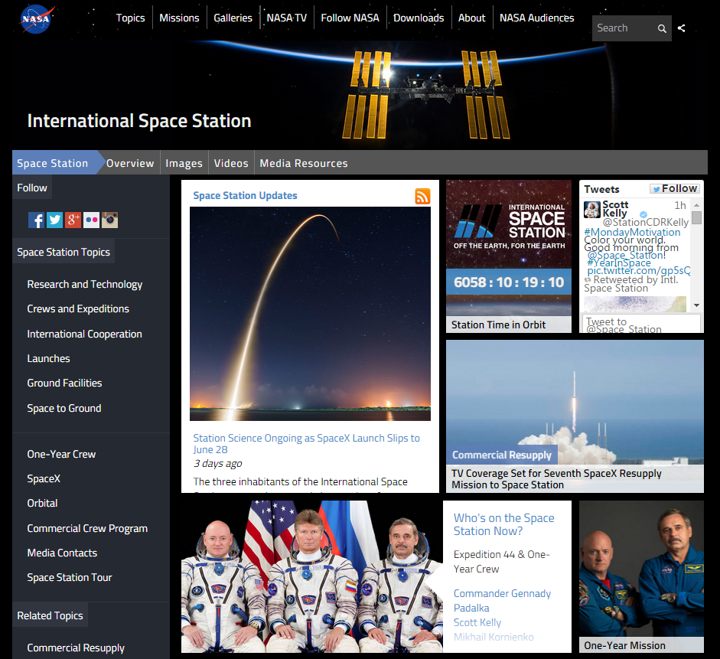
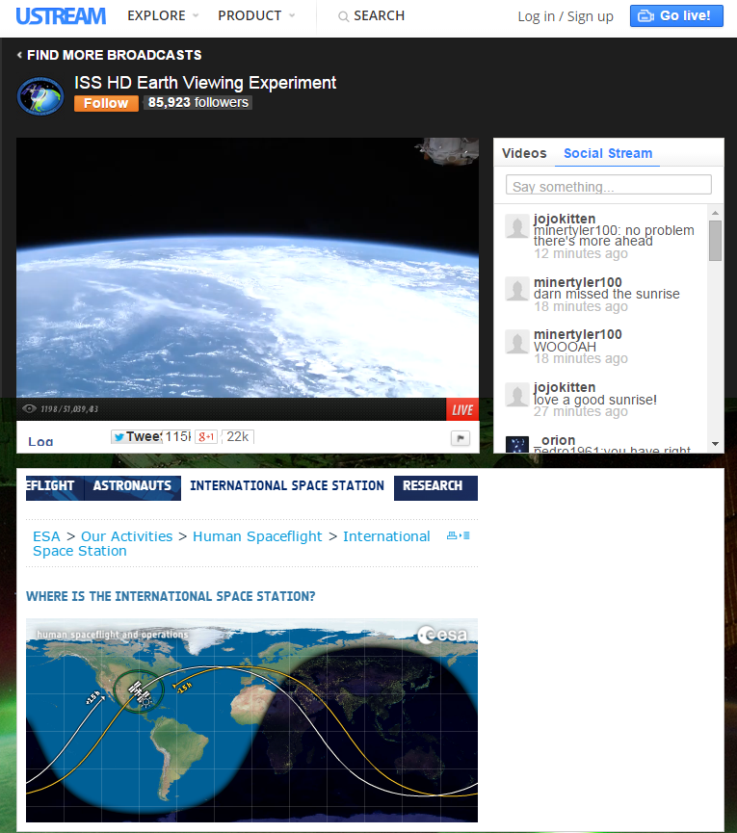
International Space Station - Live!

Slide 18
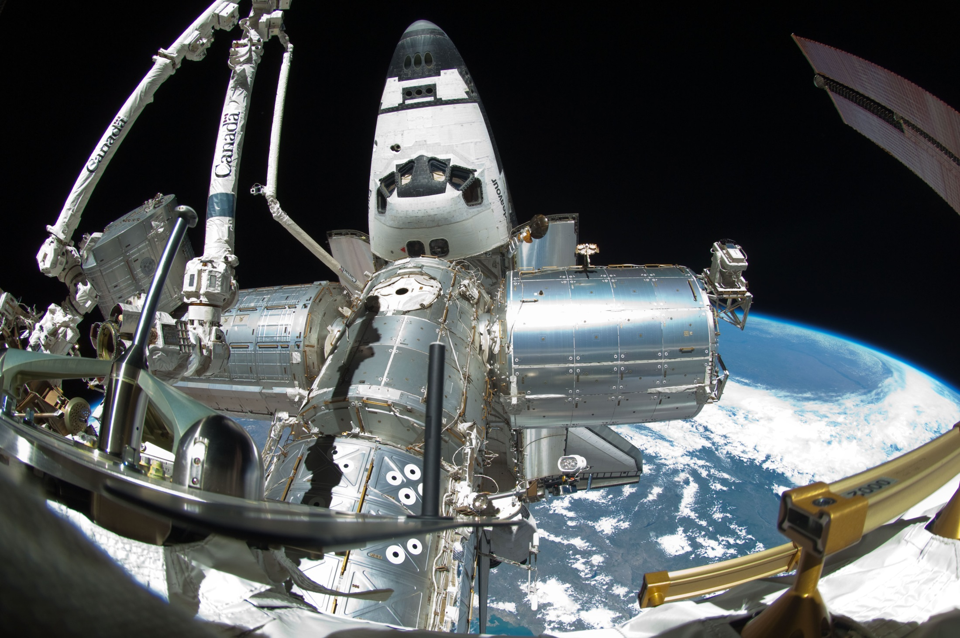
Spot the Station

Slide 19
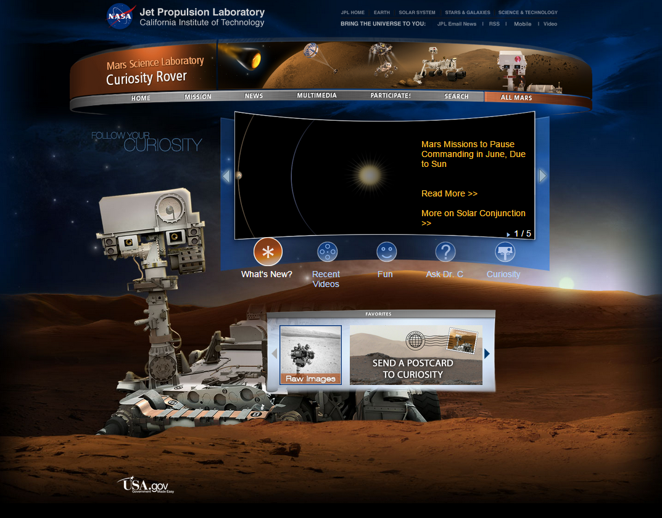
Mars Curiosity Rover

Slide 20
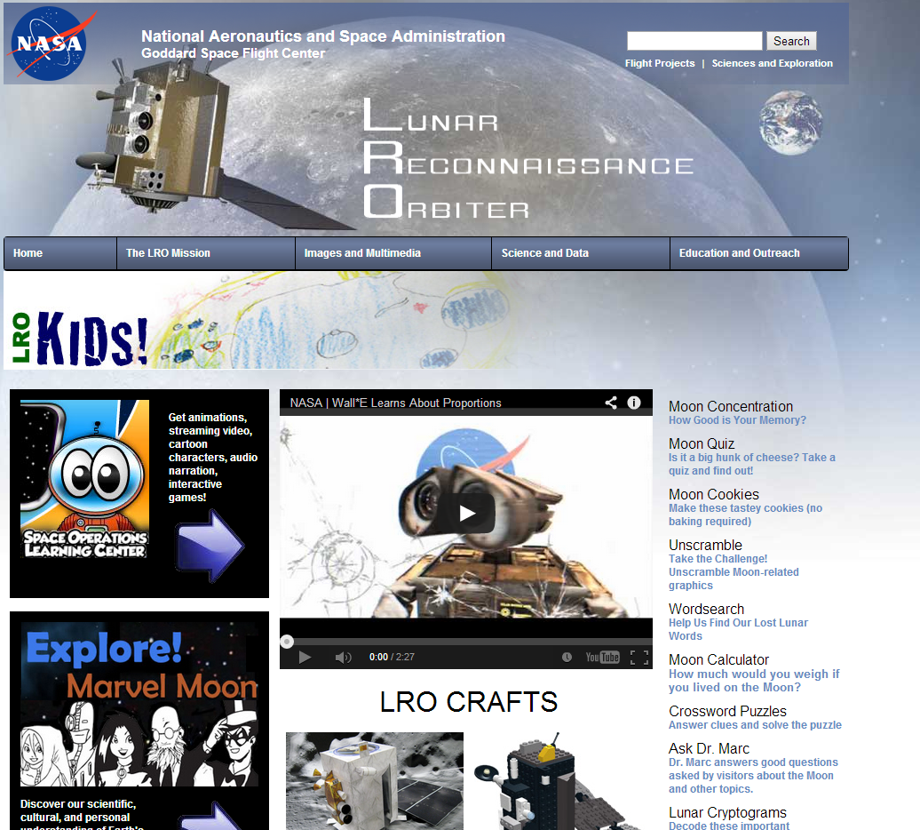
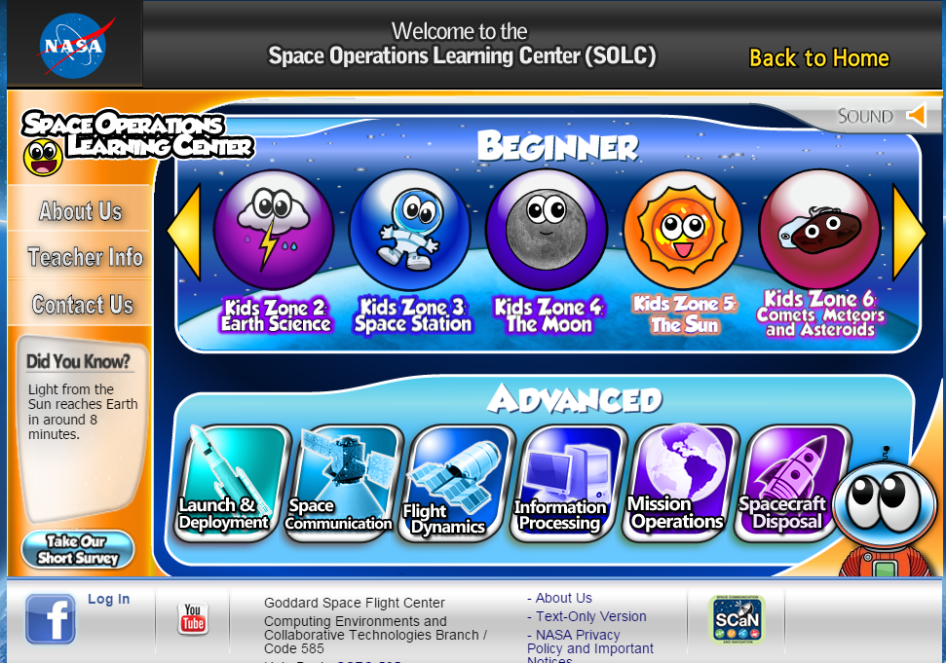
NASA – Lunar Reconnaissance Orbiter

Slide 21
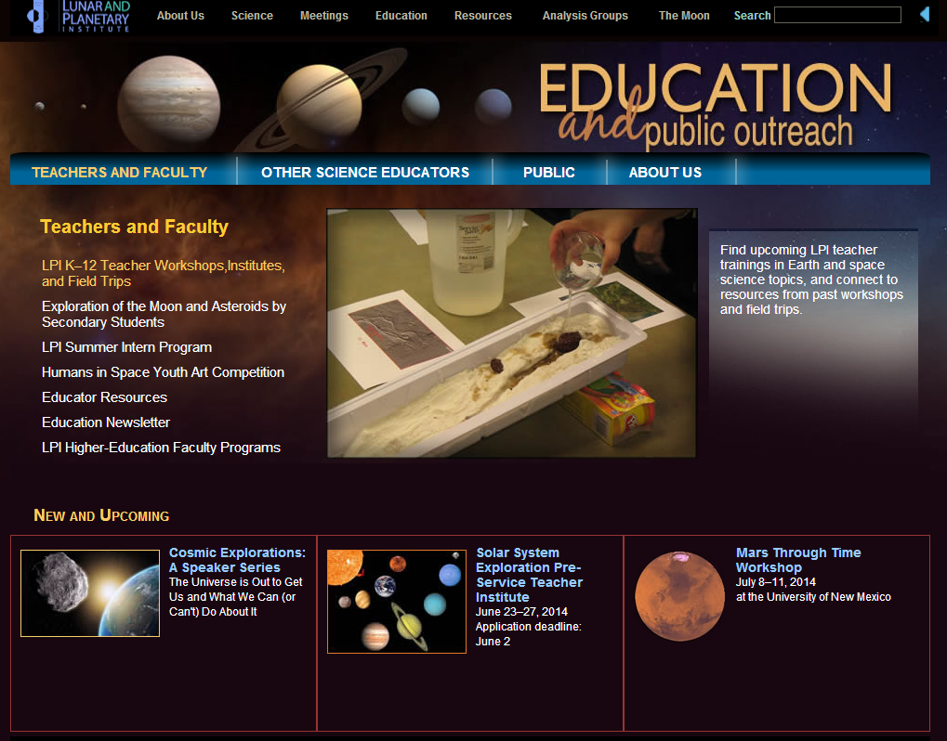
Lunar and Planetary Institute

Slide 22
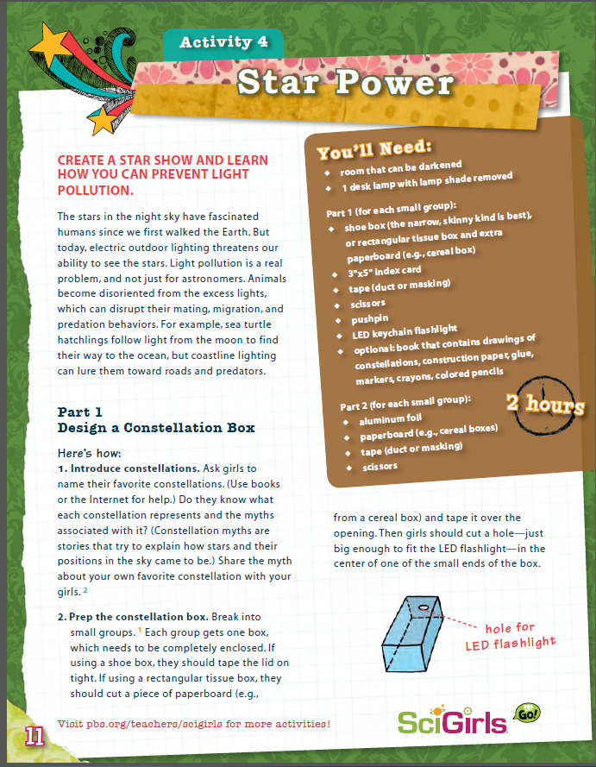
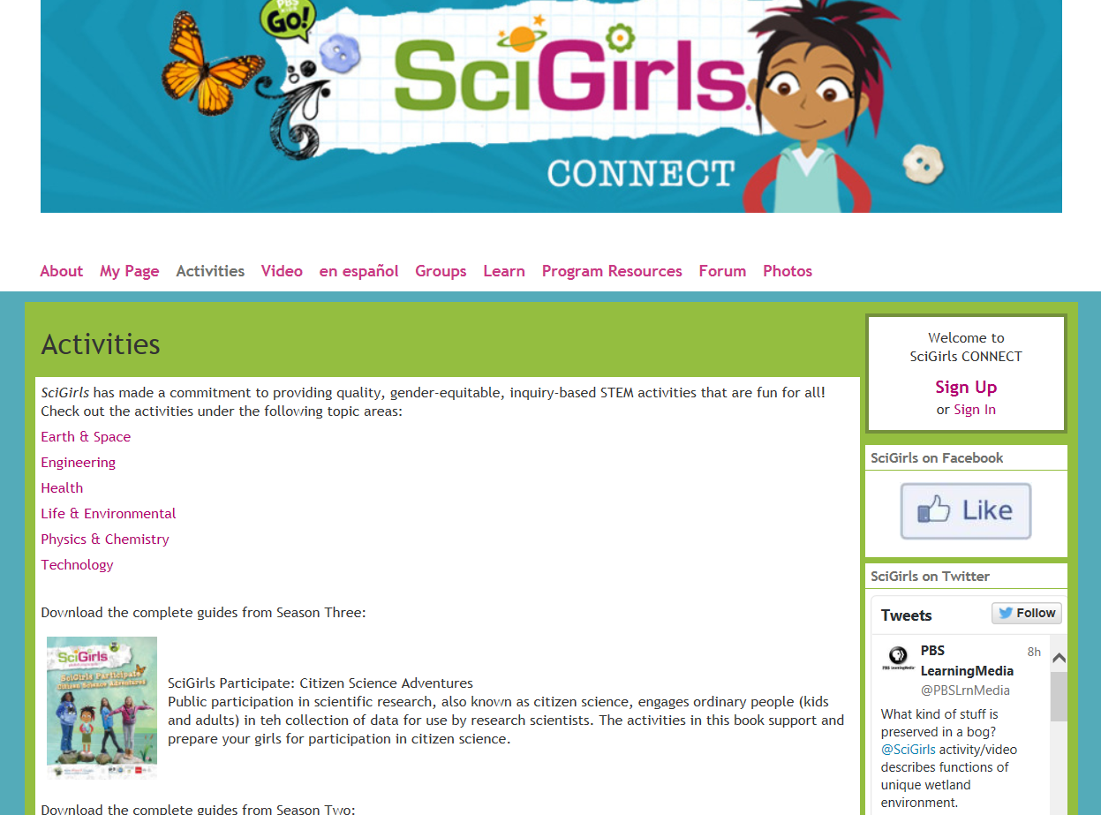
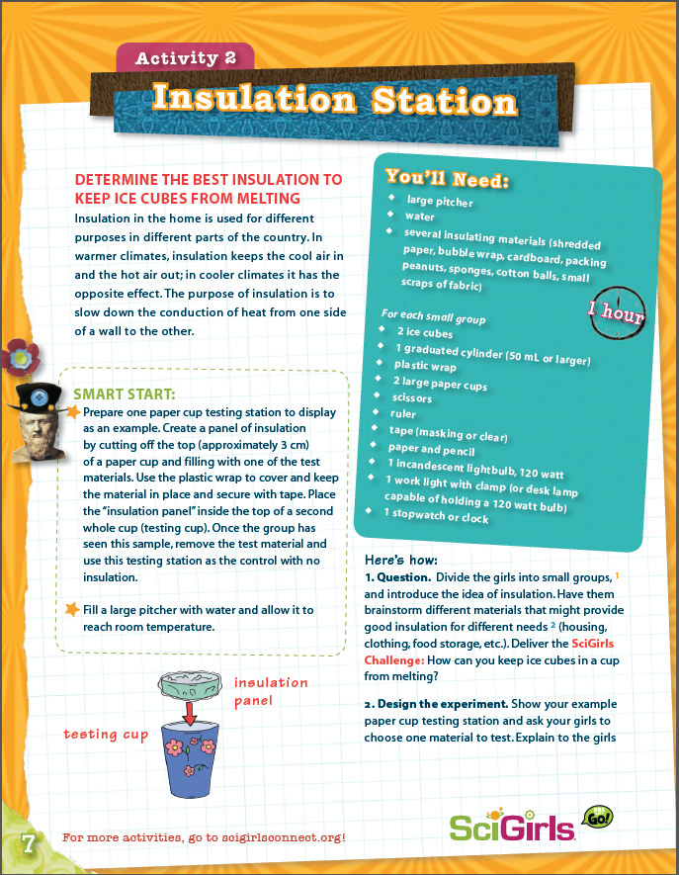
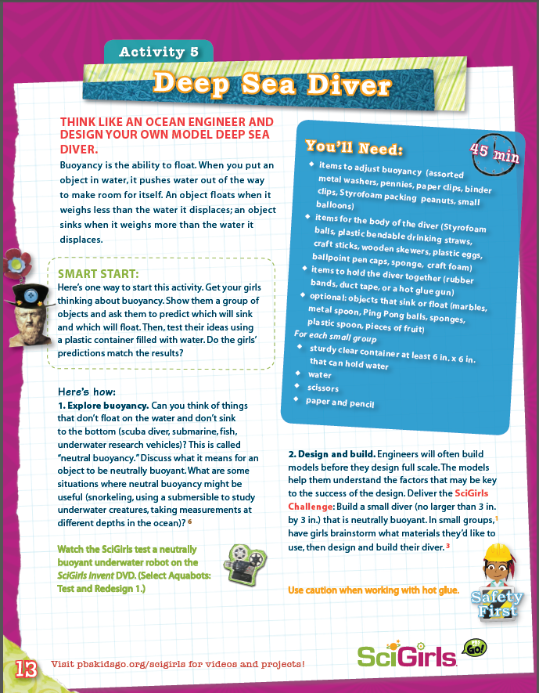
SciGirls Activities

Slide 23
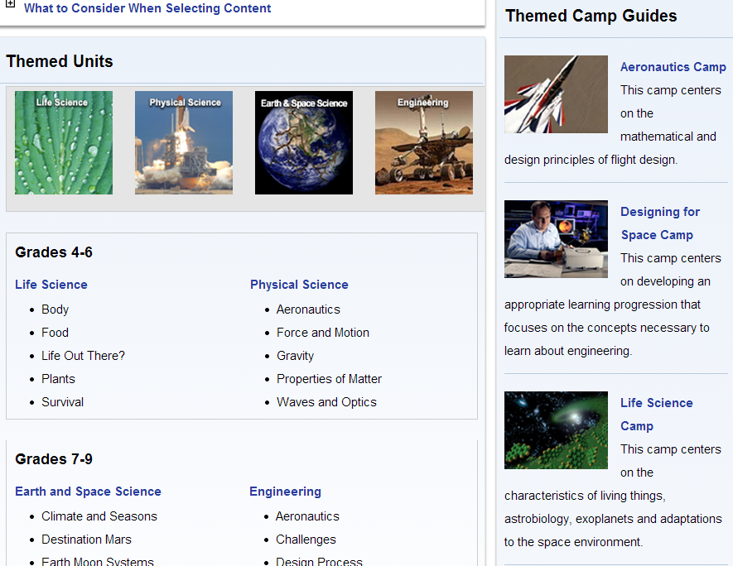
NASA Summer of Innovation

Slide 24
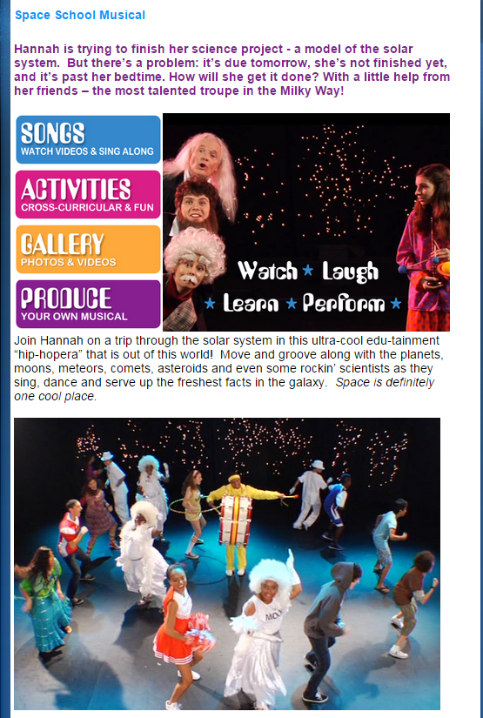
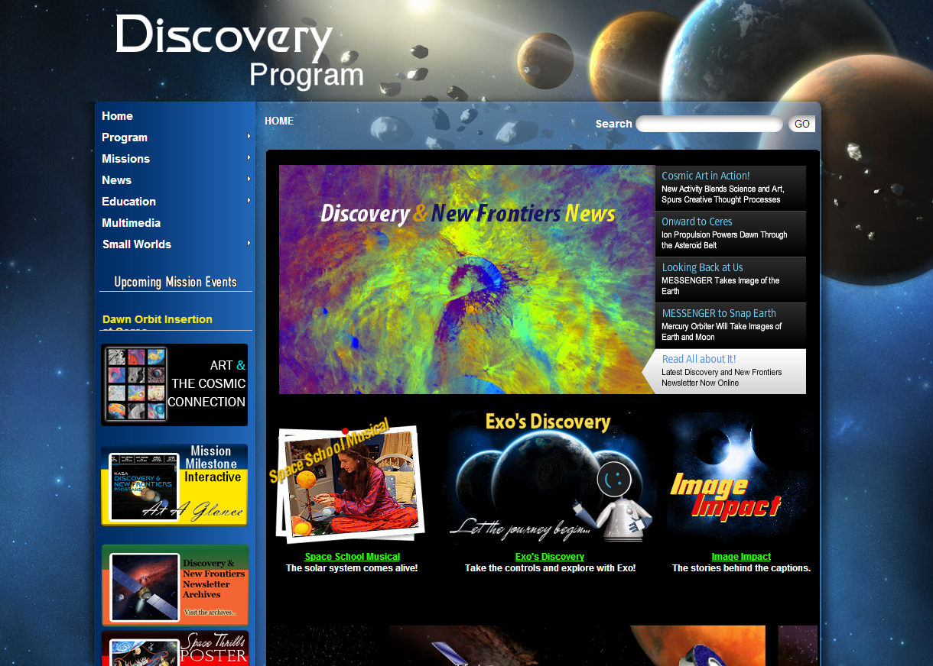
NASA Discovery Program

Slide 25
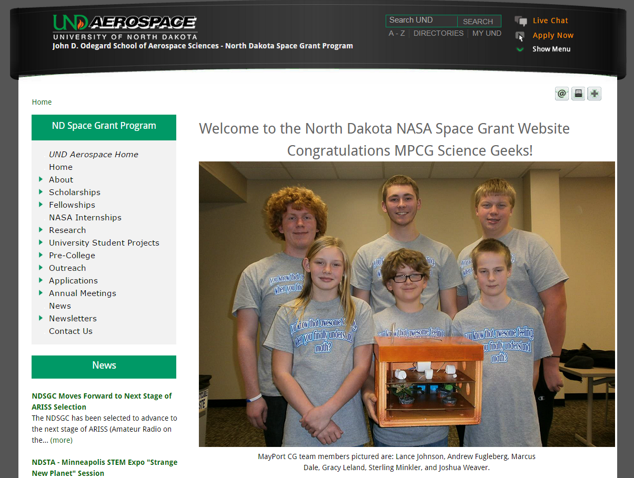
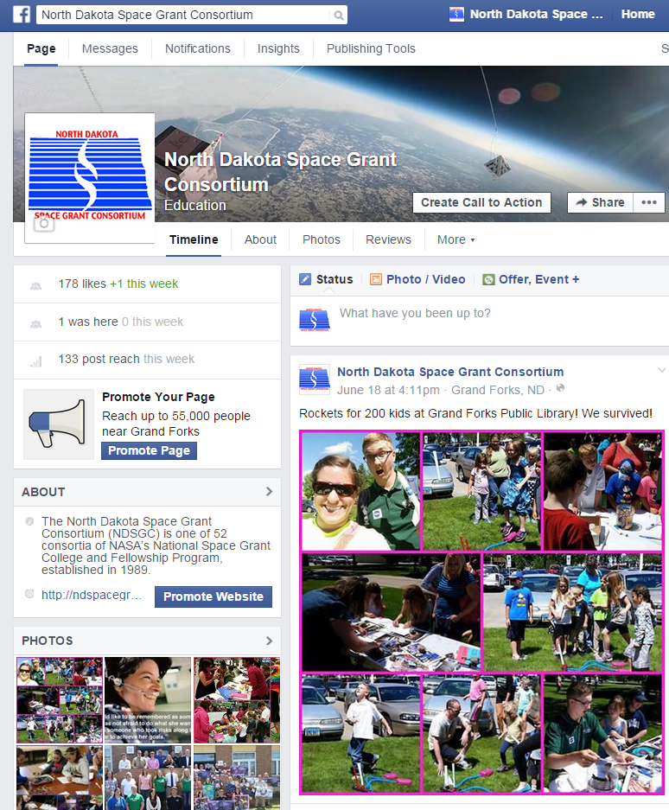
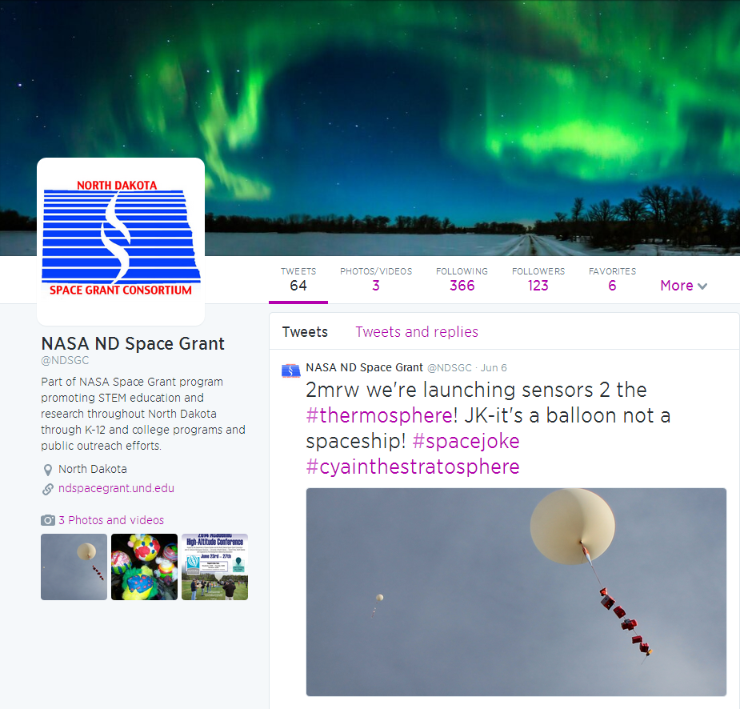
North Dakota Space Grant

Slide 26
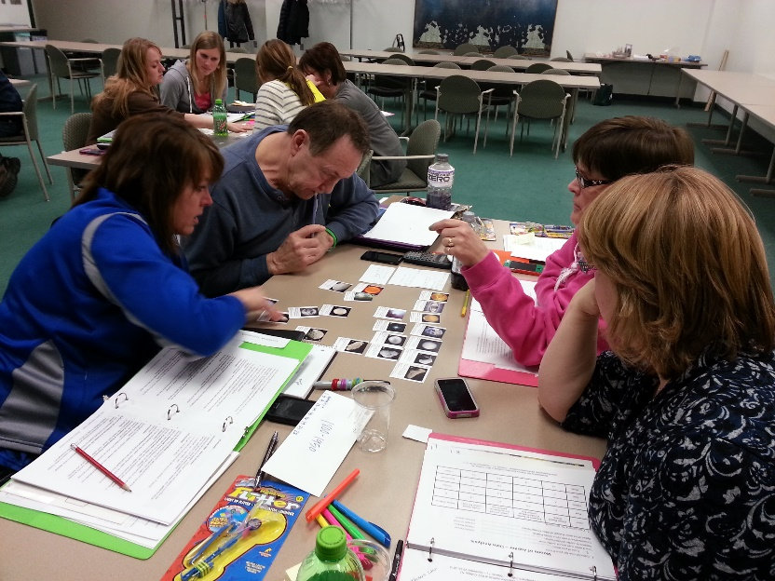
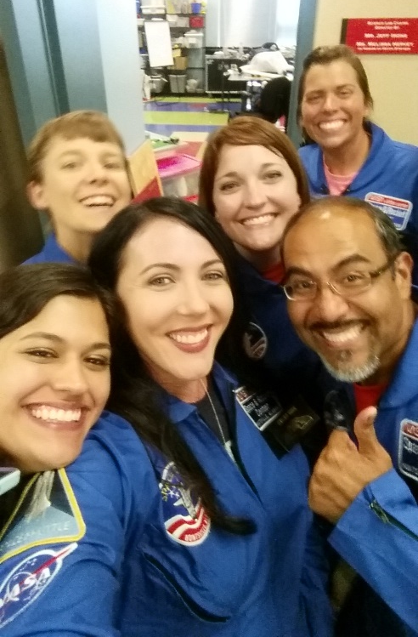
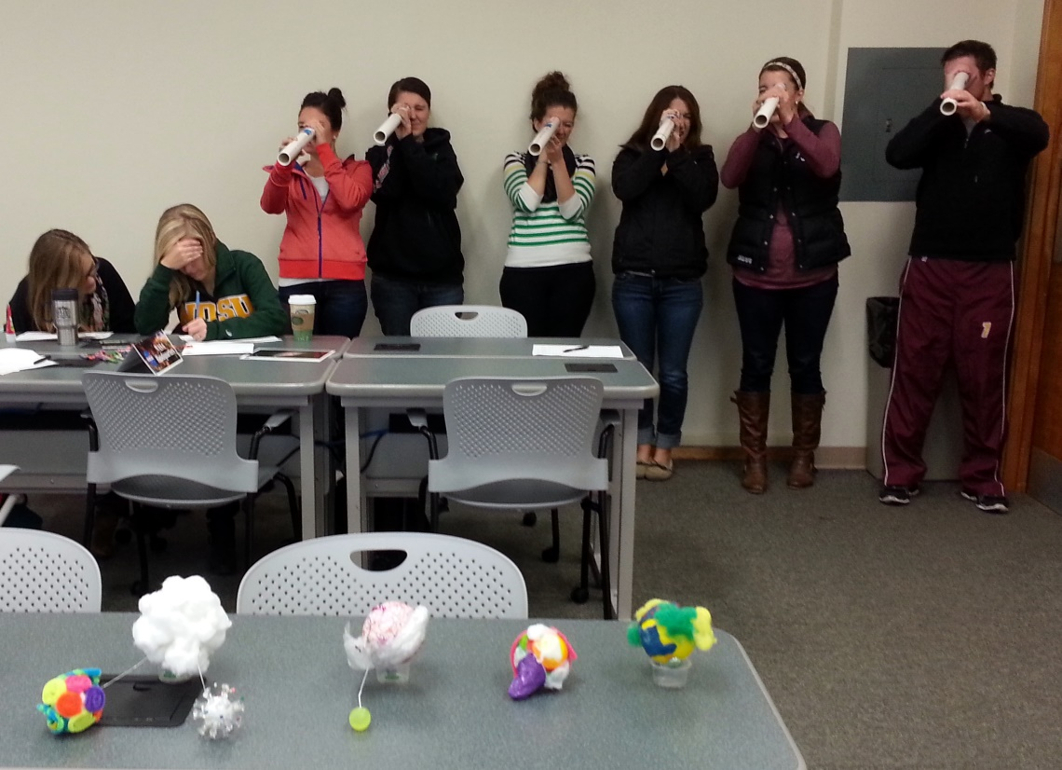
NDSGC K-12 Educator Email Listserv
Workshop opportunities
New STEM education resources for the classroom
NASA student contests/team competitions
Professional Development opportunities
Emails ~once a week

