Slide 1
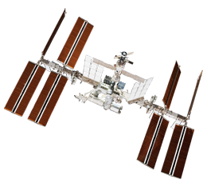
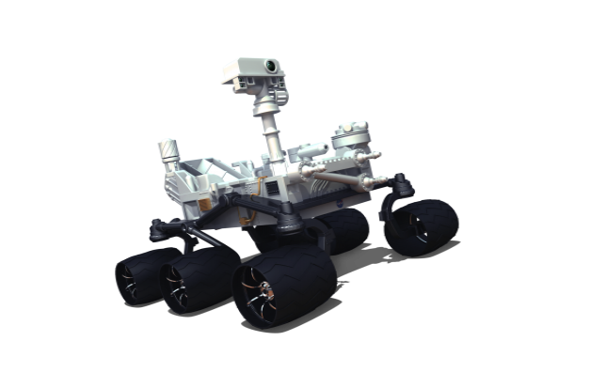
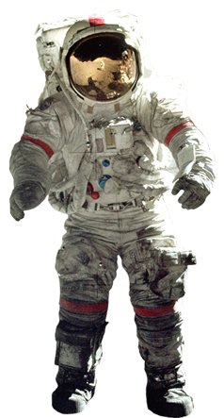
Deep sea diver and nasa educator resources
Caitlin Nolby & Marissa saad
North Dakota Space Grant Consortium

Slide 2
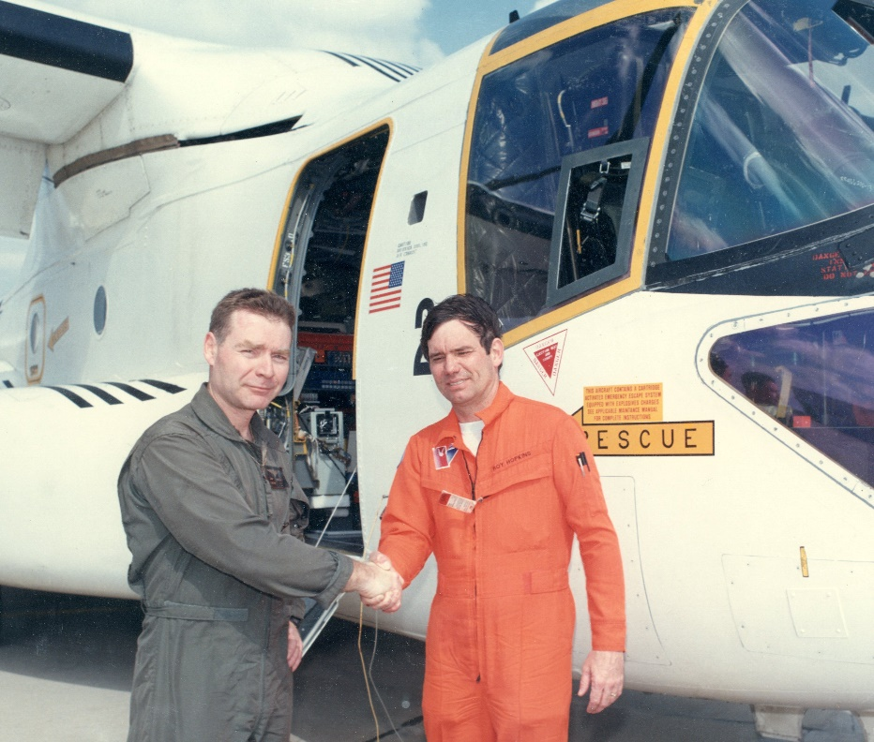
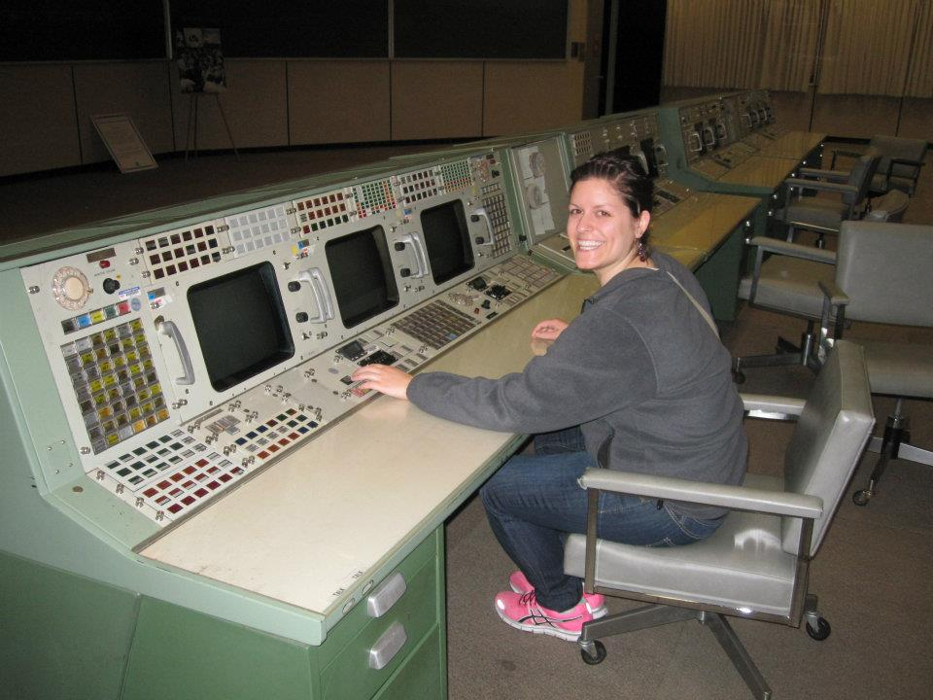
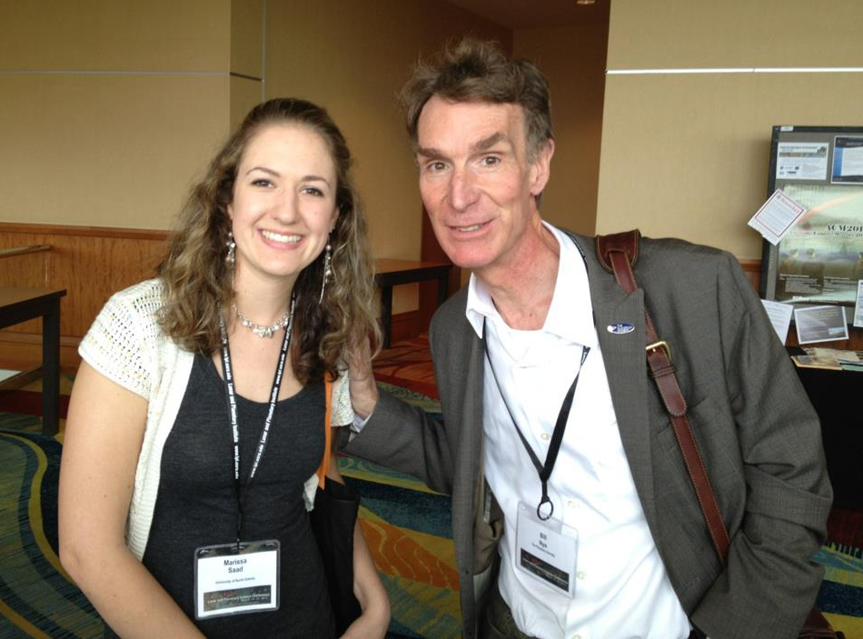
Meet the space grant team!
Director of Space Grant, Jim Casler
Deputy Director, Caitlin Nolby
Coordinator, Marissa Saad

Slide 3
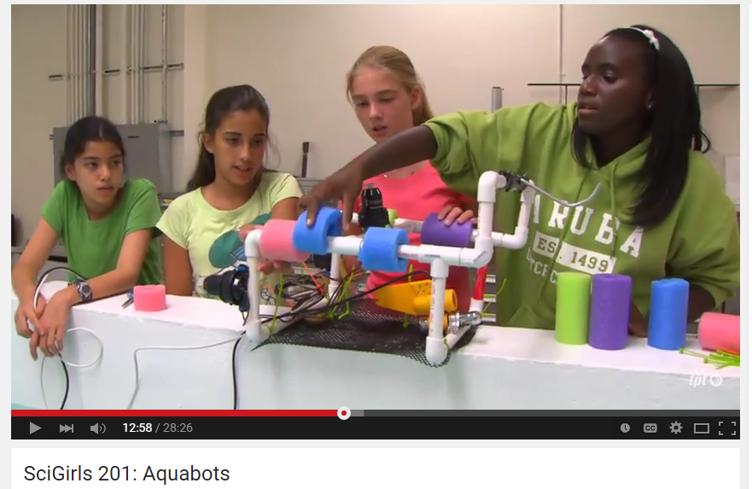
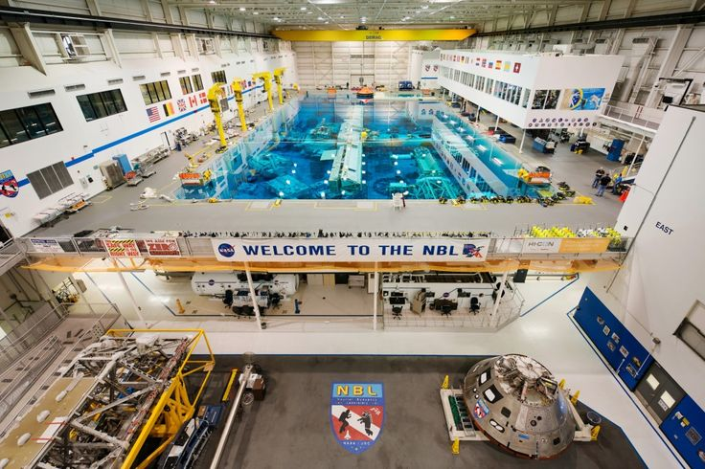
SCIGIRLS DEEP SEA DIVER
Season 2, episode 1: Aquabots
Challenge: NASA is currently preparing for long-duration spaceflight to Mars and needs to practice procedures in the NBL. They need to select a contractor to design and build neutrally buoyant tools for training.
Make predictions on given materials
Design your “deep sea diver”
Collaborative Design Review

Slide 4
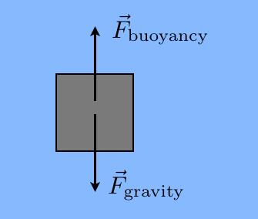
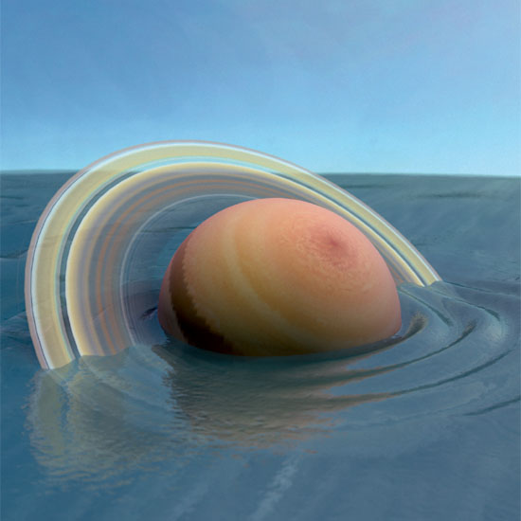
SCIGIRLS DEEP SEA DIVER
Objective: Design and Build a Neutrally Buoyant Object
What does it mean to be neutrally buoyant?
Balancing act between forces
Densities are equal
Which planet would “float” in a giant pool of water?

Slide 5
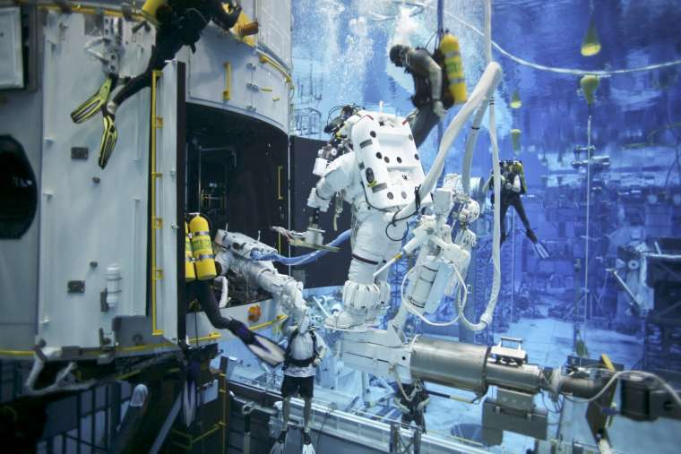
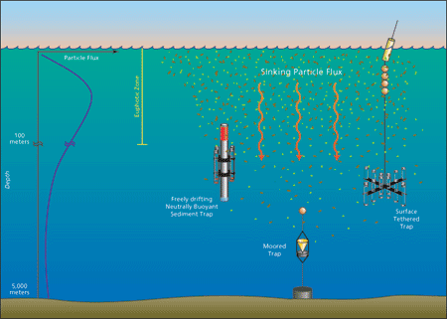
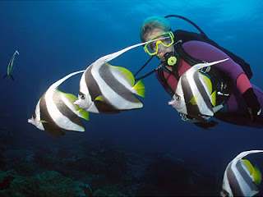
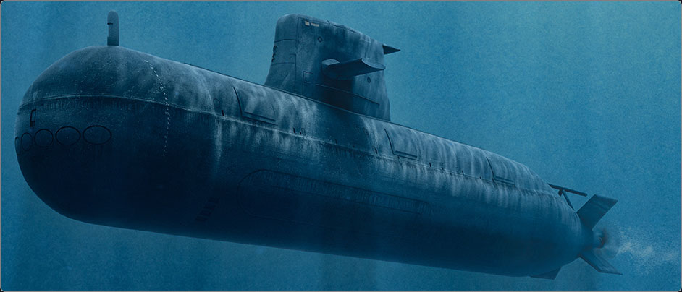
REFLECTION
What worked? Materials?
Other applicaitons?
Scuba divers
Submarines
Fish
Science! –Taking ocean measurements

Slide 6
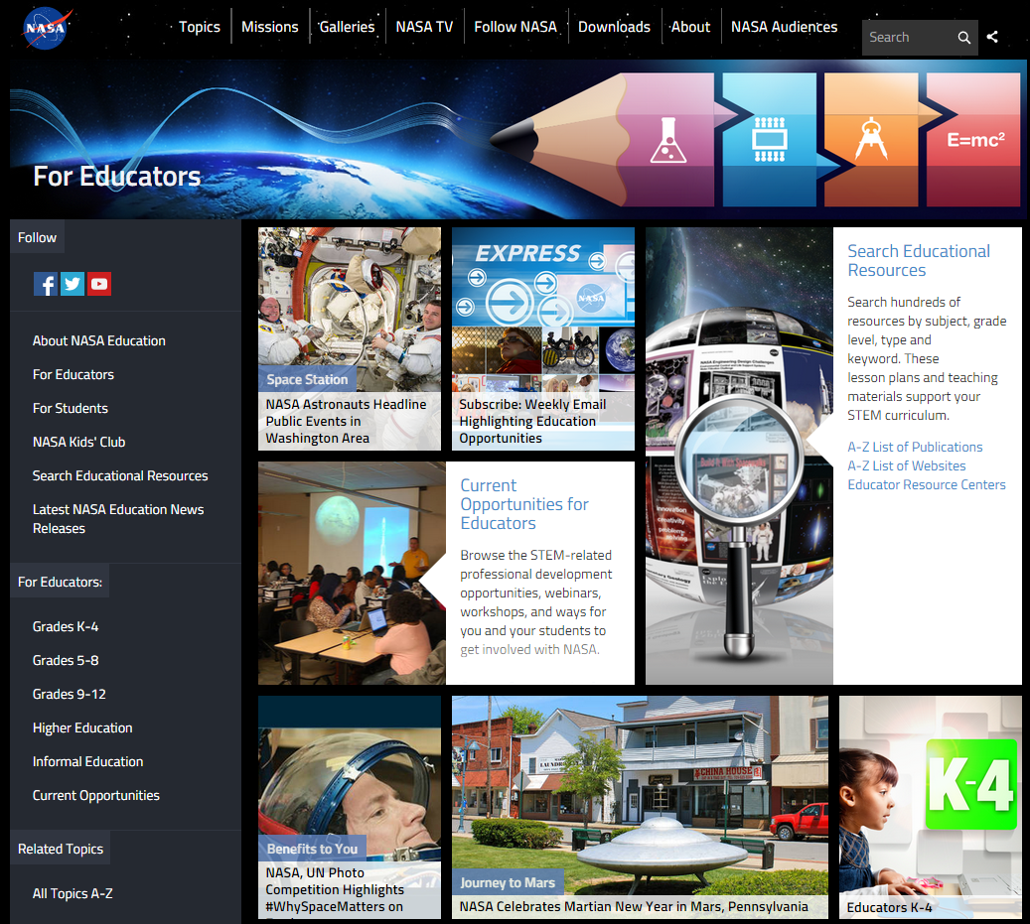
NASA Education

Slide 7
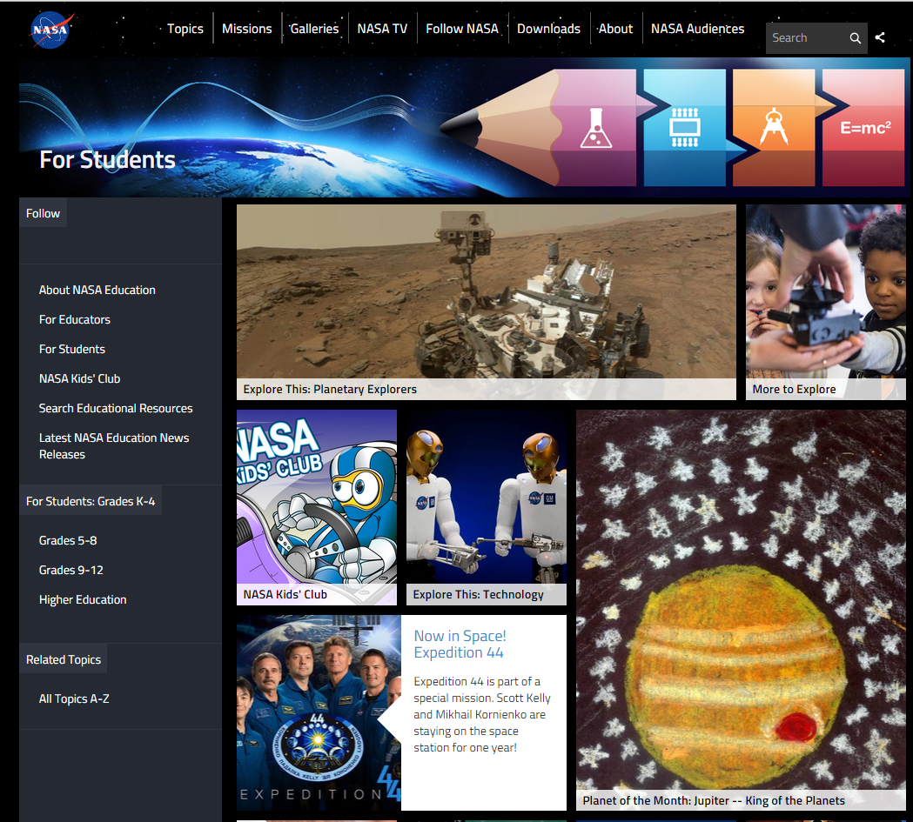
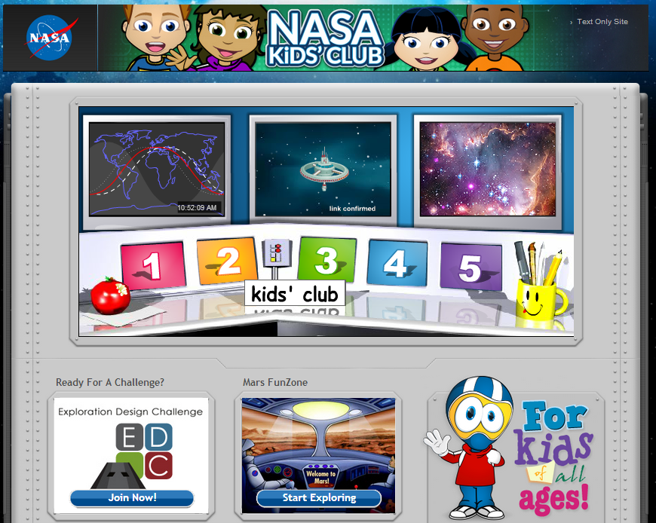
NASA for Students

Slide 8
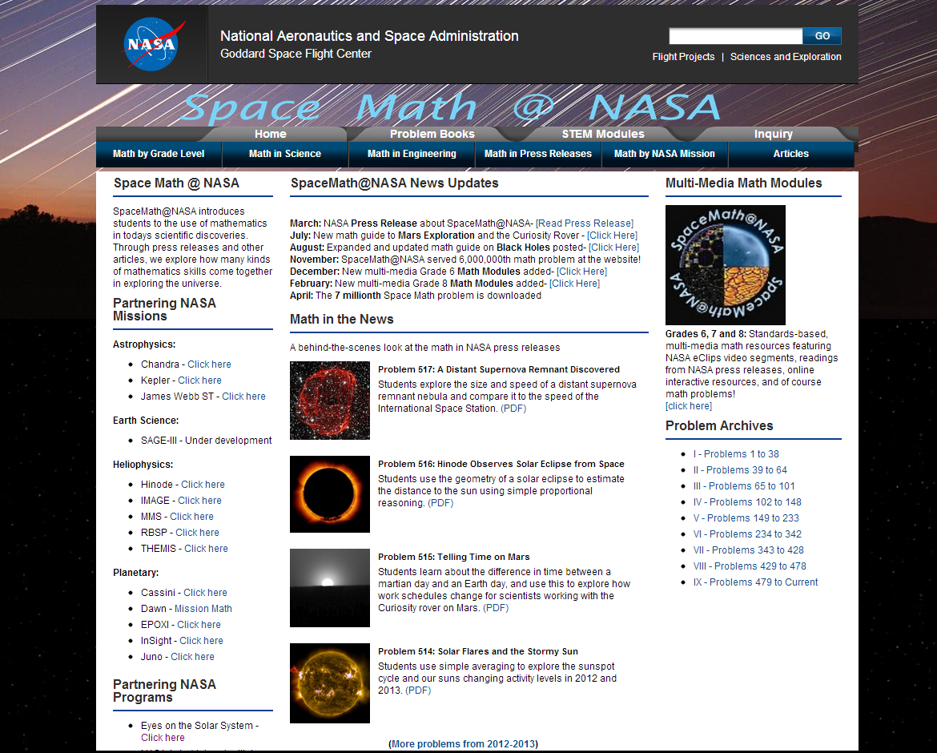
Space Math at NASA

Slide 9
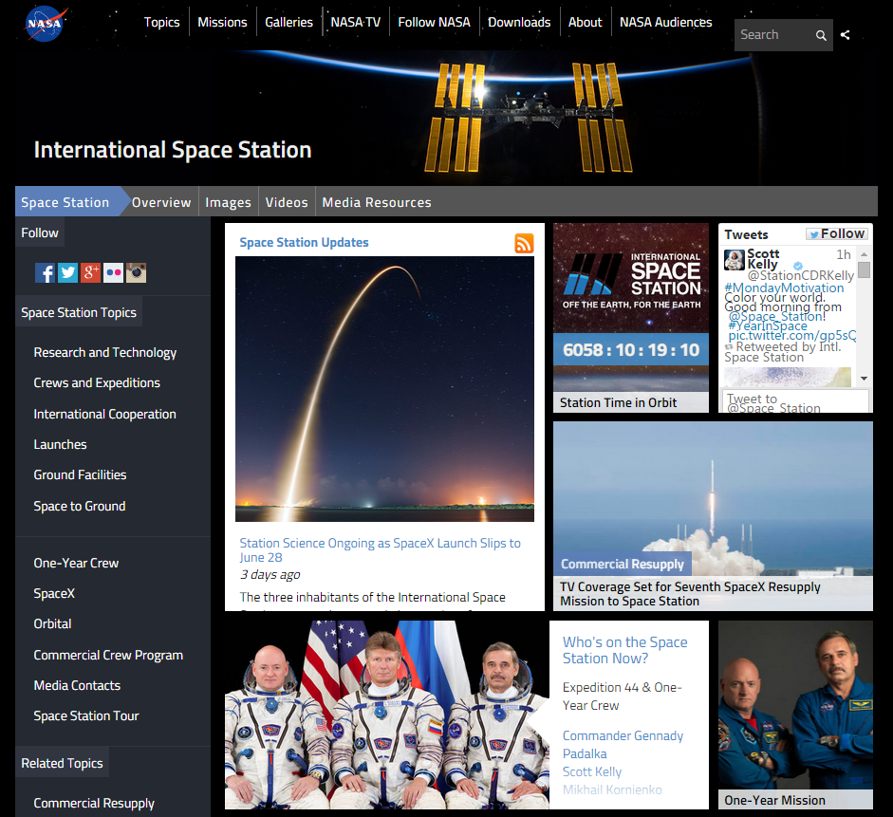
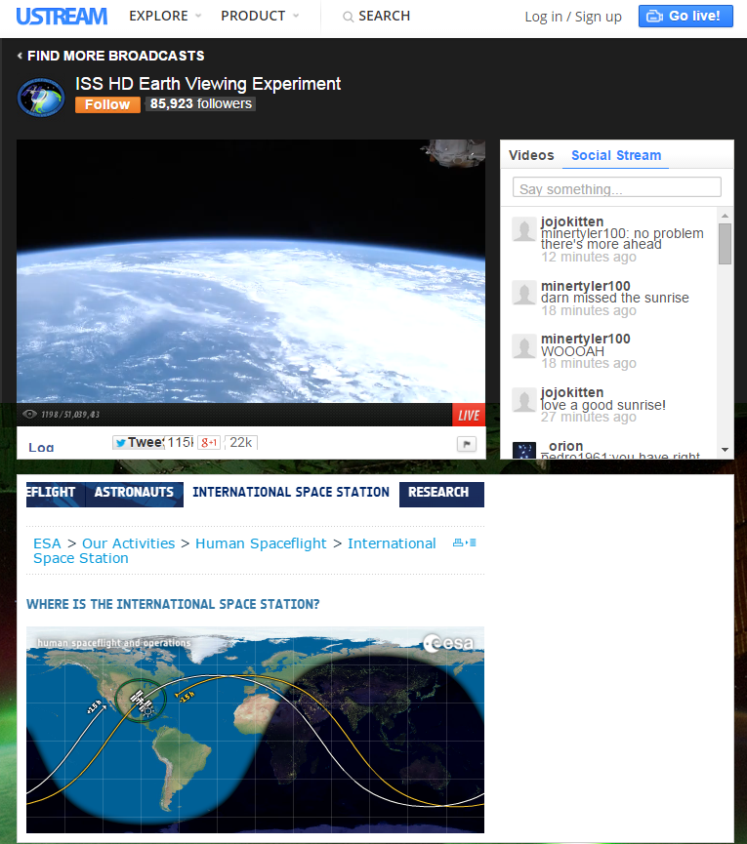
International Space Station - Live!

Slide 10
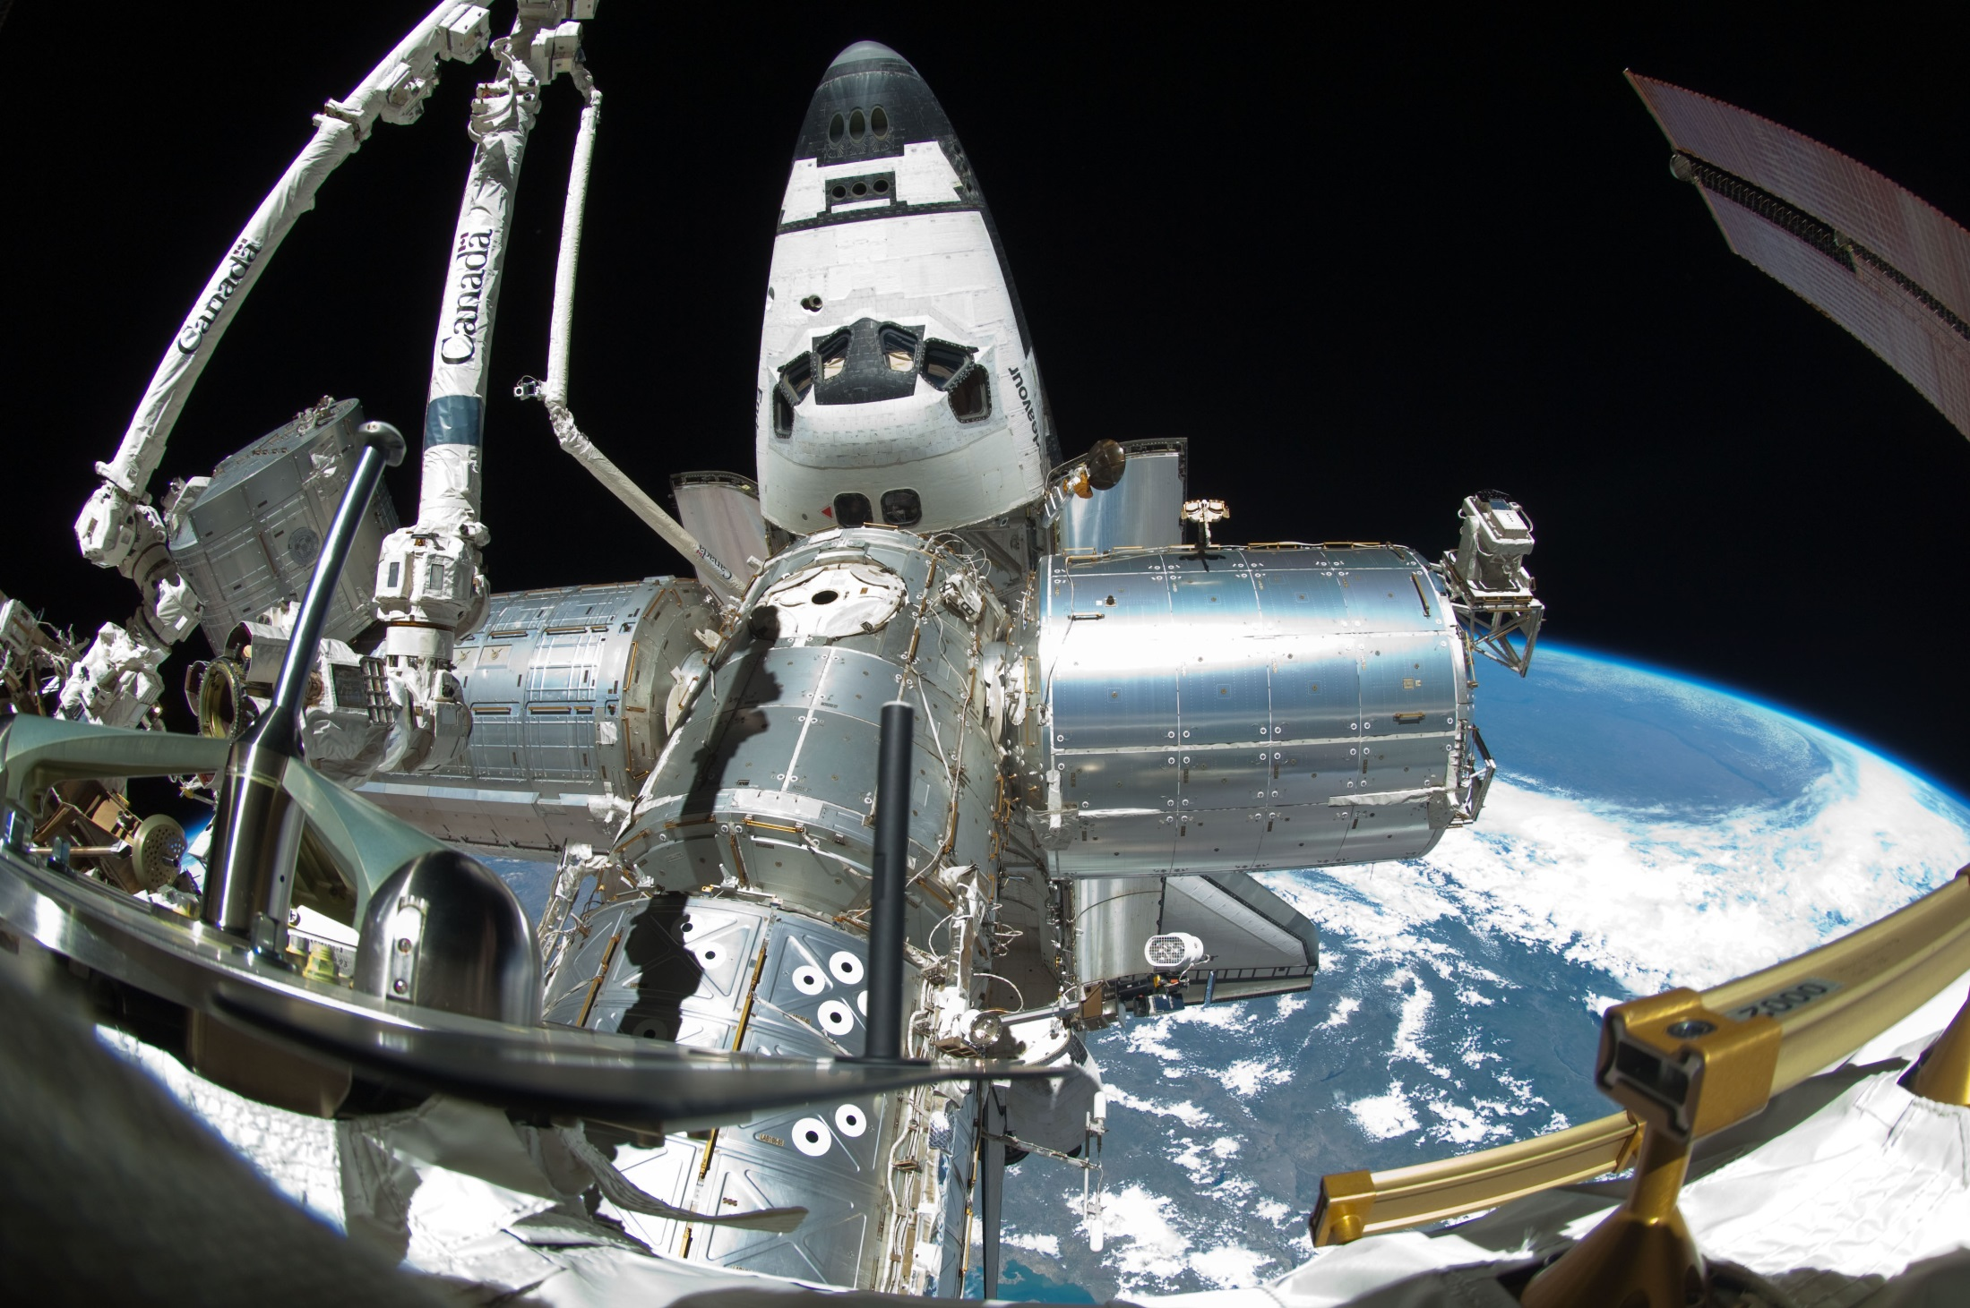
Spot the Station

Slide 11
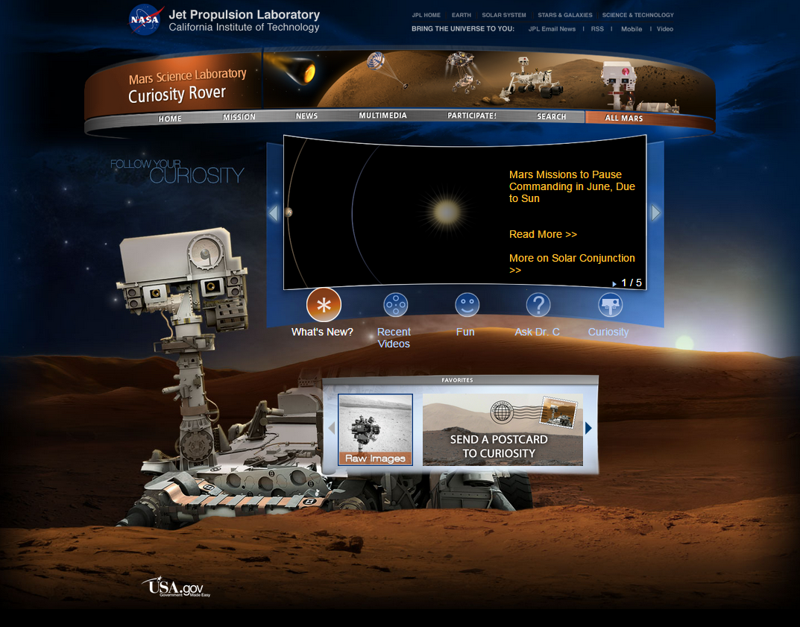
Mars Curiosity Rover

Slide 12
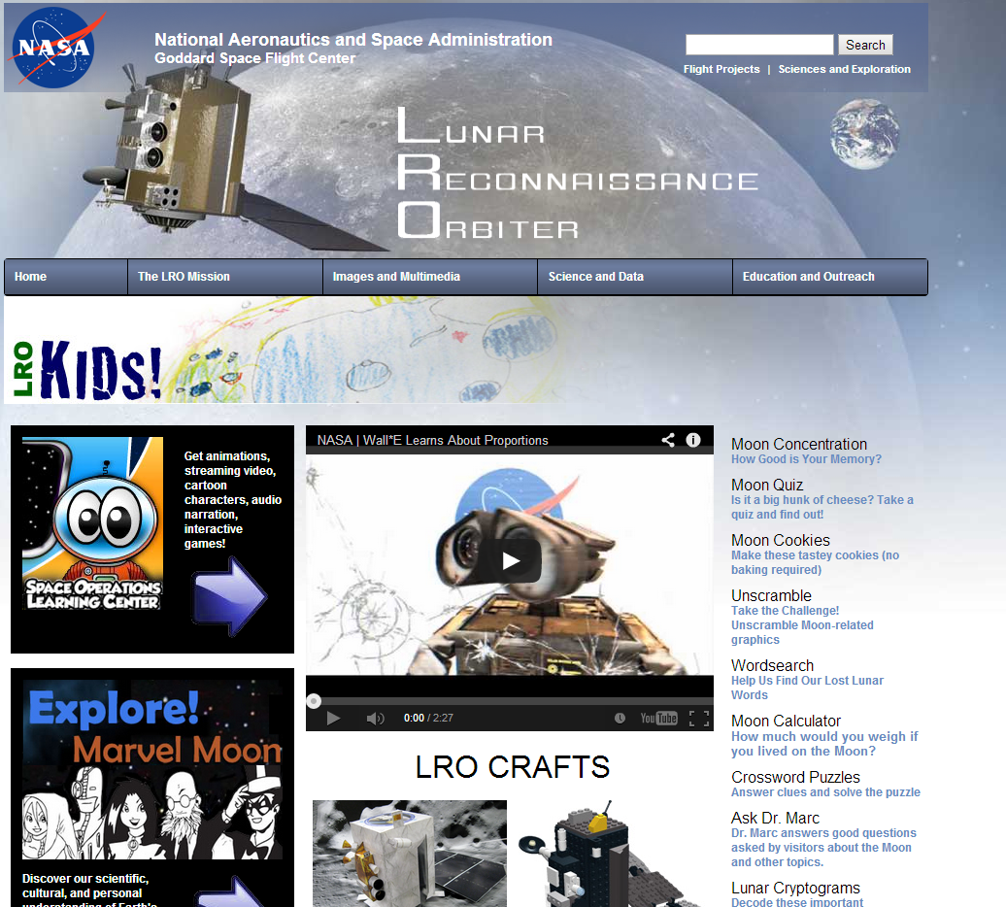
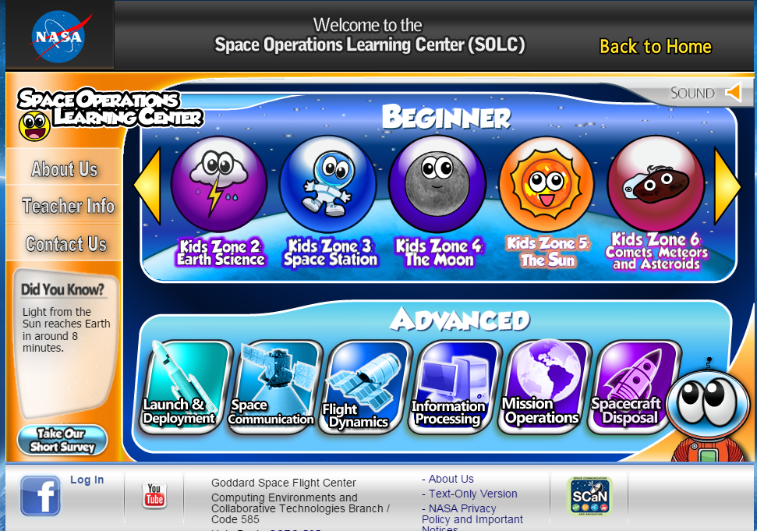
NASA – Lunar Reconnaissance Orbiter

Slide 13
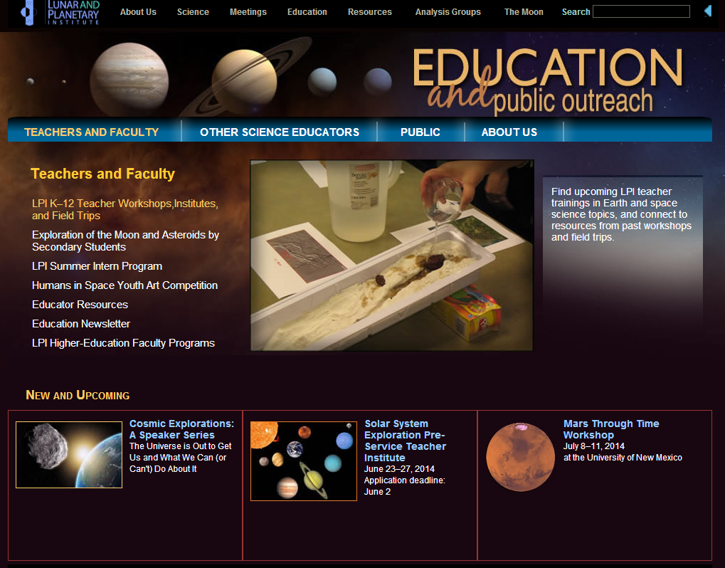
Lunar and Planetary Institute

Slide 14
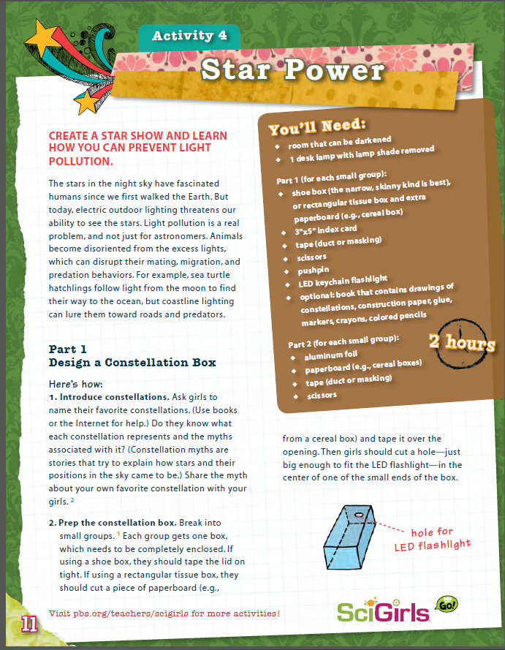
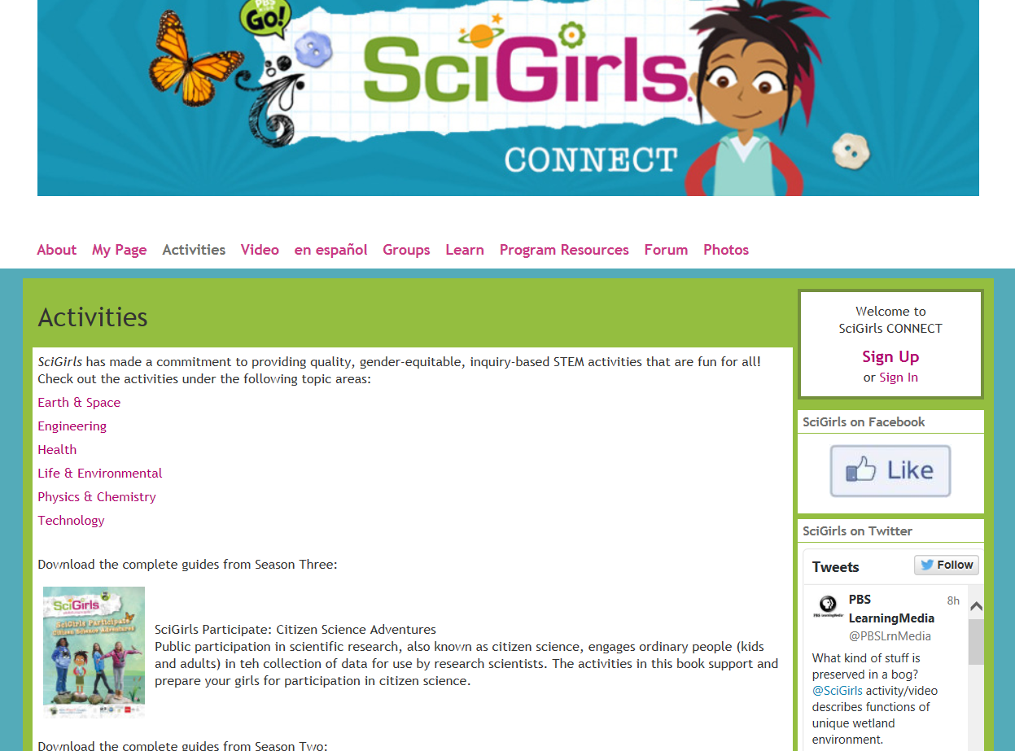
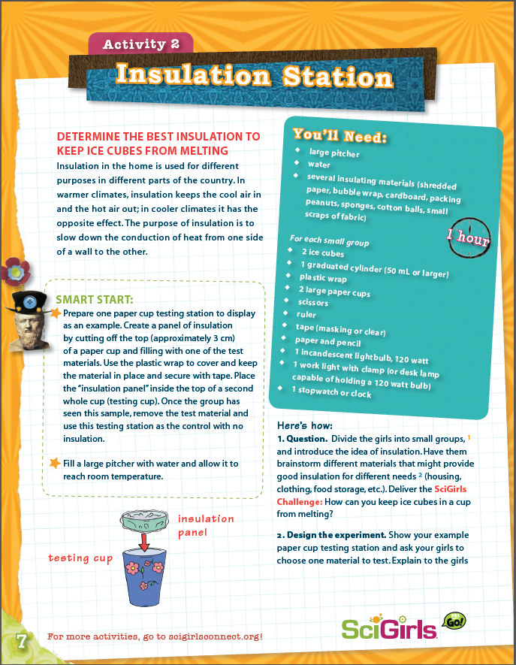
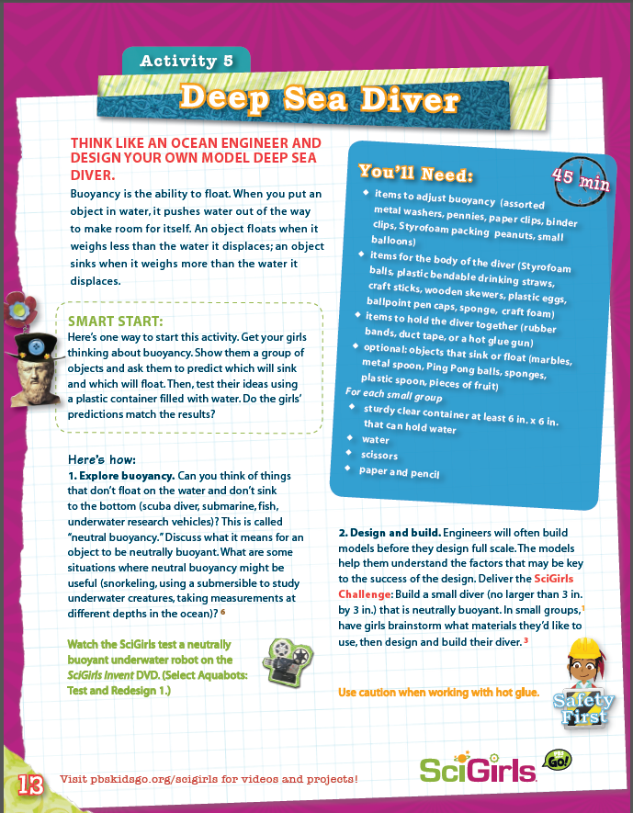
SciGirls Activities

Slide 15
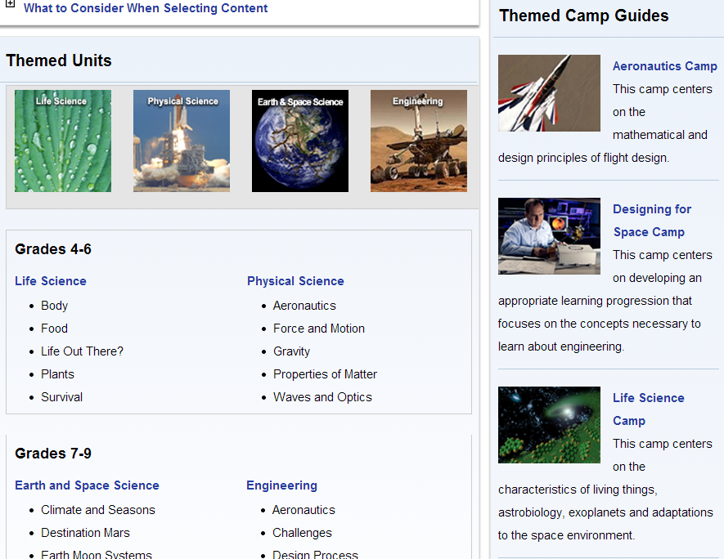
NASA Summer of Innovation

Slide 16
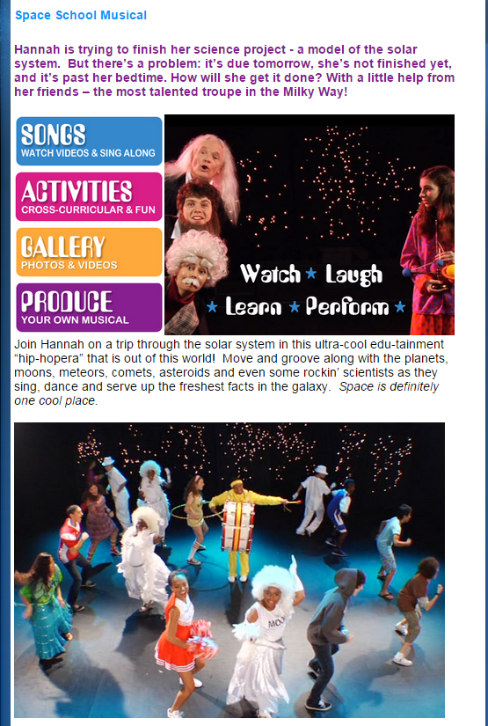
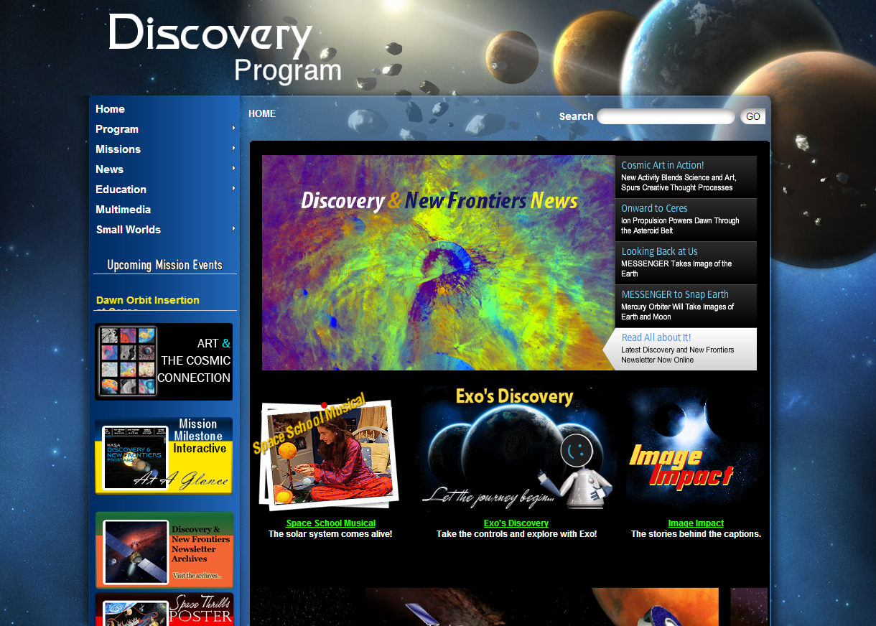
NASA Discovery Program

Slide 17
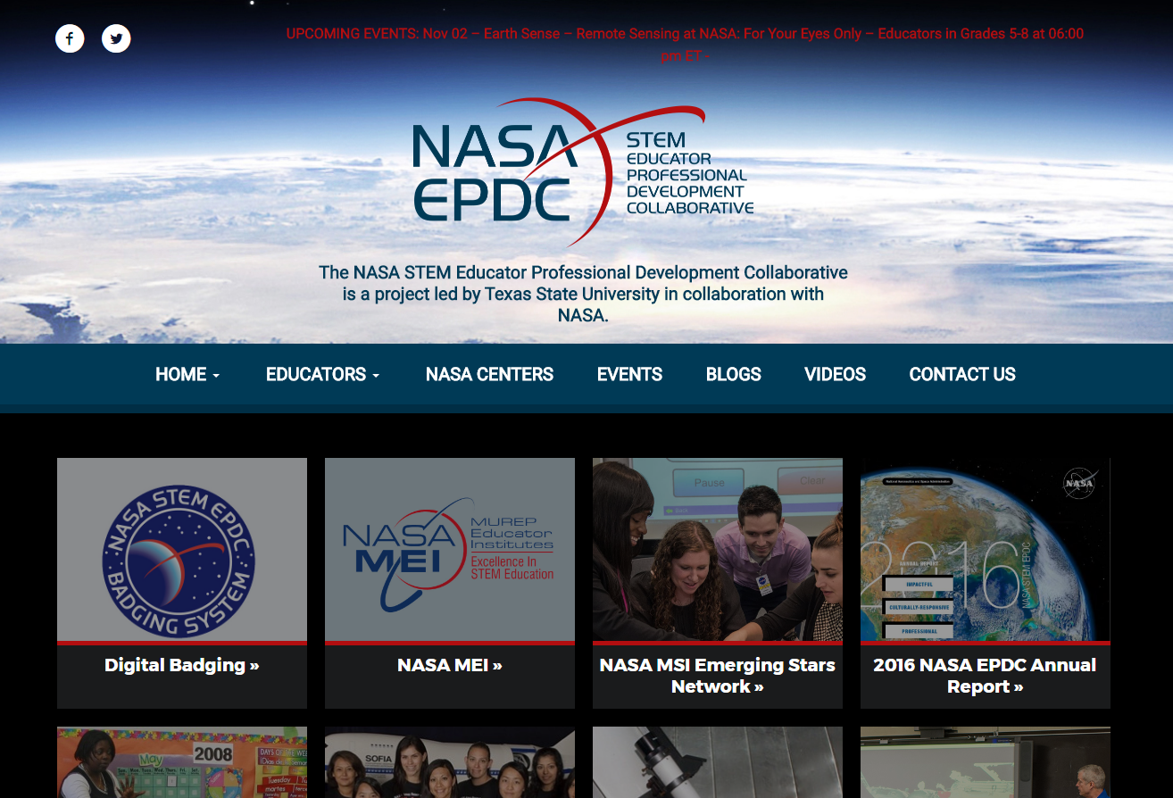
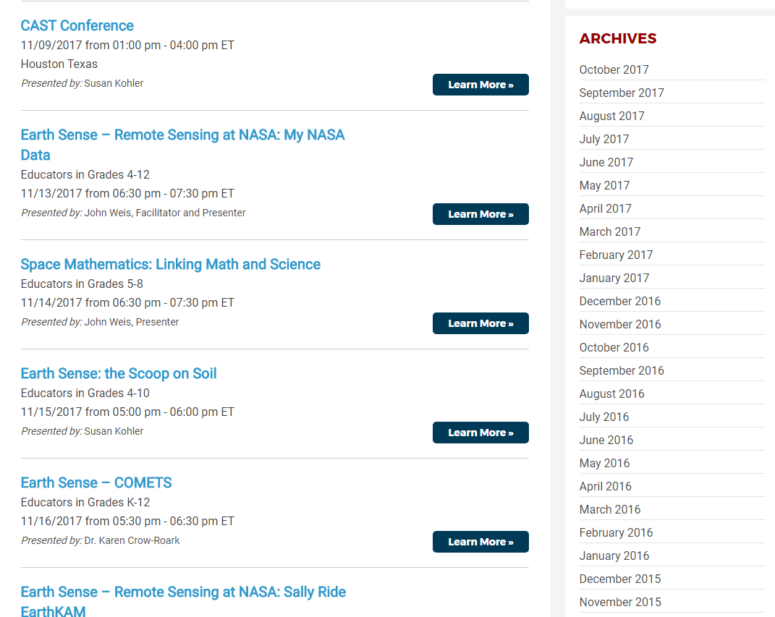
NASA Educator Professional Development Collaborative

Slide 18
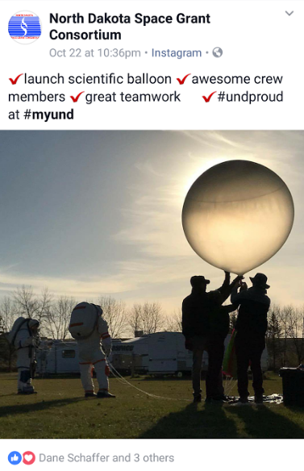
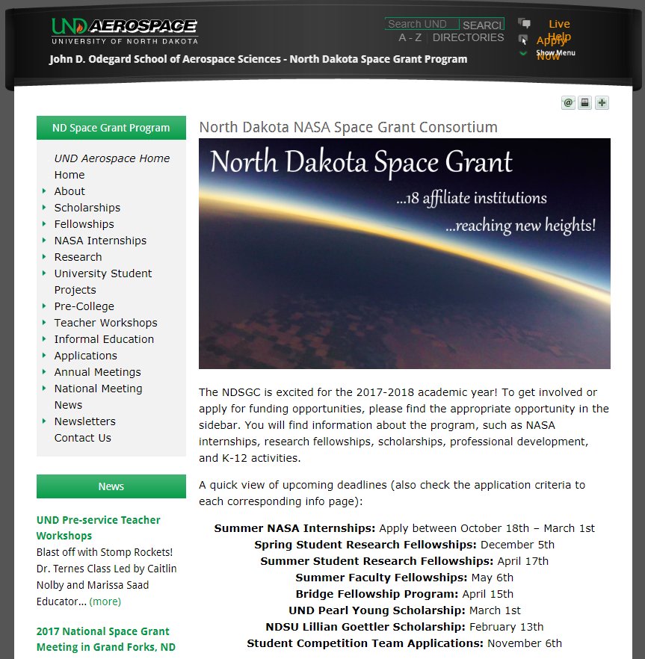
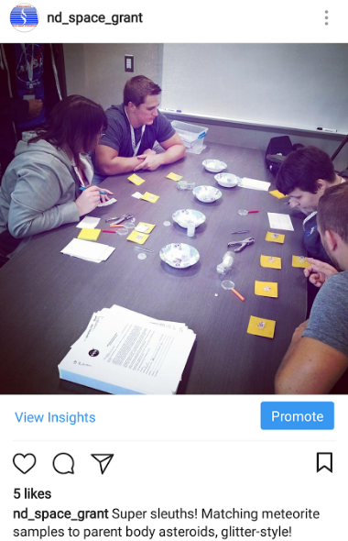
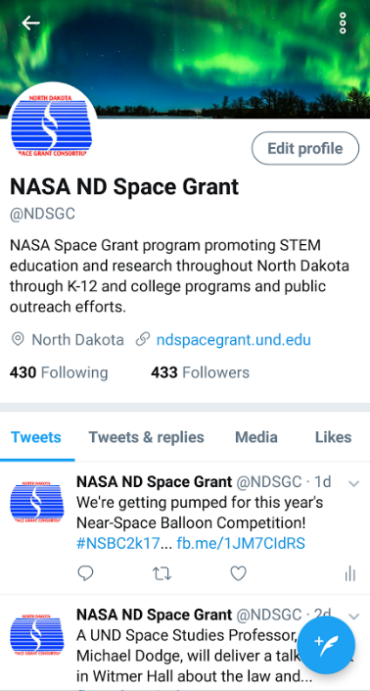
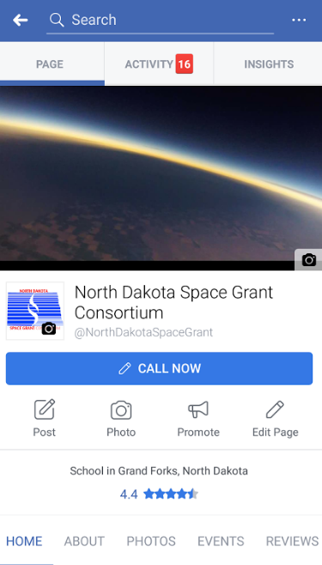
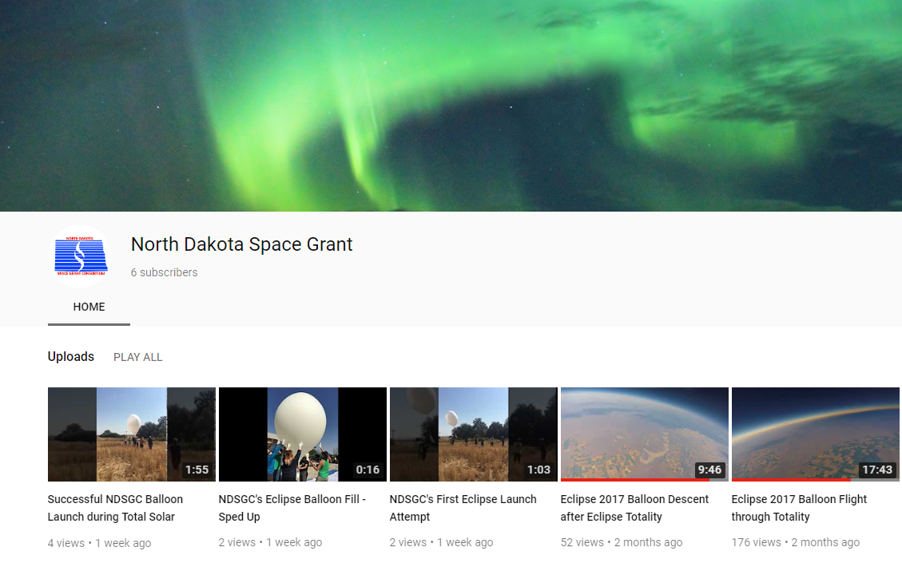
NDspacegrant.und.edu

Slide 19
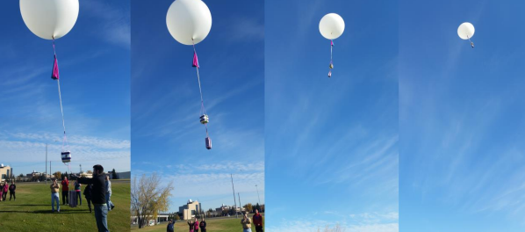
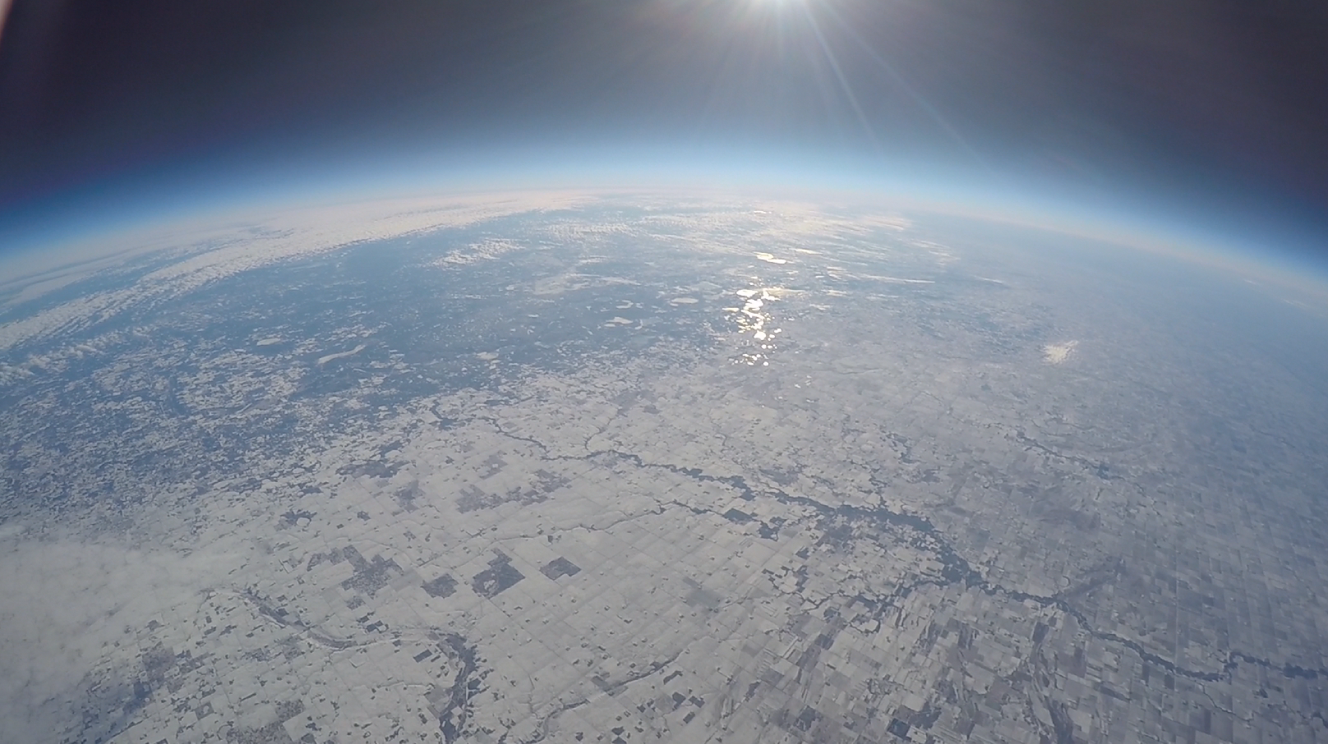
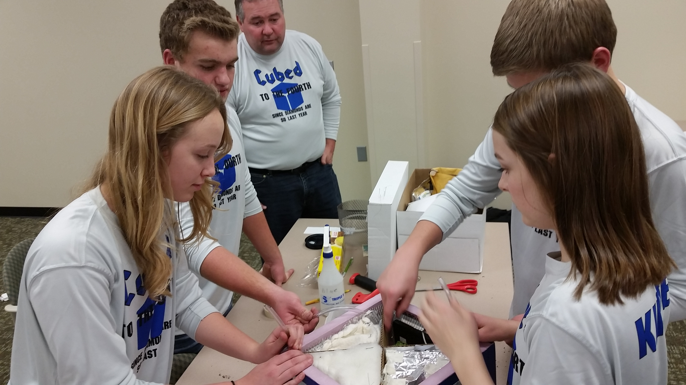
Near-space balloon competition
Annual competition each fall semester
Open to student teams grades 6-12
Middle and high school students create their own science/engineering project
Launches on a 1500-gram balloon, reaching 100,000 feet
http://blogs.und.edu/nsbc

Slide 20
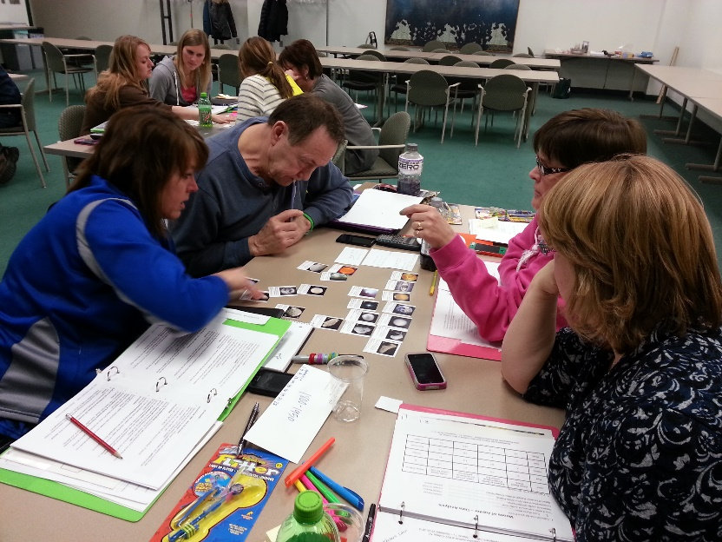
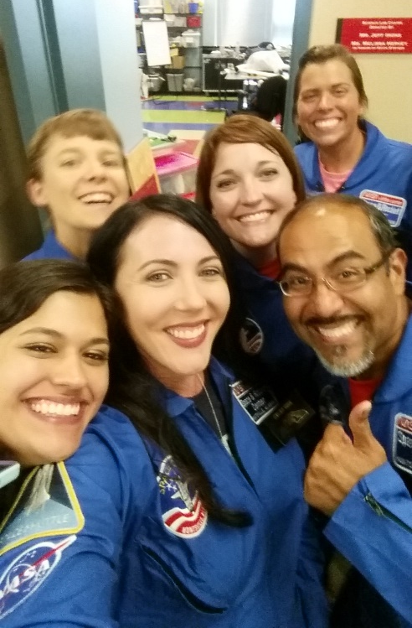
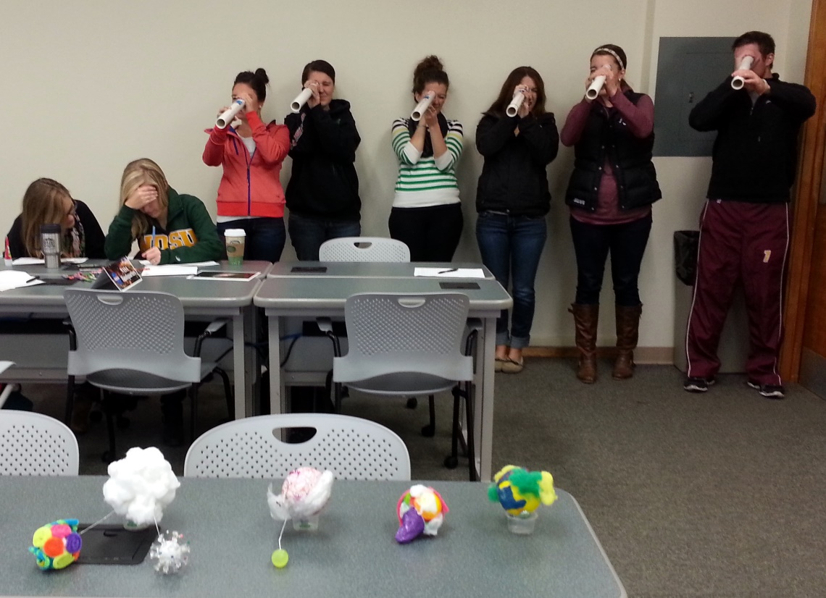
NDSGC K-12 Educator Email Listserv
Workshop opportunities
New STEM education resources for the classroom
NASA student contests/team competitions
Professional Development opportunities
Emails ~once a week

